Slide 1
Radiation results PXD10-1 (450um & 30um) / PXD10-2 (50um)

Slide 2
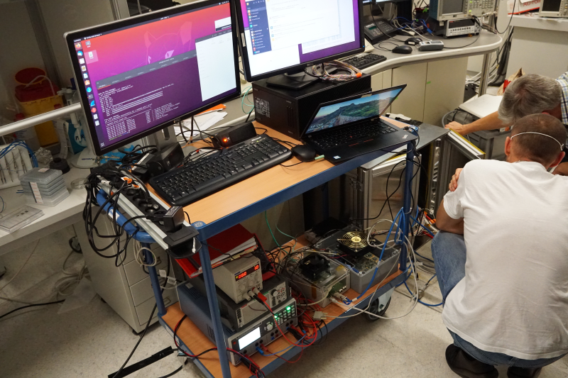
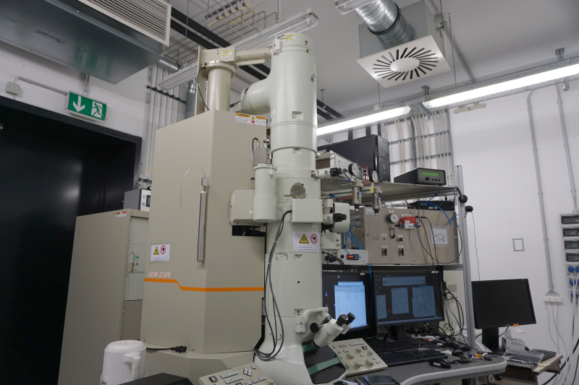
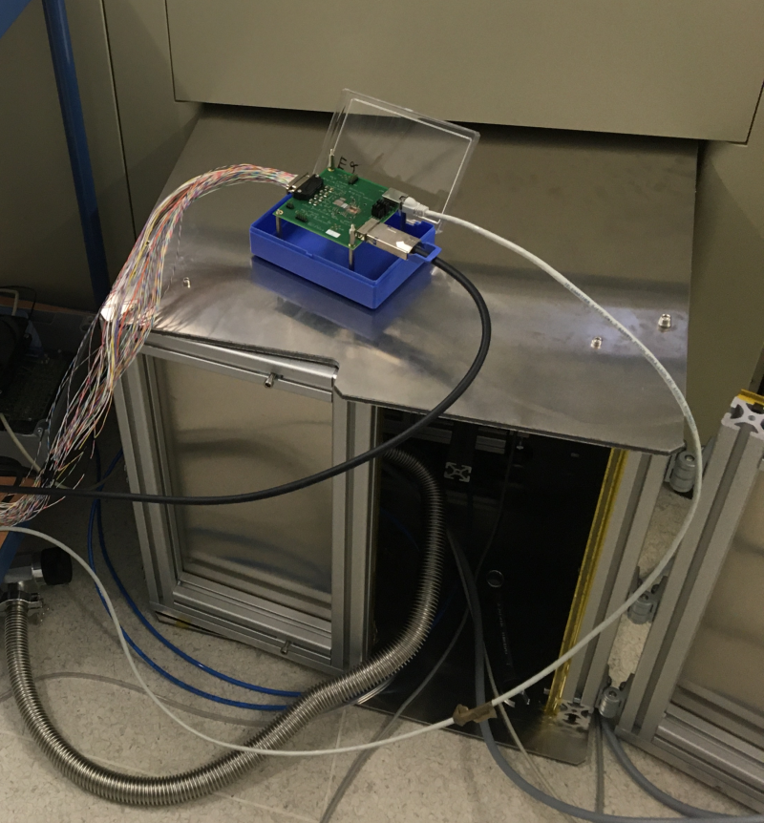
I. Overview
Setup at MPSD
Test of a Hybrid board.
Small matrix setup with vacuum chamber and radiation shield at TEM JEM-2100.

Slide 3
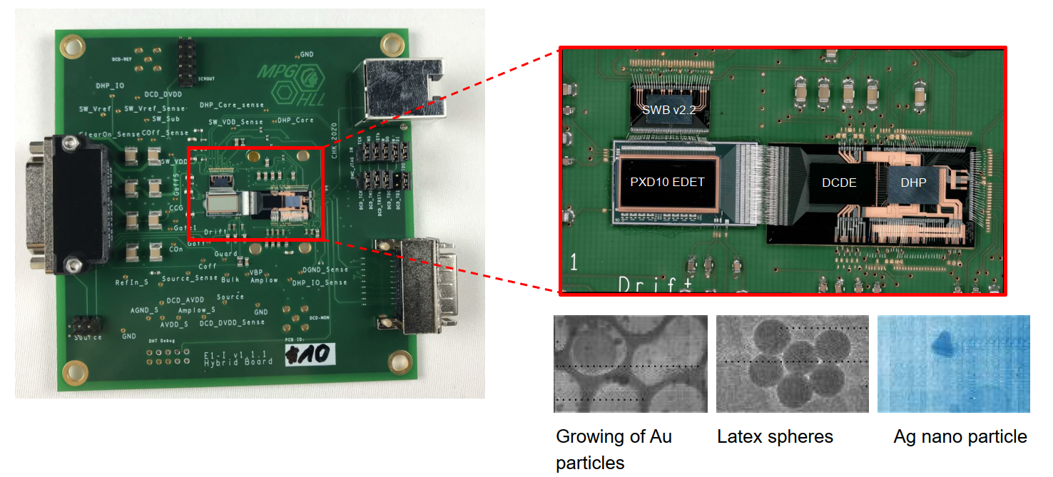
I. Overview EDET Hybrid

Slide 4
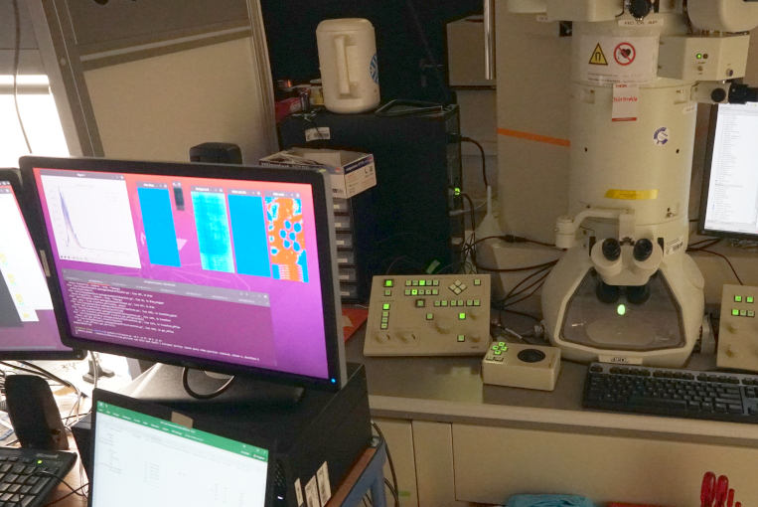
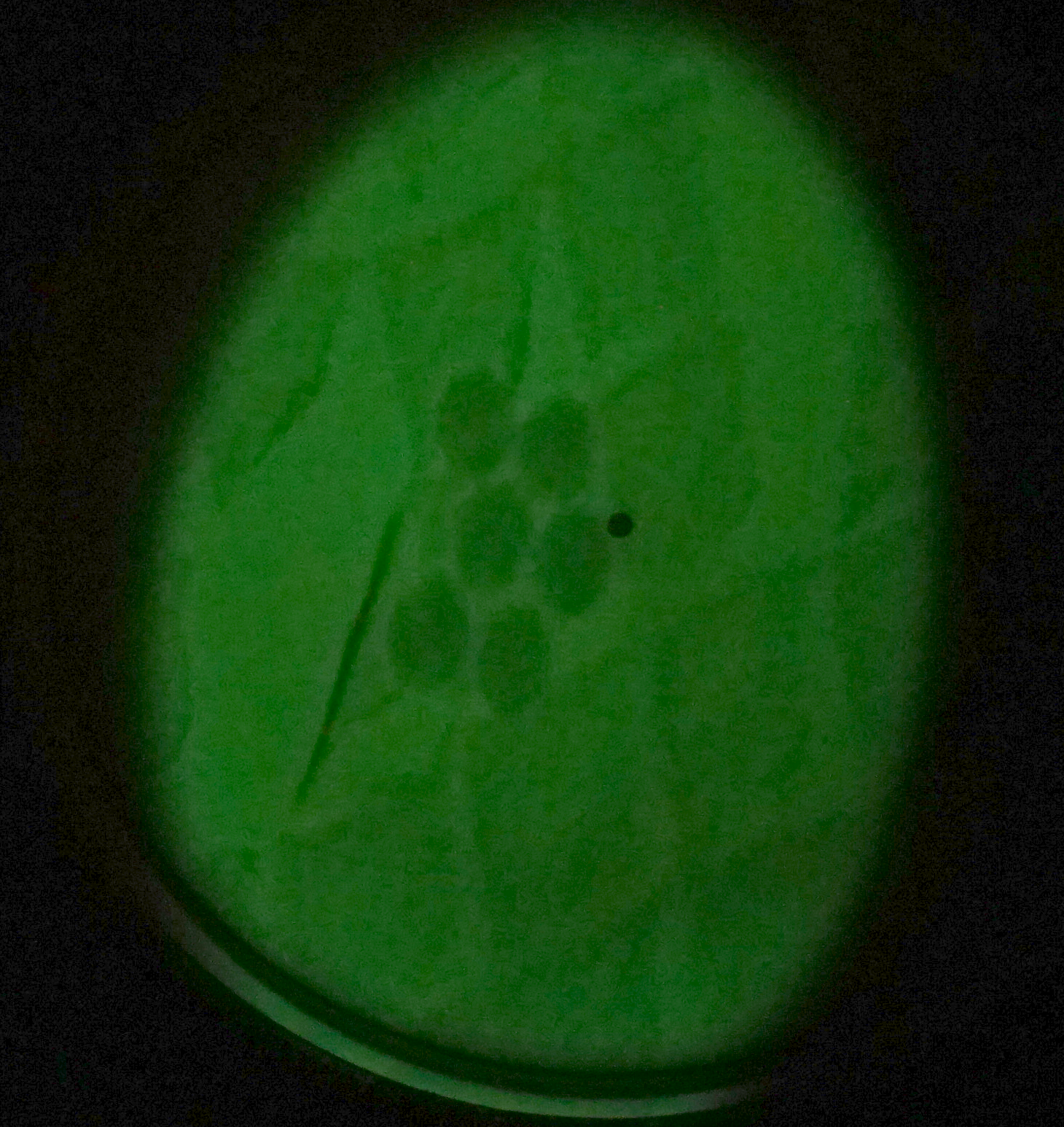
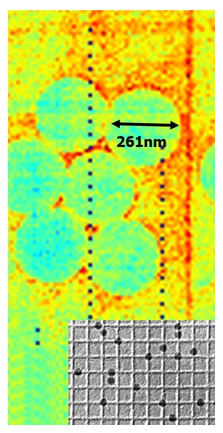
I. Overview 261nm Latex spheres@Matrix07
Diffraction Grating Replica with Latex Spheres (261nm) from PELCO (www.tedpella.com No 603) for magnification calibration.
Max Planck Society | Semiconductor Laboratory Thomas Selle/ Christian Koffmane| 15.12.2022 4

Slide 5
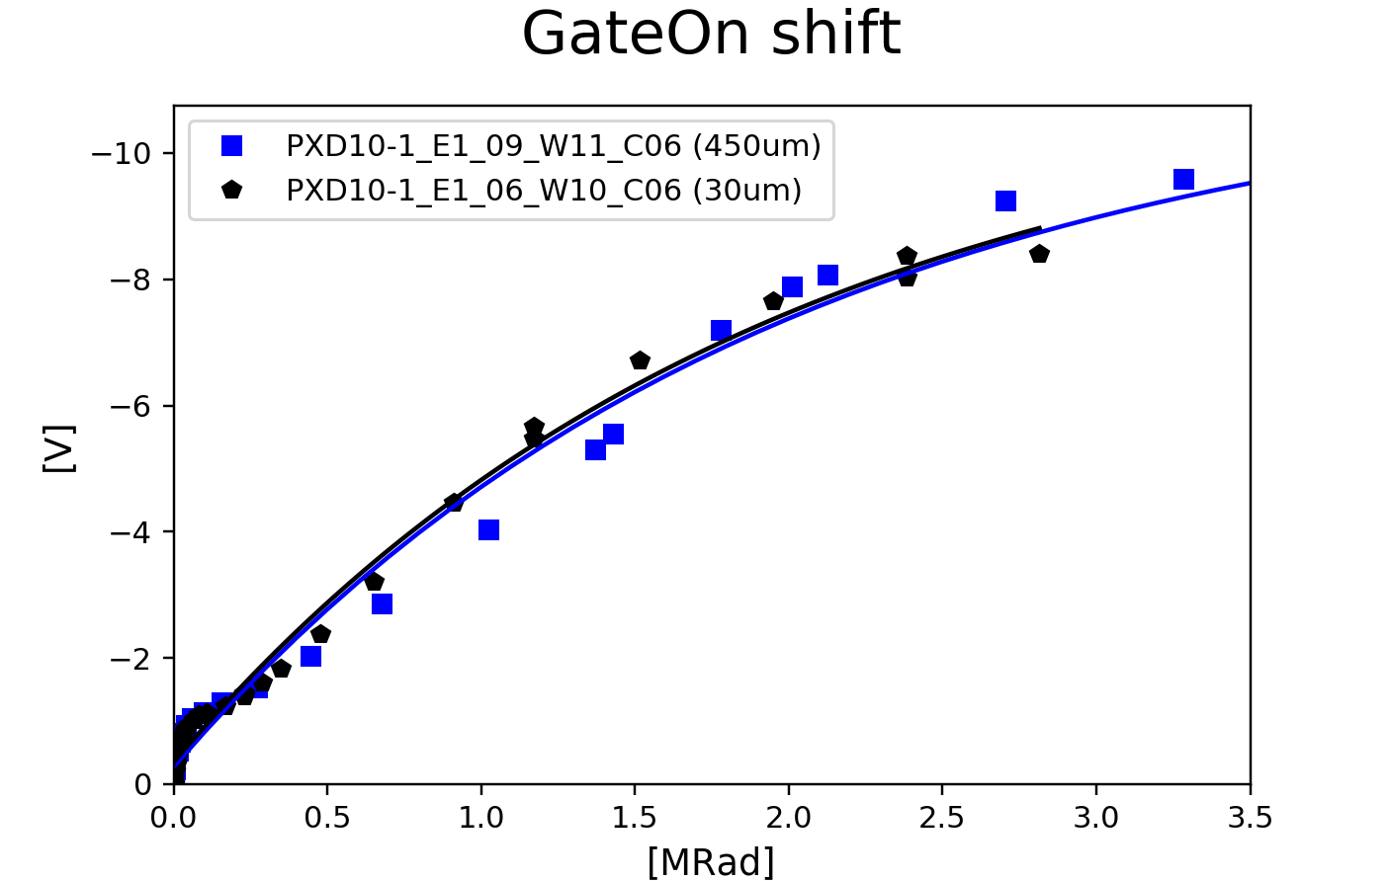
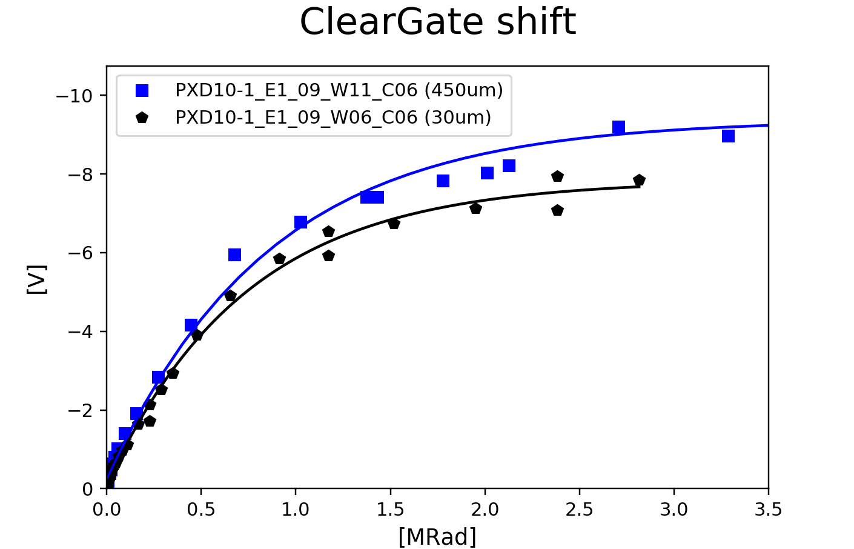
NEW: Radiation results PXD10-1 450um VS 30um (only till ~ 3MRad)

Slide 6
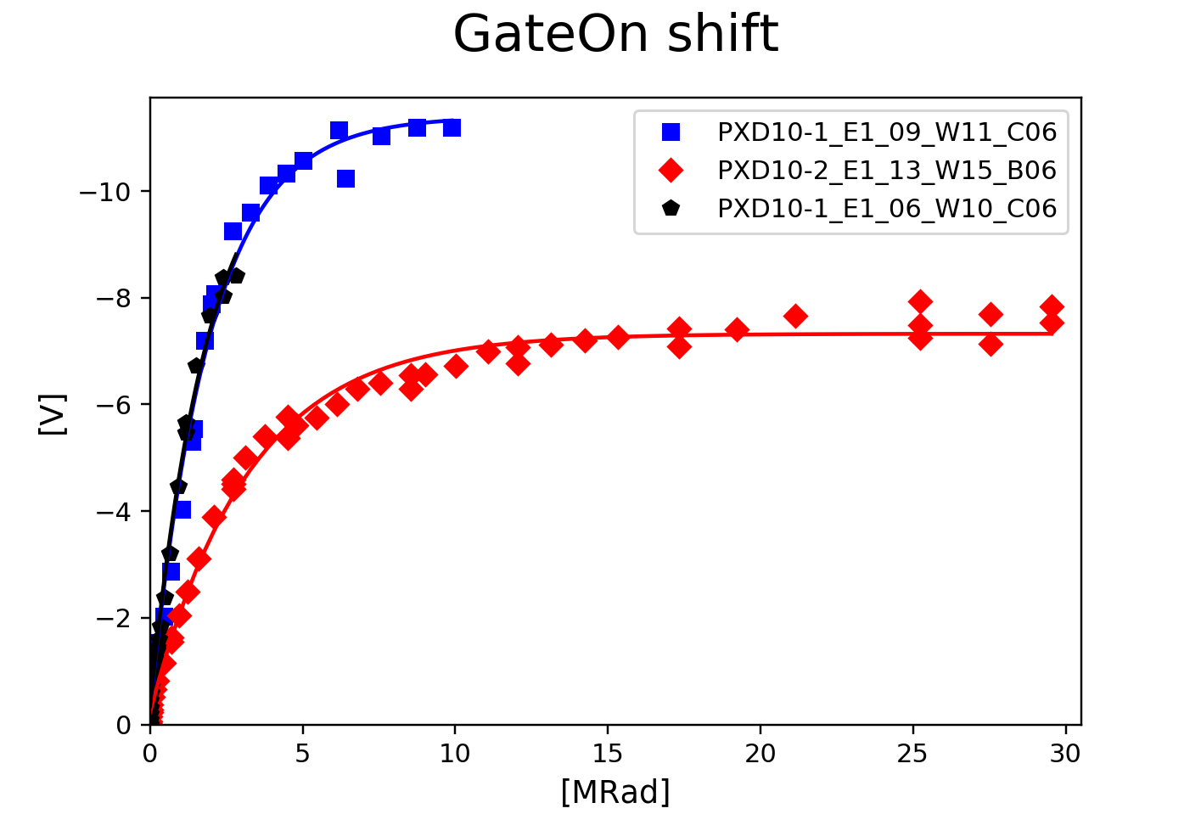
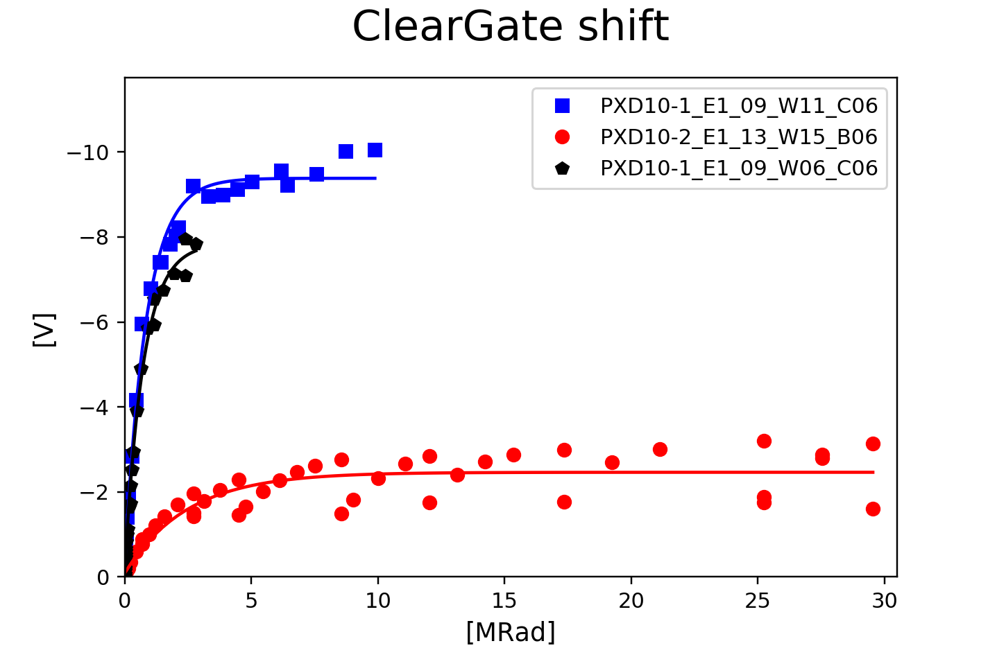
NEW: Radiation results PXD10-1 vs PXD10-2 (PXD10-2: Hybrid board #13 50um W15_B06)
Dose ~ 30Mrad ( +~ 5MRads shown last time)
GateOnShift ~ -7.5 V ClearGateShift ~ -3.2 V

Slide 7
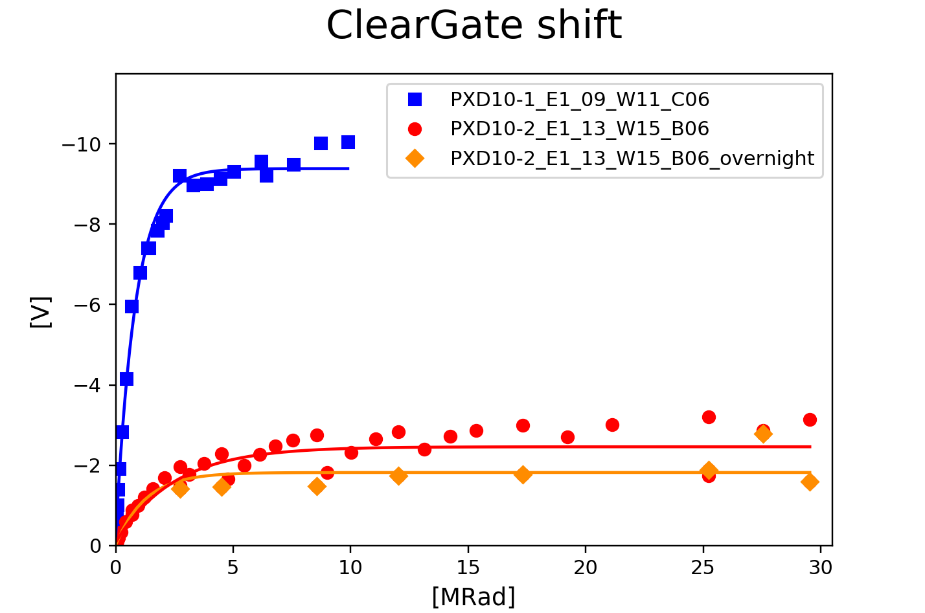
Radiation results PXD10-1 vs PXD10-2 (overnight annealing voltage steps)
Large overnight annealing of ClearGate.
System was switched off. Chiller still worked @15°C
“Overnight” waiting time 10h, 70h or 100h
System was NOT switched off.

Slide 8
Future plans
Data analysis on pixel level will be be done by Mitja. We need to know if our data acquisition is correct. Till then the radiation campaigns are deffered.
Further irradiations:
Technology option 2 (ploy2 stack-up 10nm oxide + 65nm nitride)
Standard technology irradiate till 30MRad
…

Slide 9
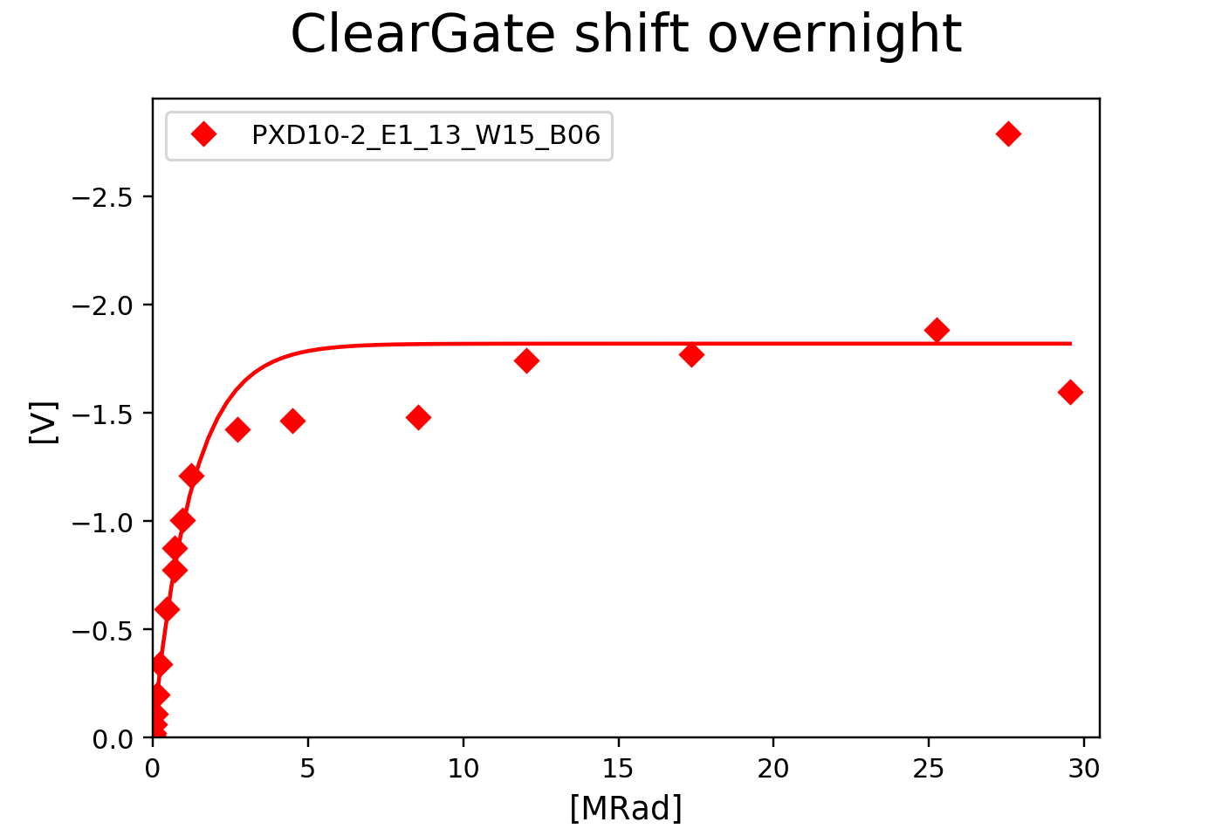
Radiation results PXD10-1 vs PXD10-2 (overnight annealing Cleargate)

