Slide 1
TNG – Camera test setup
TNG full camera test setup
Has to be done in a vacuum chamber
Analysis of outgasing load if possible
Cool down to at least ~ +15°C frame and -20°C pnCCD with TEC
Spectroscopic measurement with Fe-55
Dynamic range measurements with laser diode

Slide 2
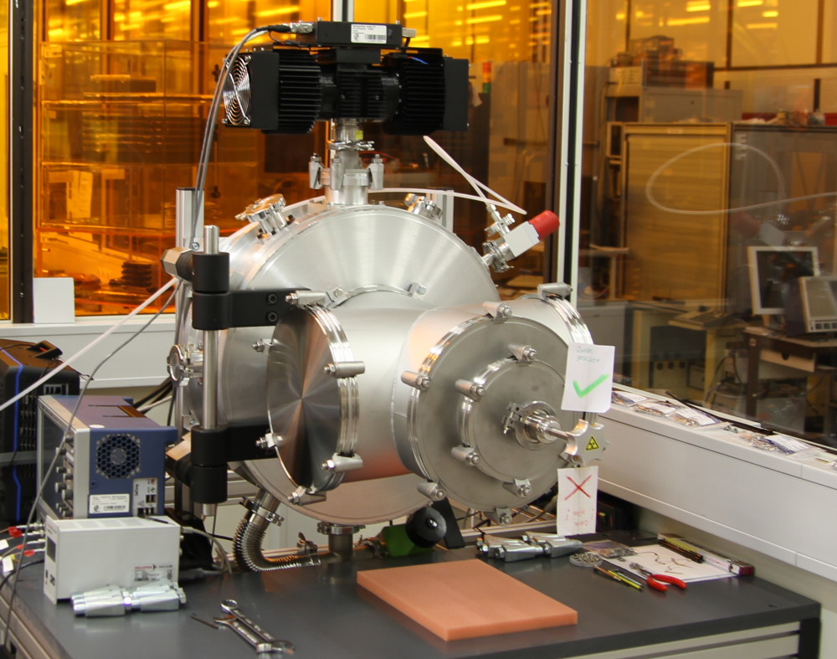
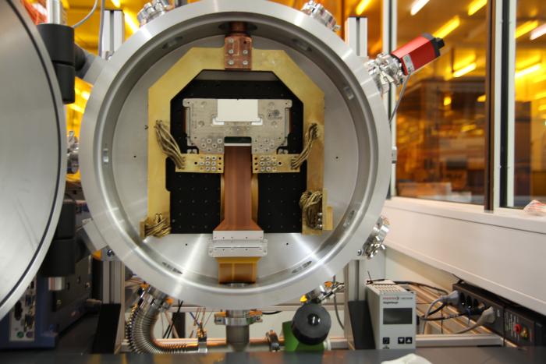
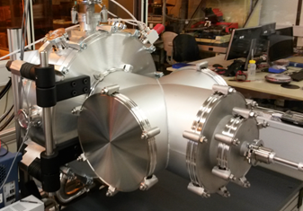
TNG – Camera test setup (vacuum chamber – use the LAMP chamber)
In this chamber we have a lot of space and most of the
equipment we need is available.

Slide 3
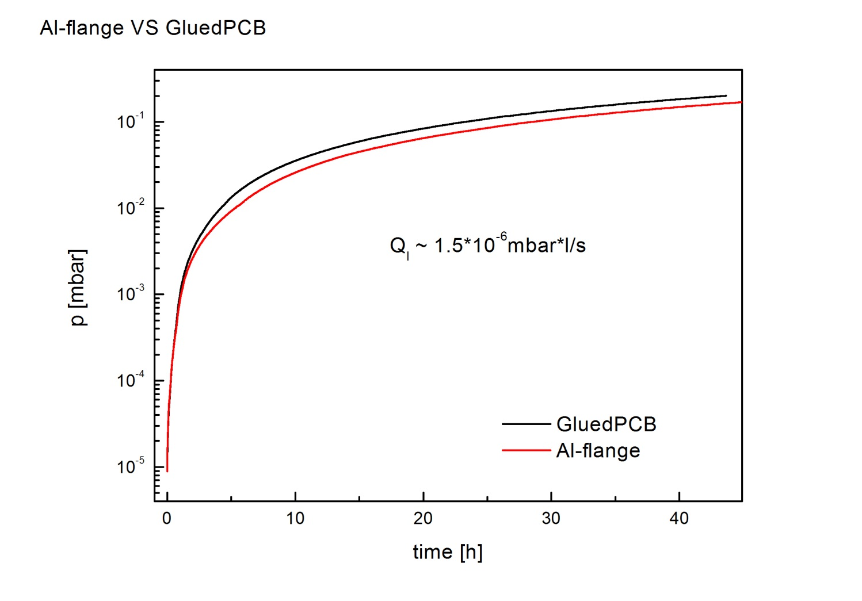
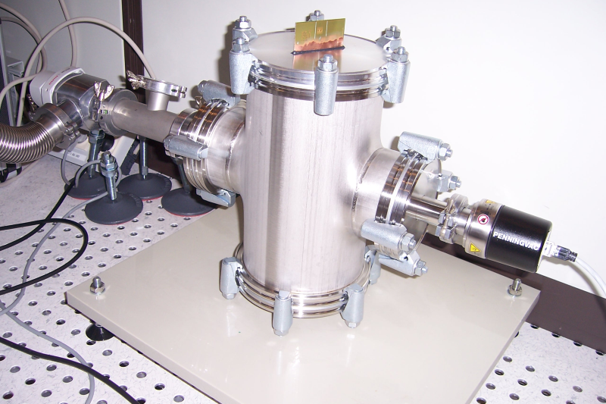
TNG – Camera test setup (Analysis of outgasing load if possible)
For FSP the simplified outgasing test was to pump down the system with and without the components and than close the valves to the pumps. The raise of the vacuum is monitored over some days and repeated.
Example with glued PCB with 3M Scotch-WeldDP490 .
Vacuum leakage rate : 1.5*10⁻⁶mbar*l/s
Small test chamber (will be used for VIC test…).

Slide 4
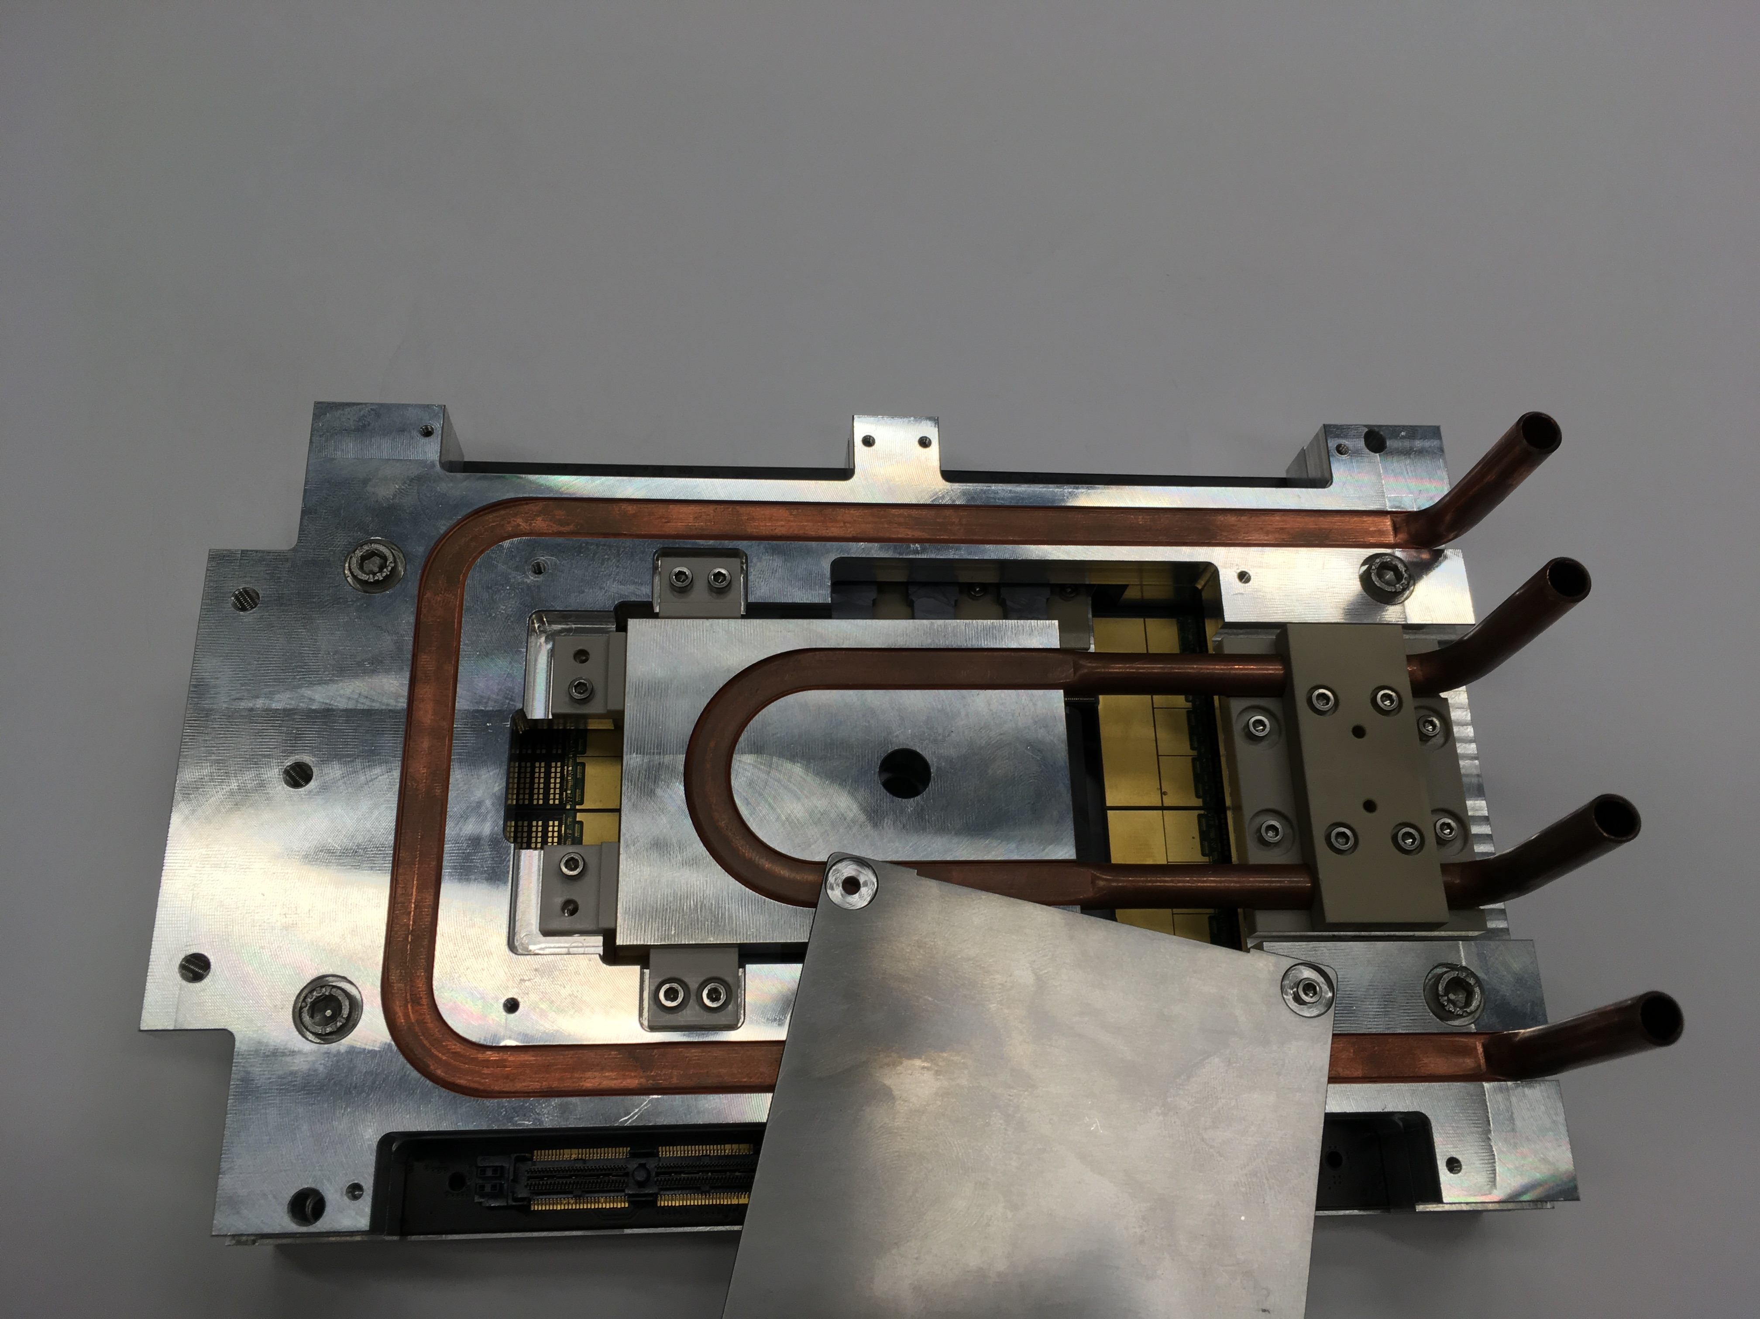
TNG – Camera test setup (Cooled down test)
Cooling can be done with water cooling or with a stirling cooler. For the water cooling a feed through flange has to be ordered and for the stirling cooling some kind of connection has to be designed (e.g copper cables).

Slide 5
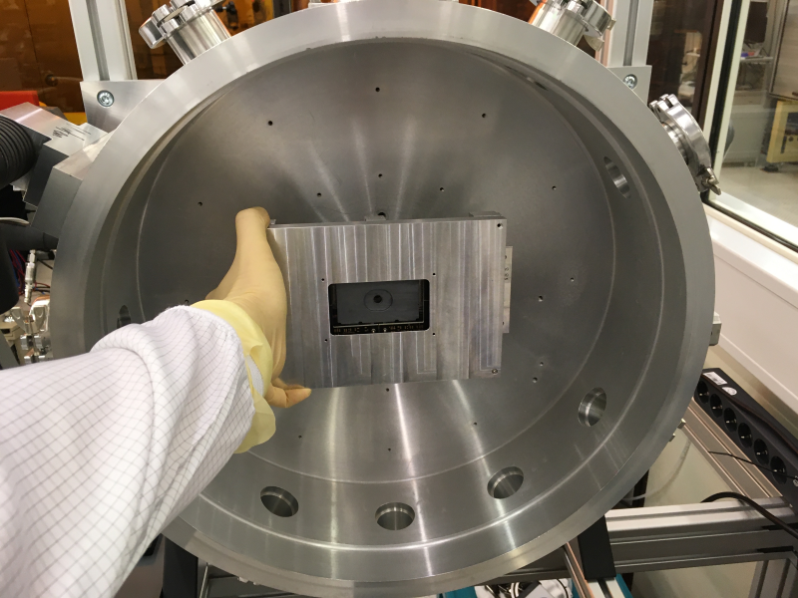
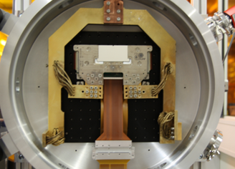
TNG – Camera test setup (Spectroscopic measurement with Fe-55)
For LAMP we used a FE-55 source. The illumination in this setup was uniformly.
Because of the size of the TNG pnCCD is nearly the same like for LAMP the setup can be reused.

Slide 6
TNG – Camera test setup (Dynamic range measurements)
The experiment like Maxymus has a high luminance and will produce a lot of electrical charge in one pixel.
We did not yet experimentally measured how big the full well capacity is.
Only linearity measuremts were done but without luminance reaching full well capacity.
Because of the produced charge will even be higher than the full well capacity we want to find out the behaviour of the sensor.
For EDET we already use a pulsed laser diode. This could be used for our measurements with some adjustments for our setup.

