Slide 1
TESTSTRATEGY FOR AN EDET MODULE & FPA Schloss Ringberg Dec 2022
Semiconductor Laboratory of the Max Planck Society
Eduard Prinker / Thomas Selle

Slide 2
USEful acronyms
ASM: All-Silicon Module
MIC : Module Interface Circuit
MBM: MIC Brain Module
XU1: Xilinx Zynq FPGA on a PCB (Mercury+ Board)
MSM: MIC Service Module
MPM: MIC Power Module
MPM light: MIC Power Module in “light” implementation (ohne HK (HK: Housekeeping))
MPMMC: MPM Mockup Connector
MHM: MPM Housekeeping module
MPMS: MIC Power Module Stack (= MPM light + MHM)
VIC: Vacuum Interconnection Circuit
DLSP: Double L-Shaped Patchpanel
BRICK: Bulk Rigid Interconnect and Cooling deck
FPA: Focal Plane Array (4 Modules)
IML: Inter-module Link

Slide 3
Testing GOALS
MEETING SPECIFICATION CRITERIA
OPTIMIZATION OF SYSTEM COMPONENTS
CALIBRATION OF SENSOR
STABILITY OF OPERATION

Slide 4
Don't invent the wheel … convenient belle pxd test routines
MEASUREMENT | DESCRIPTION | DURATION | OUTPUT
HV IV SCAN | sweep voltage of HV channel | 1.5 min | IV-curve, half-range, hard current limit
DELAY SCAN | DMC/DCDE communication ´two 4-bit delay registers | 15 min | overview of all 64 transfer lines
DEAD PIXEL MAP | semi-broken drain lines | 5 sec | mask broken pixels for offset calibration
OFFSETS | offset values of all pixels | 5 sec | mean offsets (1,000 frames), noise, dispersion
POWER CYCLE SCAN | several power cycles + emergency off | 10 min | record currents (standby/peak), offsets (peak)
OFFSET COMPRESSION | 2-bit DAC adjustment | 5 - 30 min | VnSubIn (global), IPDAC (global), 2-bit DAC (individual per pixel)
DEPFET IV CURVE | transistor current as function of the gate-on voltages | 20 min | DEPFET IV curves (mostly distorted by the ghost charge effect)
CURRENT ALARMS | mean and standard deviation values for every power line |  | Alarm alert
OTHERS | threshold scan, auto pedestal shift, VnSubIn adjustment, pedestal read-back |  | BELLE specific, not needed (especially because of much larger dynamic range)

Slide 5
…develop additionally needed methods (1) supplement edet test routines
MEASUREMENT | DESCRIPTION | DURATION | OUTPUT
SAMPLE POINT SCAN | shifting 32 switcher sequences + LED (additionally, the delays of clear, gate, clock and serin can be varied by a 4-bit register) | 10 min | optimal charge collection (avoid clear)
ADC CURVES | 6 DCDE parameters + optimization criteria, external current source | > 48 hours | ADC curves, overview plots
CHARGE COLLECTION | 2-D sweep of DEPFET voltages with constant charge injenction (LED) |  | maximize charge collection function
GHOST CHARGE | shield part of matrix, variate DCDE parameters + LED |  | minimize ADU value in shadow region DEPFET IV curves
CONSECUTIVE FRAMES | variate Laser pulse width scheme |  | charge collection and clear efficiency of consecutive frames
MODULATION TRANSFER FUNCTION | knife edge + TEM |  | ESF, LSF, MTF – curves

Slide 6
…develop additionally needed methods (2) supplement edet test routines
MEASUREMENT | DESCRIPTION | DURATION | OUTPUT
CALIBRATION PS | MPMS, DLSP |  | DAC values → voltages & currents
CHARGE CURVES | linear LED intensity increases | 5 min | injected electrons/ADU- response curves, IG/OF slope, kink
TEMPERATURES | temperature diodes: 1 per DMC, 3 DLSP |  | tbd (JTAG issues)
VACUUM TESTS | evaporation, temperature, vacuum vessel, thermal camera
???

Slide 7
HV IV Curve
BELLE: "The maximal current of the HV channel is limited by the power supply due to hardware restrictions and the software limit."
position of the exponential rise is approximated by the half maximum current range → this point can be used for grading and compare different modules

Slide 8
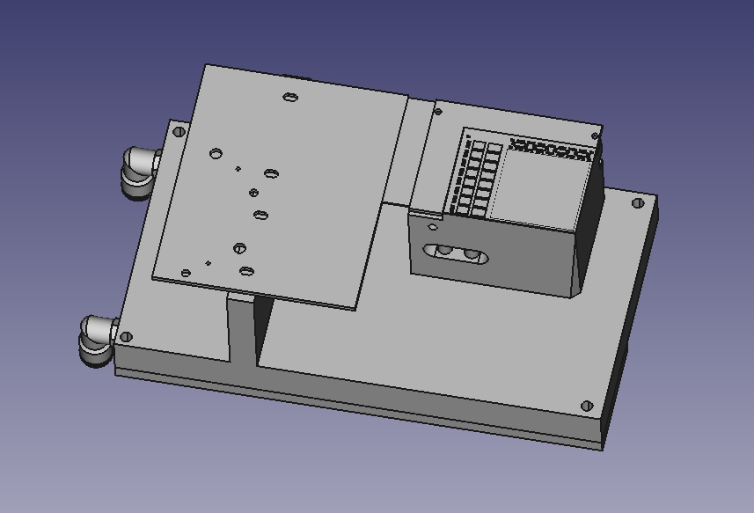
Test setup module

Slide 9
Test setup fpa

Slide 10
Delay scan bit errors depending on each global and local delay setting

Slide 11
oFFSEts offset distribution & dispersion
OFFSET = PEDESTALS (pure DCDE channel variation) + SENSOR CONTRIBUTION (leakage current, readout contribution)
DARK LEVEL: one single frame
DARK LEVEL MEAN = OFFSET

Slide 12
Power cycle scan
offset differences between two successive power cycles: thermal effects → differences should be reduced between cycles 4 and 5
observation of currents (stress test): check, if significant changes of the selected currents occur in the resulting analysis

Slide 13
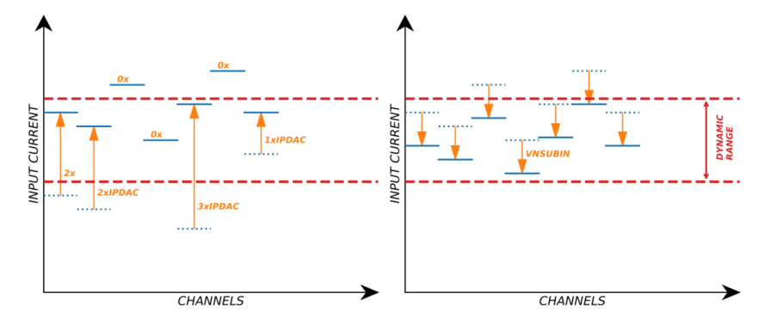
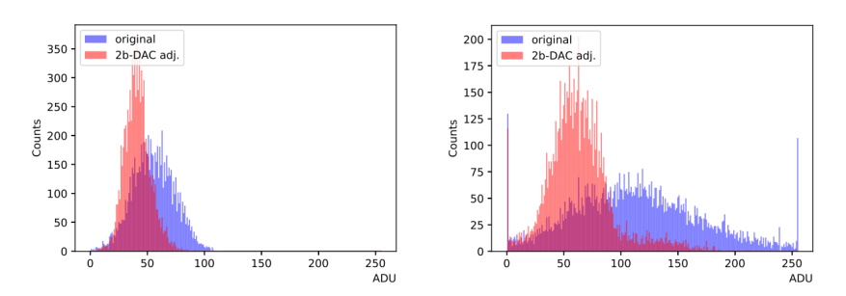
Offset compression
VnSubIn, IPDAC: global parameters
dynamically add compensation currents to input signal
different approaches: quartiles (easy implementation), assume gaussian distribution (→reduce width, J. Knopf Thesis), incorporate non-linearities (F. Lütticke Thesis)
much lower DCDE gain → quartiles approach in conjunction with individual pixel gain

Slide 14
Depfet iv curves scan
influenced by ghost charge effects – rippled curves

Slide 15
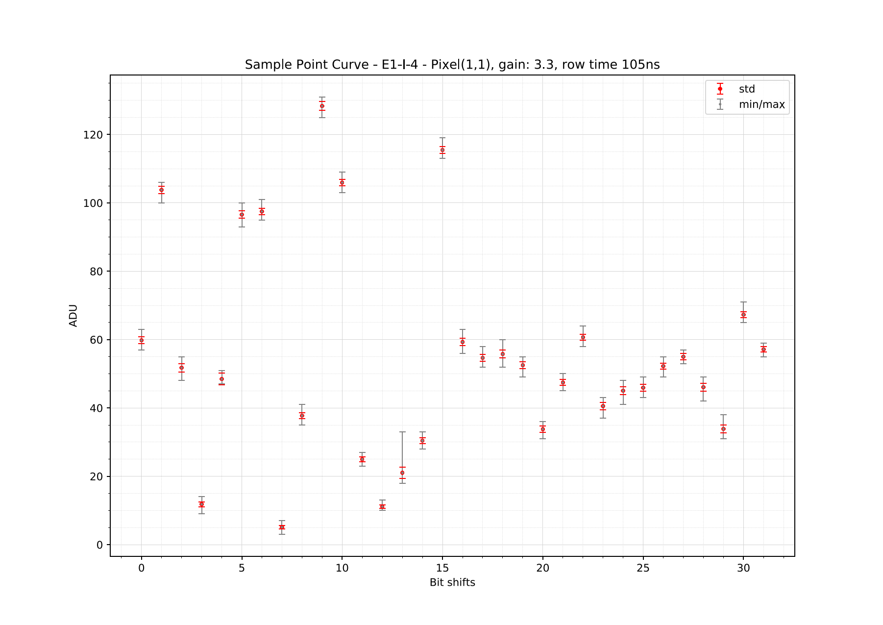
Sample point scan
shift switcher sequences (32 shifts)
illuminate by constant LED intensities
select sequence with best combination of high charge / low noise
BELLE Confluence: "In the analysis, the sampling point curve is created for a set of selected rows. Currently, no algorithm is implemented to extract the optimal bit shift and delay for the sampling point."

Slide 16
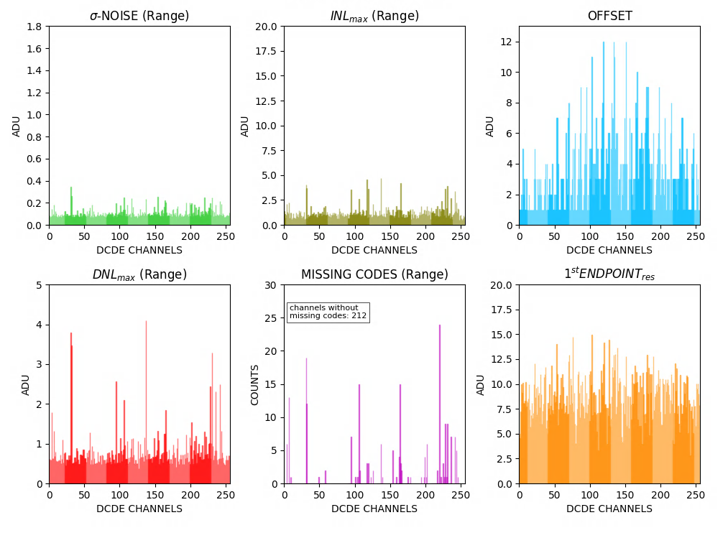
ADC Curves
significantly different approach to BELLE (external source vs. gate on increases)
ADC curve optimization: missing codes, INL, DNL, noise, offset, 1st and 2nd endpoint
variate IPSource, IPSource2, IPsourceMiddle, IFPBBias, AmpLow, RefIn
all channels (256) view
Is S²C fast enough (ramp 1,000 current steps within 1 second)?

Slide 17
Charge collection
2D-Variation of 5 DEPFET voltages + LED charge injection → AVERAGING?

Slide 18
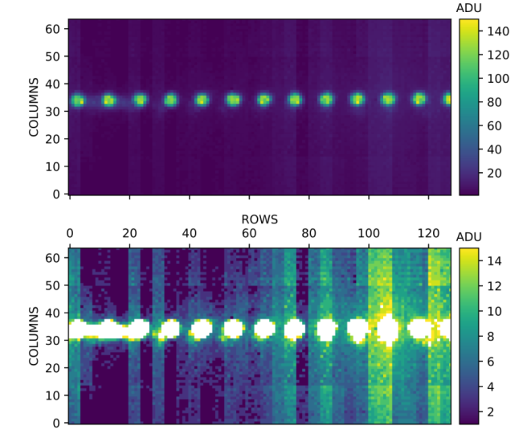
Ghost charge scans
In the following, this phenomenon of an additional measured pixel current without any
external charge injection should be referred to as the “ghost charge”. Eduard Prinker, Thesis
mitigation measures: go to maximum DAC for DCDE parameters VTCSFN, VTCCASC; enable boost SubIn

Slide 19
consecutive frames clear efficiency & charge registration
pyramidal increased/decreased pulsewidths
+
idle laser frames (no charge injection)
→
check charge collection and clear efficiency

Slide 20
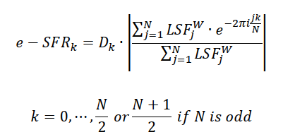
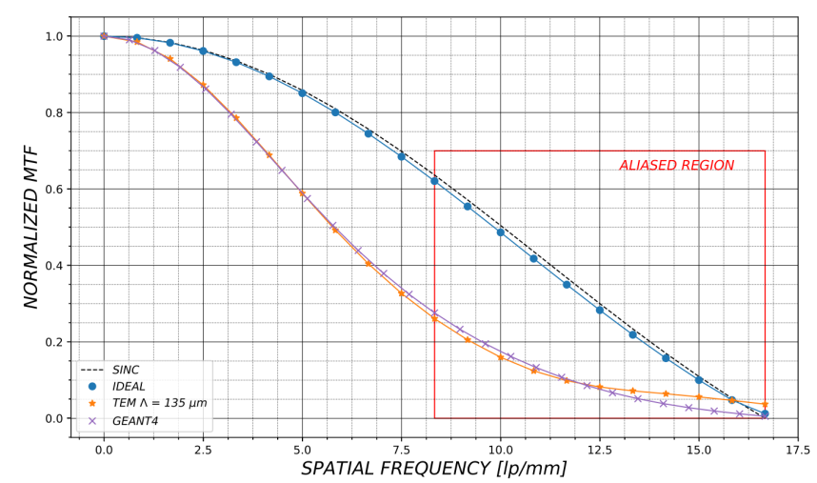
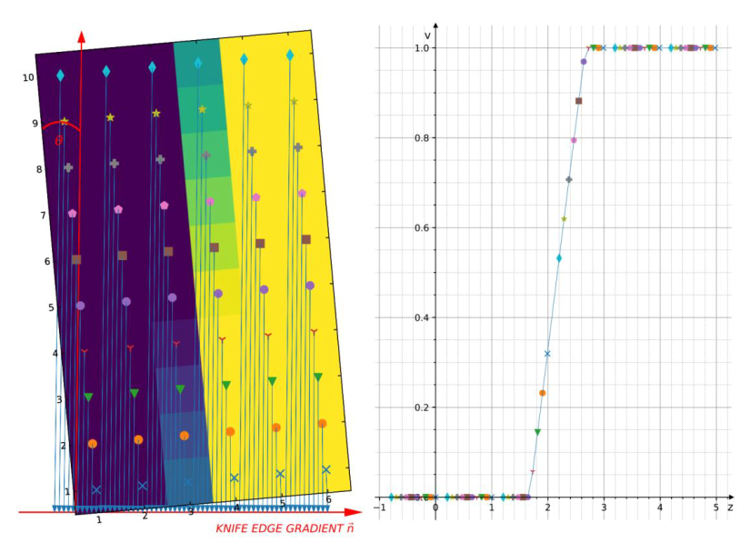
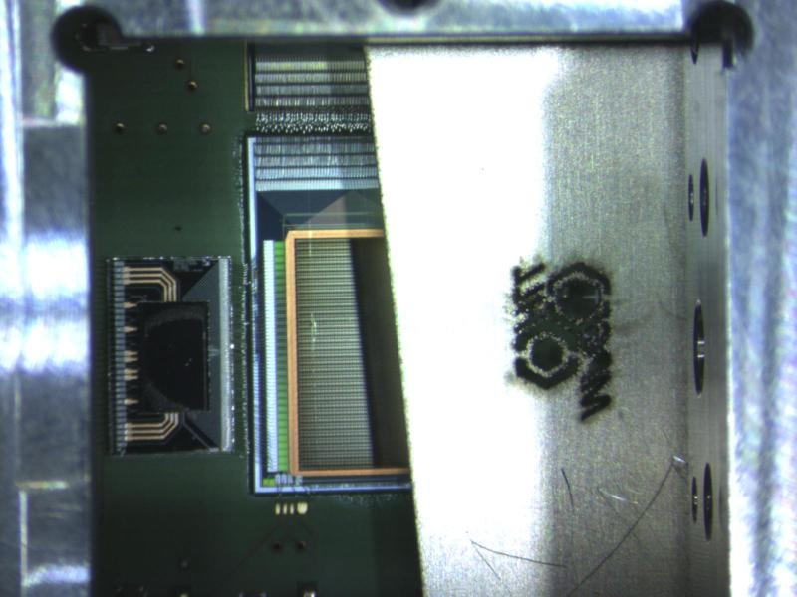
Esf, lsf, mtf – TEM MEASUREment
"Super-Sampling"
Discrete Fourier Transform

Slide 21
Automatic Calibration setup for MPMs
Electronic load
(Currents > 10mA)
MSM
(with XU1 and vimrg server)
SMU
(Currents < 10mA)
MPM&MHM
Thermal camera
2x DS2824 relay cards
(Ethernet controlled)

Slide 22
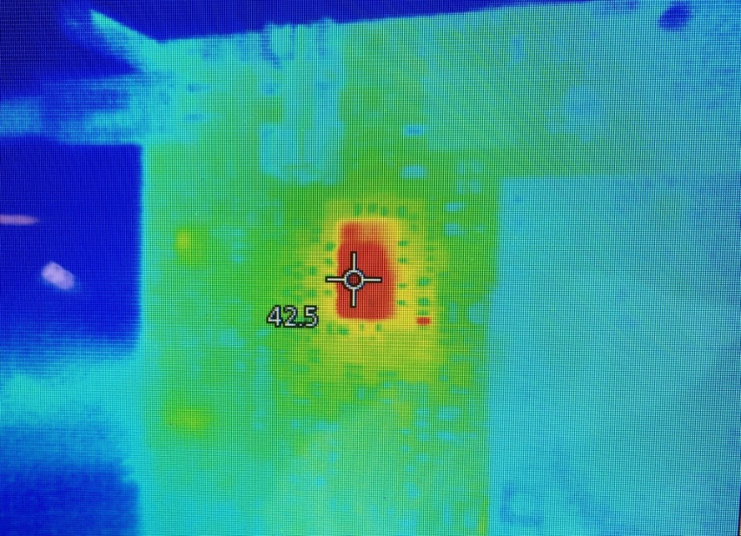
Automatic Calibration setup for MPMs
The setup is based on two DS2824 cards, one K851A electronic load for high currents, one Keithley SMU 2400 for currents mA/uA and one MSM board with a XU1. On the XU1 our usual firmware is running with the vimrg server.
Constant load test of AVDD@10A
AVDD: LDO LTM4643 fan cooled: 10A load @2.4V
Connected with the neccessary cabels to the relays cards a python script will run and calibrate automatically the MHM and MPM. Open is the adaption to the changed vimrg server and some minor problems.

Slide 23
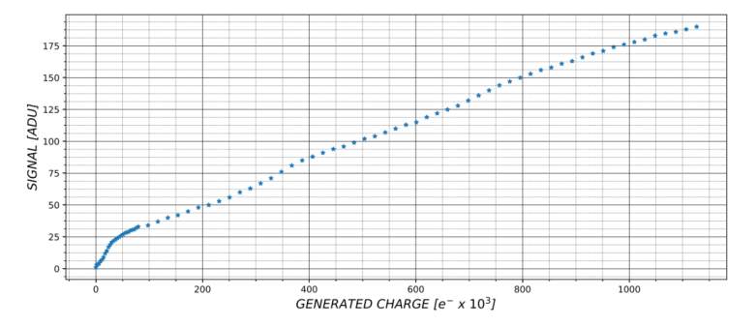
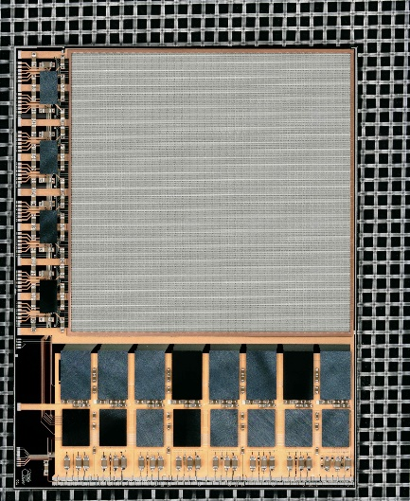
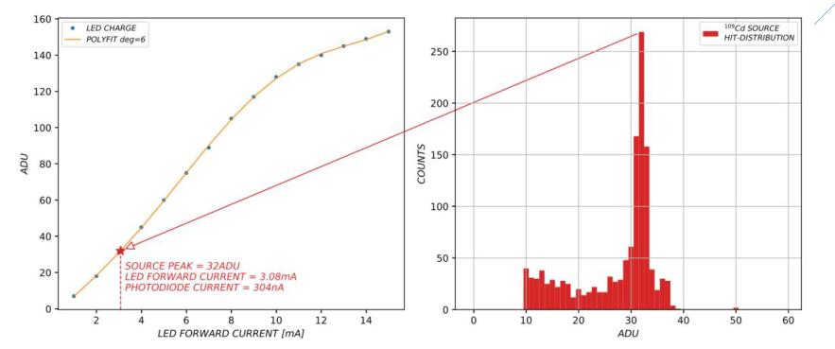
Absolute calibration
new ¹⁰⁹Cd source necessary for absolute calibration (~2 krad for pixels in "corner UDP-frame": DCD+Switcher → gate-on shift < 200 mV: H. Schreeck / M. Predikaka)
increase LED forward current by integer steps → charge curves based on generated electrons

Slide 24
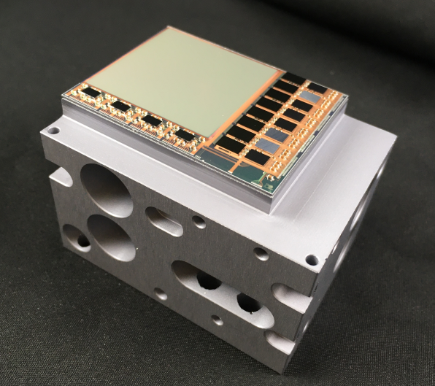
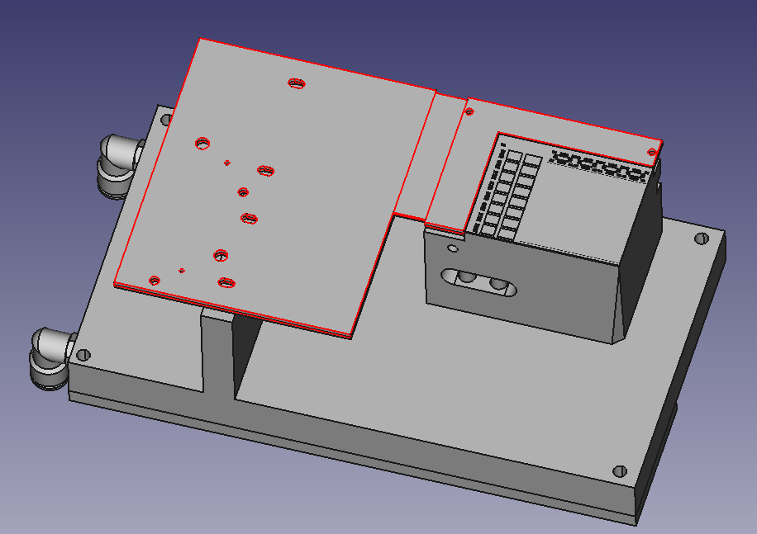
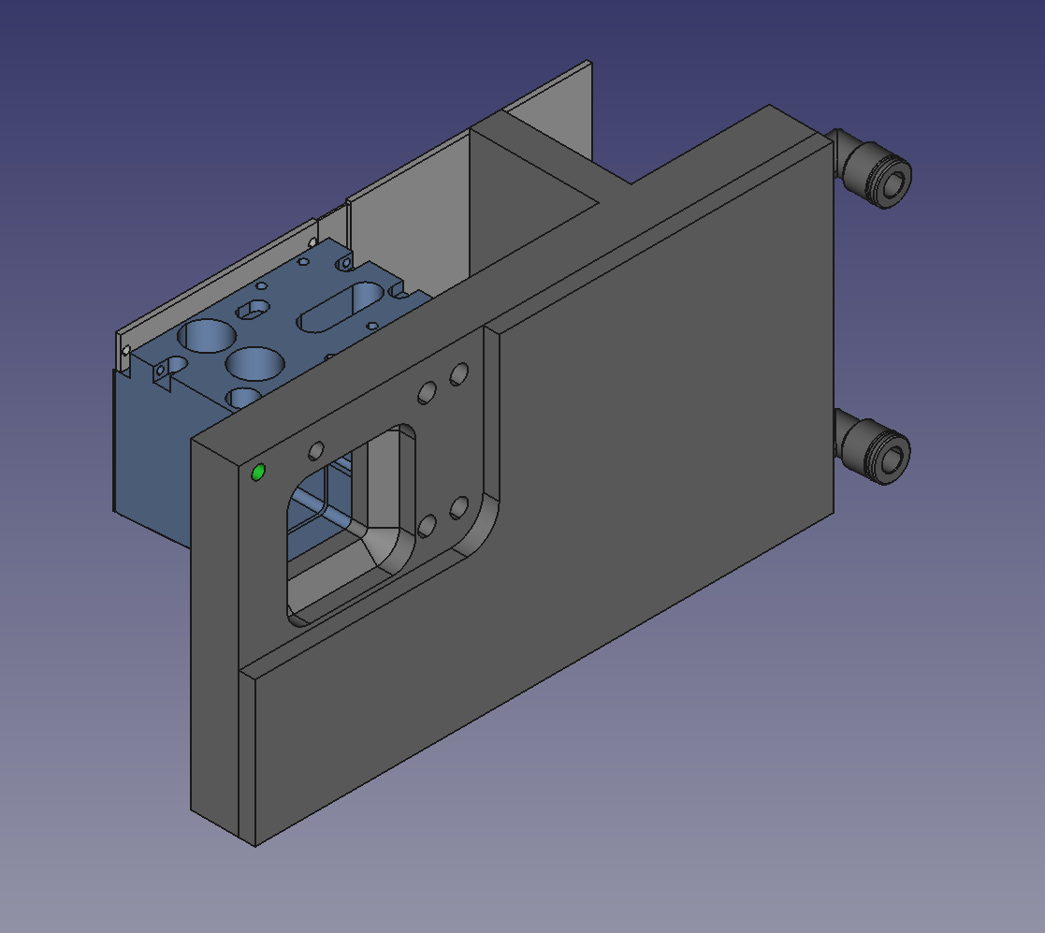
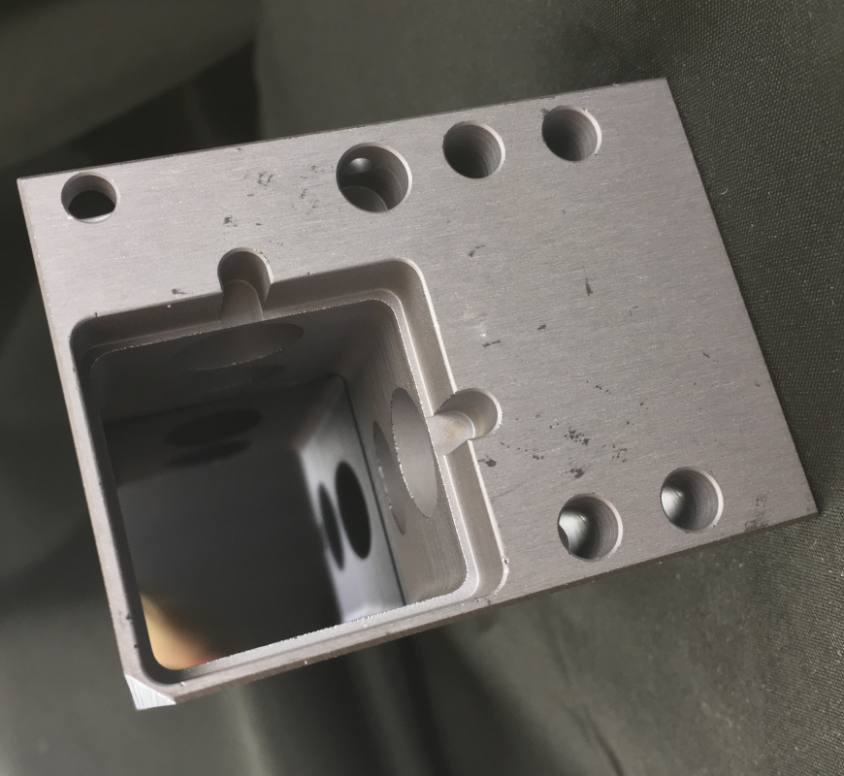
Go for EDET quarter Test-Setup
The first test of one assembled quarter will be done in a quarter-setup. This setup should have:
Some kind of cooling (water cooling or with TEC and air fan)
Easy mounting of the quarter with bonded DLSP
Backside LED illumination of the quarter for calibration.
Si-brick with glued PXD10-1 (50um)
DLSP

Slide 25
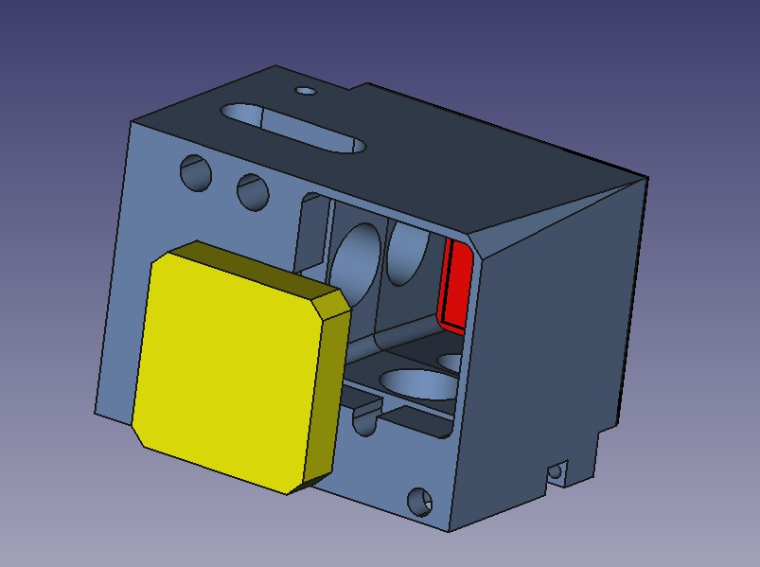
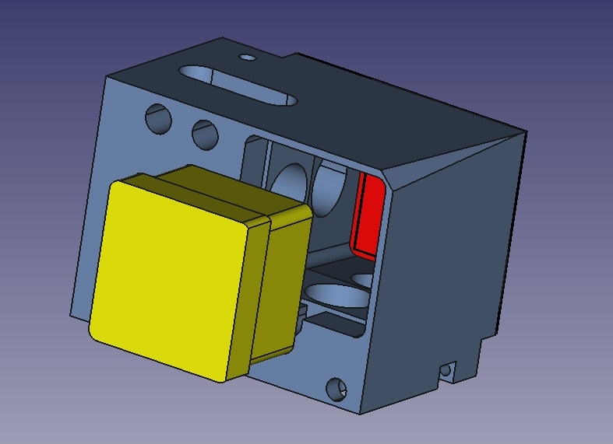
Charge curves for the module/FPA?
LED (850nm) illumination on backside + flat field optics. But this calibration scans are actually not possible → IDEAS?
Two possible setups: In both cases use a kind of milky screen for uniform illumination.
Left: Instead of the normal radiation shield use a milky screen.
Right: Use here a milky screen but in the shape that it is closer to the matrix.
Two questions: 1.) In which case we will get the better uniform illumination of the matrix?
2.) Is the reflection on the walls/cavities a problem and do we need a coating for the walls?

Slide 26
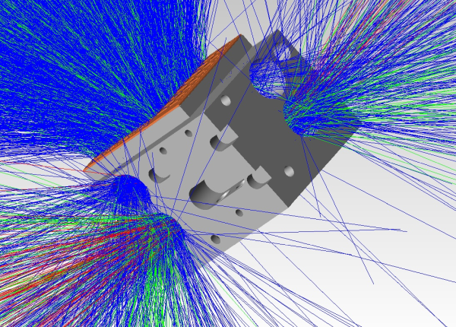
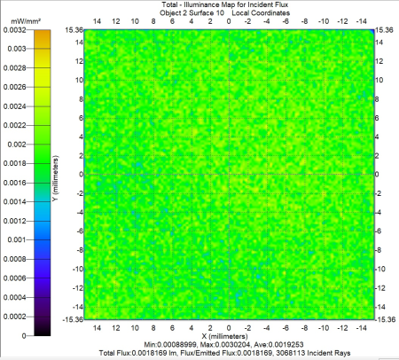
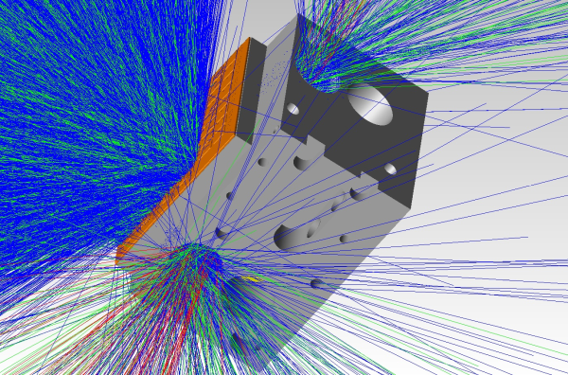
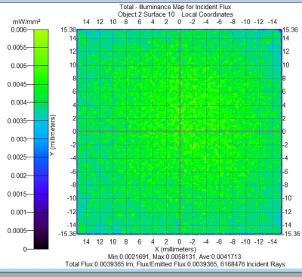
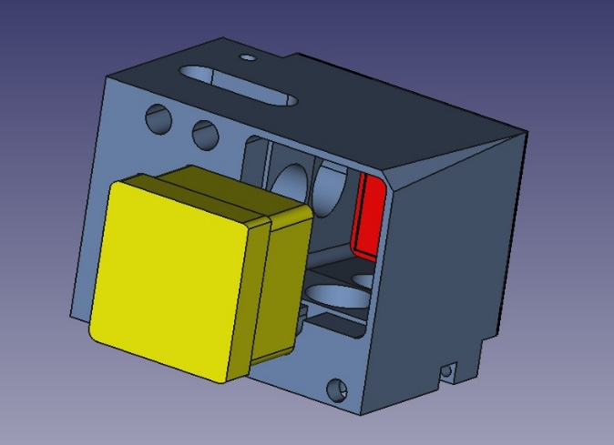
Charge curves for the module/FPA? (Some simulations with TracePro)
Option 1 seems more uniform. But more simulations will be done.

Slide 27
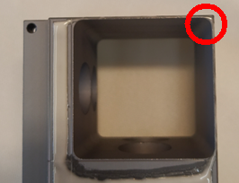
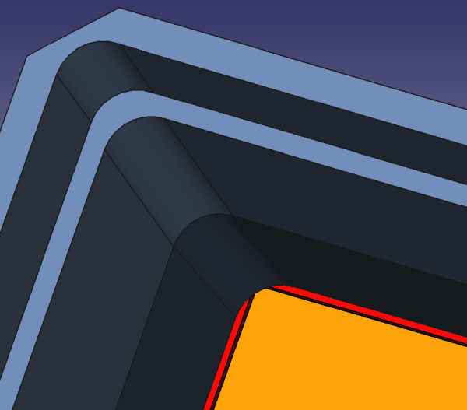
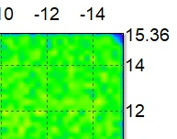
Charge curves for the module/FPA?
The optical simulation shows one thing we didn‘t take note before. In the thin wall corner the Si-brick is covering some pixels.
Question: Would this be a problem with back scattering electrons? Did Ibrahim radiation simulations shows something or was the Si-brick shape different?

Slide 28
Test setup fpa
What should we test with a EDET FPA @ HLL?
All four quarters will be already fully tested.
Critical is the mechanical assembly of the four quarters.
If the alignment of the quarters during glueing is not correct it could be that in the FPA the ASMs will touch each other → place a really thin peek cross in the middle to keep distance.
Original mounting backplate is unwieldy so we have a version with the same size but without watercooling. Instead TEC cooling could be used.

Slide 29
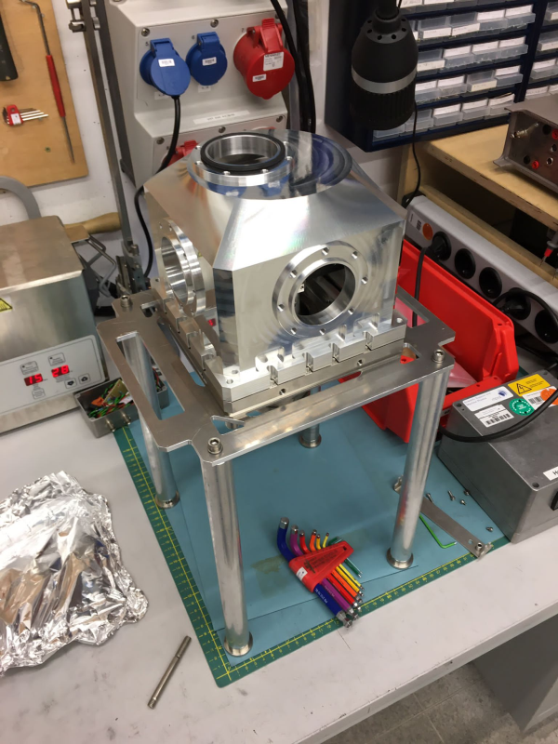
Charge curves for the module/FPA?
Quarter test at MPSD:
From mechanical side everything is ready.
The top of the vacuum chamber is designed with a displacement for better alignment of one quarter to the TEM.
Summary
Assemble DLSP on brick and bonding
Electrical tests
Thermal tests
Assembly handling with thin glued quarter

Slide 30
Summary: Go for quarter Test
Assemble of one ASM an a brick is done and looks optical good. Next step would be to bond a DLSP. Because of this ASM has the DHPT reset problem this is not useable in the TEM. But we can make some electrical and thermal test with this assembly.
As soon the needle card setup is working and one of the new ASM is tested we will glue this and also bond to a DLSP.
At this time the quarter test setup should be ready and we can test and calibrate.
Next step would be than the test in Hamburg

Slide 31
Wish you a merry christmas

Slide 32
THANK YOU FOR YOUR ATTENTION

Slide 33
BACKUP- Charge curves for the module/FPA? (Some simulations with TracePro 5 Millions rays)

