Slide 1
Overview: Data Archiving & Version Control
Project Review 2022 – Martin Hensel

Slide 2
Outline
Archiving vs. Version Control
Different kinds of Data
Accessibility
Version control systems
Product Life Cycle Management solutions
Options, so many options ...

Slide 3
Archiving versus Version Control
Archiving
Version Control
Backup the data, possibly on multiple locations (redundancy).
Control accessibility (user access control).
Timestamped (time of archivation/file creation)
May reduce data size (compression)
Can accomodate all data types.
Track how data changes over time.
Track who changes the data (commiter).
Define snapshots (commits).
Acts as a time machine for data.
Allow diverging timelines (branching).
Allow converging timelines and provide ways to integrate changes from different timelines into one (merging).
Best used for text data, most functionality not usable or not optimized for binary files.

Slide 4
Different kinds of Data
Collaborative
Compiled applications
Documentation images (png, pdf)
Schematics
Board and wafer layouts
CAD files (3D construction data)
Versioning
Source Code, Scripts (py, cpp, hpp, ...)
Documentation text
DRC/LVS definitions
Calibration data
Step files (finished 3D models)
Binary Data
Human Readable Data
Measurement raw data (xls, xlsx, npy, hd5)
Analyzed measurements (npy)
Generated plots (png, pdf)
Communications (pdf)
Measurement raw data (csv, txt)
Communications (e.g. mails, chat)
System/Client specifiactions
Archiving
Proprietary

Slide 5
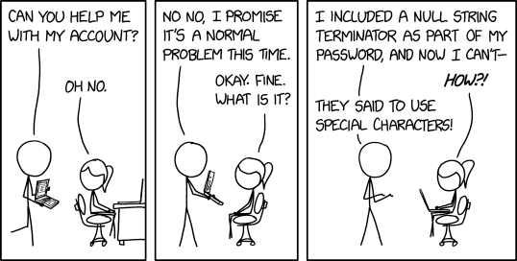
Data accessibility
Proprietary Data:
Wafer design files
Technology related measurements
Software & Firmware development
Collaborative Data:
ASIC design/tests
System specifications
In between:
Software releases
PR plots/measurements
Documentation
Who can access?
How to gain access?
How to transfer?
Who can transfer?

Slide 6
Version control systems
Human readable files: Industry standard
Binary files: It‘s complicated
We employ the industry standard: git
Other tools are available as well, e.g. SVN
The differences are mostly in administration style and where the data is stored.
On top: Usablility
User interface to work with the basic system
A way for collaborators to interact with the data and each other
Process automation (CI/CD)
Documentation
Every binary file type is different.
Data comparison almost impossible.
Most version control tools are proprietary
and handle only a small subset of all possible binary data types.
E.g. Cadence Design Entry HDL:
Version control of PCB schematics (HDL) via MS SharePoint server.
But no support for PCB layouts (boad files), although created with the same software suite.

Slide 7
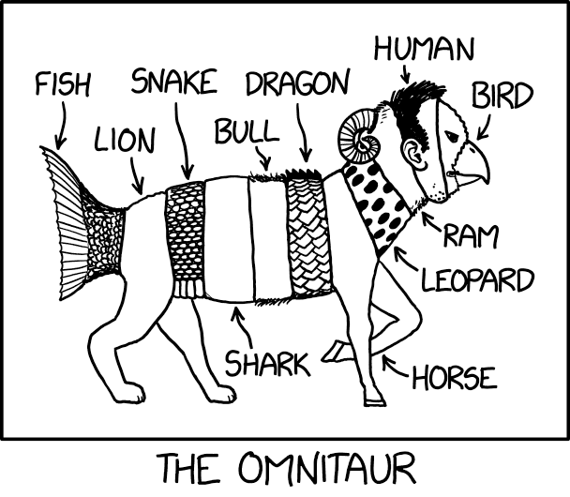
Product Life Cycle Management
Many tools provide much more functionality:
This sounds like a lot, but ...
Project planning and time tracking
Work force deployment and load optimization
Manufacturing process tracking
EDM integration (e.g. SAP orders from BOM)
Management sugar: colorful plots about nothing
Issue tracking
After-production: marketing, rollout
Knowledge bases and documentation
Efficiency scoring (e.g. yield analysis)
And many more
it may be the only solution that encompasses a good chunck of a development task, e.g. PCB design from schematic, via simulation to layout.
it can be used as a common interface between several individual version control systems and bridge the gaps left by them.
that may be true, it can be a total waste of time and man- power to manage such a system.

Slide 8
Disclaimer
The following slides can only show a small part of the available products that can be used to perform the described tasks. The presented lists cannot – and are not intended to – be complete representations of the market.
I have worked with some of the tools in the past. That introduces an inherent selection bias for some tools over others, based on previous experiences and ignorance about possibly superior alternatives and recent developments.

Slide 9
Options – Firmware and Software
For firmware and software development on git basis:
 | Gitea | Gitlab | Stash (Atlassian)
Location | Self-hosted | Hosted (GWDG) | Hosted (tbd)
Administration | mhe + vtravalja | GWDG + HLL | Hoster + HLL
Repo Structure | Organization, Project | Group, Sub-group(s), Project | Group, Project
User Structure | Organization, Team | Group, Permission | Group, Permission
Issue tracking | Integrated | Integrated | JIRA (Atlassian)
Documentation | Project wiki | Group wiki, Project wiki | Confluence (Atlassian)
Automation | Possible, but no experts available on site | Implemented, runners on HLL machines TBD | Implemented (bamboo), runner location TBD
Collaboration | Only internal | GWDG members and external via guest account | Everyone is external anyways
Price tag | Free (+ mhe & vtravalja) | Basic version free | TBD

Slide 10
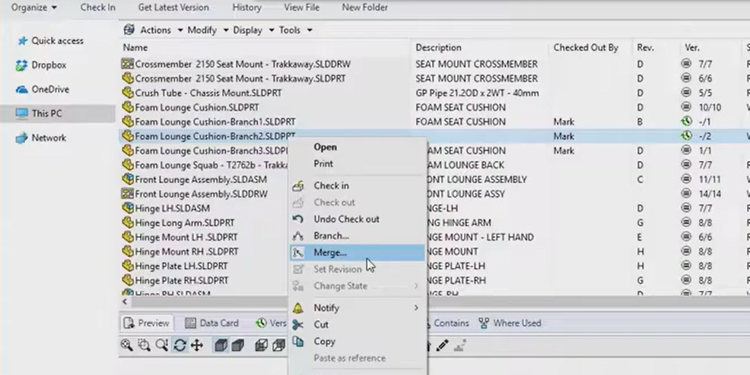
Options – 3D Modeling and CAD
Solidworks – Solidworks PDM
Autodesk – Autodesk Vault
Design workflows and automation steps (e.g. fill out drawing blocks with revision data).
Manage revision and approval permissions and requirements.
Document history and access to old versions.
Check-out-check-in system to lock files.
Branching and merging of designs for prototyping and experiments.
But no coworking on the same file, no merging of changes from different users on the same file at the same time.
https://www.solidworks.com/de/product/solidworks-pdm
https://www.autodesk.com/products/vault/overview

Slide 11
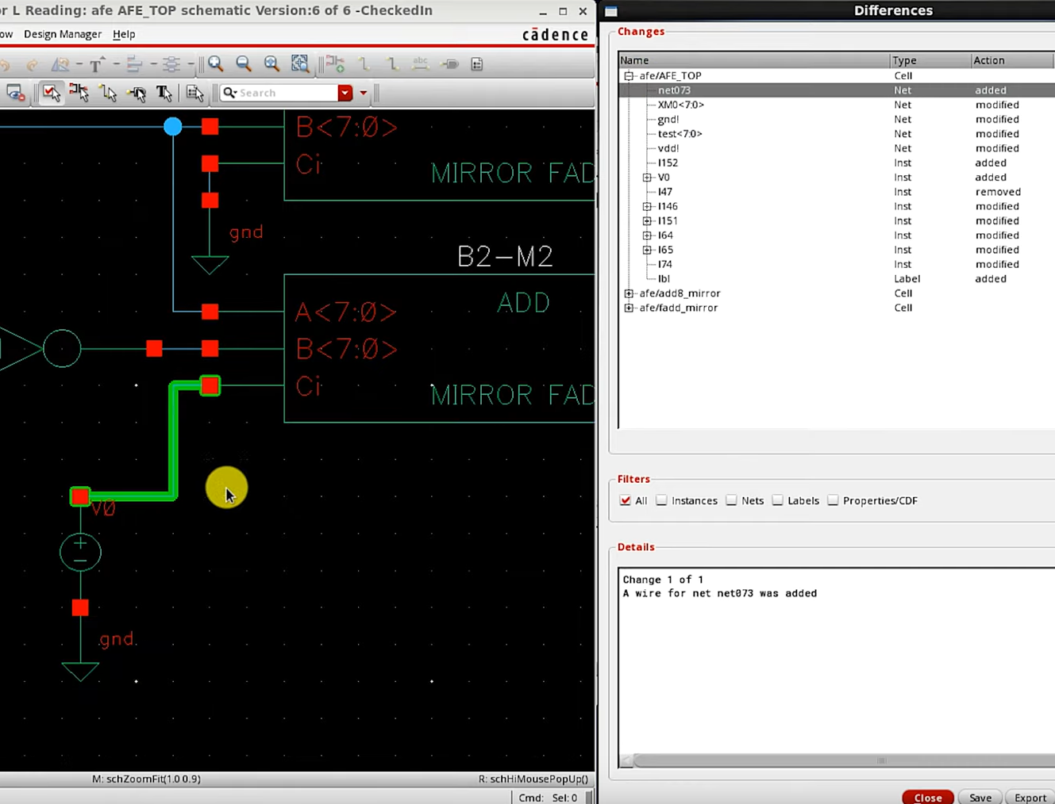
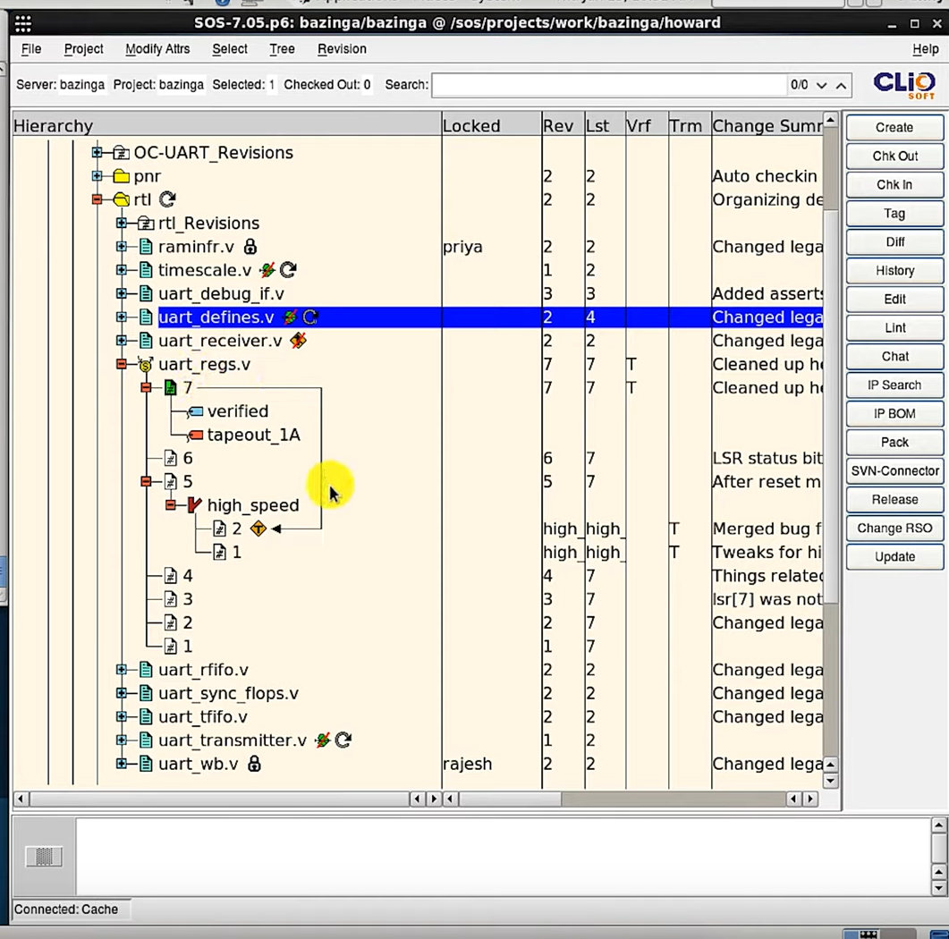
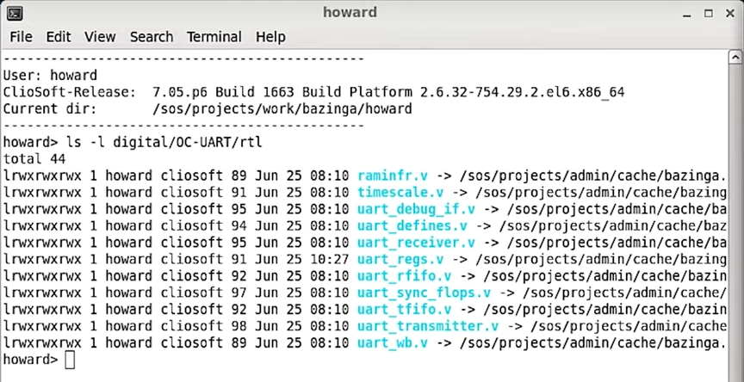
Options – Wafer Schematics and Layouts
ClioSoft SOS7 – Available from Europractice:
Complete version tracking, branching and merging of design files.
Check-in-check-out based editing: Lock the file you are working on so no other users can change it until your edits are done.
Visual differences view to compare versions of layouts and schematics.
Seamlessly integrates into Cadence Virtuoso and Library Manager and extends some functionalities like working on multiple files.
Integrates into issue and bug tracking systems e.g. Atlassian JIRA.
https://www.cliosoft.com/products/sos/
https://www.europractice.stfc.ac.uk/tools/cliosoft.html

Slide 12
Options – Cadence PCB design Suite
PCB Schematics:
Allegro EDM
PCB Layout:
Symphony Team Design
Footprints and Symbols:
Central Library
Included in Europractice package 17.2
Has to be set up for our group with a central server instance.
Check-out-check-in system to lock files, pages or hierarchy groups for editing.
Revision tracking.
Link for more information
Available since 16.6 even better in 17.2
Server based or individual system.
Open a session for several people to collaborate on the same layout.
No direct version control.
Link for more information
Work in progress by our new expert Sharif.
Allegro Pulse
Version control, product life cycle management
Link for more Information

Slide 13
So many options – Which one to take? – Discuss!

Slide 14
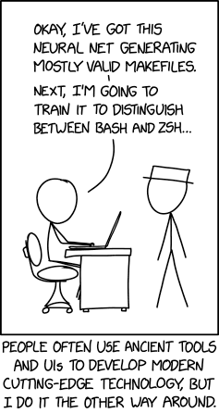
Thank you for your attention For questions please contact:
Max Planck Society – Semiconductor Laboratory
Martin Hensel
Otto-Hahn-Ring 6
81739 München
Tel.: +49 (0)89 839400-0 Fax: +49 (0)89 839400-11
E-Mail: hll-info@hll.mpg.de Internet: www.hll.mpg.de

