Slide 1
Status of Leptoquark models after LHC Run-2 and discovery prospects at future colliders
Based mainly on 2301.01754 and 2301.04119
IMPRS Recruitment Workshop
6th March 2023
Amartya Sengupta

Slide 2
Outline
Introduction and Motivation
Theoretical Overview
LHC Limits
Future Prospects
Summary

Slide 3
Introduction and Motivation
An exciting development in recent years has been the measurement of ratios of decay widths in the semileptonic rare decays of B-mesons which hinted at lepton flavour-universality violation. However, the latest announcement from LHCb showed a measurement consistent with the Standard Model (SM).
Nevertheless, there remains a mismatch with the measured branching fraction of $B_{s} →$ $μ^{+} μ^{−}$ and in the angular distribution in the decay of B $→K^{∗}$ $μ^{+} μ^{−}$ which still implies a possible new physics contribution.
There has also been some efforts to explain the anomalies in terms of new particles, such as new vector bosons or leptoquarks. Here, we examine the expected effects of leptoquarks to cause observed anomalies in the B-sector and report on current constraints and future prospects of detection.
Leptoquarks are bosons which carry both SU(2$)_{L}$ and colour SU(3) charges and therefore couple to both leptons and quarks. We probe three models of leptoquarks – scalar models $S_{3}$ and $R_{2}$ as well as vector model $U_{1}$.
For this analysis we mainly considered the anomalies in the neutral current sector with b → s transitions. Here, the main contribution comes from t-channel leptoquark exchange.

Slide 4
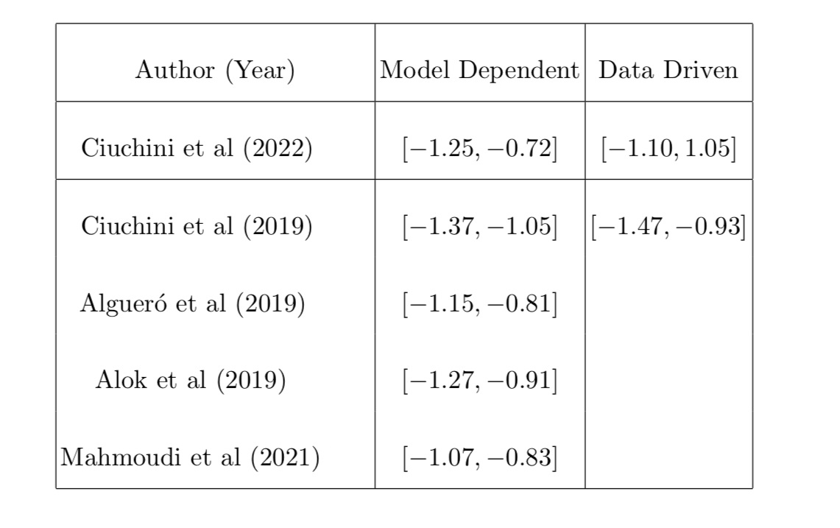
Theoretical Overview
The low-energy effective theory for the b → s flavour changing neutral current sector is described in terms of an effective Hamiltonian which can be written as
From multiple fitting studies we know that the operator whose Wilson coefficient shows significant deviation from the predicted SM value is the $C_{9}$. For the best-fit values of $C_{9}$, we use the following data

Slide 5
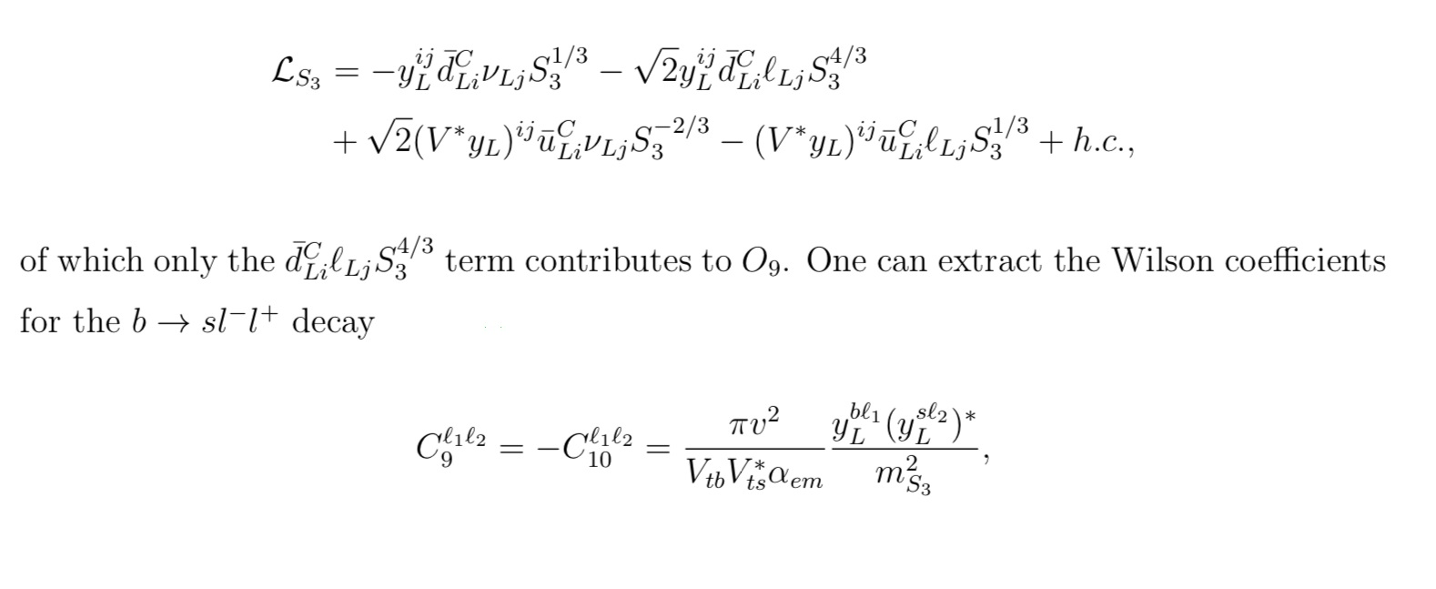
Leptoquark Models
The first leptoquark model we consider is the scalar $S_{3}$ model which is a SU(2$)_{L}$ triplet. The generalized Lagrangian can be written as,
The three triplet component states carry charges Q = -2/3, 1/3 and 4/3 respectively. By expanding out the SU(2$)_{L}$components we get,

Slide 6
The most general Lagrangian for the $R_{2}$ model describing the Yukawa interactions can be written as,
In terms of the components with each leptoquark states with charge Q, the Lagrangian can be written as,
The most general Lagrangian with coupling to both left-handed and right-handed fermions can be written as,

Slide 7
LHC LIMITS
The main goal of this part is to use published LHC data to simultaneously constrain the mass and Yukawa couplings of the Leptoquarks.
The Wilson coefficient $C_{9}$ mainly depends on three parameters roughly as $C_{9} \sim {(\frac{y_{2k}y_{3k}}{M})}^{2}$, where $y_{jk}$ refers to leptoquark coupling between quarks and leptons and M represents the leptoquark mass. It is therefore possible to independently constrain the two Yukawa couplings $y_{2k}$ and $y_{3k}$.
To achieve this, we study three different cases – first setting only $y_{2k}$ non-zero, second setting only $y_{3k}$ non-zero and third setting both equal.
Since the latest LHCb data seem to indicate that electrons and muons have identical behaviour, we have considered the analysis for both first and second generation of leptons.
We re-interpreted both the dilepton resonance search with 139 ${fb}^{−1}$ data [1903.06248] and the non-resonant dilepton search at 139 ${fb}^{−1}$ data [2006.12946] from 13 TeV pp collisons at ATLAS. However, we find that the non-resonant search results in much stronger limits and therefore we have used it for our analysis to constrain the leptoquark couplings.
We can also see that in the case where a single leptoquark state can couple to both electrons and muons, the stronger constraints on couplings and mass can come from non-resonant $e$ $μ$ channel. Therefore, we have also considered this scenario where both $y_{k1}$ and $y_{k2}$ are non-zero.
Direct leptoquark mass limits are obtained from strongly pair-produced mode followed by the decay of each leptoquark into a lepton and a jet [2006.05872].
We generated events using Madgraph with the required fiducial cuts listed in [2006.12946] and using the 95% upper limits for the most constructive signal region.

Slide 8
Exclusion Plots of $y_{2k}$ and Mass of leptoquarks for same flavour dilepton search
The bright red regions at the top are disallowed from non-resonant dimuon searches at 139 ${fb}^{−1}$ data.
The corresponding di-electron limit is the lighter line inside the bright red region.
The solid dark red regions at the bottom are obtained from requiring perturbative couplings consistent with $C_{9} \sim {(\frac{y_{2k}y_{3k}}{M})}^{2}$ and $y_{3k}$ ≤ 1.
The mass limits are obtained by turning on $y_{2k}$ ≠ 0 alone, thus allowing leptoquark decays to all possible scenarios for a particular coupling.
The leptoquark mass limits are 1.7 TeV for the $S_{3}$ and $R_{2}$ models and 2.3 TeV for the $U_{1}$ model for the case where a leptoquark decays to a muon and a jet.
For the electron and a jet case, the mass limits are 1.8 TeV for the $S_{3}$ and $R_{2}$ models and 2.4 TeV for the $U_{1}$ model

Slide 9
Exclusion Plots of $y_{3k}$ for same flavour dilepton search
The solid red regions at the bottom are obtained from requiring perturbative couplings consistent with $C_{9} \sim {(\frac{y_{2k}y_{3k}}{M})}^{2}$
The darker region is inconsistent with the observed upper limits on $y_{2k}$.
The corresponding di-electron limit is the lighter line inside the dark red region.

Slide 10
Exclusion Plots of $y_{2k}$ = $y_{3k}$ for same flavour dilepton search

Slide 11
Collider Limits for different flavour dilepton search for the $U_{1}$ model
The dilepton process in this case $p p → e$ $μ$ does not exist in the SM. Therefore, we get the strongest limit with the 3.2 ${fb}^{−1}$ data. For this analysis we have extrapolated the data to 139 ${fb}^{−1}$ luminosity using Pythia.
The top left panel shows the limits on the coupling to second generation quarks with $y_{22}= y_{21}$.
The top right panel shows the limits on the coupling to third generation quarks with $y_{32}= y_{31}$ and the bottom panel shows the case where all four couplings are equal.
We can clearly see that the universal coupling scenario is likely ruled out by 3000 ${fb}^{−1}$ HL-LHC run.
There is no direct limit on the case with e $μ$ final state in the published search, which if existed, would give a far better mass limit.

Slide 12
Collider Limits for different flavour dilepton search for the $S_{3}$ model

Slide 13
Collider Limits for different flavour dilepton search for the $R_{2}$ model

Slide 14
Future Prospects
From the best-fit value of Wilson coefficients we know we need a high suppression scale to explain the anomalies.
If we set both the couplings to one, then we get the required scale are 16 TeV for $R_{2}$ case and 23 TeV for $S_{3}$ and $U_{1}$ cases. Resonantly, producing a leptoquark of this scale is therefore not possible at the LHC.
From the previous plots we can also see that in the non-universal case there is a significant exclusions in couplings but not enough to reach region that explain the observed anomalies.
Therefore, for future detection of Leptoquarks we have considered the planned HL-LHC run at 3000 ${fb}^{−1}$luminosity and Muon colliders with CM energy of 3TeV.
For the muon collider we have considered $μ^{+}μ^{−} →$ j j as our signal. We have used only untagged jets and we look events with $M_{jj}$ > 500 GeV.
For highest sensitivity case, we have chosen $y_{22}= y_{32}$ for this calculation.

Slide 15
Current and Future Reach of Leptoquark Couplings
For HL-LHC we find that leptoquark masses of 2.2 TeV for both $R_{2}$ and $S_{3}$ models and 2.8 TeV for the $U_{1}$ model can be excluded for leptoquark decaying into a muon and a jet.
For the Muon Collider case the SM-only cross-section at LO is 0.0596 pb at 1 ${fb}^{−1}$ luminosity.
Using this, we can calculate the parameter space corresponding to a 5$σ$ discovery as well as regions that can be excluded at 2σ.
In the $U_{1}$ case, a muon collider is capable of excluding the entire viable parameter space with 1 ${fb}^{−1}$ and to exclude the $R_{2}$ and $S_{3}$ models 5 ${fb}^{−1}$ and 6.5 ${fb}^{−1}$ luminosity will be needed.

Slide 16
Summary and Conclusions
We examine the limits from direct collider searches on leptoquark models that can explain the anomalous measurements in the B-mesons decays.
We focus on three specific models- two scalar leptoquark models $S_{3}$and $R_{2}$ and one vector leptoquark model $U_{1}$.
We have used non-resonant dilepton searches to place limits on both the mass and coupling to SM fermions by looking at changes to the shape of the dilepton mass spectrum.
We can find the current mass limits are 1.77 TeV, 1.72 TeV and 2.3 TeV respectively for the three models and it can reach up to 2.2 TeV for $S_{3}$and $R_{2}$ and 2.8 TeV for $U_{1}$ models.
We also estimate the reach of proposed 3 TeV muon collider. With very minimal assumptions, $S_{3} ,$ $R_{2}$ and $U_{1}$ models show significant deviation in dijet contributions that can be observed for the entire range of parameter space with less than 6 ${fb}^{−1}$ data for all the models.

