Slide 1
Data Handling Processor v0.1 Preliminary Test Results - August 2010
Tomasz Hemperek

Slide 2
DHP01 Overview
Technology
IBM 90nm – 9 metal layer
1.2 core / 1.8 IO voltage
Interface
32 (4x8) 400 MHz inputs from DCD (HSTL18)
LVDS control signals (clock, trigger, sync)
CMOS JTAG
Hi-speed CML output
Internal Blocks
Common mode correction
Pedestal subtraction (static and dynamic*)
Zero suppression (threshold)
Channel framing and serialization
DCD offset correction
Raw data storage up to (2048 rows)
Sequencer for switcher
Configurable delays
Clock generation (PLL)
Configurable trigger latency (up to 1024 rows)
Slow control (JTAG)
ADC & DAC

Slide 3
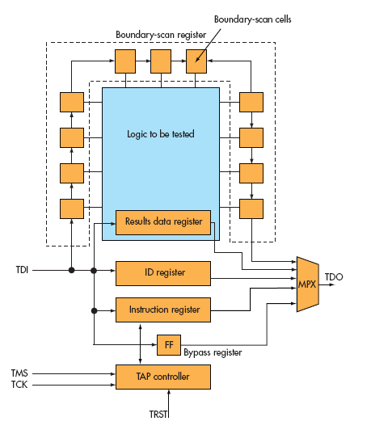
Slow control - JTAG
Boundary scan
EXTEST
SAMPLE
PRELOAD
INTEST
Configuration
BYPASS
IDCODE
USERCODE
ADC
BG
CORE_READBACK
CORE_REG
DAC
DACENC
GLOBAL_REG
MEM_ADDRESS
MEM_DATA
OFFSET_MEM_ADDR
OFFSET_MEM_DATA

Slide 4
DHP – Signal Rates & Data Flow

Slide 5
Processing
Deserializer (1 to 4)
Common mode correction
Buffering for latency
Pedestal correction
Hit Pairing
Readout
Output framing

Slide 6
Operating modes
MEMORY ACCESS
Allows to access memory block through JTAG interface for pedestal and offset correction.
RAW DATA RECORD
Storing raw data to memory (support for trigger).
RAW DATA SEND
Sending through fast output link all memory contents.
AQUSITION
Normal operation mode where data are going through all processing stages. Support for trigger and latency buffering.
TEST
Like AQUSITION but new data are not being recorded.

Slide 7
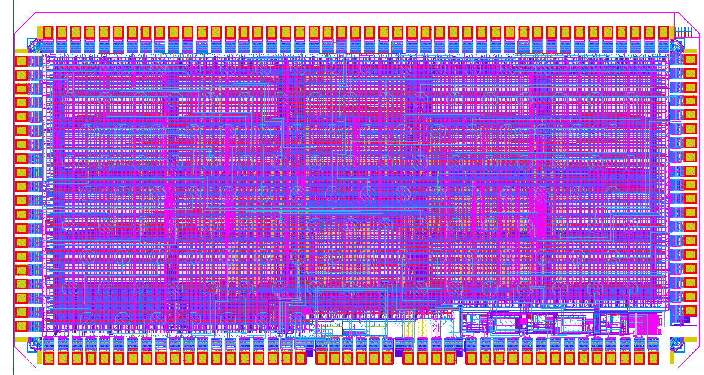
DHP01 - Layout
Prototype with 32 input chip
4mm
HSTL RX
RAW DATA
MEMORIES
OFFSET
MEORIES
RAW DATA
MEMORIES
2mm
OUT FIFO MEORY
LVDS RX
2xPLL
CML TX
ANALOG
~5.5mln transistors

Slide 8
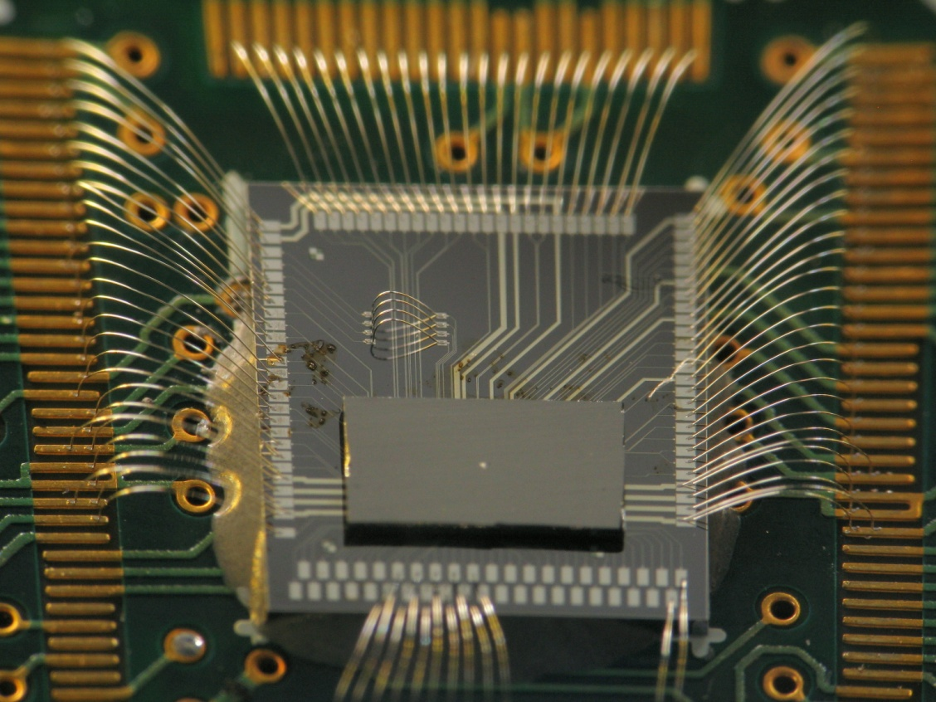
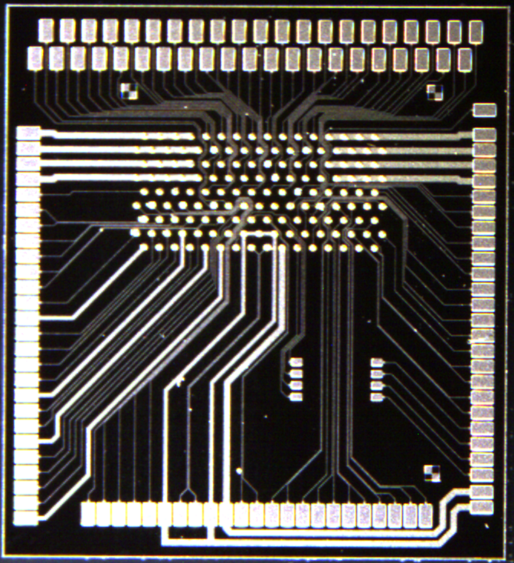
DHP01 – Bump bonding

Slide 9
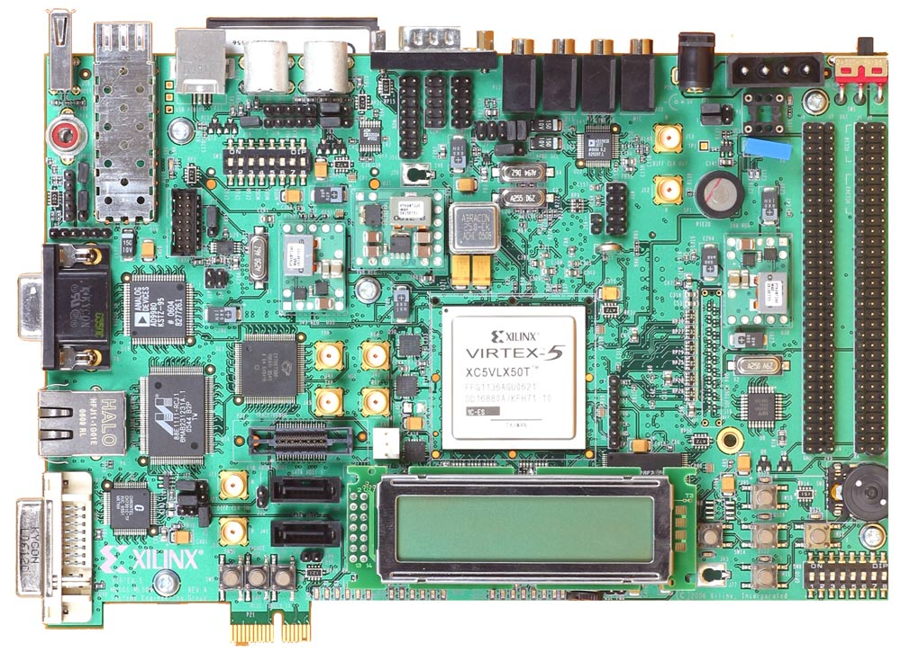
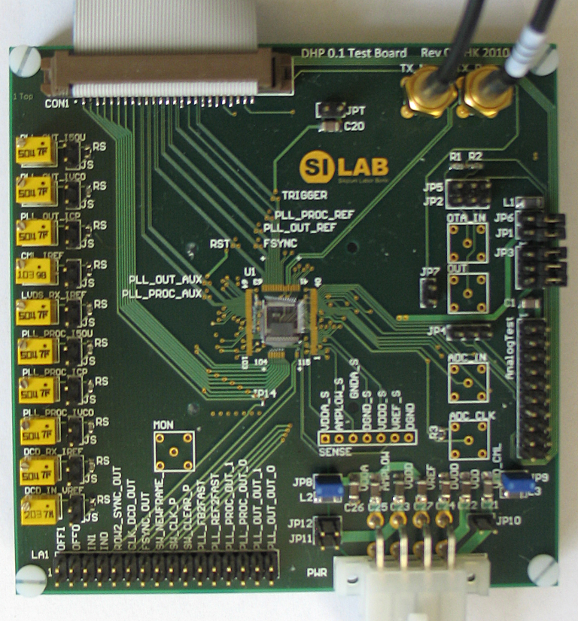
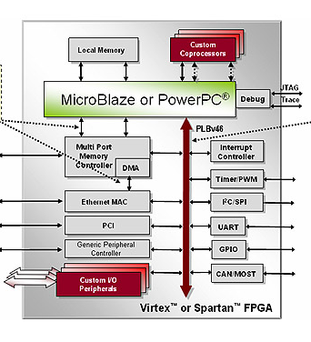
Test Setup
Xilinx XUPV5-LX110T
GPIO
SMA/Coax
ETHERNET/UDP/TCP/IP
UART

Slide 10
Testing till now
Looks to be working:
LVDS Input
HSTL like Input (from DCD)
Slow control (JTAG)
Memories read/write
CML Hi-speed link (tested up to 1.555 GHz) data transition
Input readout
Patter generator
To Do:
Analog parts
Processing (different configurations)
DCD communication and synchronization

Slide 11
Power
Measurement conditions:
1.2 V, 400MHz (100MHz Core)
Current consumption:
CML TX - ~25 mA
2xPLL - ~5mA
digital core - ~60mA

Slide 12
PLL and CML
1.5552 GHz – data transmission (random 8b10b)
WB + ~5 cm PCB + SMA +~40cm coaxial cable + SMA
100 ps/div
100 mV/div

Slide 13
Problems till now
Looks like CMOS output pads can work till ~100MHz so unable to test with DCD at 400 MHz
Configuration of one PLL output (slow one) not fully accusable (simple bug known from submission) there is a workaround
-> More results in Valencia

Slide 14
Timeline
Finish test setup to be ready for hi-speed data accusation
Prepare setup with DCDB
Radiation tests
DHP 1.0:
scale design to full size chip → (beginning/middle of 2011)
Need to know exact processing algorithm (needed corrections and data sizes) !
Need to know final number for occupancy

Slide 15
Thank to
Bonn:
Hans Krüger
Andre Kruth
Mikhail Lemarenko
and others
Barcelona:
Albert Comerma
Angel Dieguez
Lluıs Freixes
Eva Vilella
and others

Slide 16
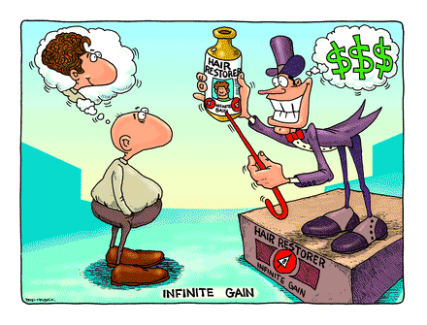
Thank You.

