Slide 1
Fabrication and testing of Resistive Plate Chambers
Turković Timur ,Fallavollita F., Kortner O. ,Kroha H. ,Proto G. ,Soyk D.
23.03.2023, DPG-Frühjahrstagung

Slide 2
Upgrade of ATLAS muon spectrometer for HL-LHC
Installation of 272 thin-gap RPC triplets (i.e. 1 mm gas gap between the RPC electrodes) in inner layer of barrel to maximize muon trigger acceptance and efficiency.
Challenges:
High γ-radiation background: 10 kHz/cm² required rate capability
Required longevity: > 10 years of operation at HL-LHC
Very tight space constraints; only 4 cm in height available for triplet of RPC gas gaps
Gas-mixture:
C₂H₂F₄(94.7%),
C₄H₁₀ (5%),
SF₆ (0.3%),
at atmospheric pressure
5.8kV
Parallel plate gaseous ionization detector without wires and a small gas gap
Use of highly resistive electrodes to limit avalanche development and graphite layer on outsides the electrodes for high voltage contact
Inner surface coated with linseed oil varnish to obtain a smooth surface
Position measurement with pick-up strip
Thin-gap RPCs:
Gas gap thickness (High Pressure Laminate (HPL) electrodes distance) and operating voltage reduced to minimize the signal in order to meet the required longevity and high-rate capability; 400 ps time resolution
Highly sensitive, low noise electronics necessary to detect the small RPC signals

Slide 3
Production
To produce required number of RPCs additional production capabilities necessary
Creation of a new production site in Munich → Max-Planck-Institute developed production procedures and materials that are transferred to commercial companies
For initial evaluation of the companies and production procedures each company produced several small test samples
Size of a sample: 40x50 cm²
Production procedures:
Production step 1: Graphite coating
Production step 2: Application of electrical contact and gluing of Polyethylenterephthalat (PET) foil on HPL plate
Production step 3: Positioning of spacers and lateral profiles
Production step 4: Gluing HPL plate onto spacers and profiles
Production step 5: Closing the gas gap with second HPL plate
Production step 6: Sealing
Production step 7: Leak test
Production step 8: Oil coating

Slide 4
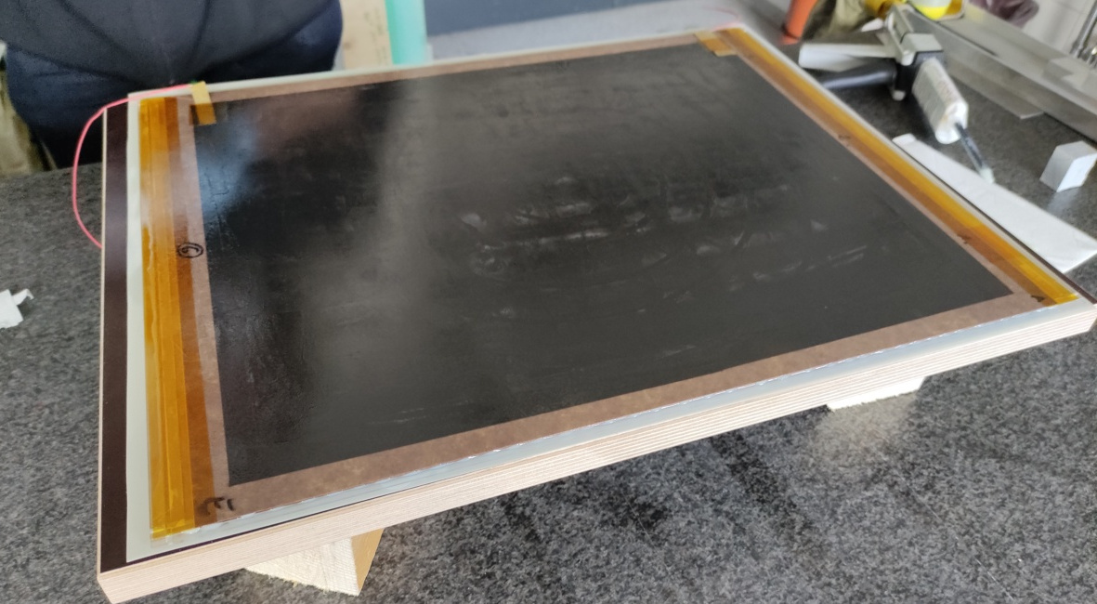
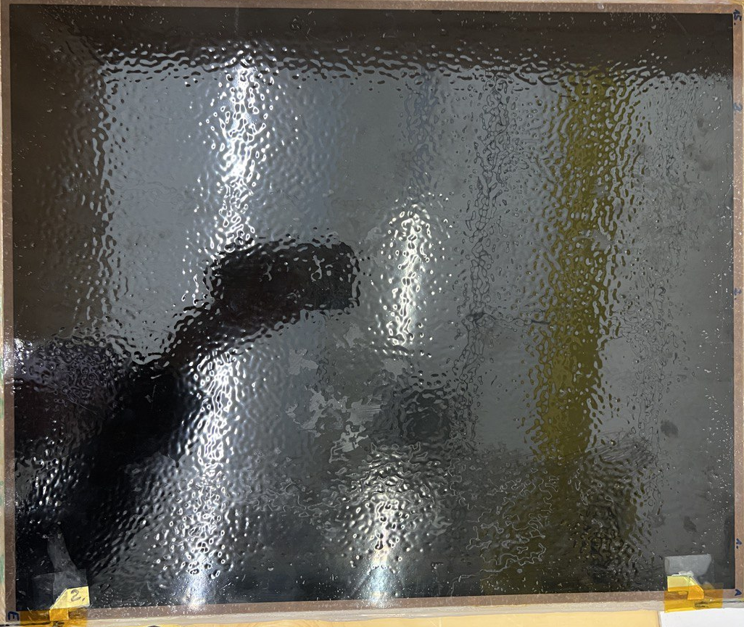
Preparing the electrodes
Electrical contact: Copper pad is glued to graphite layer using conducting silver glue
Insulating: The PET foil with pre-applied Ethylen-Vinylacetat (EVA) is placed on outside of electrodes and heated up with heating mats

Slide 5
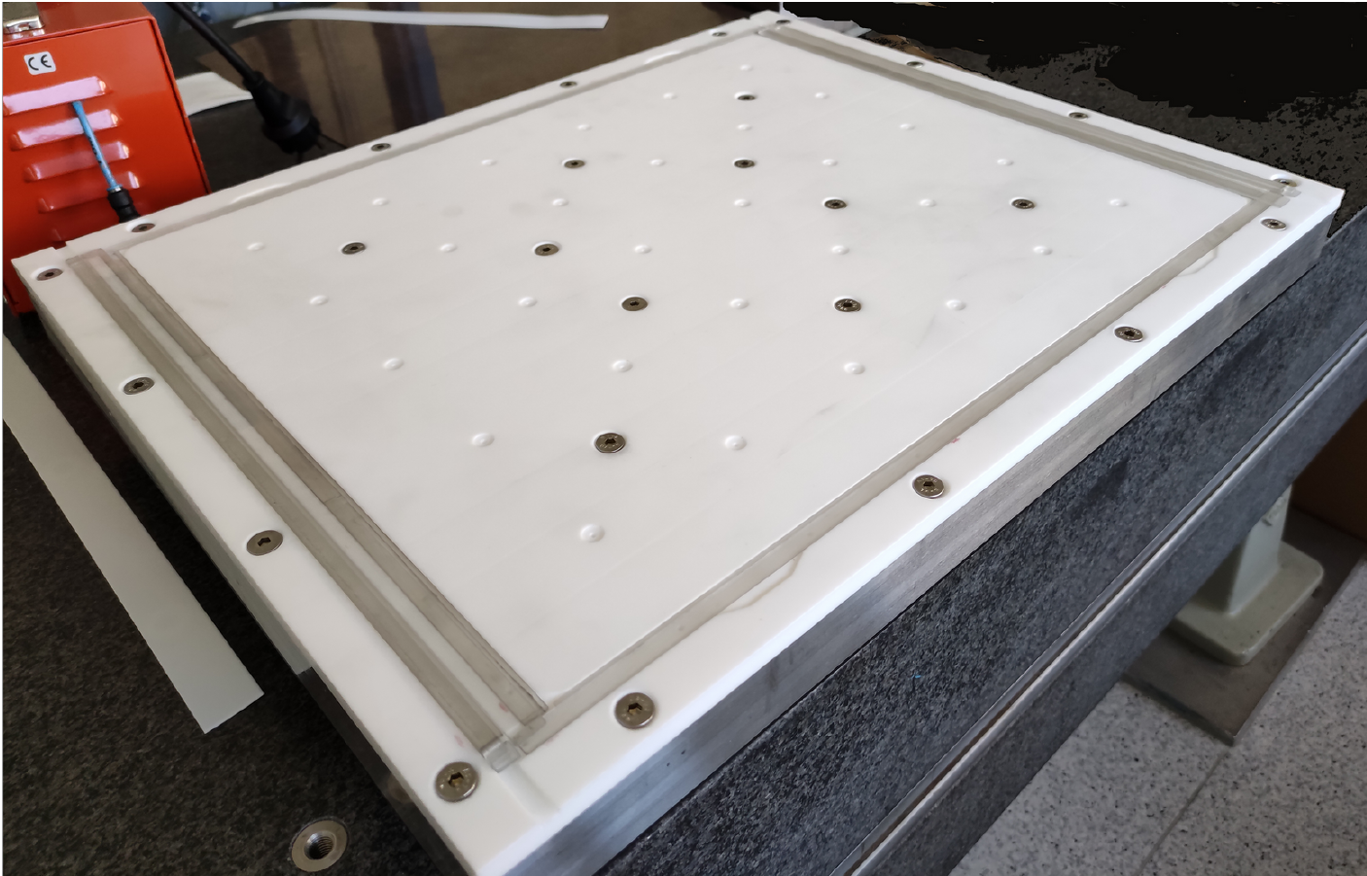
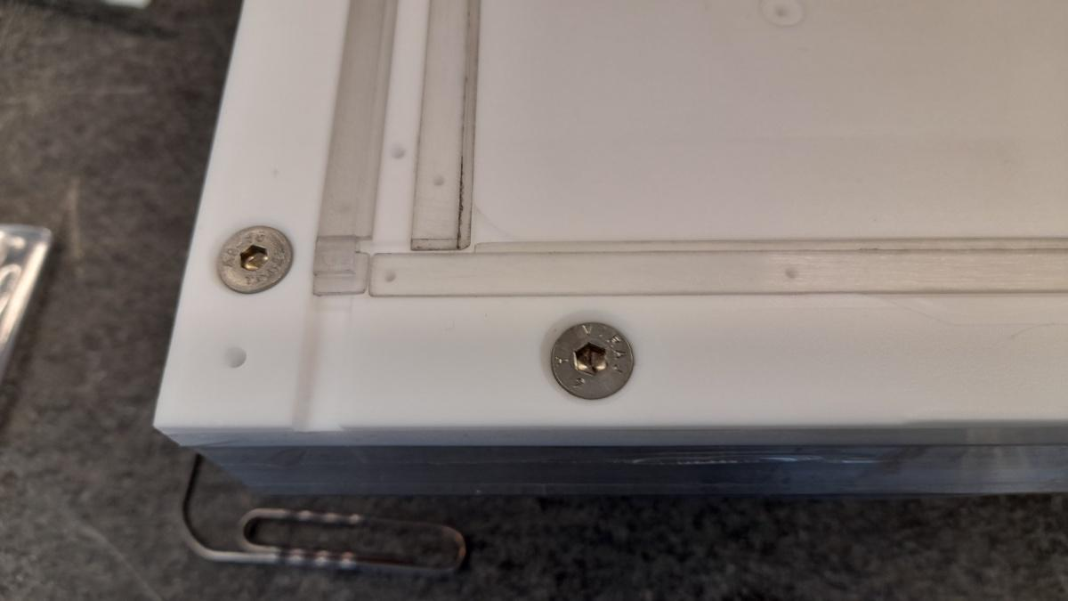
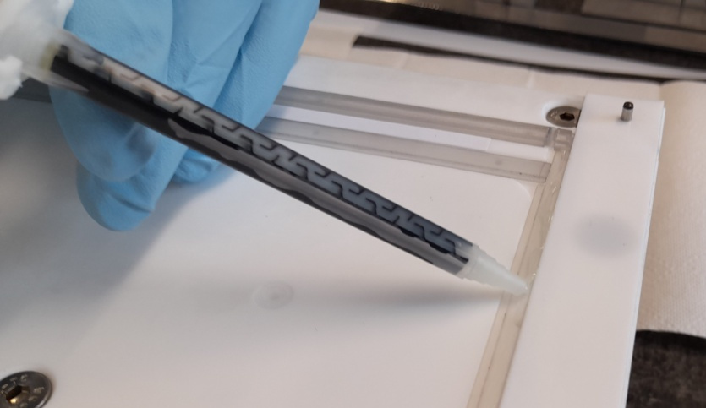
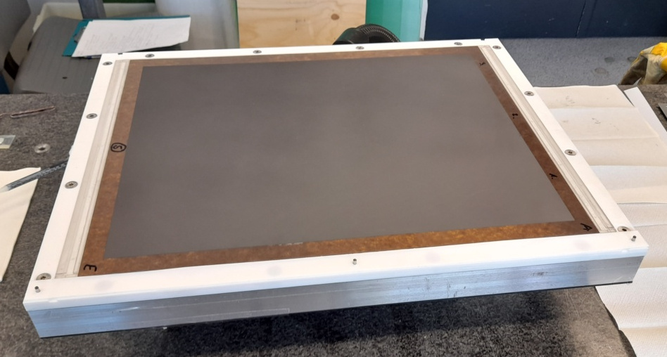
Positioning spacers and lateral profiles
Template designed and built for this step:
Made from Teflon to prevent glue sticking to template
Dimples and notches help place spacers and lateral profiles
Allows for the use of a vacuum pump to suck down the profiles and spacers, fixing them in place
HPL plate pressed on top of spacers and profiles
Glue must cure for 6h

Slide 6
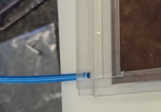
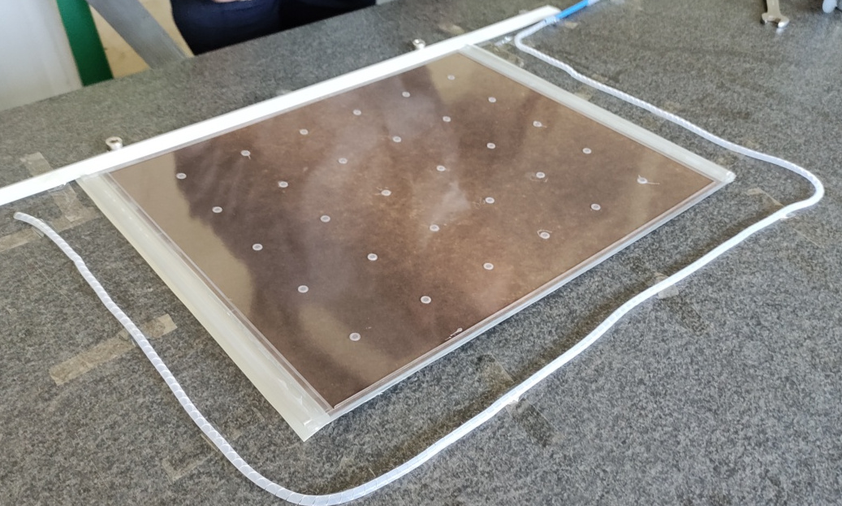
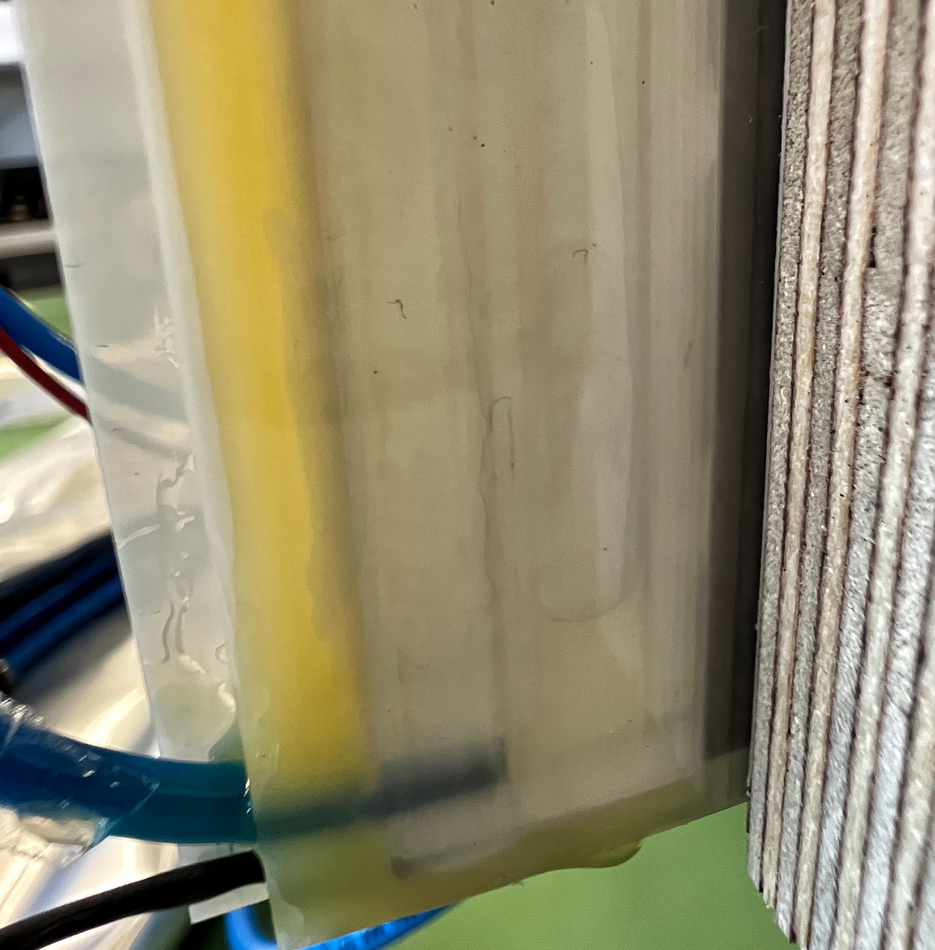
Closing, sealing and linseed oil coating the gap
Gas pipe inserted into lateral profiles
Gap closed by gluing second electrode on top of first one, wich has spacers and profiles already applied
Then sealed gas gap is filled with linseed oil and slowly drained to create an even and protective coating
Linseed oil has to dry for a week with constant airflow pumped through gap

Slide 7
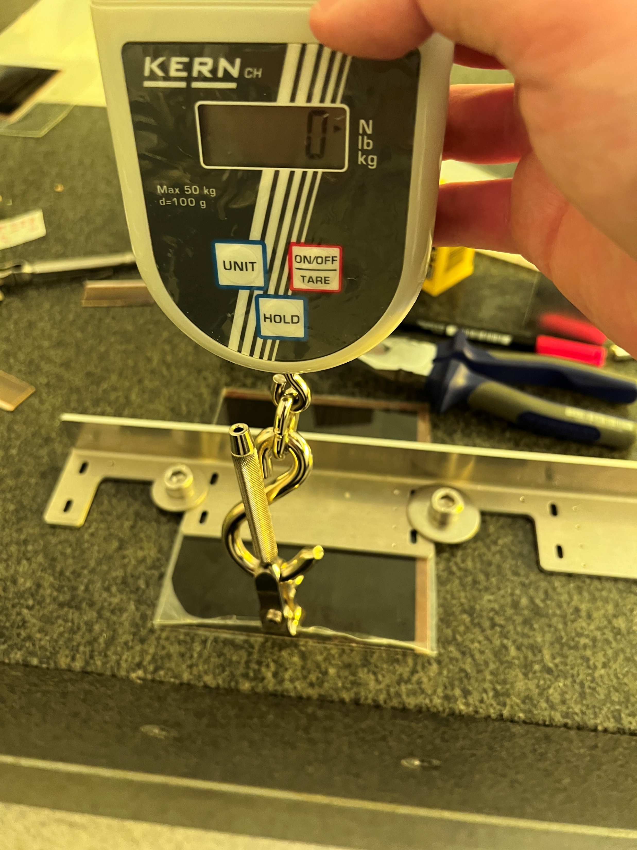
Testing of different glues
Target strength
Glue still flexible after curing preferred
Strength and ease of use during manufacturing were evaluated
Tested by pulling off pieces of PET with newton meter for measuring of strength
Tested glues compared to example provided by current CERN supplier
Best material: GMP Perfex Gloss (commercially available PET foil with pre-applied EVA hot-melt addhesive)

Slide 8
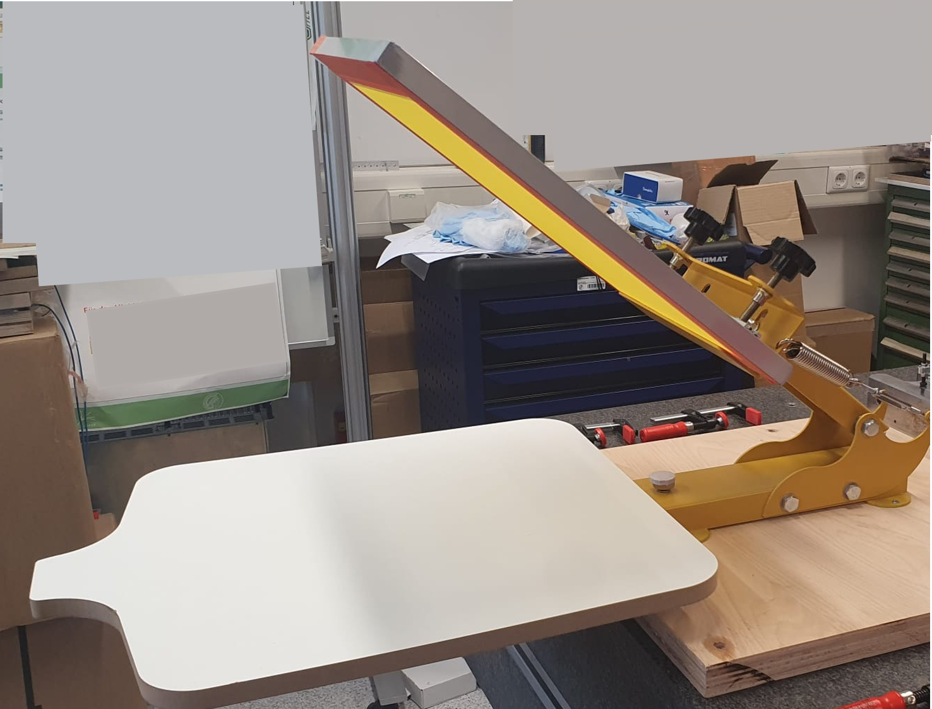
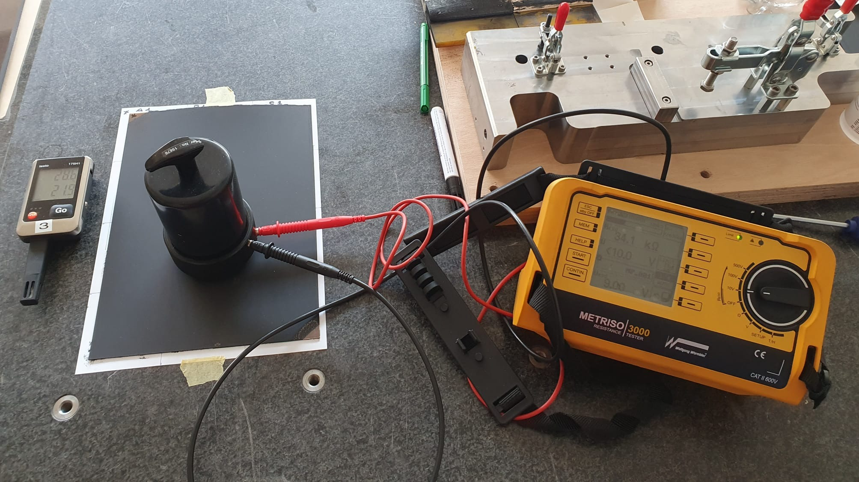
Graphite coating
T90 mesh
Goal: determine best procedure for silk-screen printing and drying
Test setup: standard T90 silk-screen (polyester with 90 threads per cm)
Carbon Paste WCP-3200HL (15) from Heysung Trade Company
Measuring surface resistivity using METRISO 3000 Resistance Tester (IEC 61340-4-1)
Printing Base
Sample
METRISO 3000

Slide 9
Graphite coating results
Heat up to 105°C for drying 1-1.5h
average resistivity of (296± 5.7) kΩ/□
End values match tolerance for ATLAS RPC
Double printing reduces the resistivity further
Double layered edge can be used for high voltage contact → lower resistivity on edge improves voltage distribution

Slide 10
Voltage current curves
Voltage-Current curves are a quality measure for RPCs
First part of the curve linear: ohmic resistivity dominates the current behavior
Limit of 0.8 µA/m² at 3kV
Second part exponential: gas amplification sets in → more and more of current generated in gas → dominates the curve
Limit of (total current – ohmic part) = 0.8 µA/m² at 6kV
Beginning of the exponential regime indicates size of the gap

Slide 11
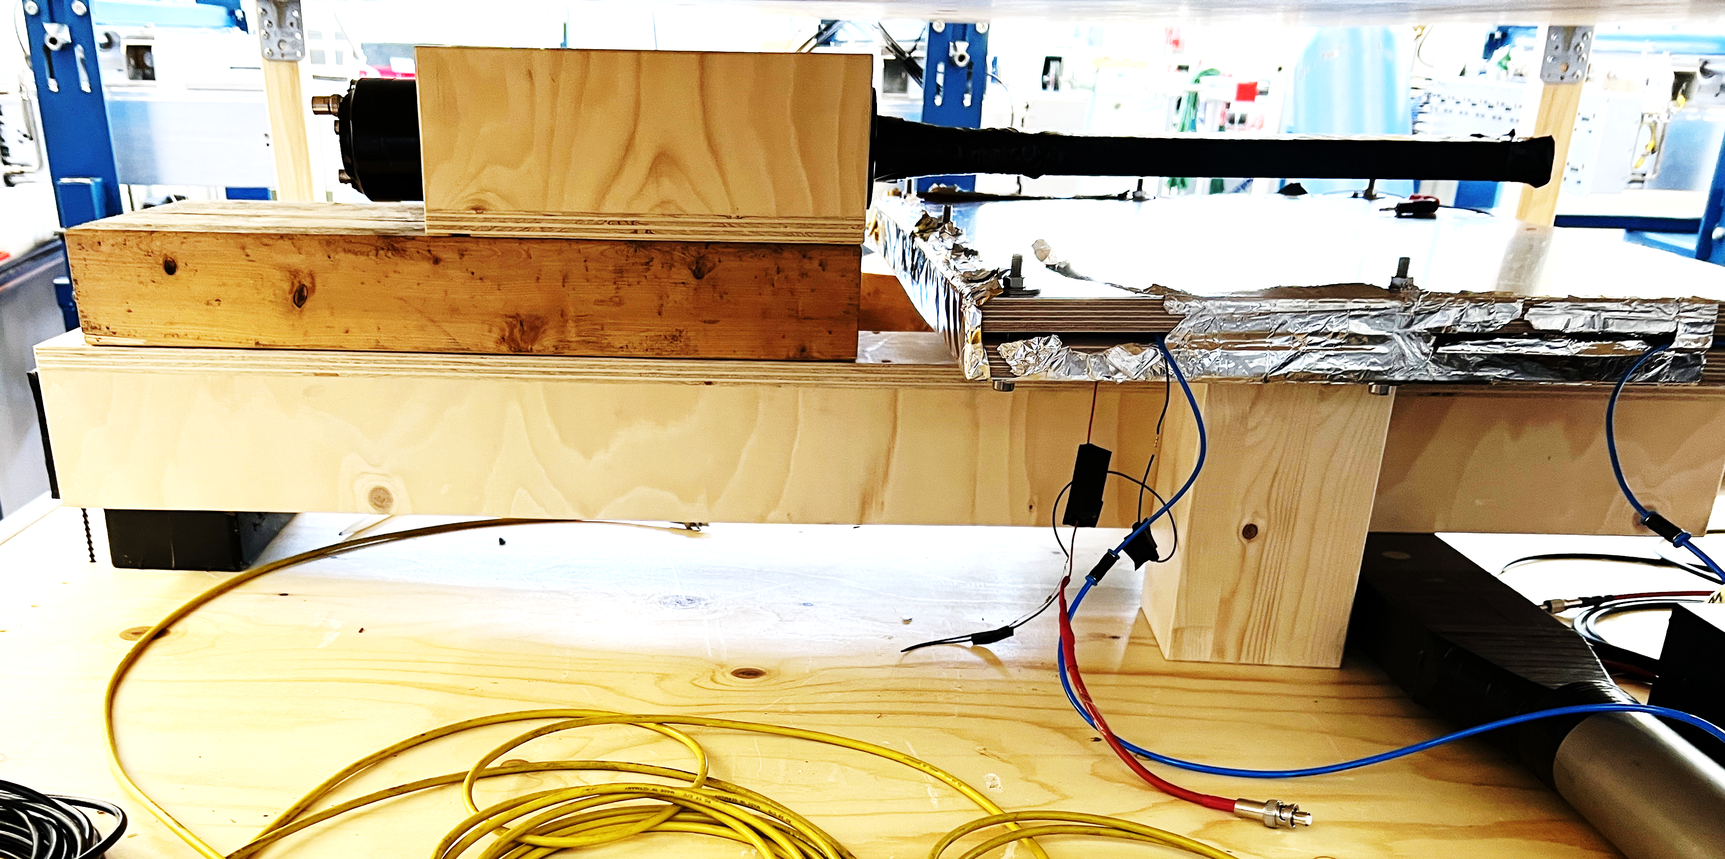
Efficiency curves
Measurement with cosmic muons
Two scintilators perpendicular to each other below the tested gas gap in hardware and configuration as hardware trigger
One small scintilator above the chamber as software trigger
Readout chain: Strip → Amplifier → discriminator → TDC (addapted sMDT prototype)
Results show expected behaviour
Effieciecy scan for Chamber 3
No end resistor on strip -> curve shifted to lower voltage
No correction for geometry applied

Slide 12
Summary
Production procedure compatible with industrial standards established
Technology transfer to three companies.
Successful production of small size prototype RPCs by these companies
Next steps:
Production start for fullsize prototypes by the companies
1 year ageing study of the full-size prototypes at the GIF++ to certify the production

