Slide 1
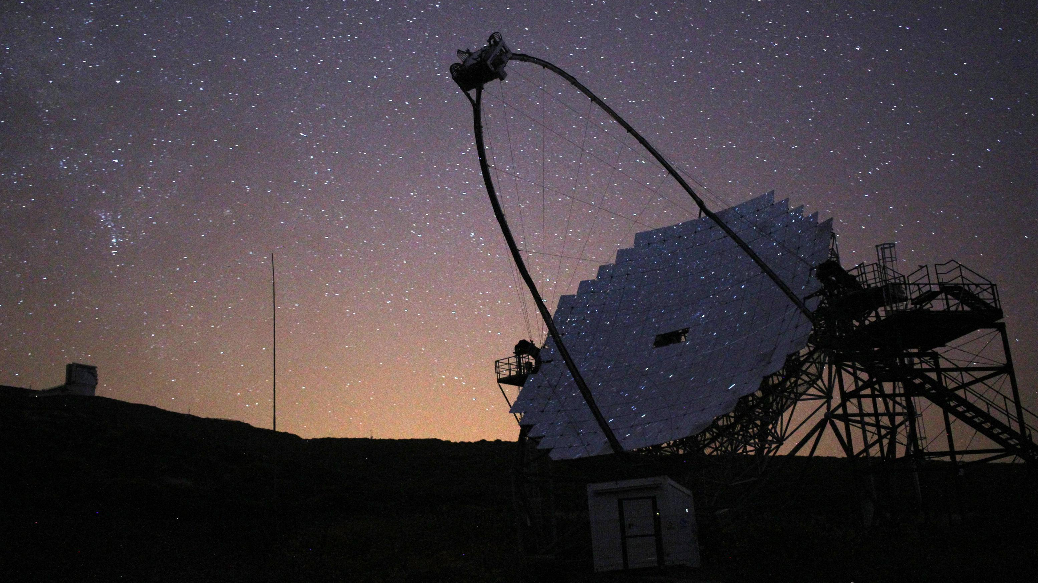
Towards an automatic mode of operation of the MAM subsystem of MAGIC
Angela Bautista
Presentation for the DPG SMuk Spring Meeting
23 Mar 2023

Slide 2
Ground-based Gamma-ray Astronomy

Slide 3
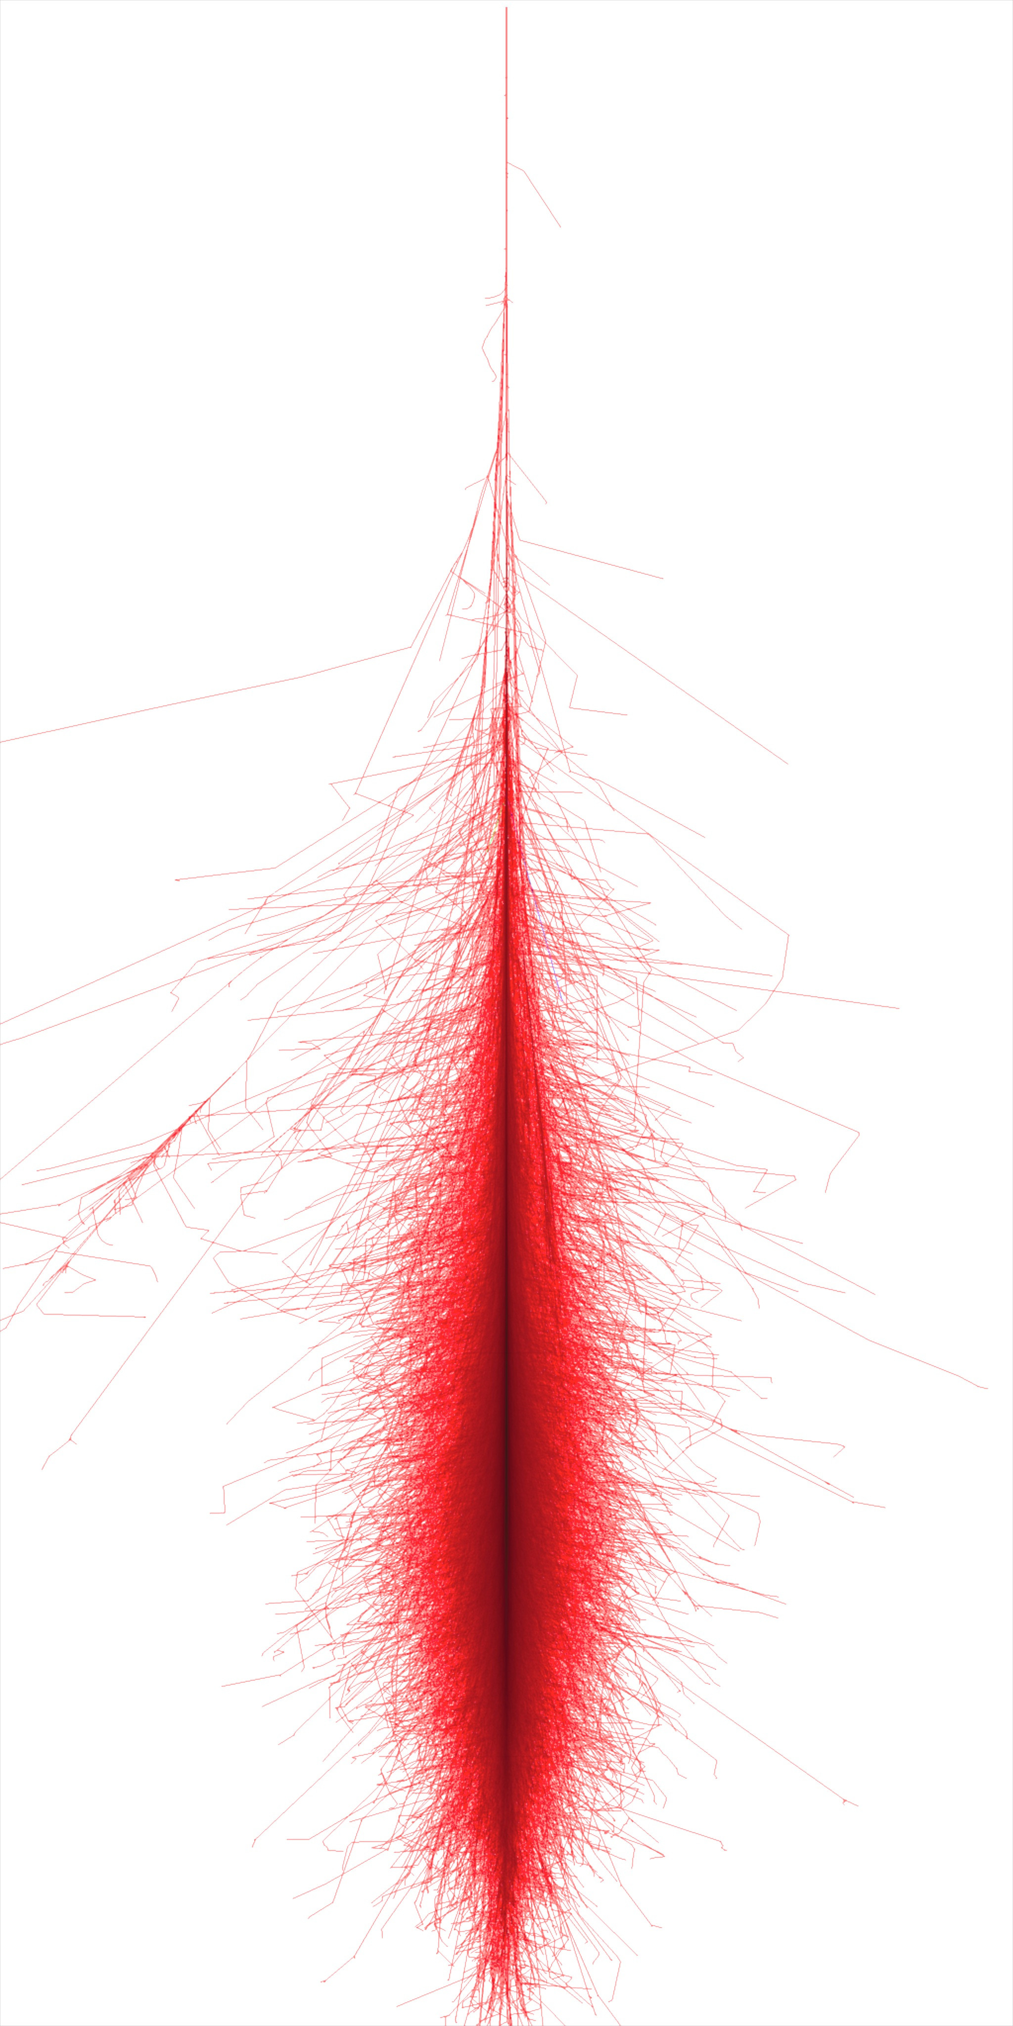
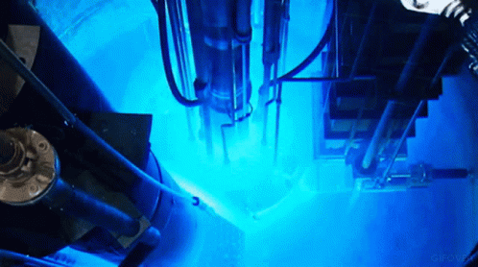
Ground-based Gamma-ray Astronomy
Atmosphere
Extensive air shower
Credits:https://tenor.com/view/
Cherenkov radiation
Cherenkov radiation: Light emitted when charged particles exceed the speed of light in a medium
Very High Energy gamma-ray produces shower of secondary particles

Slide 4
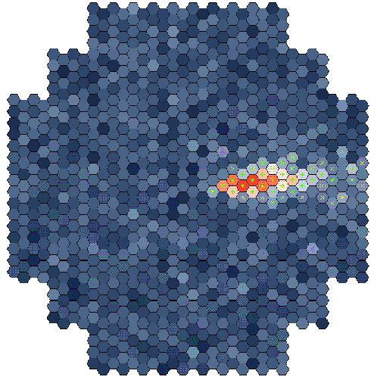
Imaging Atmospheric Cherenkov Telescope (IACT)
rayo gamma
Cherenkov light
≈ 10 km
Adapted from W. Hofmann

Slide 5
IACT array
gamma-ray direction

Slide 6
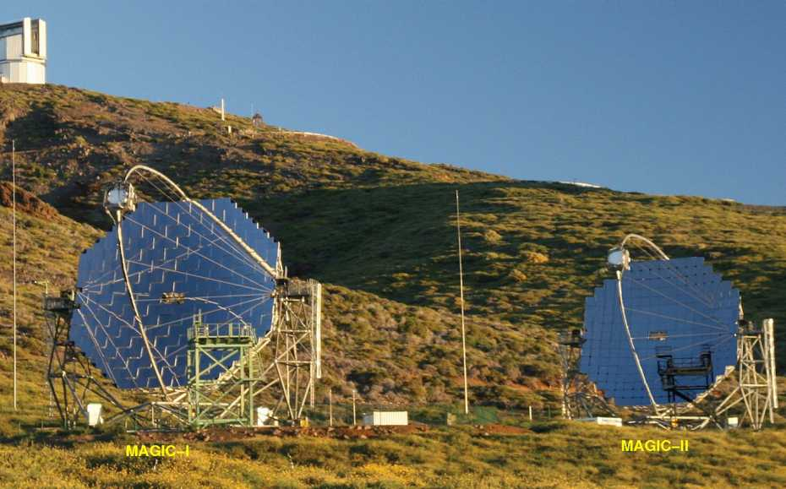
The MAGIC Telescopes
Two 17-m diameter Imaging Atmospheric Cherenkov Telescopes (IACTs)
Detect gamma rays in the Very High Energy range, 20 GeV to 100 TeV
Cherenkov photons used to estimate the energy of the incident gamma-ray
Credits: https://ipa.phys.ethz.ch/research/ResearchProjects/magic.html

Slide 7
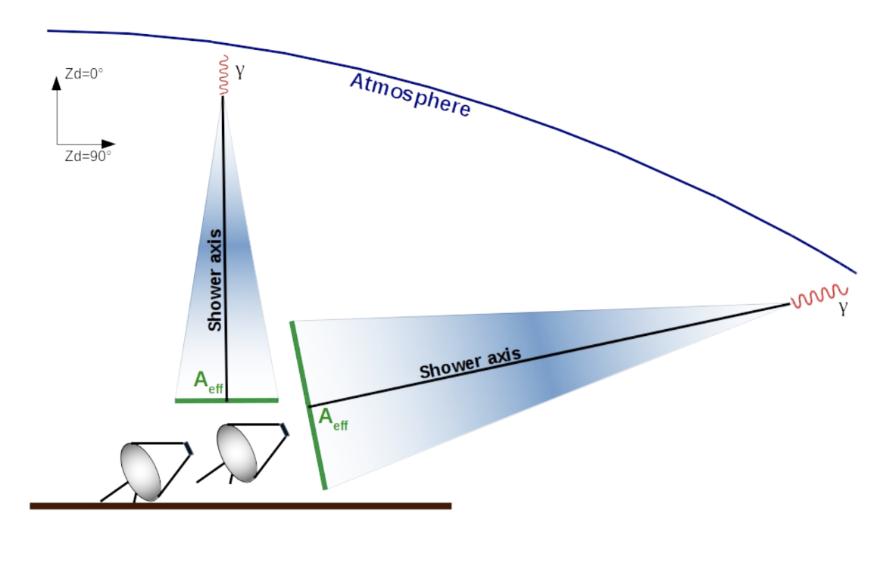
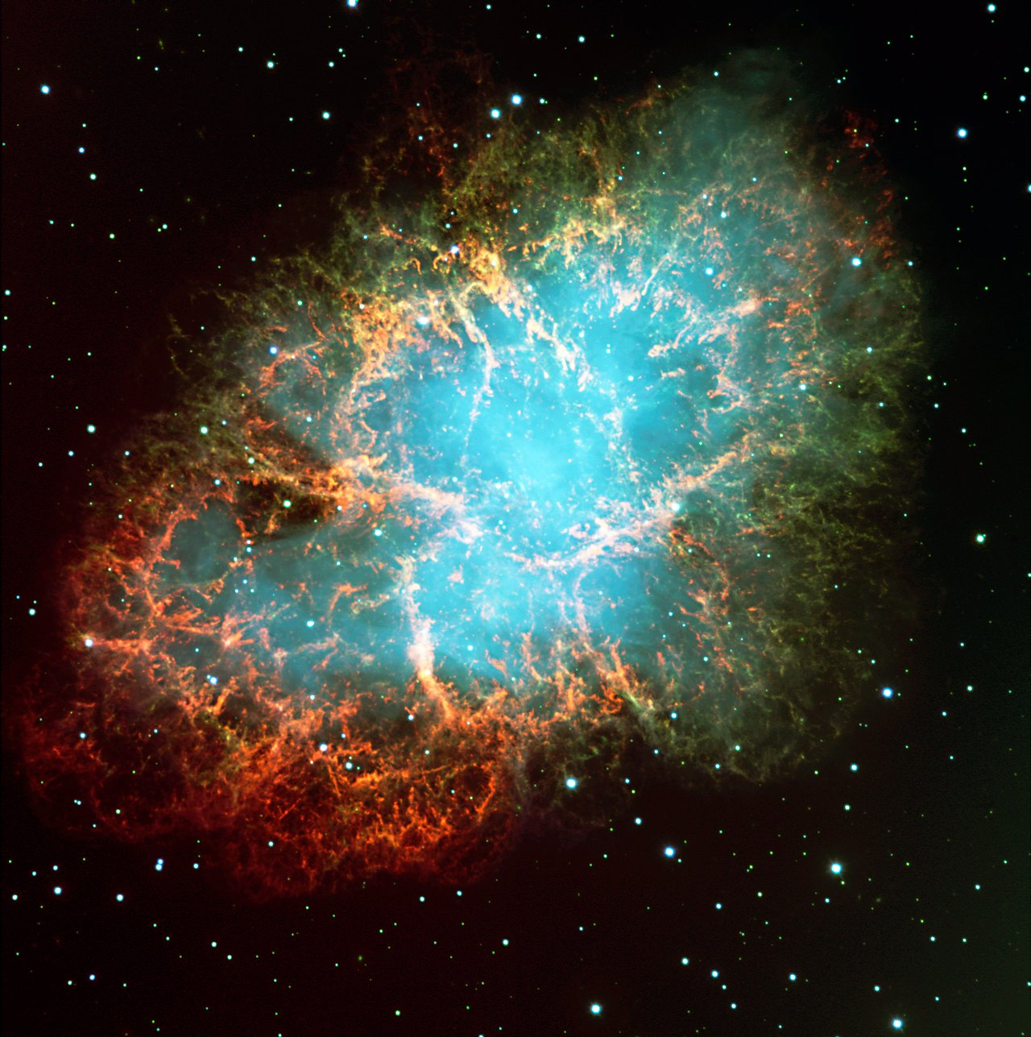
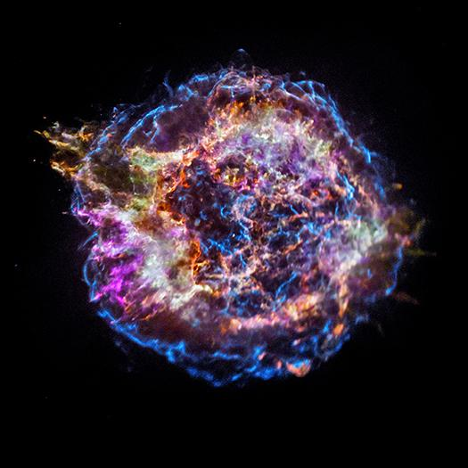
Very Large Zenith Angle (VLZA) Observations
The hunt for PeVatrons!
Credits: van Scherpenberg, J. (2023) Very Large Zenith Angle Observations with MAGIC
What are they?
Only the most energetic gamma-rays reach the detectors
Detect gamma-rays with energies above 100 TeV with MAGIC
We can probe particle acceleration up to the PeV range with gamma-rays with energies in the UHE range (above 100 TeV)
We are looking for them with MAGIC!
Notes:
There is a special mode of observation in MAGIC, ZA, image, when the shower develops at ZA higher than 70deg,(vlza), with vlza observations we are getting closer in this search

Slide 8
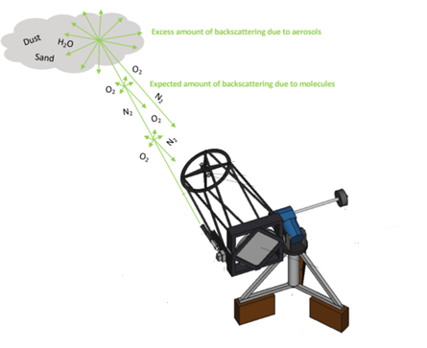
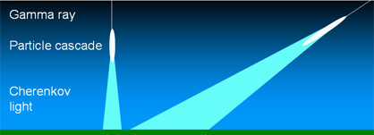
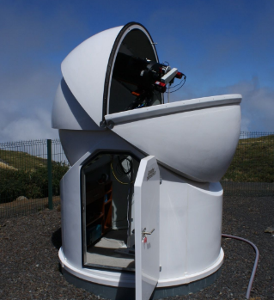
Calibration Subsystems
LIDAR measures atmospheric transmission up to 70 deg zenith angle
Credits: Schmuckermaier, F. (2023) Correcting MAGIC Telescope data with the LIDAR
NO LIDAR :(
solution
MAGIC Atmospheric Minion (MAM)
Light Detection and Ranging System
(LIDAR)
Atmospheric corrections for VLZA observations
Atmospheric corrections using backscattered light from a laser
Notes:
For the correct analysis of MAGIC data

Slide 9
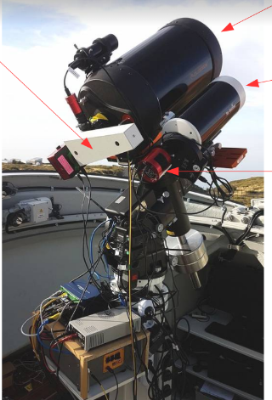
The MAGIC Atmospheric Minion (MAM)
11-inch telescope
spectrograph
Subsystem to correct VLZA MAGIC data
Task: monitor the atmospheric transmission (AT) in real time in the pointing direction of MAGIC using photometry and spectroscopy
5-inch telescope
CCD camera
Credits: Pihet, M (2023) MAM Technical Operation Manual

Slide 10
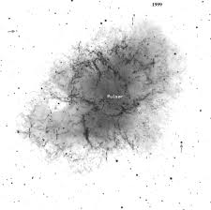
Plan automatic mode of operation of MAM
How? MAM will track a star in the close vicinity of a MAGIC target and measure the Atmospheric Transmission
Photometric mode:
- Focus on VLZA MAGIC targets
- Identify bright stars for each target
- Calibration of stars selected (we need this to measure transmission)
Requirement: magnitude at airmass zero
Notes:
Say what is airmass

Slide 11
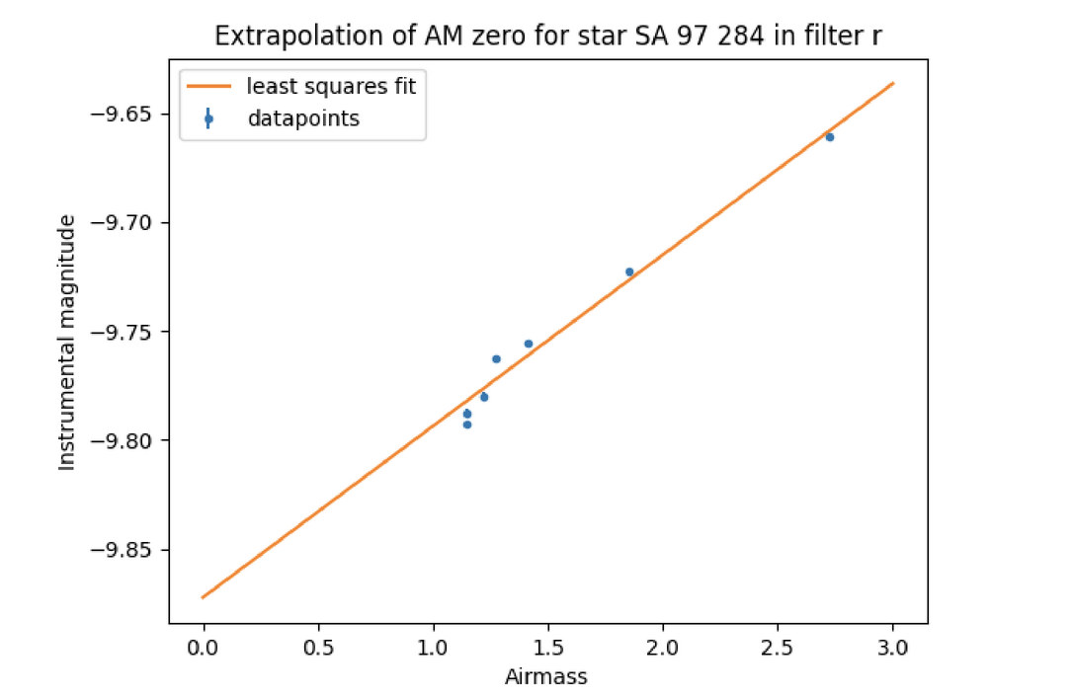
Plan automatic mode of operation of MAM
How can we measure the magnitude at airmass zero?
1
2
Credits: Pihet, M (2020) Calibration of a photometric filter system with a 5-inch telescope susbsystem of the MAGIC Telescopes
Measure the magnitude at different zenith angles
More VLZA targets.
Spectroscopic mode, take a spectra and measure the atmospheric transmission
Repeat this process, we should obtain the same magnitude at airmass zero.
Next step, calculate atmospheric transmission.
Notes:
Spectroscopic mode implemented once photometry is ready to use

Slide 12
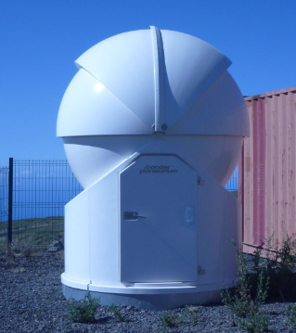
Take Home Message
MAM installed at the MAGIC site to correct for the atmospheric effects during VLZA observations
It will measure the atmospheric transmission in real time in the pointing direction of MAGIC
MAM subsystem will be crucial for the hunt of PeVatrons with MAGIC!
Credits: Pihet, M (2023) MAM Technical Operation Manual

Slide 13
Backup

Slide 14
Atmospheric Transmission
Flux observed F:
$$F=F_{0}e^{−τX}$$
$F_{0}$: total flux of a star in units of $s^{−1}$, number of det. photons per second
$τ$: optical depth of the atmosphere, $X$: airmass
Atmospheric transmission T: Fraction of starlight reaching the observer
$T= \frac{F}{F_{0}}=e^{−τX}$
Atmospheric transmission:
$T={10}^{−0.4(m_{instr}−m_{instr},AM0)}$

Slide 15
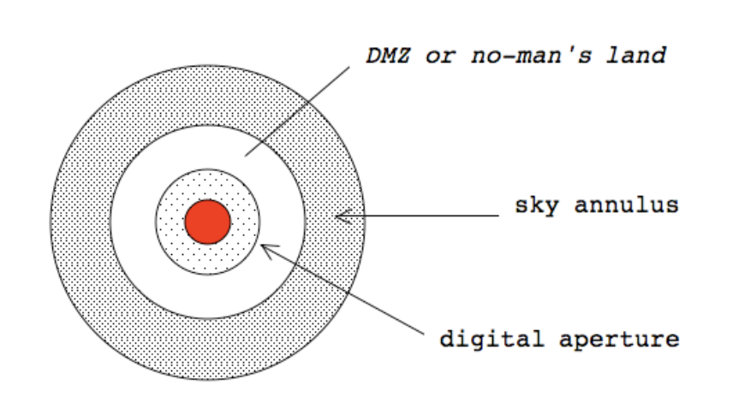
Flux Measurement
Aperture photometry
Total flux of a star:
$S=F−n_{pix}N_{s}$
-S: total electron count of the star
-n_pix: total number of pixels in the aperture
-Ns: total number of sky electrons per pixel
-F: total count inside of the inner aperture

Slide 16
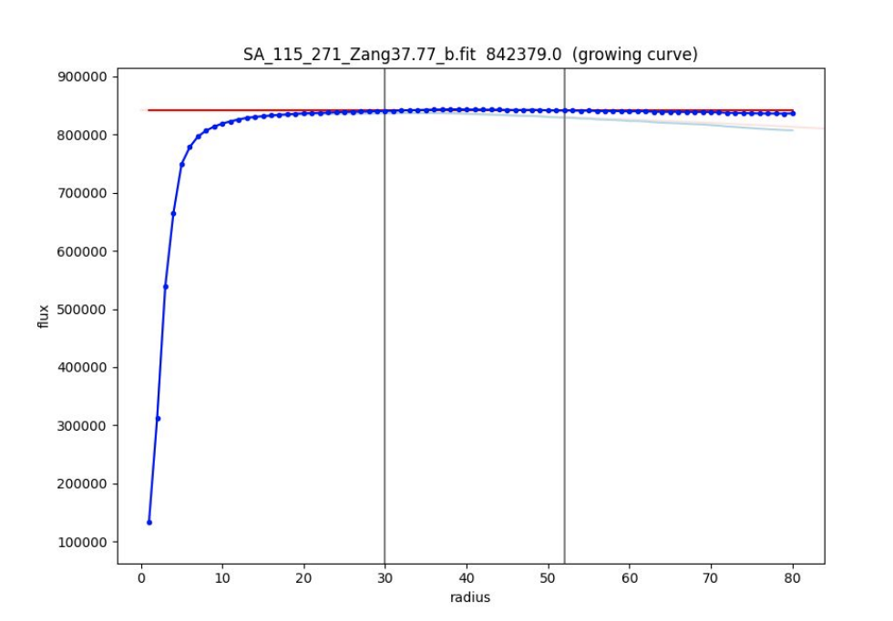
Flux Measurement
Aperture photometry with growing curve correction

