Slide 1
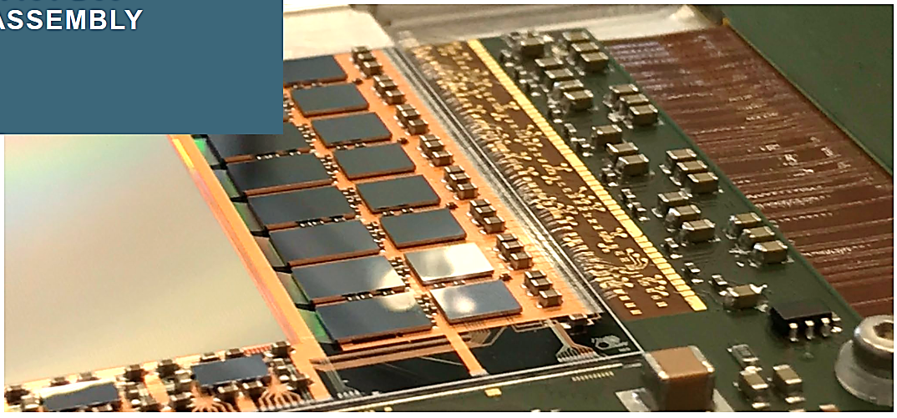
25th International Workshop
on DEPFET Detectors and Applications
The EDET DH 80k Instrument
Tutzing, 23.05.2023

Slide 2
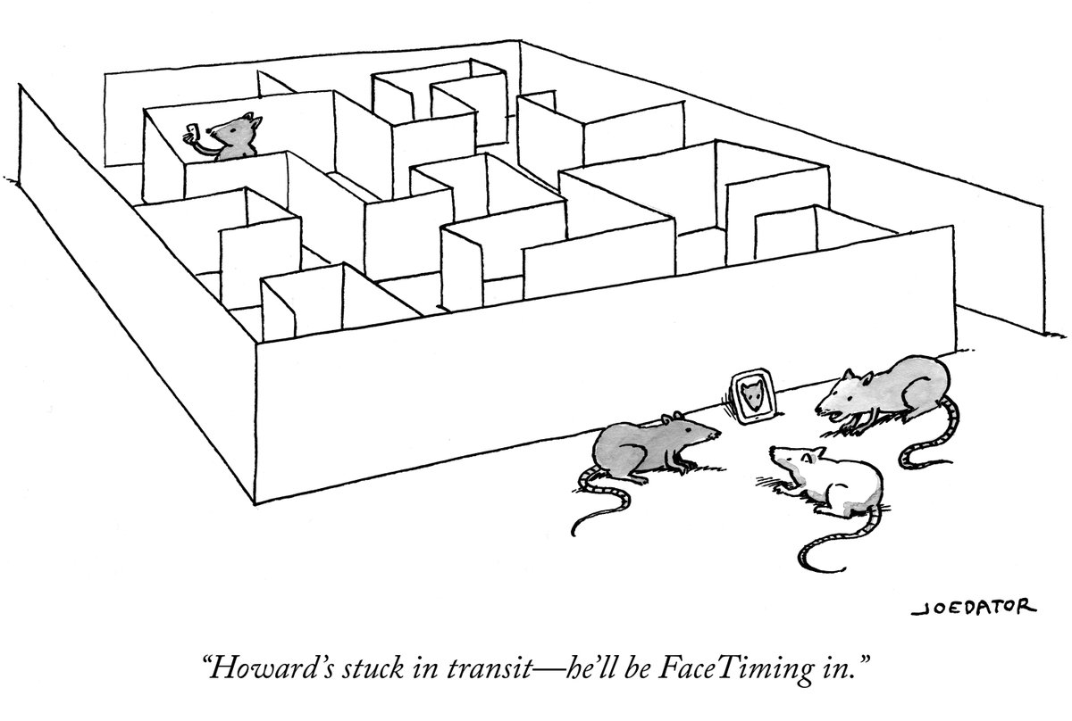
EDET DH 80k
1 MPixel direct hit electron detector with 80 kHz framerate
J. Treis, L. Andricek, M. Hensel, C. Koffmane, J. Ninkovic, M. Polovykh, M. Predikaka, E. Prinker, R. Richter, T. Selle, A. Vostrukhin
MPG Semiconductor Laboratory
S. Epp, D. Gitaric
MPSD Hamburg
I. Peric
KIT Karlsruhe
T. Hemperek, H. Krüger
Bonn University

Slide 3

Scope
Introduction
to the application
Tour
of the instrument
Some measurement highlights
Status & outlook

Slide 4


Application
"Normal" imaging:
Continuous illumination w/ fixed intensity
Discrete, "gated" exposure by shutter
Finite signal integration time
Exposure time defines image contrast
Tradeoff between image contrast and impact of motion blur
Defined by the dynamics of process
"Stroboscopic" imaging:
Short, discrete illumination periods with high intensity (flashbulb)
Pulse intensity defines image contrast
„Delta“-pulse like exposure
Decouples exposure time, image contrast and motion blur
Frequency of illumination defines time resolution
Pulse duration defines impact of motion blur

Slide 5

Requirements
Stroboscopic imaging in TEM world is challenging:
Fast imaging → Direct electron detection
Stroboscopic illumination → Pulsed electron source
Real space imaging → Large sensitive area
High intensity → High dynamic range
High contrast range → Signal compression in sensor
Direct electron detection → Thin substrate
High pulse frequency → High framerate
"Grey scale" image → No data reduction possible
Small volume → Extremely high integration density

Slide 6
Requirements
Dynamic range
  Single primary electron sensitivity
  Primary electron @ 300 keV on 50 µm Si
  → Distinguish 8k e- from noise
  50 (better 100) primaries per pixel to provide enough contrast
  → 800k signal electrons to be stored in pixel
Operation in vacuum:
  Small volume / extremely compact setup
  Cooling / thermal stabilization
Multiple scattering:
  Thin sensitive detector substrate
  No support layer
  Highly efficient beam dump for traversing electons
  Advanced thermal support
Flexible operation modes
  Enhanced sequencing capabilities
Data rate
  Max. burst frequency 100 Hz ( 50 frames each)
  Digitization with 8 bit resolution
    Tile module data rate 1.28 GByte/s gross
    Total data rate ~ 6.4 GByte/s gross
    Data reduction / zero suppression difficult

Slide 7

Challenges
Complex detector system
Simple, easy-to-use camera
Special requirements on hard-, firm- and software:
Easy applicability
User-friendliness
High degree of automation
User experience:
  Expandability
  Customization
  Service
  Short instrument downtime
Design of system components must take these requirements into account
Development does not finish when the system goes online:
  Learn from sensor
  Learn from user

Slide 8
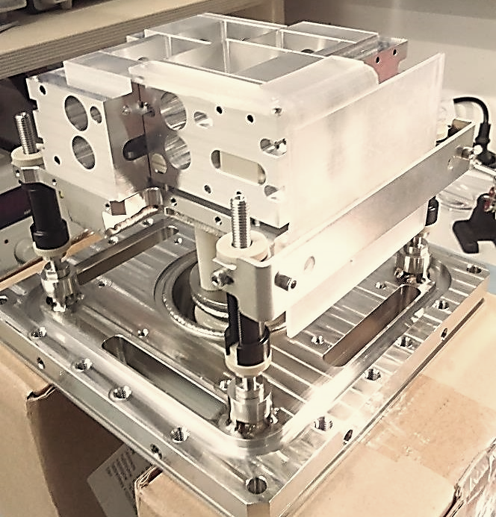
FPA

Slide 9
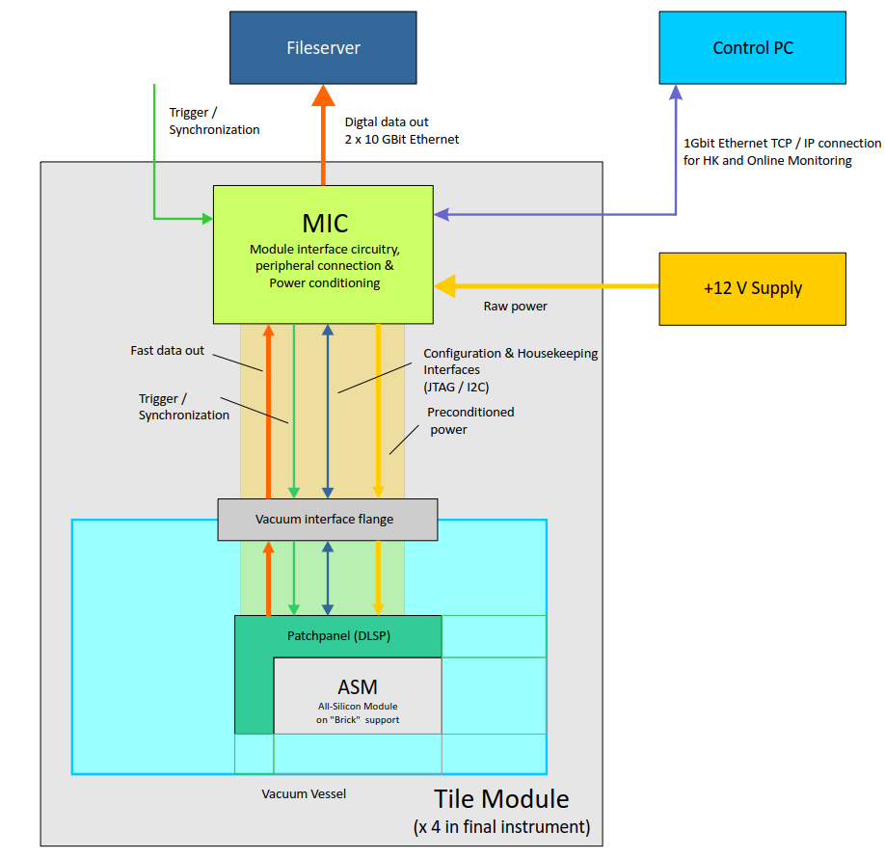
Module structure

Slide 10
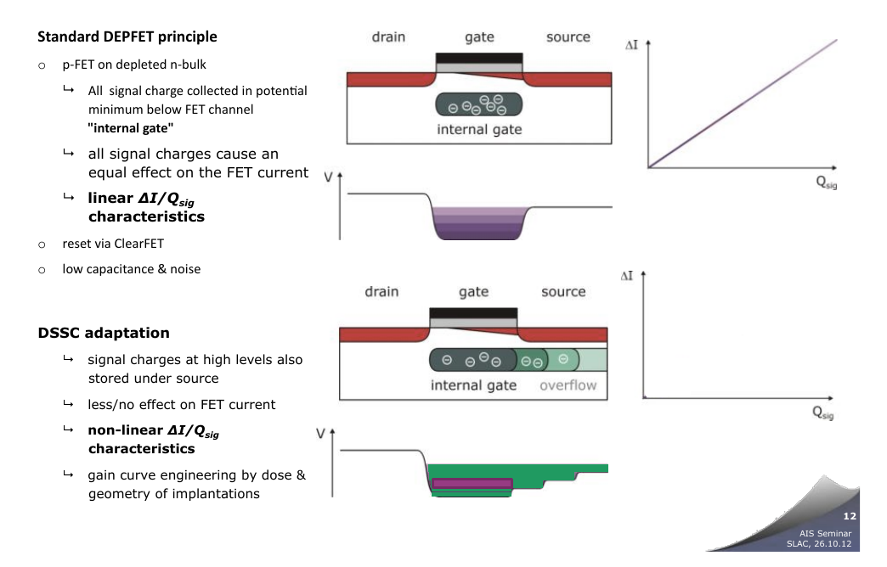
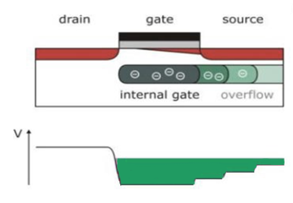
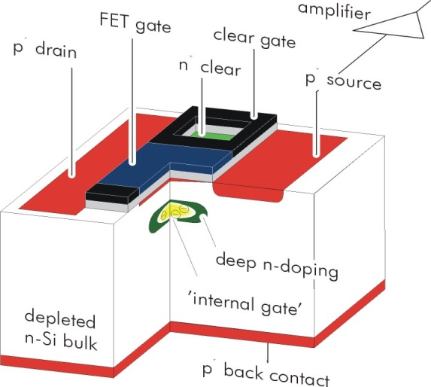


Pixel matrix
DEPFET integrated amplifier
p-channel FET on depleted n-bulk
Signal charge collected in potential minimum below FET channel
"Internal gate", low capacitance & noise
FET current modulation ≥ 300 pA/el.
Reset via clearFET
Charge storage
Readout on demand
Rolling shutter mode
EDET pixels:
Dynamic range problem
Implement signal compression in pixel
Overflow to source to tailor dynamic range

Slide 11
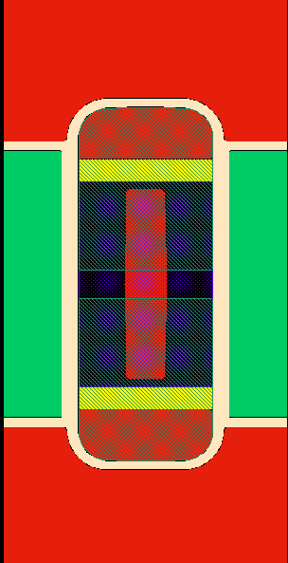
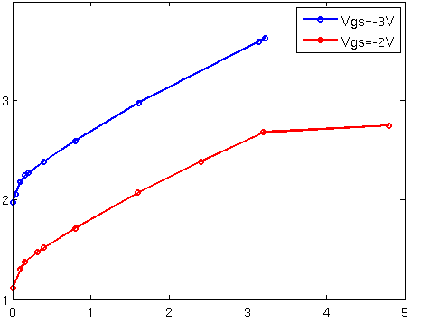
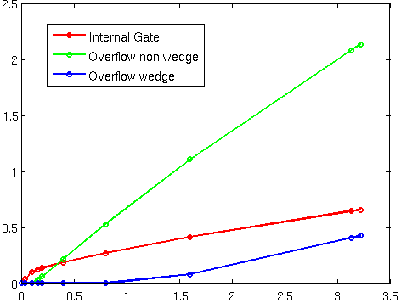
Pixel matrix
EDET pixels:
Shape of source implant creates two overflow regions
Different onset points of overflow
Large dynamic range
Sensor w/ integrated signal compression
Drift
DEPFET Gate
(ext + int)
Drain
Clear
Source
Response curve (V_{DS} = -5 V)
Charge distribution (VGS = -3 V, VDS = -5 V)
Drain current (100 µA)
Signal charge (Me⁻)
Overflow
regions
No additional deep-n
drift field by wedge shape
Secondary OF
Primary OF "Kink"
Signal charge (Me⁻)
Signal charge (Me⁻)

Slide 12
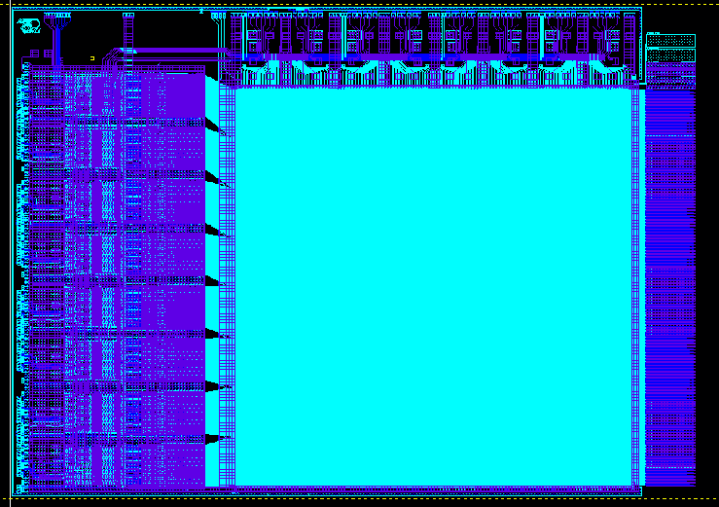
Detector ASM
„All-Silicon Module“
JTAG
Bias contacts
Switcher Bank
Pixel array
30.7 x 30. 7 mm²
Bondpads
for DCD / DMC
data & supplies
Chip size
~ 50 x 38 mm²
Test pads
(removed after
met. 1 testing)
DMC array
DCD array
(EDET specific DCD-E)

Slide 13
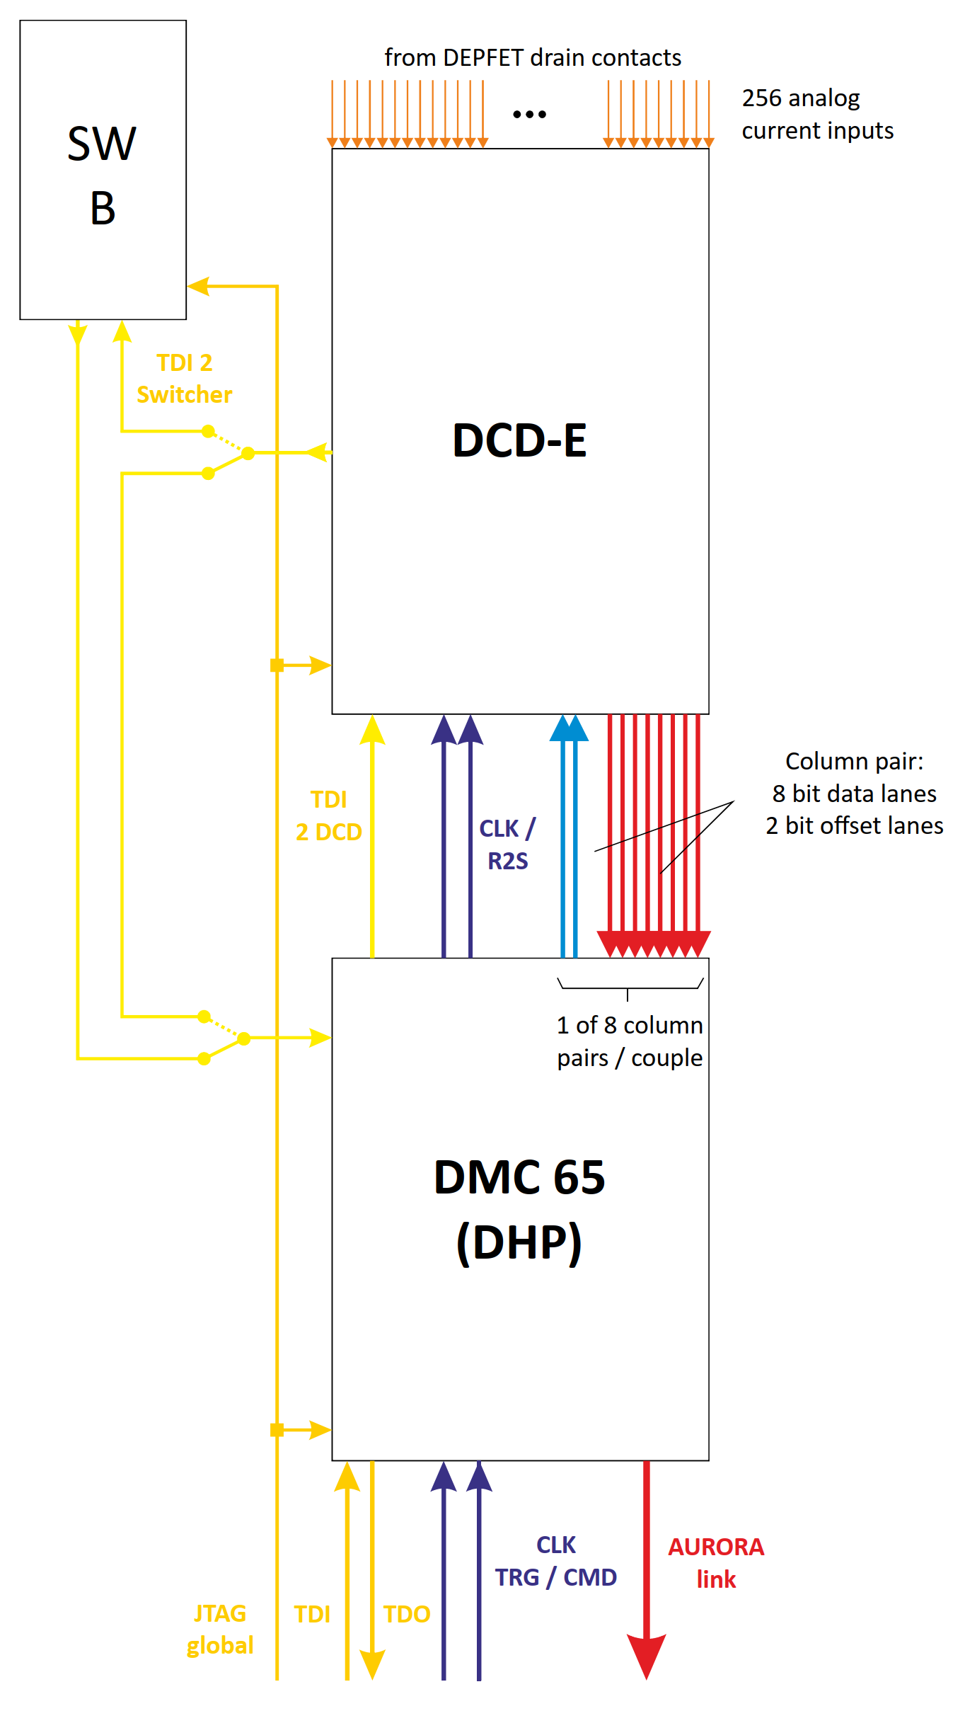
Detector ASM
ASM:
Detector matrix, front-end ASICs and supporting passives on common substrate
Thinned down to 50 -30 µm thickness in sensor region
Direct Current Digitizer (DCD-E)
  UMC 130 nm technology
  256 channels read in parallel
  8 bit digitization, 100 ns conversion
  64 parallel data output links @ 320 MBit/s
Only for first couple
DEPFET Movie Chip 65 nm (DMC 65)
  TSMC 65 nm technology
  Data FIFO, serializer & pattern generator for all DCDs and Switchers
  Controlled by single TRG / CMD signal stream
  Fast data transfer to periphery using 1.6 GBit AURORA link
Front-end ASIC „couple“
Switcher-B:
  AMS H18 HV technology
  Controller IC, 32 channels
  Each channel driving gate and clear lines of 4 ASM pixel matrix rows in parallel

Slide 14
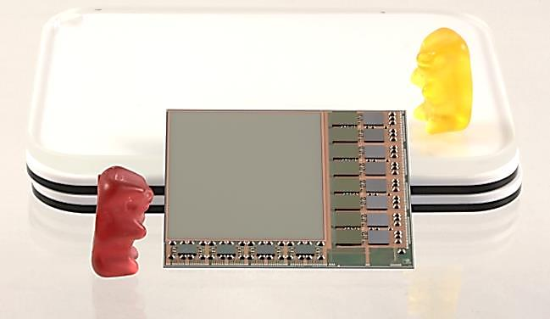
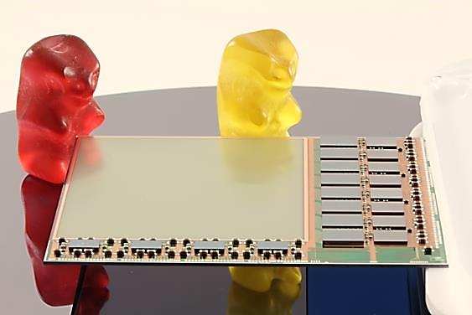
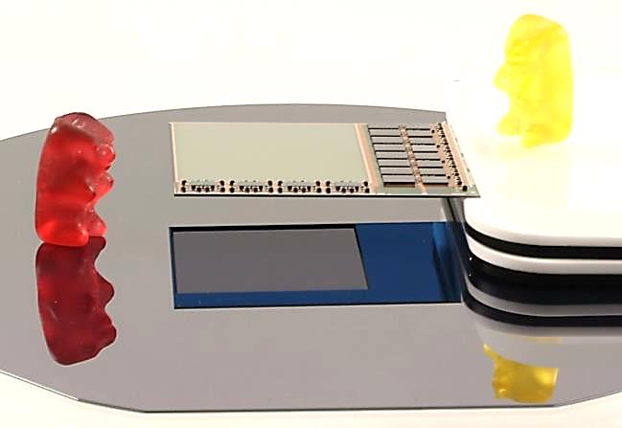
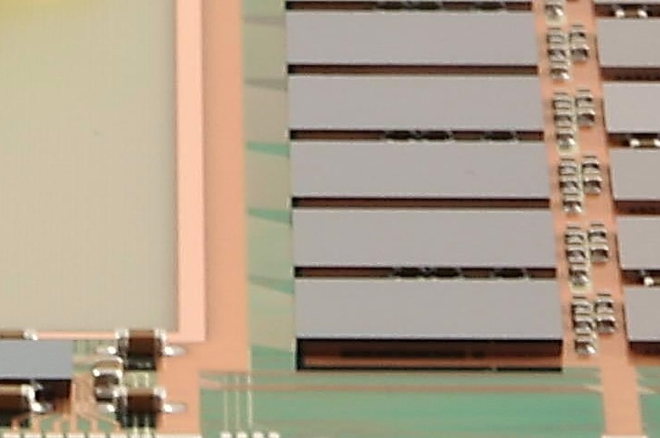
ASMs

Slide 15
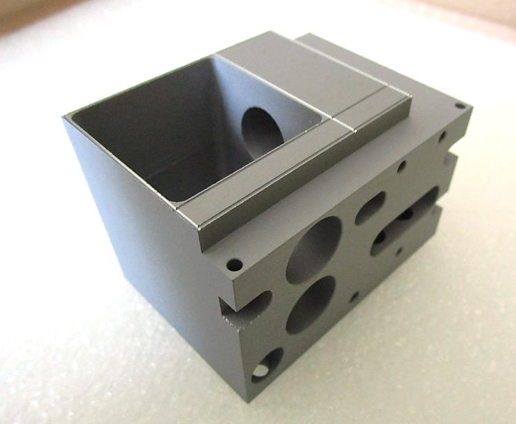
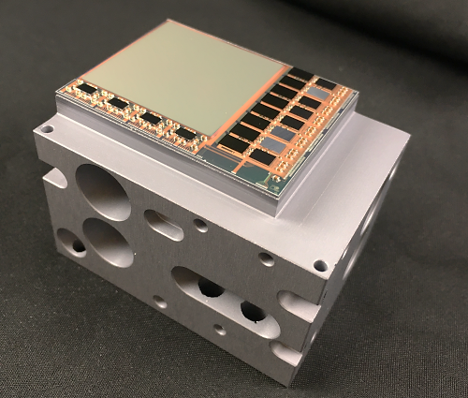
BRICK support
Beam dump
Venting holes
Cutouts for mounting fixtures
„Base Rigid Interface and Cooling linK“

Slide 16
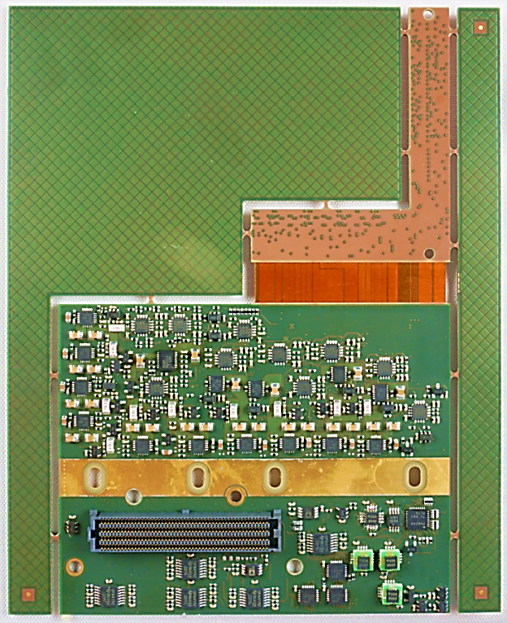
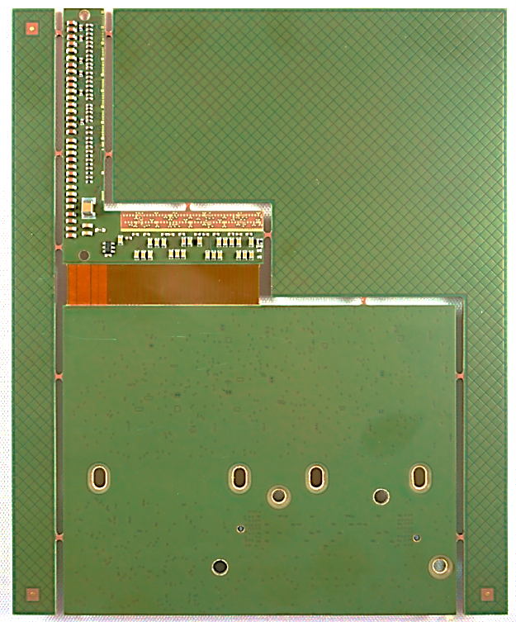
DLSP
„Upper“ L
„Lower“ L
Flex part for 90° bend
Thermal interface
Connector to DLSP bracket of VIC
„Double L-Shaped Patchpanel“

Slide 17
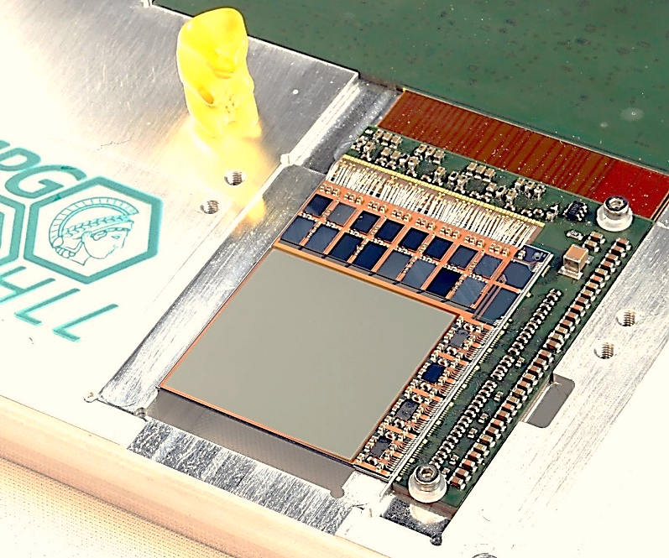
EMCM
„Electrical Multi-Chip Module“

Slide 18
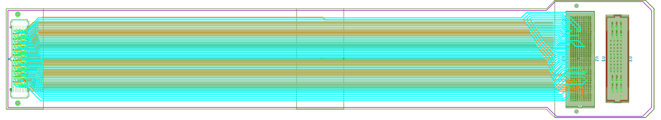
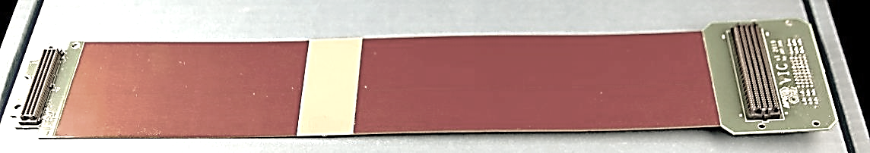
VIC
FR4 face for vacuum flange attachment
DLSP bracket
MIC bracket
„Vacuum Interlink Circuit“

Slide 19
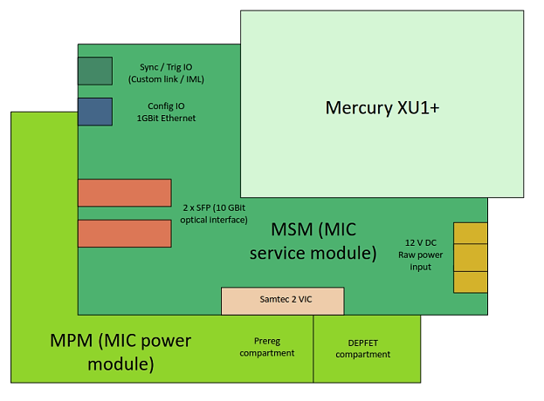
MIC
(MBM – MIC Brain Module)
„Module Interface Circuit“

Slide 20
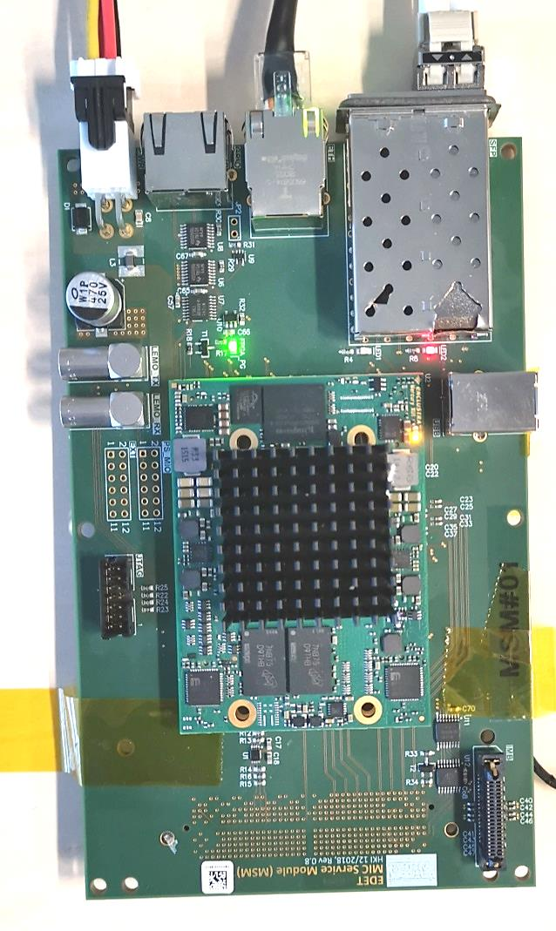
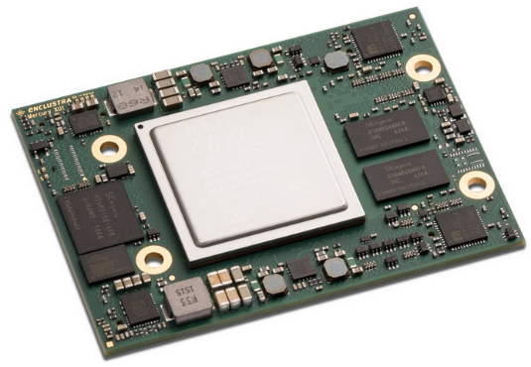
MSM/MBM
USB-C (unused)
IML connector
SFP slots (10 GBit optical Ethernet)
FMC connector to MIC bracket of VIC (below)
GBit Ethernet (TCP/IP for Main com/CFG)
GPIO RJ45
Power supply connector
GPIO LEMOs
Mercury+ XU1 feat. ZYNQ Ultrascale SoC

Slide 21
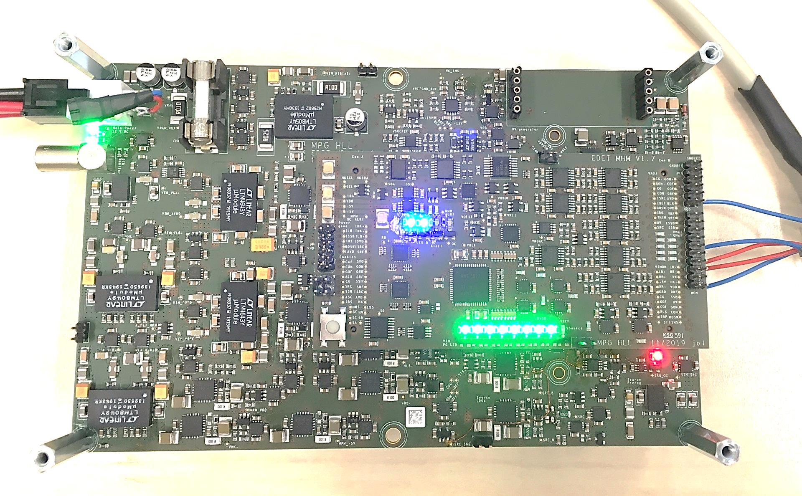
MPM(S)
(empty) slot for HV converter
Single 12 V power supply input
MPM „light“ baseboard
MHM piggy back (MIC Housekeeping Module)
„MIC Power Module Stack“

Slide 22
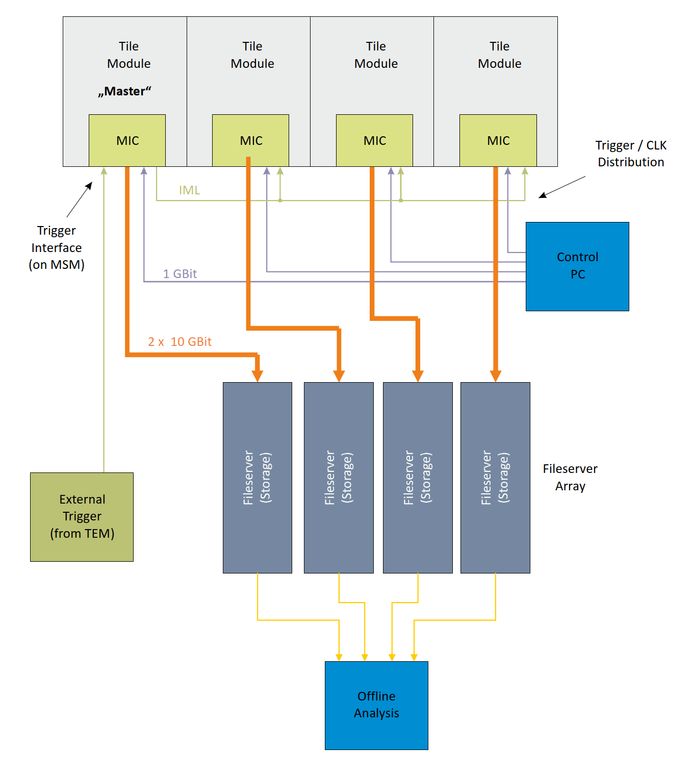
System structure

Slide 23
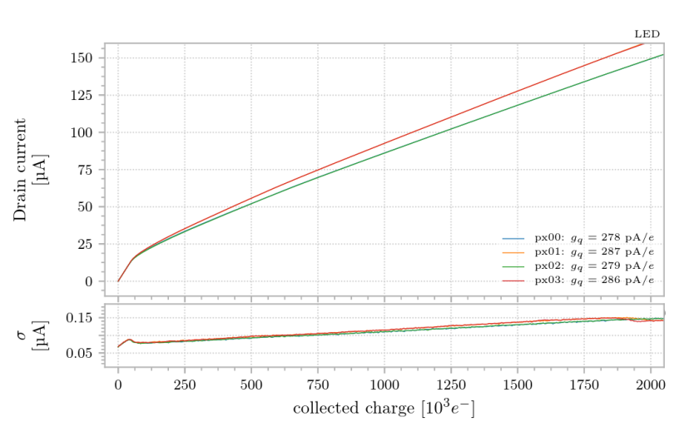
Measurements

Slide 24
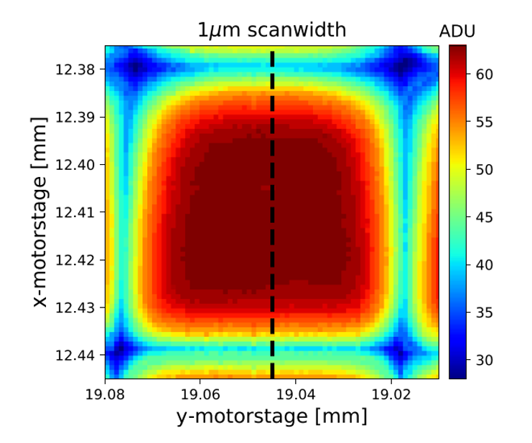
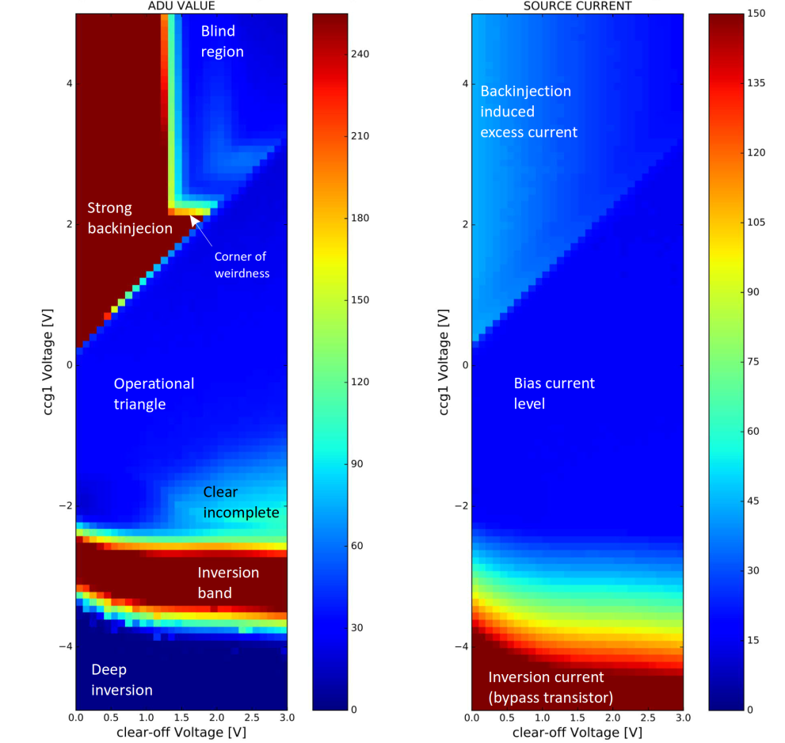
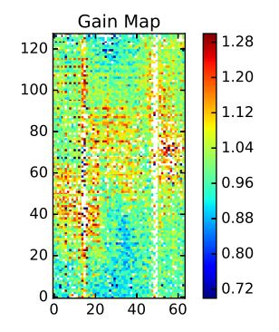
Measurements

Slide 25
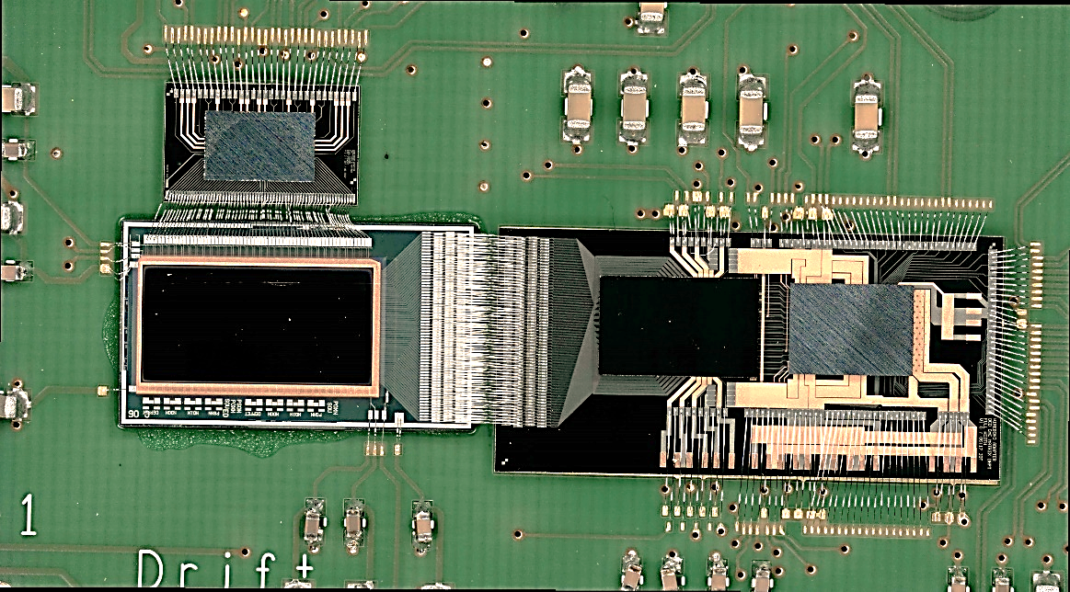
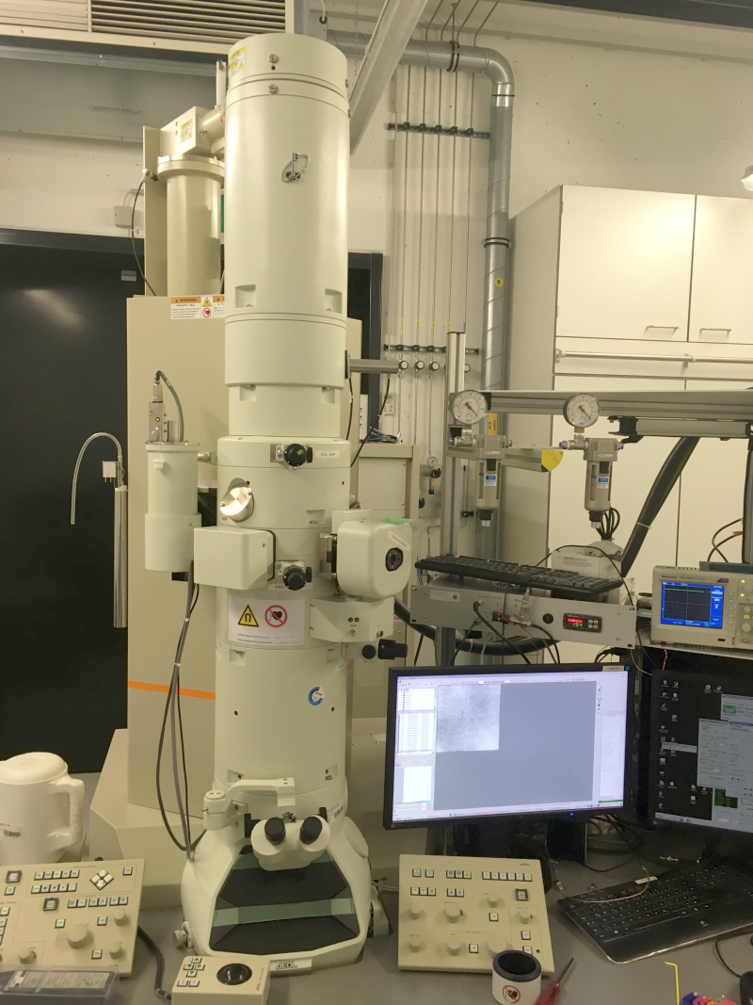
Prototpe @ MPSD
Small-area detector prototype
JEOL type JE-2100 TEM

Slide 26
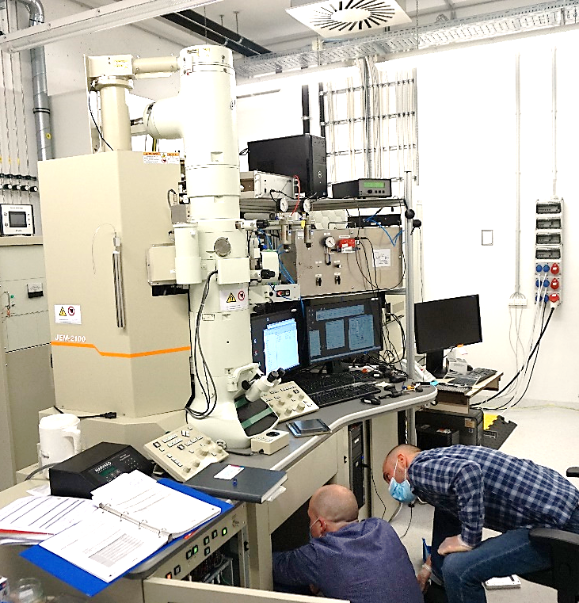
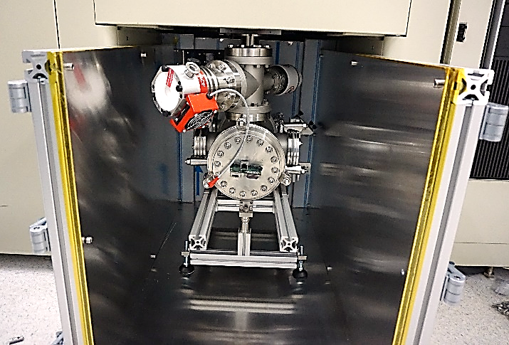
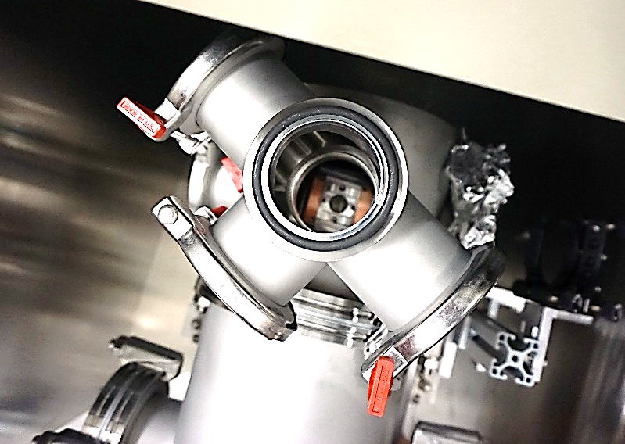
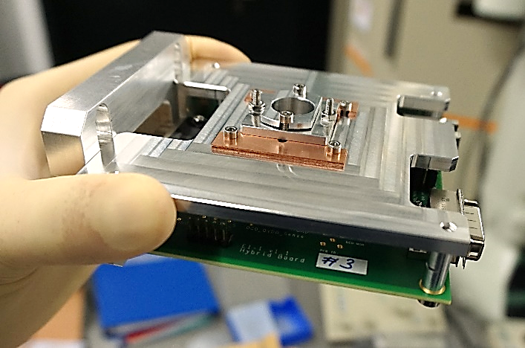
Prototpe @ MPSD

Slide 27
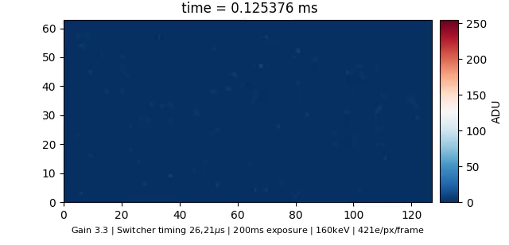
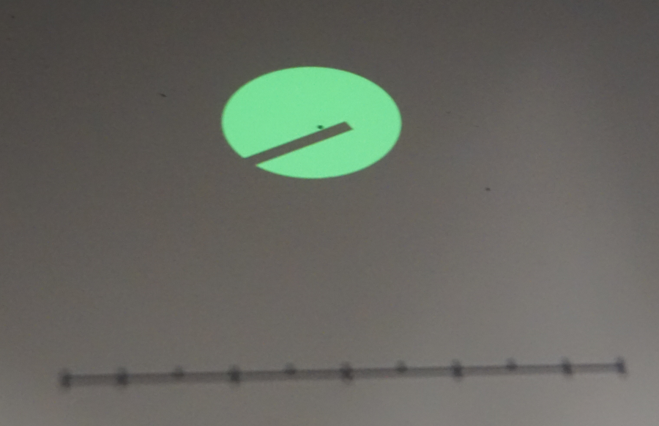
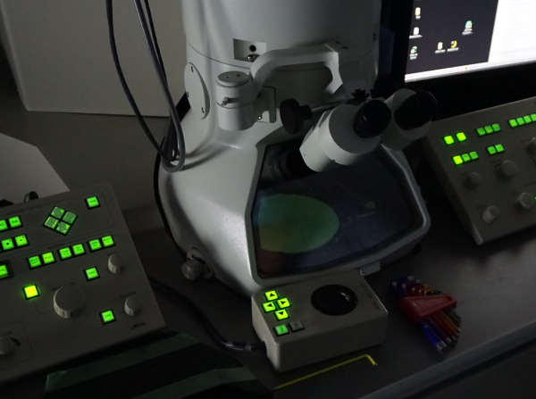
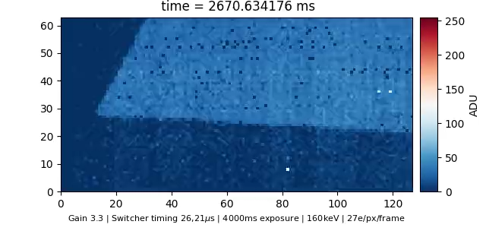
Prototpe @ MPSD
Turning ON the electron beam:
Slanted edge movement:

Slide 28
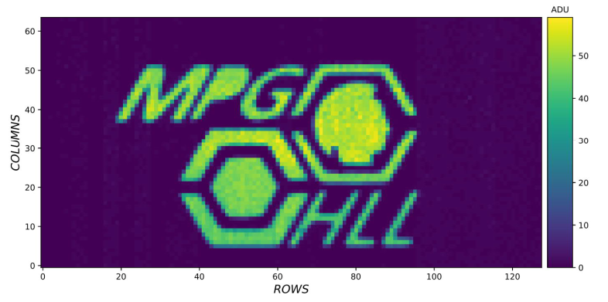
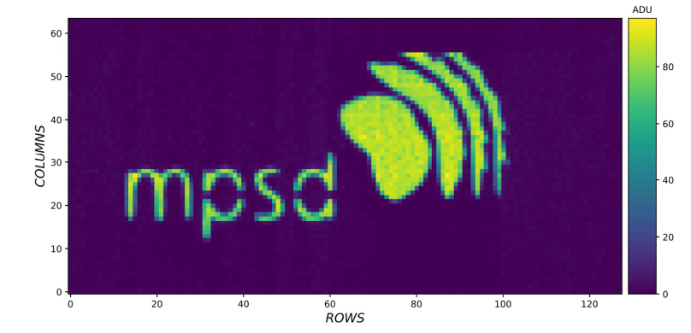
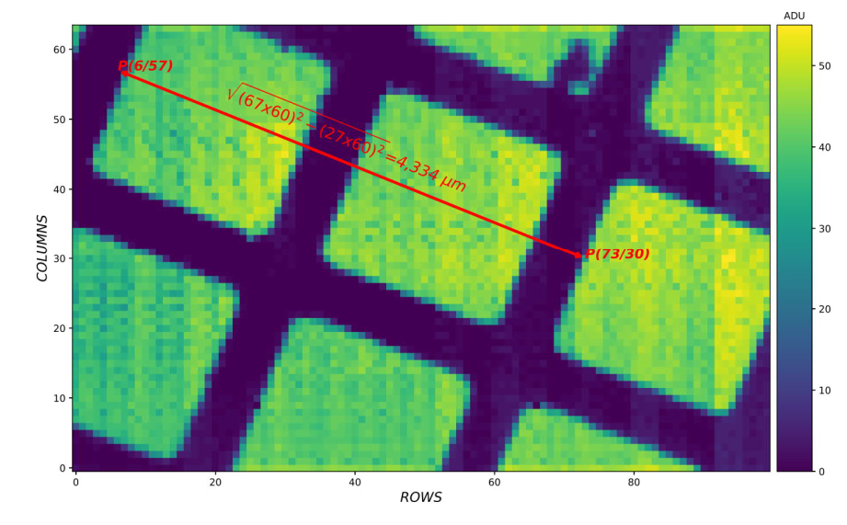
Prototpe @ MPSD
Logo images taken with a titanium shadow mask.
Calibration mesh with 25 um mesh period (19 um hole, 6 um line width).

Slide 29

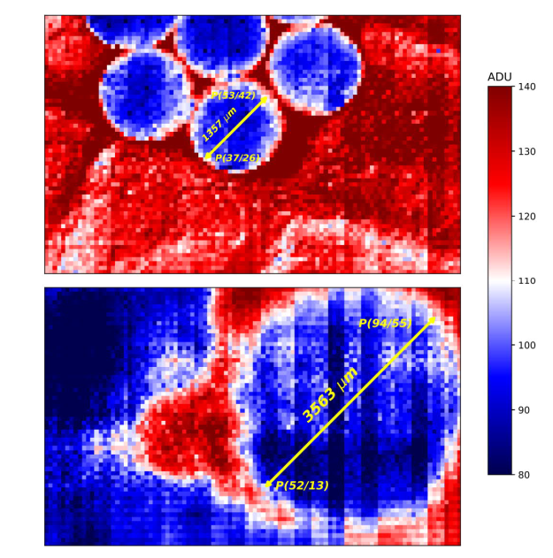
Prototpe @ MPSD
Images of 261 nm latex spheres for calibration purposes

Slide 30
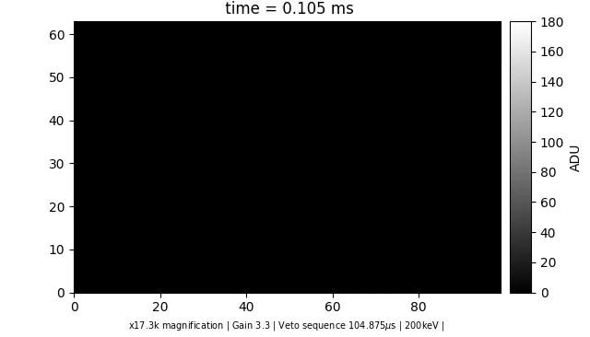

Prototpe @ MPSD
Electron induced growth of nanoparticle gold:
10 kfps
Mesh-like structure is the alumina carrier of the liquid cell
Liquid cell contains chloroauric acid

Slide 31
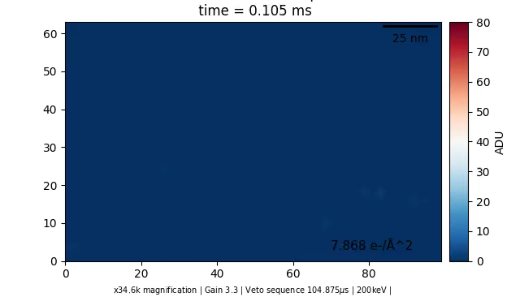
Prototype @ MPSD
Electron induced destruction of silver nanoparticle:
10 kfps
Environmental cell with silver crystal and molecular oxygen
Ozone oxidates Ag
Secondary electrons reduce AgO

Slide 32
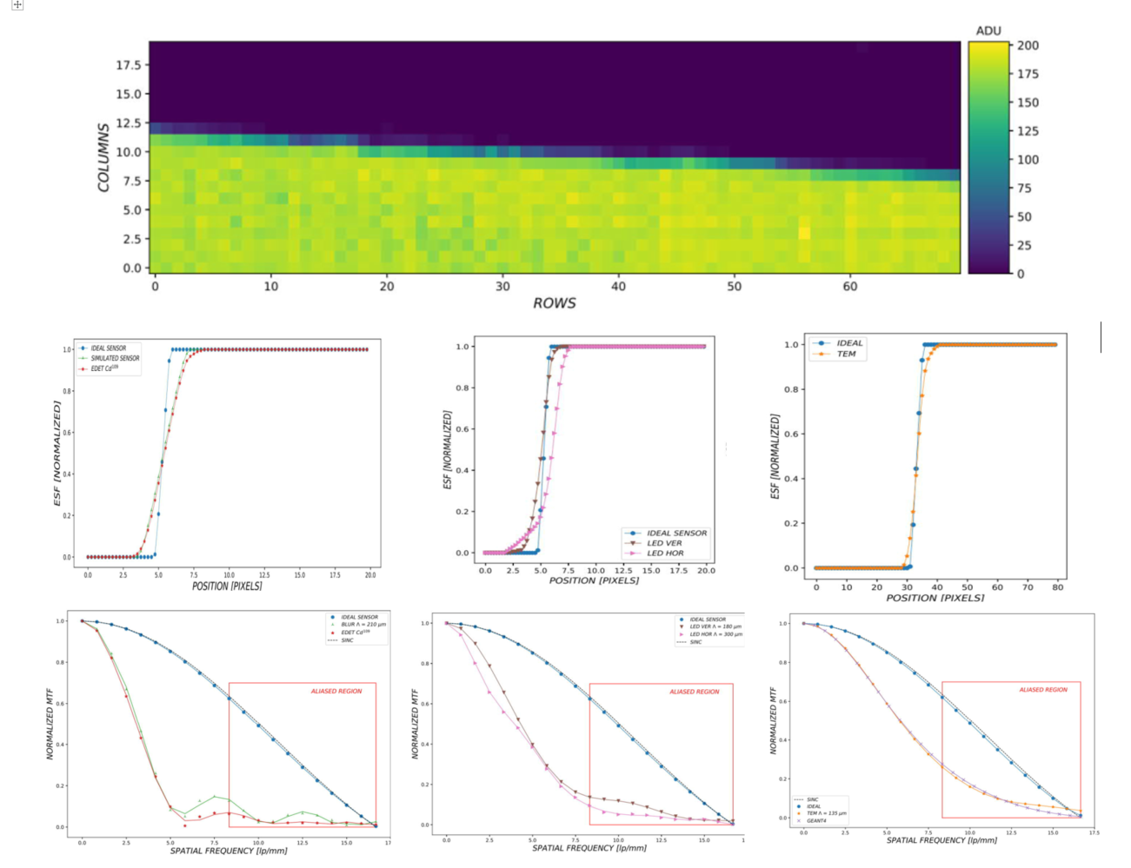
Prototpe @ MPSD
EDET prototype matrix MTF measurements:
Top row: Raw data of “knife edge” shadow mask used for MTF determination.
Middle row: Edge spread functions as reconstructed from knife edge image for 109 Cd source illumination (left), LED illumination (middle), and electron illumination at the TEM (right).
Bottom row: MTF as calculated from the ESFs in the middle row.
Deviation in the ESF onset for the LED illumination is notable.
Indication for an intra-row crosstalk phenomenon referred to as “ghost charge”, which needs to be compensated by adapted DCD settings.
Intra-row chrosstalk (ghost charge)

Slide 33
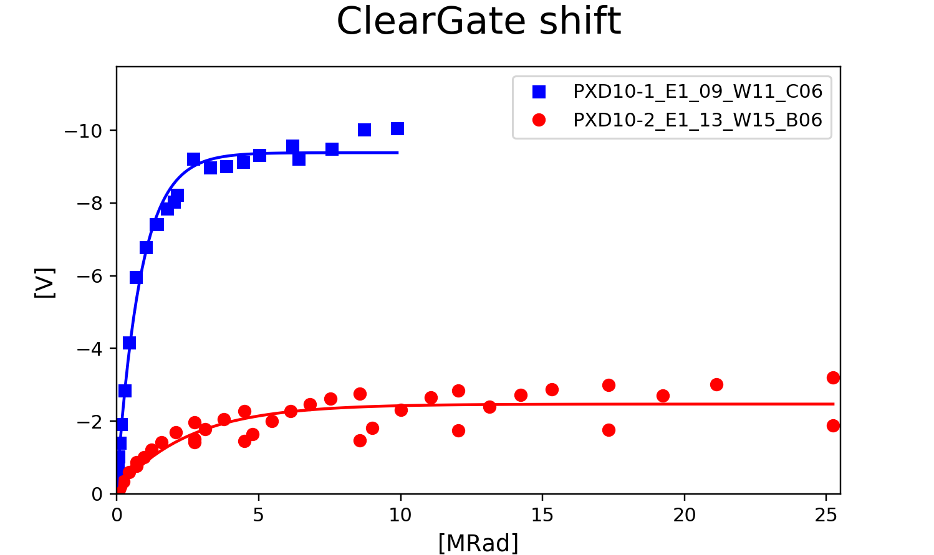

Prototype @ MPSD
Radiation damage is a big issue for EDET:
Threshold voltage shift for both gate and cleargate
Gate & Cleargate threshold voltages change during measurement (intensity depending)
Mitigation using voltage adaptions and offset DACs
Inhomogeneities can cause lack of CHC and even insensitive regions over matrix
Using TEM as representative radiation source and dosimeter
PXD-10-2: Technology pathfinder production
Very promising results compared to “standard” BELLE technology:
  Factor of ~ 2 lower shift for Gate
  Factor of ~ 3 for Cleargate
Overnight annealing

Slide 34

Project status

Slide 35
Project status
chk
mxm, alm
sib
chk, mhe?
danilo
…
Fabrication
ATG test
Dicing
Population
Probecard test
Brick integration
PXD-10-3 awaiting completion
Testing after al2n still has to be done
PXD-10-2 awaiting population
PXD-10-1 modules require DMC / DMC 65
Probecard available
Probecard setup in qualification
Irreversible step
Beyond, module rework is extremely difficult
Glueing procedure tbd.
…
danilo
chk, tbd.
tjs, tbd.
tbd.
FPA /
Quadrant module
DLSP integration
Qualification
(MPMMC ?)
Qualification
(MPMS)
FPA integration
Attach DLSP to brick
Bonding of DLSP to ASM
Step can be skipped
For reference purposes only
Requires 2nd MPMMC specimen
Status of 2 EMCMs
Requiring MPMS specimen which are calibrated & tested
Update status
Characterization and calibration measurements
Based on qualification results
Insertion in vacuum vessel

Slide 36

Project status
  PXD 10 overview:
  3 Batches were produced. Currently, last sensor batch fabrication is in final state
  PXD-10-1:
    Pilot production
    4 wafers in total (2 thin / 2 thick)
    11 modules tested good
    Some modules have many open drain lines
    Layer system affected by DHP RESET bug (inverted polarity = permanent reset)
    Some modules populated with DHPs
    Some modules lost in repair attempt
    Remaining modules usable with DMC 65 only
  PXD-10-2:
    Experimental variants (rad hard oxides)
    4 wafers in total (2 thin / 2 thick)
    10 good modules after ATG testing
    Improved topology resulting in less oped drain lines
    1 wafer with 3 “good” modules lost during thinning process (some small devices might be usable)
    2 modules populated with DHP backend for use as first Quadrant ASMs
    ASMs awaiting test w7 ASM PC system before assembly
„It‘s a kind of intelligence test.“

Slide 37

Project status
  PXD 10-3 status:
  8 wafers in total
  ATG test completed
  19 quadrant devices with no issues
  10 with minor, repairable or cosmetic defects (usable)
  Yield ~ 90%
  Backthinning process completed successfully
    Some wafers show tiny ( < 50 mm silicon remnants at window edges)
    Irrelevant for operation
  Decision was made to split in two batches (4 wafers each)
  To do:
    BCB
    Sputtering of TiW
    Copper deposition
    Copper lithography
    BCB
  First batch: Using HLL equipment for TiW sputtering
  To be fully completed before batch 2 production is resumed
  Finalization of first batch June ’23 (some issues)
  Finalization of second batch not (!) before move

Slide 38
Project status
Variants
Availability
Comment
Switcher-B V2.1 (old)
Switcher-B V2.2 (broken Sout)
Switcher-B V2.3 (new)
30- 40 pcs. for EDET
Many, only for small dev.
promising first results
Test effort @ HLL (wafer)
New, improved design
To arrive at KIT 12/22
Bumping @ IZM
Switcher-B
4 x per ASM
DCD-E
8 x per ASM
Version 1.0
2 deliveries
Batch of tested
76 tested left
KIT responsibility
DCD-EC as alternative?
DHP
8 x per ASM
Version 1.2b
100 chips solely for EDET
24 left
35 as donation from BELLE project
Many lost for PXD-10-1
Sufficient stock for PXD-10-2 and first PXD-10-3 ASMs
OR
Version 1.0
100 chips solely for EDET
97 left
Testing complete
Additional wafers ordered
DMC 65
8 x per ASM
1 Quadrant module uses 8 DHP / DCD ICs and 4 Switchers
1 FPA uses 16 Switchers, 32 DHPs/DMCs and 32 DCDs
1 Small device assemby uses 1 DCD / and 1 Switcher

Slide 39

Project status
  DLSP “light” status:
  DLSP „light“ becomes DLSP
  No „full“ version required, but potential resubmission will have bugfixes and patches:
    Fix wrong casing
    add calibration connector
    modified range resistors for AMP_LO voltages
  8 populated specimen, 2 bare PCBs
  2 patched & calibrated (used for EMCM test)
  6 uncalibrated devices
  3 of which have issues w/ I2C (defect, to be fixed)
  At present, procurement of vital DLSP components is unavailable due to supply chain issues
  We will have to live with what we have for the time being
  Remove calibrated DLSP from EMCM and use for first ASM
  Possible thanks to modular approach

Slide 40

Project status
  VIC status:
  10 specimen from Turm
  Fulfilling requirements
  Define assembly and population procedure
    Similar to GREST / FSP flex assemblies
    More „stiff“ flex / larger heat capacitance
    Different flange material might have impact on glueing behaviour
    Test!
  VIC is much more complex than originally required.
  VIC design foresees 72 = (8 x 8) + 8 differential LVDS lanes as projected for the old DMC 40 nm
  VIC optimized for DMC 65 would need only 8 lanes in total
  Second batch of VIC:
    Less sophistcated, simpler stackup
    Fewer layers
    More flexible

Slide 41

Project status
  MSM status:
  6 populated specimen
  Originally for EDET
  Problem:
    Succesful design
    Used as digital interface PCB for variety of projects
    Common hardware platform is XU1
  Most of them are patched and being used
  Not all setups will be continuously in use
  Re-use of patched MSM for Quadrant operation
  Second batch of PCBs (MSM V1.1) ready (20 pcs.)
  Bugfixes / eliminate patches
  In population...

Slide 42

Project status
  MBM status:
  Total number of 20 MBMs purchased
  10 „old“ with smaller and
  10 „new“ with larger onboard memory
  Sufficient stock for the near future
  Commercial unit
  Vital component for many projects

Slide 43

Project status
  MPMS status:
  6 populated specimen
  Solely for EDET purposes
  2 specimen tested
    Minor bugs
    Patches required
  Partially calibrated
  Calibration mandatory for use with DLP/ASM
  Issue:
    Population of additional units depends on availability of components
    Power regulators
    Digital switches
    Analog switches / multiplexers
  Availability of these components critical
  Some spares for repairs
  We will have to live with what we have

Slide 44


Project status
  ASM assembly:
  Definition of handling and glueing procedure done
  Revision and improvement of tooling
  Test glueing processes and quality monitoring
  Open issue:
    How to assure „flatness“ of bondline if ASM specimen is bent?
    DLSP adapter shape issue solved?
  Mechanics:
  Few minor issues popped up:
    How to align modules wrt. each other?
    How to assure “safety distance”?
    Incorporation of calibration LED / diffusor
  Suggestions, need discussion.

Slide 45

Project status
  ASM test & PC assembly:
  Used to qualify ASMs prior to assemby
  Detect repairable defects
  Prevent assembling devices with irrepairable defects
  Check all connections using JTAG and take offset map
  Probecard hooked up and comissioned
  Minor technical difficulties
  Minor adaptions and modifications
  Second setup required, as use of old EMCM setup will continue.
  Second MPMMC specimen required
  Quadrant module testing:
    ASM PC
    „EMCM“ setup
    MPMS supply

Slide 46

Project status
  Firmware development fairly advanced
  Three major tasks upcoming:
  1: TRG / CMD sequencer for DMC 65
  New / upgraded TRG/CMD sequencer IP to support new DMC 65 features
  Reaction to external trigger signals / internal timers
  Support parking
  Support purging
  Support exposure times
  Support on-the fly adjustable variables
  Support windowing...

Slide 47

Project status

Slide 48

Project status

Slide 49

Project status

Slide 50

Project status
  2: Implementation of Inter Module Link
  Coordinated operation of 4 modules on one FPA
  Distribution of clock
  Distribution of trigger signals
  Single-point access for external trigger signals etc.
  Both for DMC and DHP based quadrants

Slide 51

Project status
System Control Unit (SCU):
Forwards clock for use as synchronous clock source in all modules
Generates TRG command sequence for all modules
Interacts with external trigger signal in tbd. way.

Slide 52

Project status
System Control Unit
SCU is IP in one (?) of the modules
Sparse option
Clock source selection
TRG command generation
Configurable trigger interface
IML
RJ45
IML
IML Hardware consists essentially of a two-fold LVDS fanout
Delay adjustment via identical cables

Slide 53

Project status
  3: Upgraded Metadata processing
  DMC records data in form of data frames (AURORA)
  A data frame can consist of anything between the data of a single line to the data of a full burst
  No structure inside data frame
  No information about:
    Frame size
    windows / window sizes
    Timestamp of windows
  Information can be reconstructed ex post using data volumina and data frame timestamp
  Especially if operating sequences involve branching, information („metadata“) about the actual sequencing is required.
  From the end user point of view, inserting this information into the primary data stream is highly desirable
Data frame of ~ 6.3 MB can, for instance, consist of...
„Standard“ burst of
48 frames with 512 rows
„Window“ burst of
96 window frames
of 256 rows
„Window“ bursts with
17 frames with 512 rows
34 window frames with 256 rows
56 window frames with 128 rows
...In arbitrary combinations

Slide 54

Project status
  3: Upgraded Online Monitoring capabilities
  Insert metadata to fast data stream during DAQ
  Format information known to SCU sequencer
  Most simple approach would be insertion of „detector/window frame tag“ (DFT) word indicating new „format“
  Tolerable increase of data volume
  Eases also extraction of OMO data from stream on demand
  Disadvantage: TRG/CMD stream also needs to transport format signals
  DIrect access to sequencer data only for „Master module
  „Format copy“ option?
  „Data latency“ needs to be accounted for

Slide 55

Project status
  Online monitoring software:
  GUI functions (color mapping, scaling) moved outside main C code
  - Integrating channels are transferred to GUI as 24bit
  - Intuitive GUI script for image preview
  - Mouse pan and zoom-in/out
  - Pixel value, coordinates and DCD/Switcher indication
  - Build-in global and ROI histograms
  - Brightness/contrast adjustment using histogram
  - More than 200 color maps
  - Pause/resume and screenshot buttons
  - Code optimization to use CPU AVX2 vector instructions (up to 20x boost)
  - ~65000 FPS at i5-6600 CPU
  - Data stream diagnostics
Well prepared for quadrant module operation
Well prepared for DMC operation
Updates on GUI and user friendlyness

Slide 56

Project status
  Housekeeping software
  VI server:
  Underwent many major revisions
  Configurable
  Supports variety of different interface standards
  Supports instrument safety functions
  Much more than just a simple HK software:
  Reliable and versatile tool
  Standard configuration and housekeeping software for many setups:
    FSP TNG
    PXD13
    sCCD
    4SBC

Slide 57

Measurements and knowledge
  New challenges incoming:
  Adjustment of module parameters
    Link parameters
    DMC input delays
    Sequence delays
    offset DAC values
    Voltage scans
    Calibration of pixels
  Study dynamic behaviour of large matrix
  Study Temporal response
    With DHP
    With DMC
  Develop standard characterization routines
  Develop automatic measurement functions
  Develop analysis
    Sensor properties
    Imaging performance
  Based on what we have
    Adapted to large module
    Optimized / sped up
  Still some way to go
  Experimental measurement smuch earlier

Slide 58

Software
  Upcoming challenge:
  Software / firmware needs to “grow”
  Job is not done once the Quadrants are working
  Maintain and upgrade software to satisfy user requirements
    Simple configuration (one-button)
    Add new features
    Failsafe
    Foolproff
  Adapt software to support high time-resolution operation of DMC
  Adapt software to add new tests, measurements, calibration routines, scans...

Slide 59

Next steps
Assemble & operate first quadrant modules:
  Evaluate operational dynamics & timing behaviour
  Sufficient sensitive area to do significant science
  DHP based prototypes will already allow for operation with reduced framerate
Comissioning of first DHP based quadrant modules (missing: ASP PC power supply)
Measurements in Hamburg
DHP based FPA?
In parallel: Continue qualification of DMC
Target: Population of DMC based quadrant modules
Implement extended TRG/CMD sequencer IP capable of exploiting additional features of DMC 65
Implement simple „day 0“ version of inter-module link for coordinated operation of 4 quadrant modules on an FPA
Continue irradiation studies

Slide 60

Questions?

Slide 61

Backup slides

Slide 62

Speed calculations
from FIFO size
Some (relevant?) example window modes:
Window | Electrical rows | Topological rows | Area 30.72 x (mm²) | FOV Area (mm²) | Max. burst size (windows)
Full | 128 | 512 | 30.72 | 944 | 48
Half | 64 | 256 | 15.36 | 236 | 96
Quarter | 32 | 128 | 7.68 | 59 | 192
Combo 64 | 16 | 64 | 3.84 | 15 | 384
Octett | 8 | 32 | 1.92 | 3.7 | 768
Quadruple | 4 | 16 | 0.96 | 0.92 | 1536
Doublet | 2 | 8 | 0.48 | 0.23 | 3072
Singlet | 1 | 4 | 0.24 | 0.058 | 6144
Shown here is the case for max. contiguous ROI
Actual position of window area / ROI on sensor may vary
FOV area

Slide 63
Speed calculations
Corresponds to
time resolution
Window | El. rows | Top. rows | # skipped (el.) rows | Total readout time (µs) for mem_inc = |  |  |  |  | Frame rate (kHz) for mem_inc =
 |  |  |  | 1 | 2 | 4 | 8 | 16 | 1 | 2 | 4 | 8 | 16
Full | 128 | 512 | 0 | 12.8 | 12.8 | 12.8 | 12.8 | 12.8 | 78.125 | 78.125 | 78.125 | 78.125 | 78.125
Half | 64 | 256 | 64 | 12.8 | 9.6 | 8 | 7.2 | 6.8 | 78.125 | 104.17 | 125 | 138.89 | 147.06
Quarter | 32 | 128 | 96 | 12.8 | 8 | 5.6 | 4.4 | 3.8 | 78.125 | 125 | 178.57 | 227.27 | 263.16
Combo 64 | 16 | 64 | 112 | 12.8 | 7.2 | 4.4 | 3 | 2.3 | 78.125 | 138.89 | 227.27 | 333.33 | 434.78
Octett | 8 | 32 | 120 | 12.8 | 6.8 | 3.8 | 2.3 | n/a | 78.125 | 147.06 | 263.16 | 434.78 | n/a
Quadruple | 4 | 16 | 124 | 12.8 | 6.6 | 3.5 | n/a | n/a | 78.125 | 151.52 | 285.71 | n/a | n/a
Doublet | 2 | 8 | 126 | 12.8 | 6.5 | n/a | n/a | n/a | 78.125 | 158.73 | n/a | n/a | n/a
Singlet | 1 | 4 | 127 | 12.8 | n/a | n/a | n/a | n/a | 78.125 | n/a | n/a | n/a | n/a
Same timing as for
windowing in idle mode
Optimum time
resolution
Optimum time
resolution

Slide 64
Speed calculations
Window | El. rows | Top. rows | # skipped (el.) rows | Dynamic burst size¹ (windows) for mem_inc = |  |  |  |  | Burst rate² (Hz) for mem_inc =
 |  |  |  | 1 | 2 | 4 | 8 | 16 | 1 | 2 | 4 | 8 | 16
Full | 128 | 512 | 0 | 53 | 53 | 53 | 53 | 53 | 92 | 92 | 92 | 92 | 92
Half | 64 | 256 | 64 | 112 | 109 | 107 | 107 | 106 | 87 | 89 | 91 | 91 | 92
Quarter | 32 | 128 | 96 | 250 | 231 | 221 | 217 | 214 | 78 | 84 | 88 | 90 | 91
Combo 64 | 16 | 64 | 112 | 600 | 512 | 468 | 446 | 435 | 65 | 76 | 83 | 87 | 89
Octett | 8 | 32 | 120 | BE | 1225 | 1037 | 943 | n/a | BE | 63 | 75 | 82 | n/a
Quadruple | 4 | 16 | 124 | BE | BE | 2475 | n/a | n/a | BE | BE | 63 | n/a | n/a
Doublet | 2 | 8 | 126 | BE | BE | n/a | n/a | n/a | BE | BE | n/a | n/a | n/a
Singlet | 1 | 4 | 127 | BE | n/a | n/a | n/a | n/a | BE | n/a | n/a | n/a | n/a
¹ Nominal burst size plus frames acquired in
transfer time of burst with nominal length
² Defined by transfer time of data from burst
with dynamic burst size
Break even: data read rate slower
than data transmission rate
Transition to „quasi-continuous“ mode

Slide 65





Currently the biggest challenge
Will keep us busy for some time...

