Slide 1
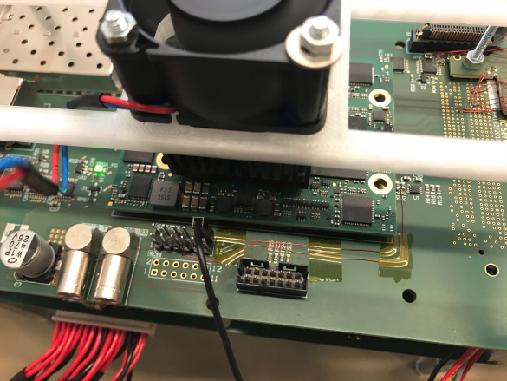
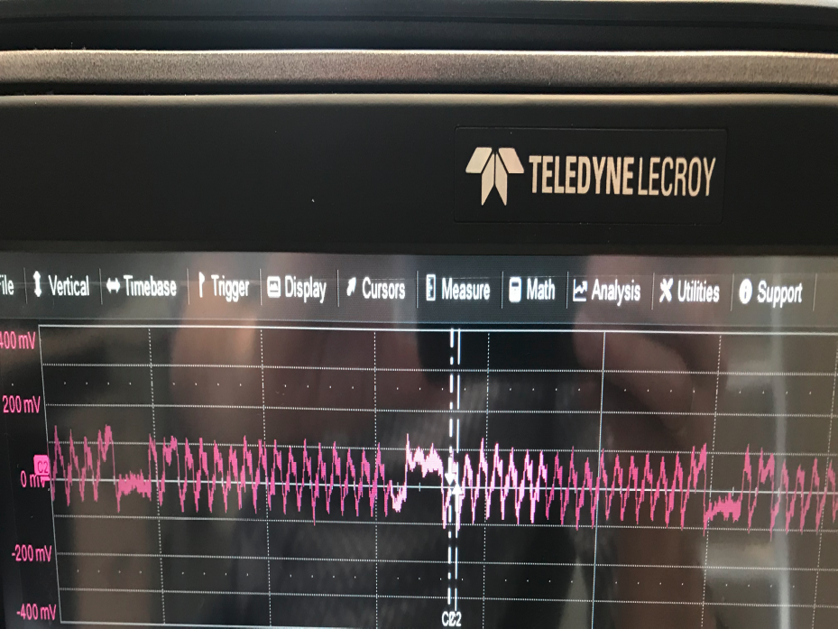
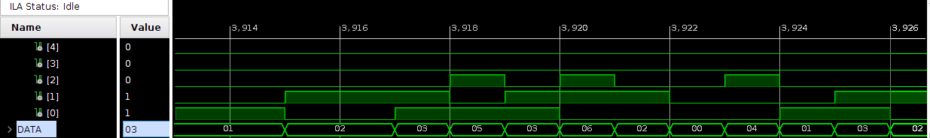
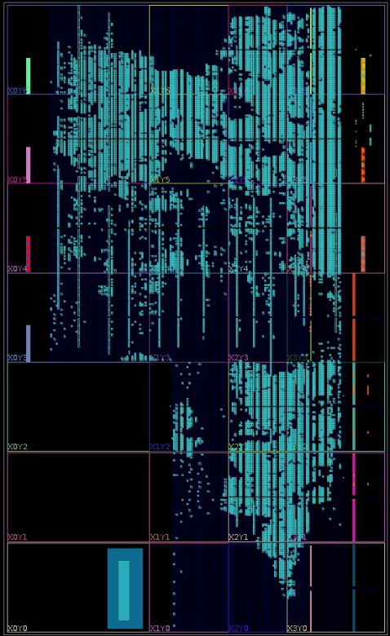
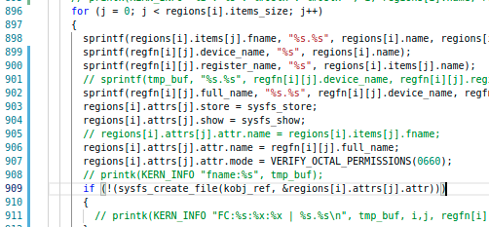
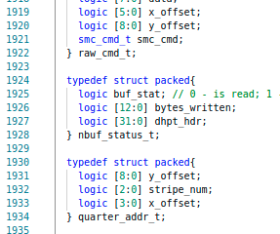
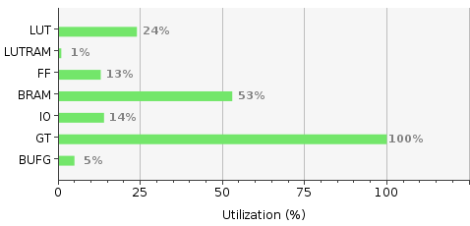
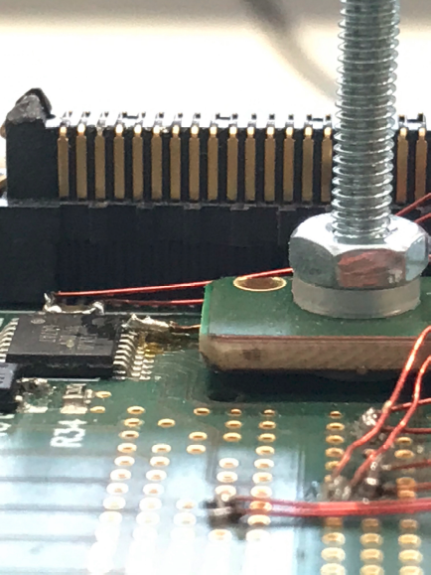
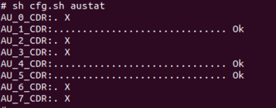
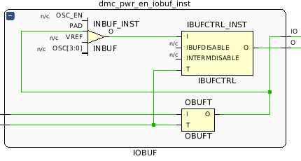
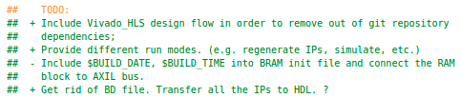
Edet80k firmware
Tutzing, May 2023

Slide 2
Agenda
Overview EDet80k DAQ system tasks and block scheme
Firmware data path overview
Simulation testbench overview
Firmware debug scheme
Results
Firmware design future steps

Slide 3
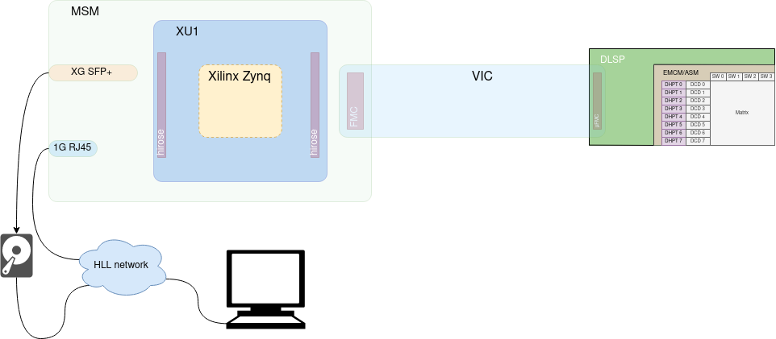
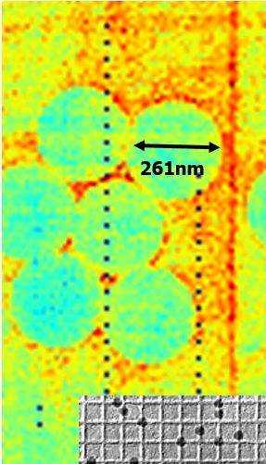
EDet80k block scheme
EDet80k DAQ system tasks and block scheme
DMC(DHP)
DCD
Firmware

Slide 4
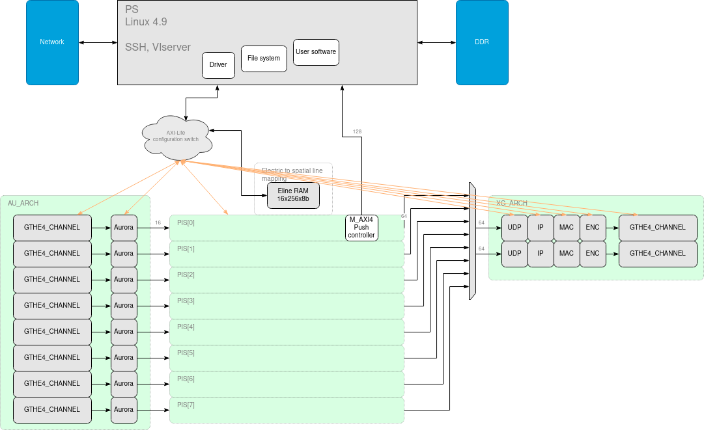
EDet80k firmware brief
Data path
Scalable
Reusable
data
dummy
gen
1. Filtering
2. Remapping
3. Header handling
4. Slicing
5. Sending
data
dummy
gen

Slide 5
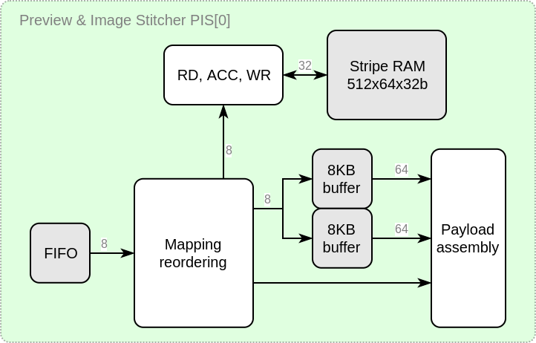
EDet80k firmware brief
Data path (detailed)
data
dummy
gen
data
dummy
gen
1. Filtering
2. Remapping
3. Header handling
4. Slicing
5. Sending

Slide 6
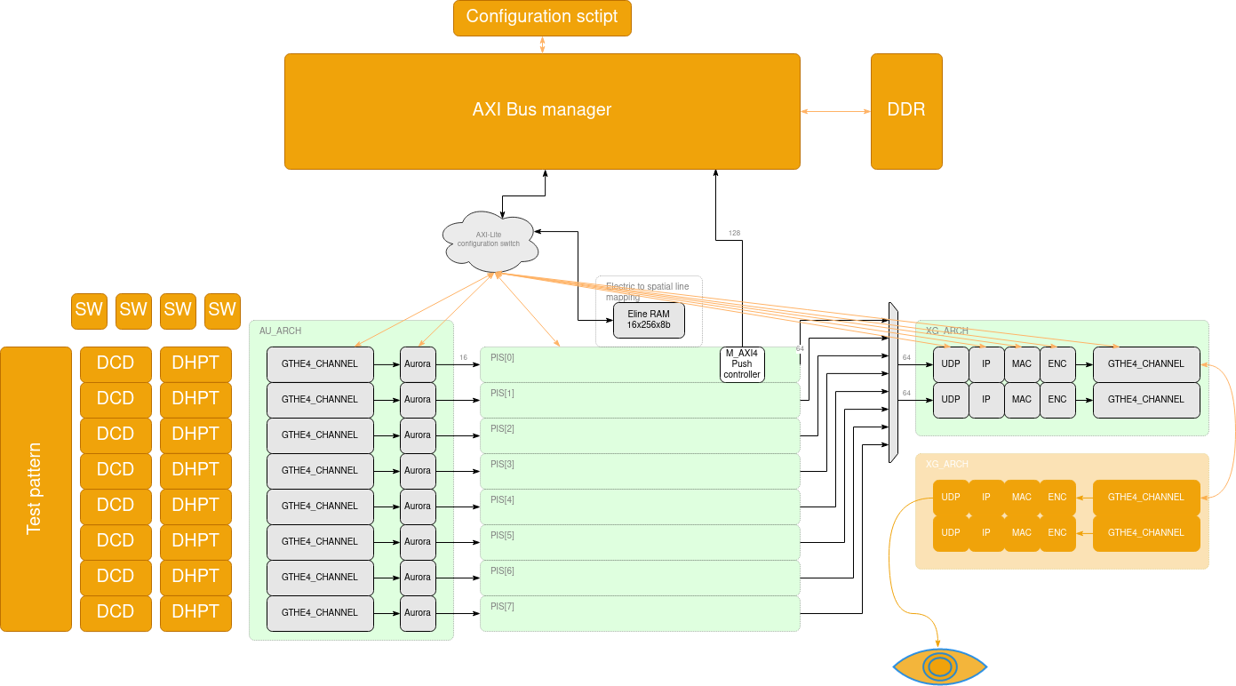
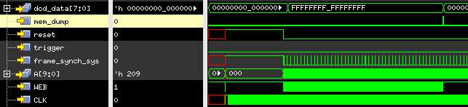
TESTBENCH
Add-on

Slide 7
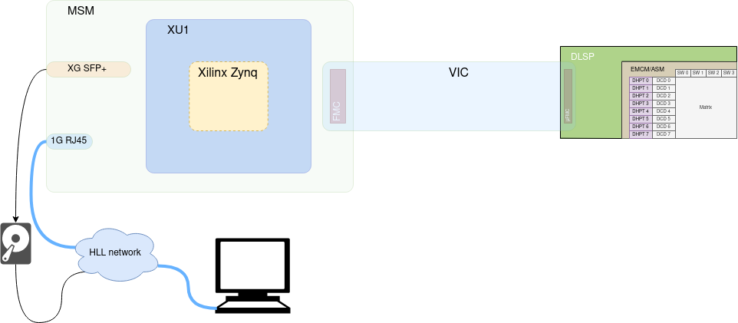

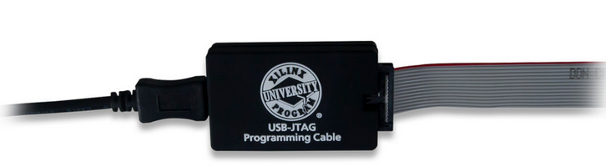
Firmware debug
State-of-the-art
NW: TCP
PS: Linux + Driver + Software
PL: IP core

Slide 8
EDet80k firmware
Tools used to build the firmware
FW generation: Vivado (No GUI, non-project-mode)
No proprietary data formats => text only (verilog, tcl, bash, etc.)
Version control software (git)
Simulation: Cadence, Vivado libs
HW debug: Vivado

Slide 9

EDET80k firmware CURRENT RESULTS
Concept works as intended
Successful run with 8 channels
Resources for future updates

Slide 10
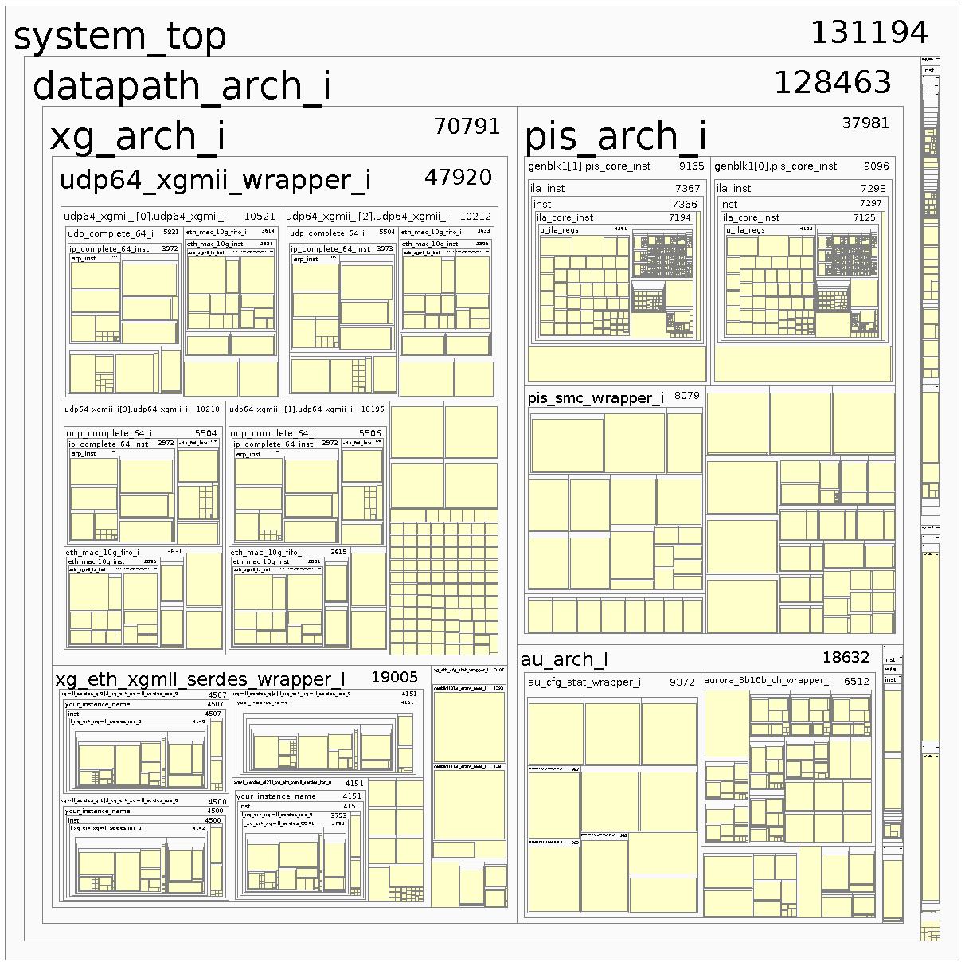
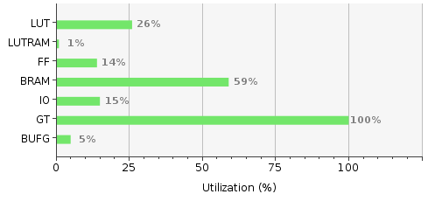
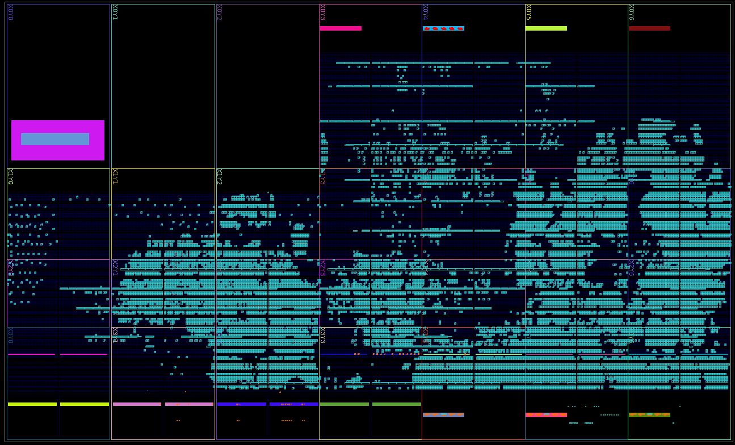
EDET80k firmware CURRENT RESULTS
Resources utilization

Slide 11
Firmware design
Future steps
DMC requires intelligent managing (sequencer upgrade, refer to J.Treis’ presentation)
PS Linux kernel & filesystem upgrade (MQTT)
Smart data markup (coherent with DMC)
Modules synchronization in full FP operation (CLK, TRG distribution)

Slide 12

To be continued
Thank you for your attention
Discussion time.
Questions, remarks, suggestions.

Slide 13
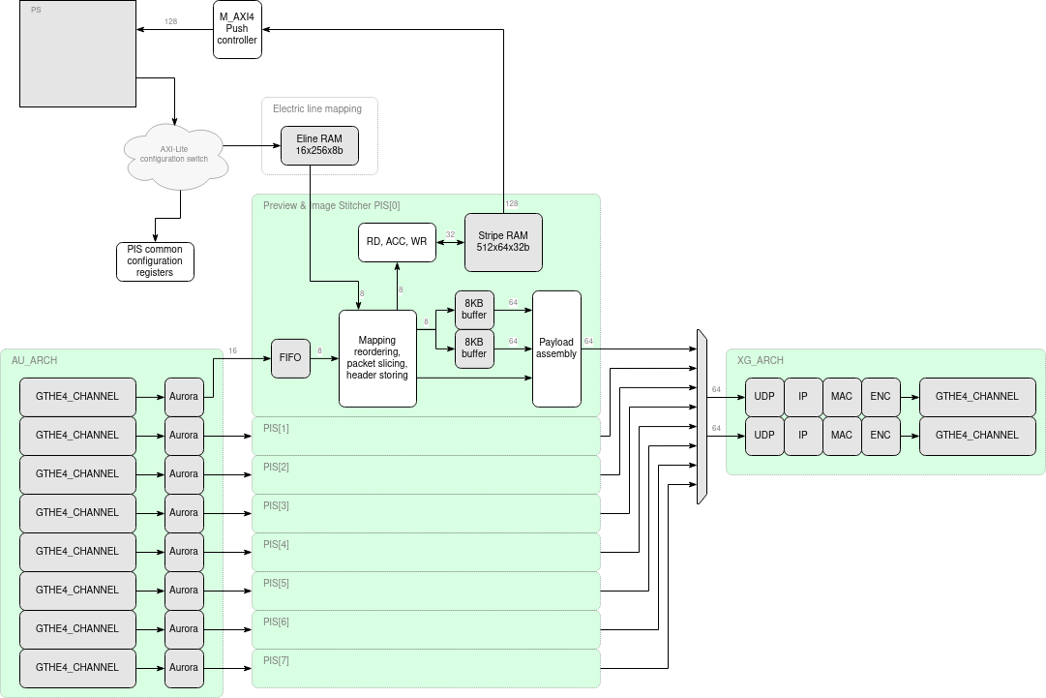

Slide 14
