Slide 1
PROPOSALS FOR DCDE UPGRADE
Semiconductor Laboratory of the Max Planck Society
Eduard Prinker

Slide 2
DCDE GAIN SETTINGS – COMPARISION TO BELLE FEEDBACK RESISTOR r_{f}
 | BELLE II | EDET
En30 | 26k | 30k
En60 | 13k | 3k
En90 | 19k | 1.5k
En120 |  | 15k

Slide 3
Possible DCD GAIN SETTINGS
EDET
BELLE
En30 | En60 | En90 | En120 | Gain | Gain Factor
1 | 1 | 1 | 1 | 0.06 | 1.00
0 | 1 | 1 | 1 | 0.06 | 1.03
1 | 1 | 1 | 0 | 0.06 | 1.06
0 | 1 | 1 | 0 | 0.07 | 1.10
1 | 0 | 1 | 1 | 0.09 | 1.43
0 | 0 | 1 | 1 | 0.09 | 1.50
1 | 0 | 1 | 0 | 0.10 | 1.57
0 | 0 | 1 | 0 | 0.10 | 1.65
1 | 1 | 0 | 1 | 0.15 | 2.54
0 | 1 | 0 | 1 | 0.17 | 2.75
1 | 1 | 0 | 0 | 0.18 | 3.00
0 | 1 | 0 | 0 | 0.20 | 3.30
1 | 0 | 0 | 1 | 0.67 | 11.00
0 | 0 | 0 | 1 | 1.00 | 16.50
1 | 0 | 0 | 0 | 2.00 | 33.00
En30 | En60 | En90 | Gain | Gain Factor
1 | 1 | 1 | 0.40 | 6.55
0 | 1 | 1 | 0.51 | 8.49
1 | 0 | 1 | 0.73 | 12.08
1 | 1 | 0 | 0.58 | 9.53
0 | 0 | 1 | 1.27 | 20.90
0 | 1 | 0 | 0.87 | 14.30
1 | 0 | 0 | 1.73 | 28.60

Slide 4
Large gap in DCDE GAIN SETTINGS
BASIC SCENARIO 100 TEM electrons
generate $\sim 800,000e^{−}$ within pixel → induce drain current of about 70-90 µA: gain 11 range too small (200 ADU: 42µA), gain 3.3 range too large (200 ADU: 136µA) → would prefer a gain setting of 6/7 times lowest gain setting

Slide 5
Process variations dcde contribute to one third of observed offset variation (30μA)
from ADC scans external current source

Slide 6
2-bit dac + ipdac reduces range of observerd offset distribution

Slide 7
Higher bit resolutions
average IPDAC current step ≈2µA: 2-bit DAC@3 + IPDAC=5 → lowest pixel ADU would jump to other side of distribution → would wish an increase in bit resolution for both: e.g. 3-bit DAC + 8-bit IPDAC

Slide 8
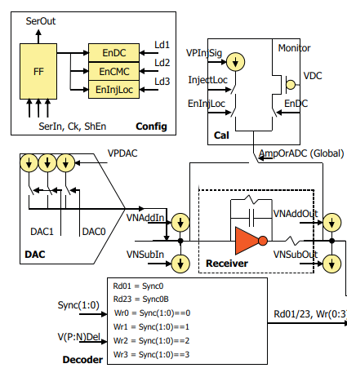
Dcde settings optimization ADC transfer curves
actually, gain 3.3 is used for DCDE settings optimization
BELLE approach not applicable
need about 250µA per DCDE channel provided by an external current source
over 16,000 different settings
optimizing all channels at once would significantly reduce measurement time
PROBLEM: supply line to DCDE channels does not allow for such large currents (if 2 or more channels were connected only one channel could be brought into saturation, even after external current source intensity was doubled)

