Slide 1
GHOST CHARGE
REVISITED
Semiconductor Laboratory of the Max Planck Society
  Eduard Prinker

Slide 2
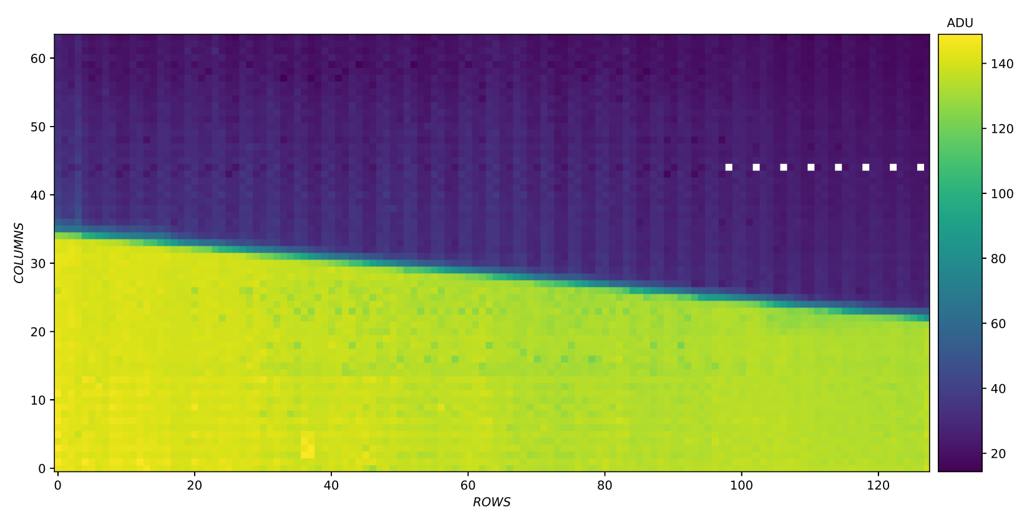
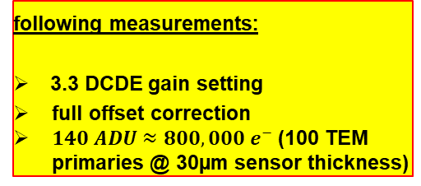
DESCRIPTION – LED ILLUMINATION
PHYSICAL EXPLANATIONS:
DIFFRACTION:@850nm wavelength and used geometry ≈ 70µm
REFLECTION: possible
following measurements:
3.3 DCDE gain setting
full offset correction
$140 ADU≈800,000 e^{−}$ (100 TEM primaries @ 30µm sensor thickness)
Pronounced gradient in the "dark zone", depending of how many pixels of one row got enlighted. This phenomenon of an additional measured pixel current without any external charge injection should be referred to as the “GHOST CHARGE”

Slide 3
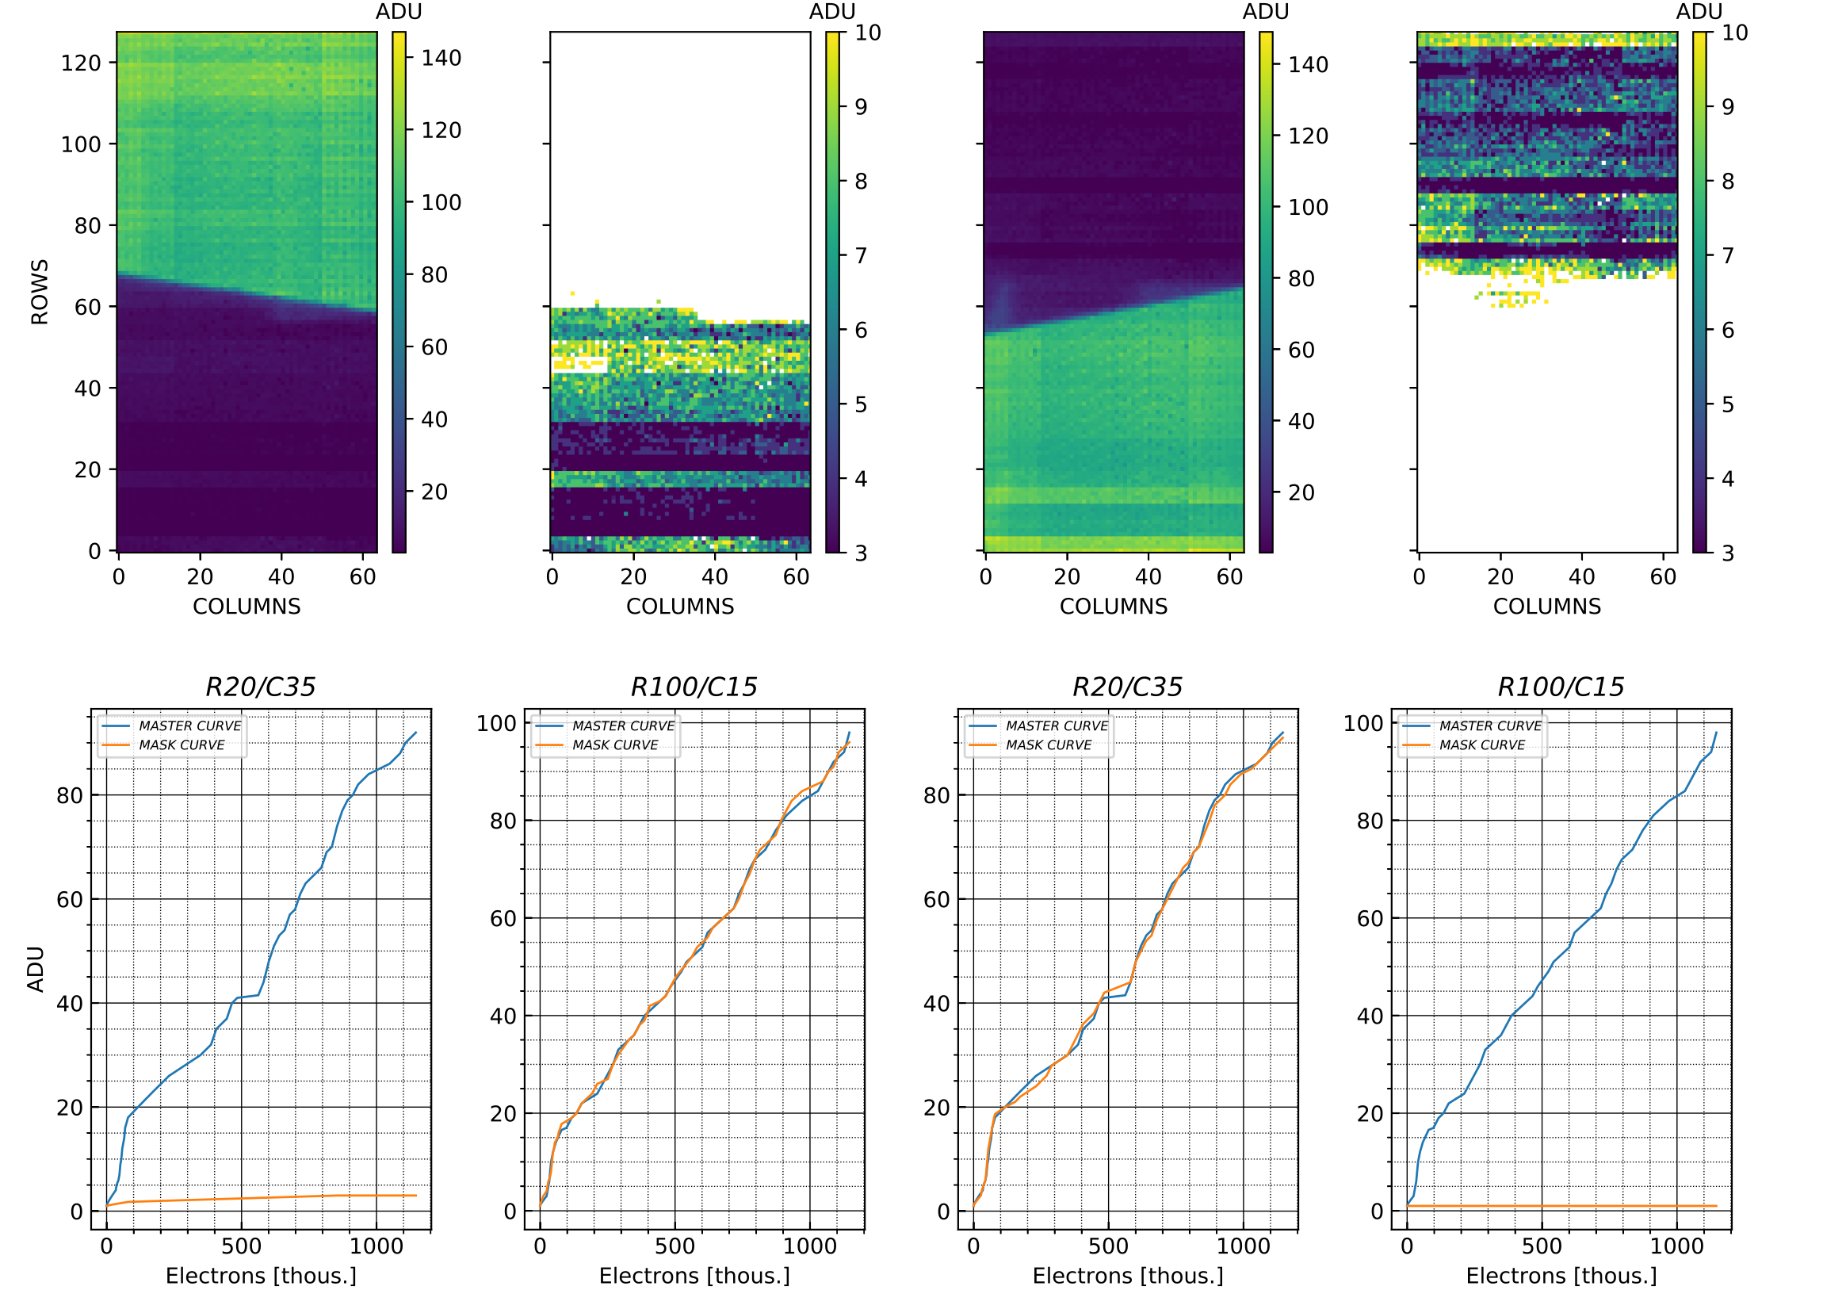
TUNGSTEN MASK TOP and BOTTOM
mind scale!
consequence of rolling shutter readout?
REFLECTION?
→ UNLIKELY
MASTER CURVE: standard LED charge scan without any obstruction to the matrix
tiny slope

Slide 4
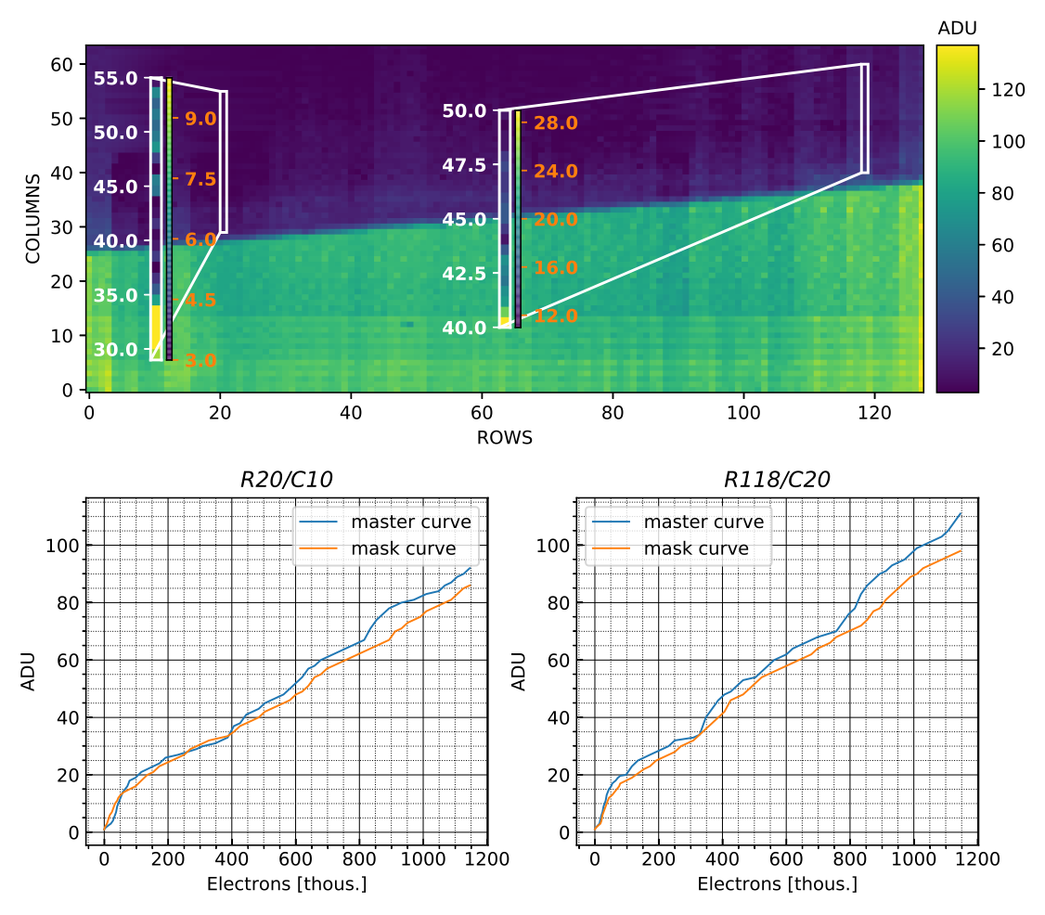
Ghost charge positive correlation with fraction of illuminated pixels?
the more charge (intensity + illuminated pixels) in an electrical row, the more ghost charge was observed

Slide 5
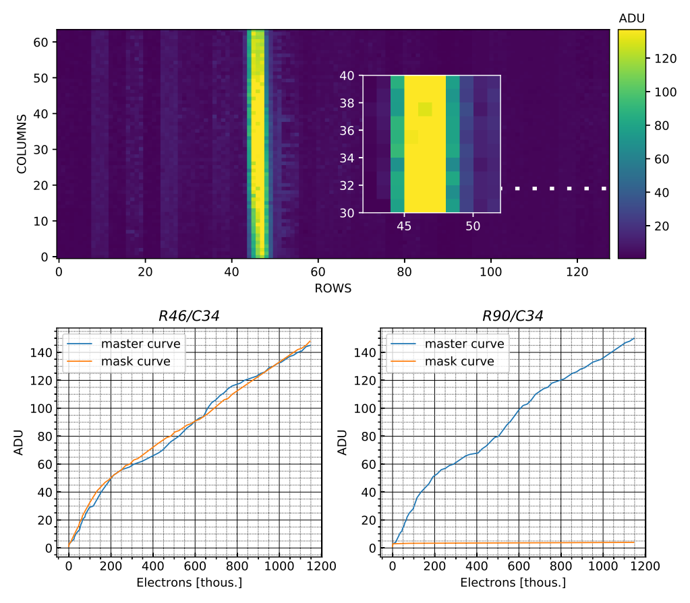
Mask slit for one electrical row
much "nicer" shape of slit charge curve
Possible Reason: no influence from other matrix rows?

Slide 6
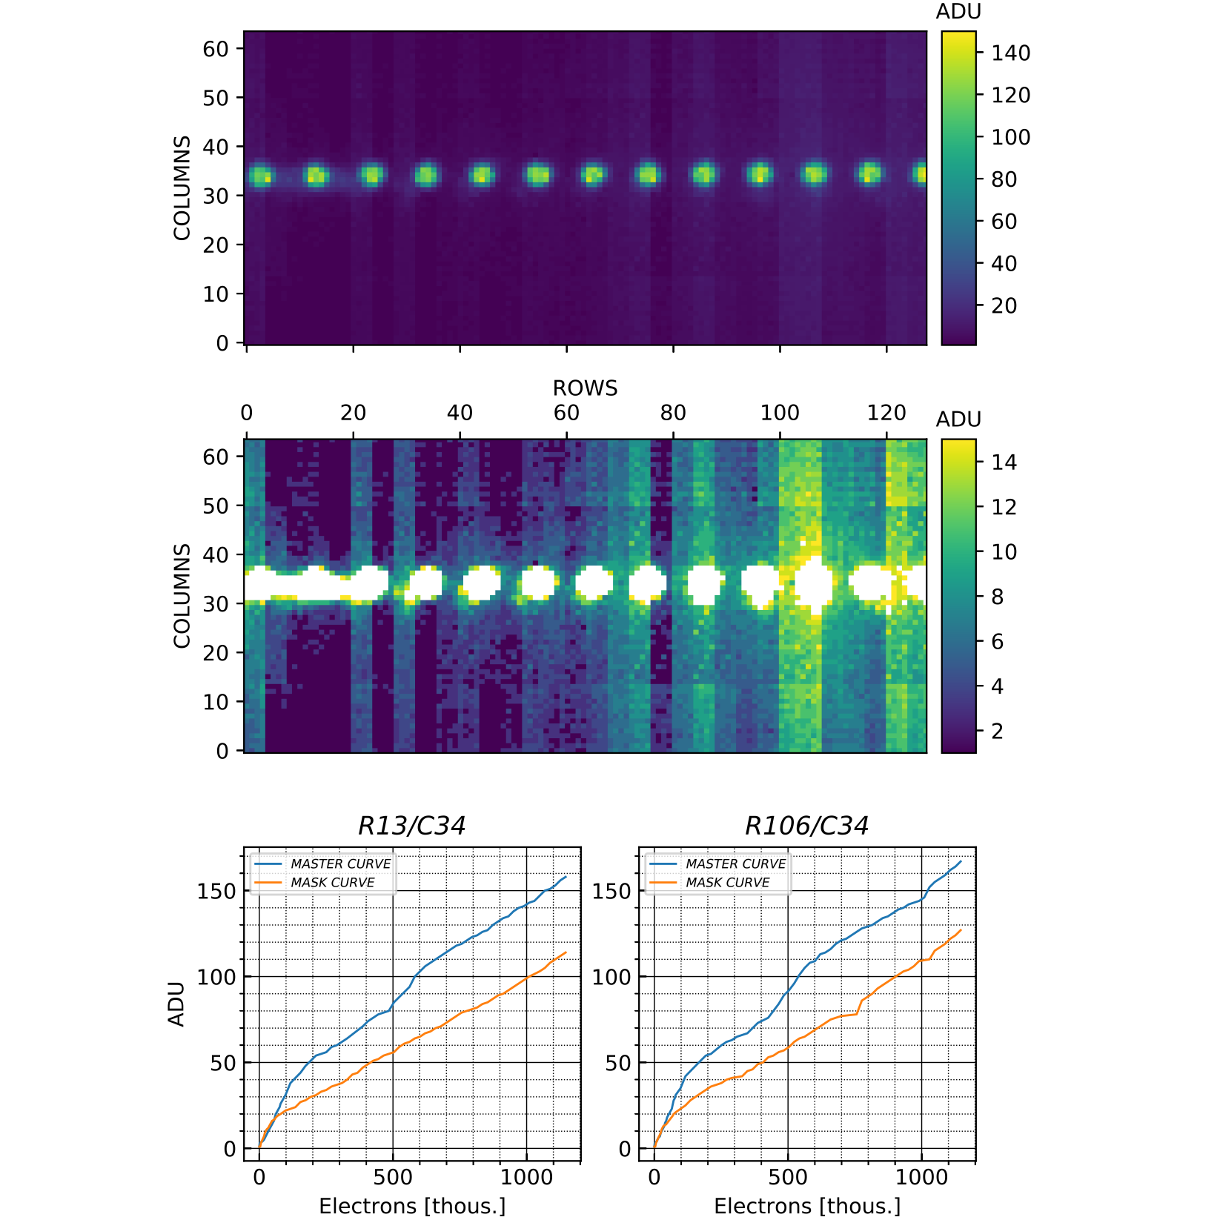
Mask holes
Amplitude of illuminated pixels significantly lower
Some rows show distinct ghost charge effect

Slide 7
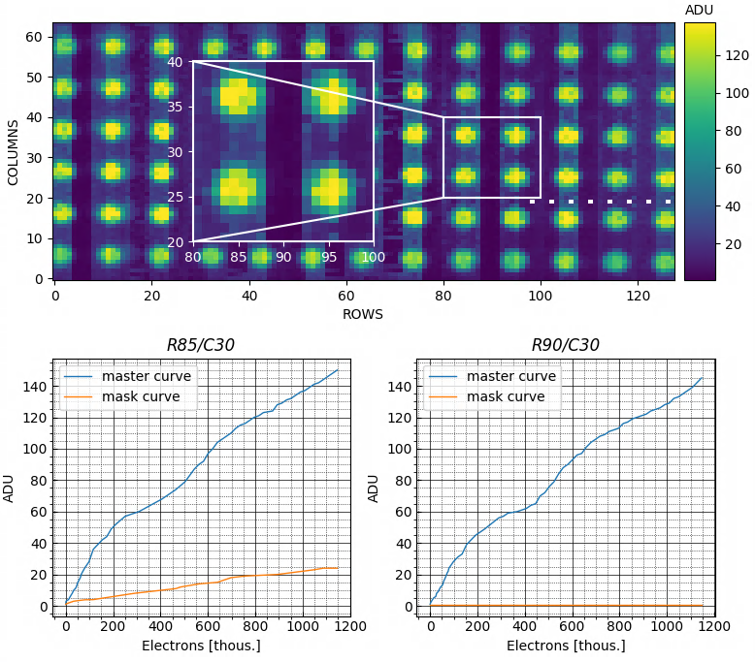
TUNGSTEN MASK WITH HOLE GRID
Why reflections in preferential direction (electrical line) and not in drainline direction?
Inset shows that electrical rows without any external charge contained zero or only small ghost charge signal

Slide 8
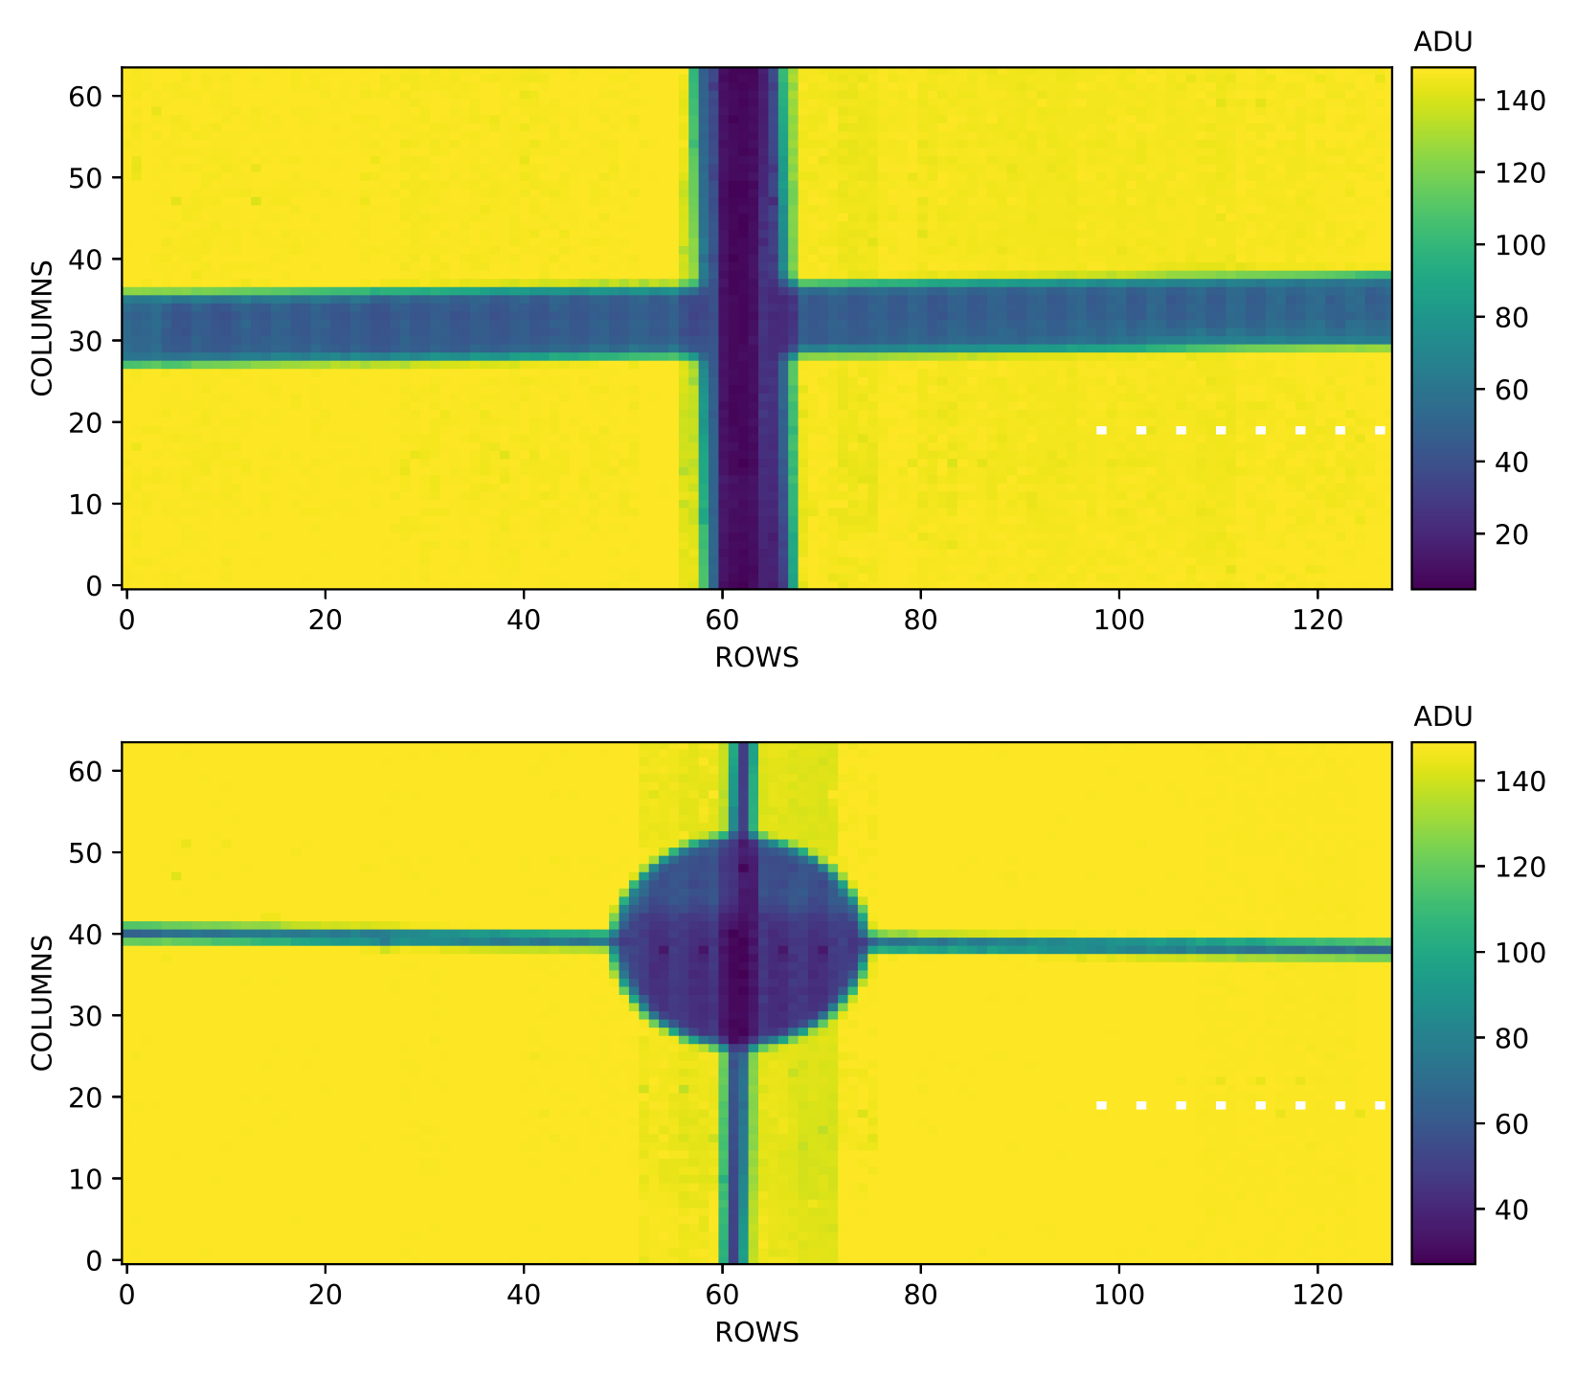
Cross and circle mask
Beam in drainline direction exhibits significant ghost charge
Mind the reduced signal charge level for rows partly covered by the circle

Slide 9
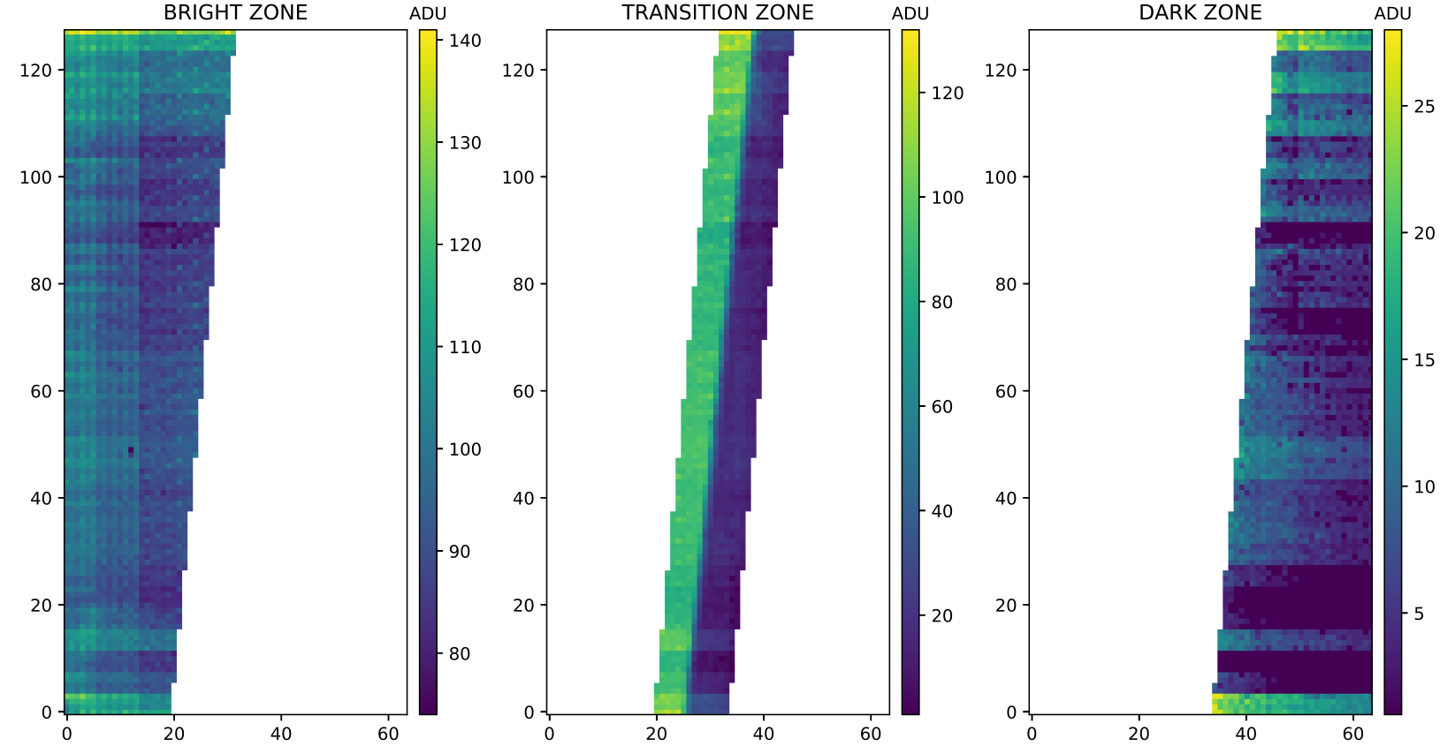
Ghost charge (I) positive correlation with illuminated pixels seems to be not clear

Slide 10
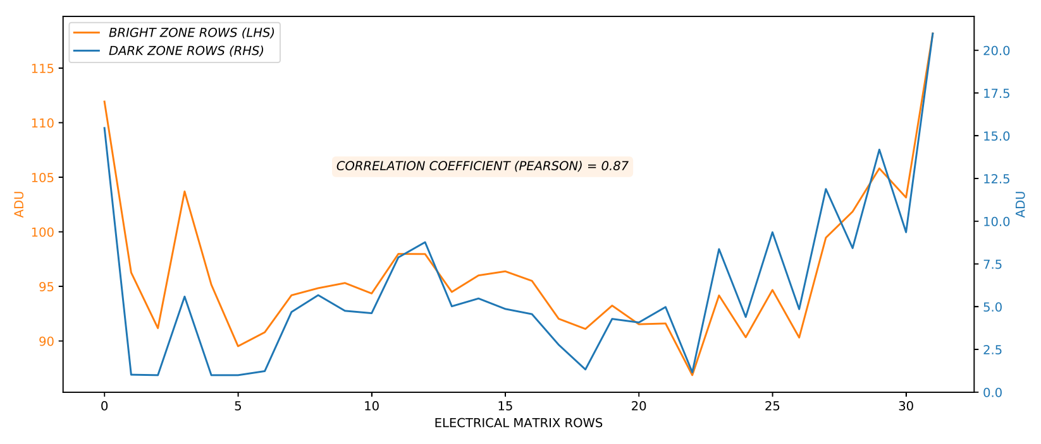
Ghost charge (II) positive correlation with illuminated Pixels seems to be not clear

Slide 11
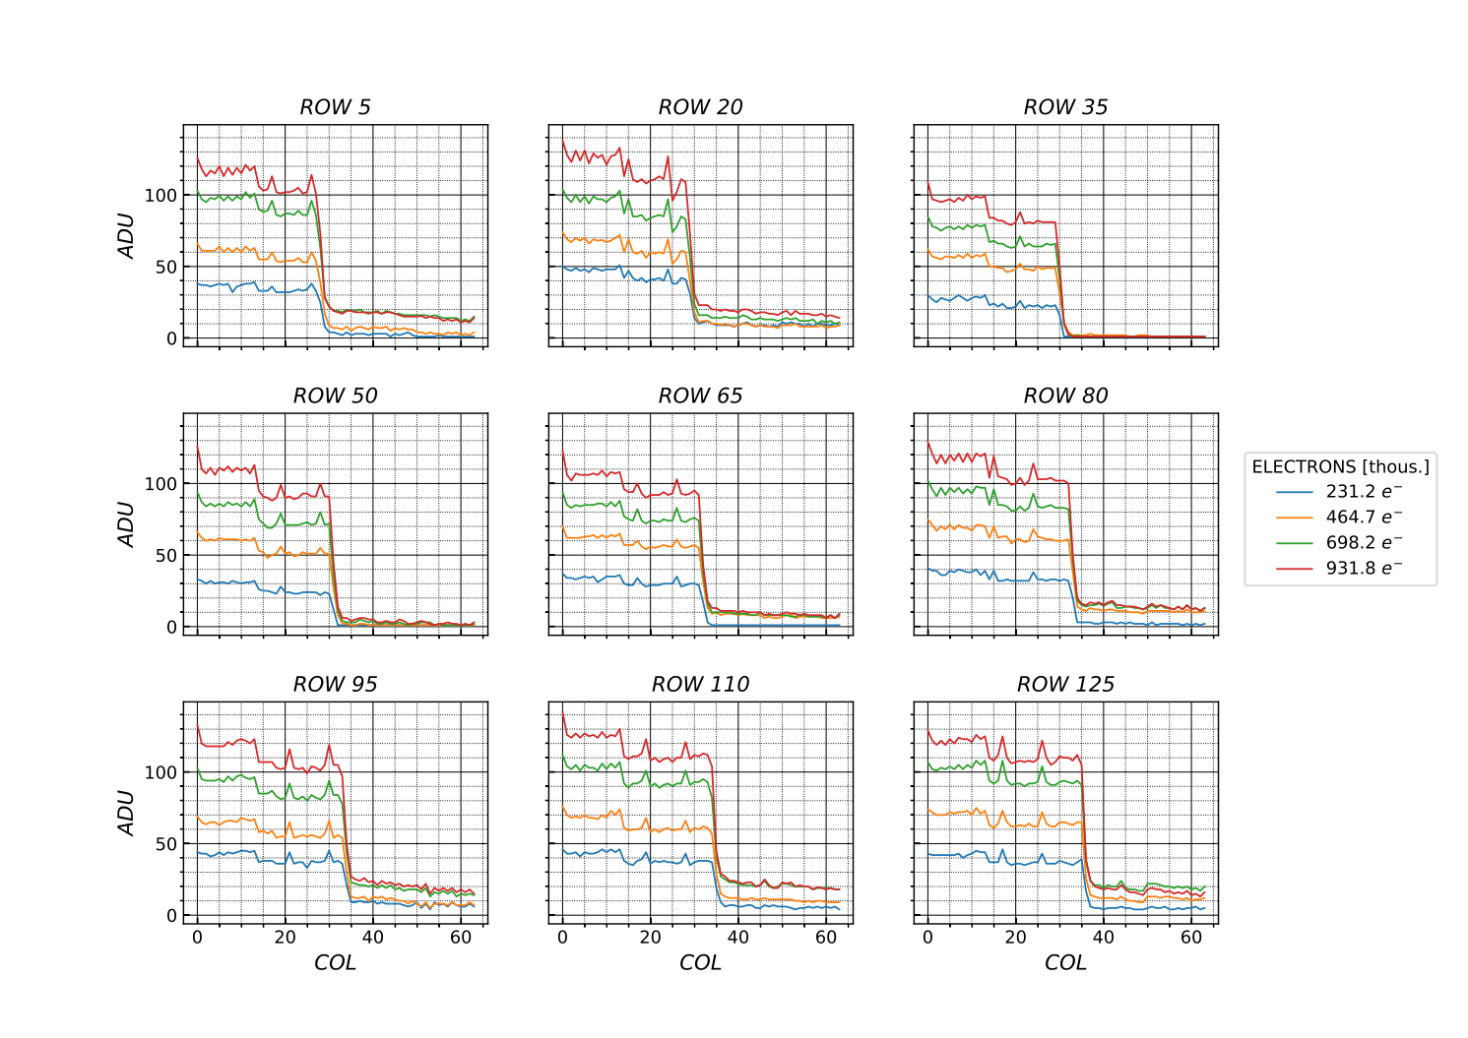
Selection of 9 pixel rows
4 different illumination intensities

Slide 12
Influence of system parameters
INCOMPLETE CLEAR
    increase clear low / clear high difference ("clear spread") from 15V to maximum permissible 20V → no effect on ghost charge level
    Double duration of clear pulse (from 4 to 8 out of a total of 32 clock cycles) → no effect
      MATRIX PARAMETERS
        adjustment of matrix voltages → no effect on ghost charge
      DCDE PARAMETERS
        go to maximum DAC for VTCSFN, VTCCASC (TIA current sources) → significant improvement

Slide 13
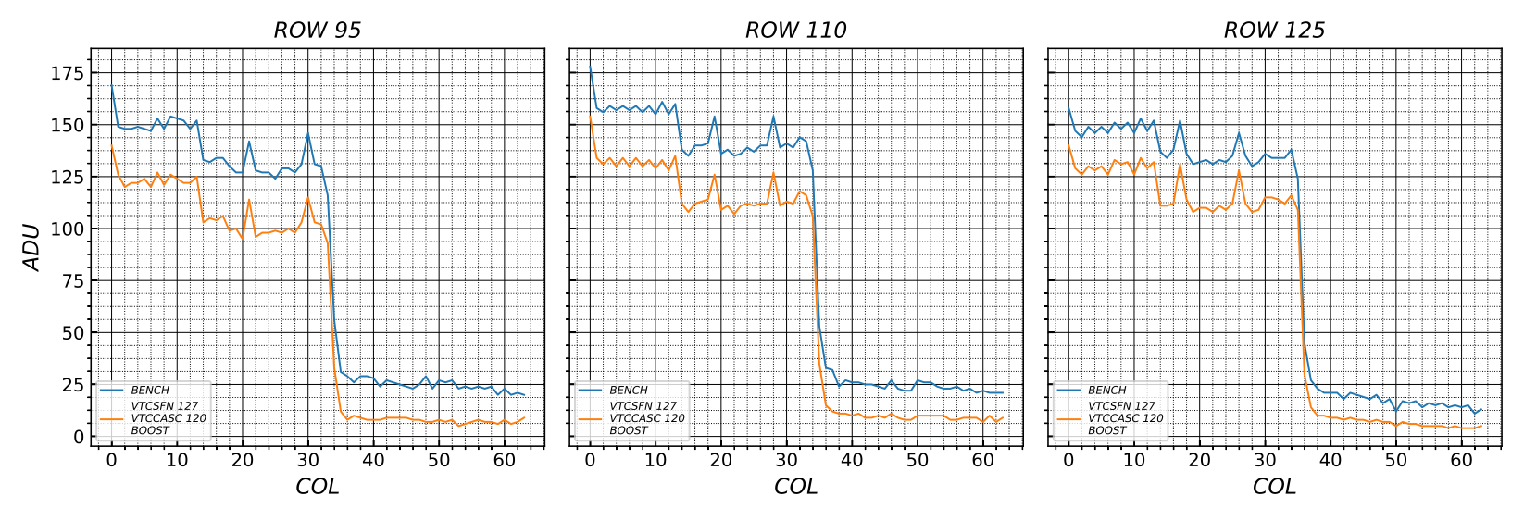
DCDE PARAMETERS VTCSFN/VTCCASC
DAC from 60 → 127/120

Slide 14
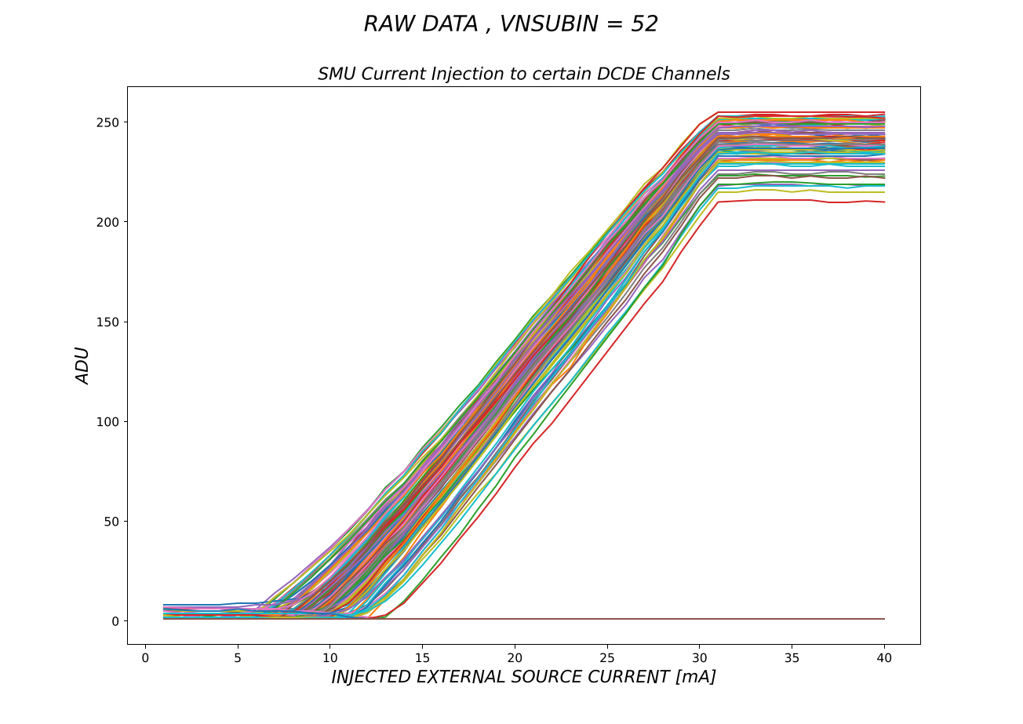
Suspicion: dcde responsibility?
Isolated generation of effect
for all channels:
2-bit DAC: 3
IPDAC: 15
128 channels connected
SMU: 40mA
Investigation of parameter dependence

Slide 15
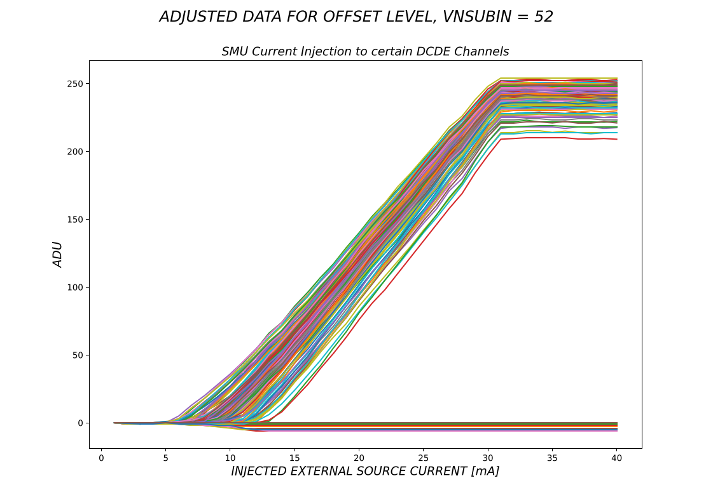

Slide 16
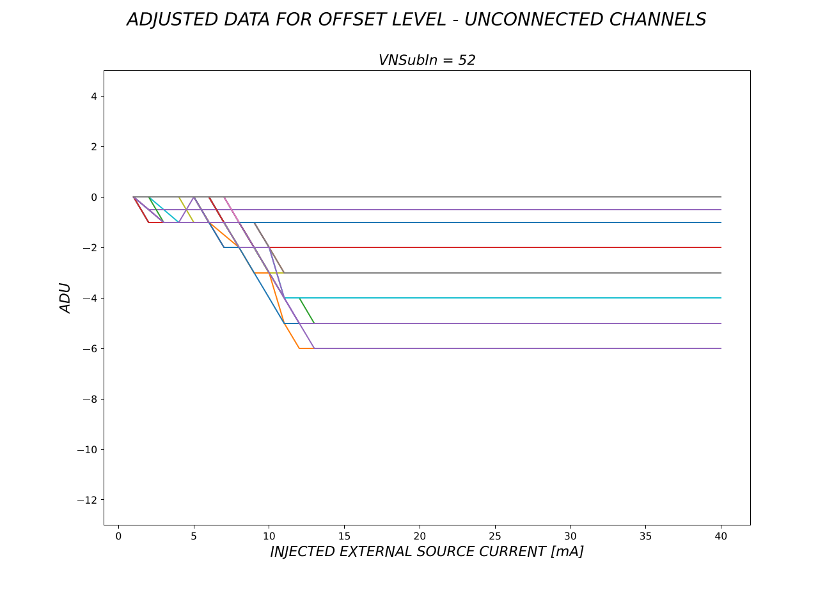
for most of unconnected channels no change
some channels move to negative ADU values with higher currents in neighboring channels

Slide 17
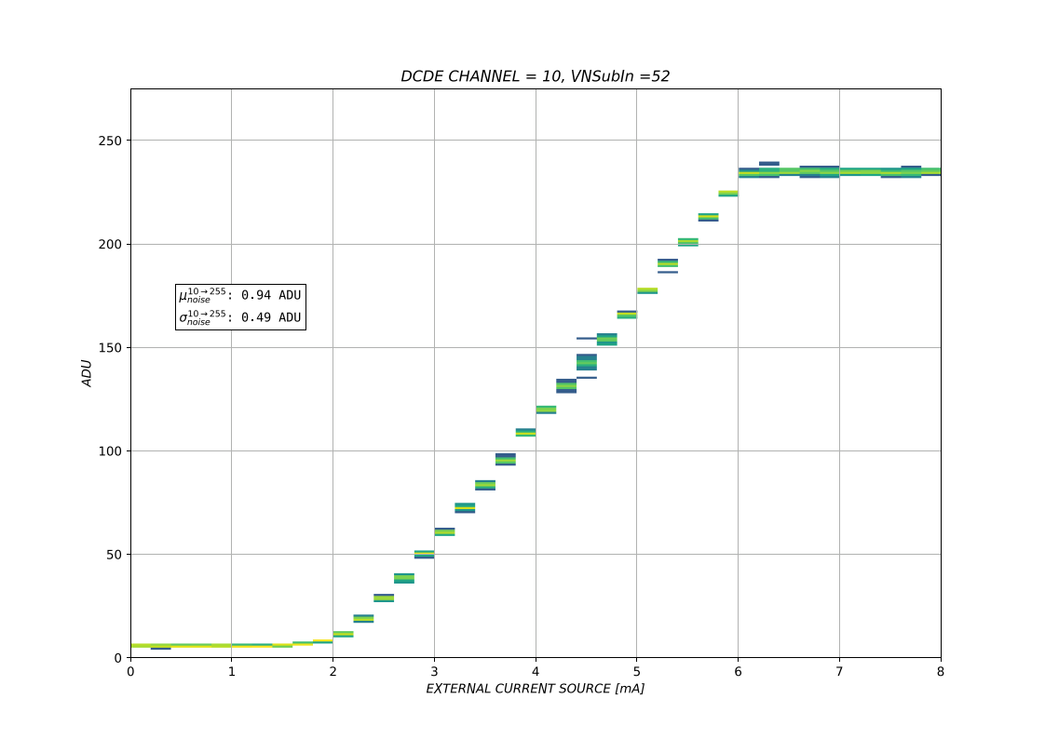

Slide 18
