Slide 1
EDET SENSOR CALIBRATION
Semiconductor Laboratory of the Max Planck Society
Eduard Prinker

Slide 2
Problem: pixel-to-pixel gain variations main reason: variations in manufacturing process
focused laser spot ($∅<10µm)$ scan by 3 µm motorstage steps + recording only largest ADU values exhibit quite different same charge responses per pixel (EDET double pixel structure exemplarily marked by a black rectangle: every second pixel row (vertical direction) is pervaded by a drift line rounding down the collected charge at the corners)

Slide 3
Pixel gain dispersion typical for all Si-detectors Conventional linear calibration
Ideally, after interposing a specific calibration algorithm, each pixel reacts in an equal way, if exposed to an equal external stimulus → monochromatic radiation or radioactive source: e.g. BELLE detector
different pixel gains, different peaks
linear extrapolation
"absolute" calibration
¹⁰⁹Cd source
#
ADU
22keV peak ~ $6,000 e^{−}$

Slide 4
Nonlinear response curve of an edet pixel
internal gate region $\sim \frac{280pA}{e^{−}}amplification$
overflow region $\sim \frac{70pA}{e^{−}} amplification$
influencing electrons only partly in the drain/source channel
200 keV TEM electron
→ ~${7,000 e}^{−}$ @ 30µm thickness
→ ~$15,400 e^{−}$@ 50 µm thickness
SIGNAL COMPRESSION: high contrast images combining high energy resolution for areas obtaining only low signal charge

Slide 5
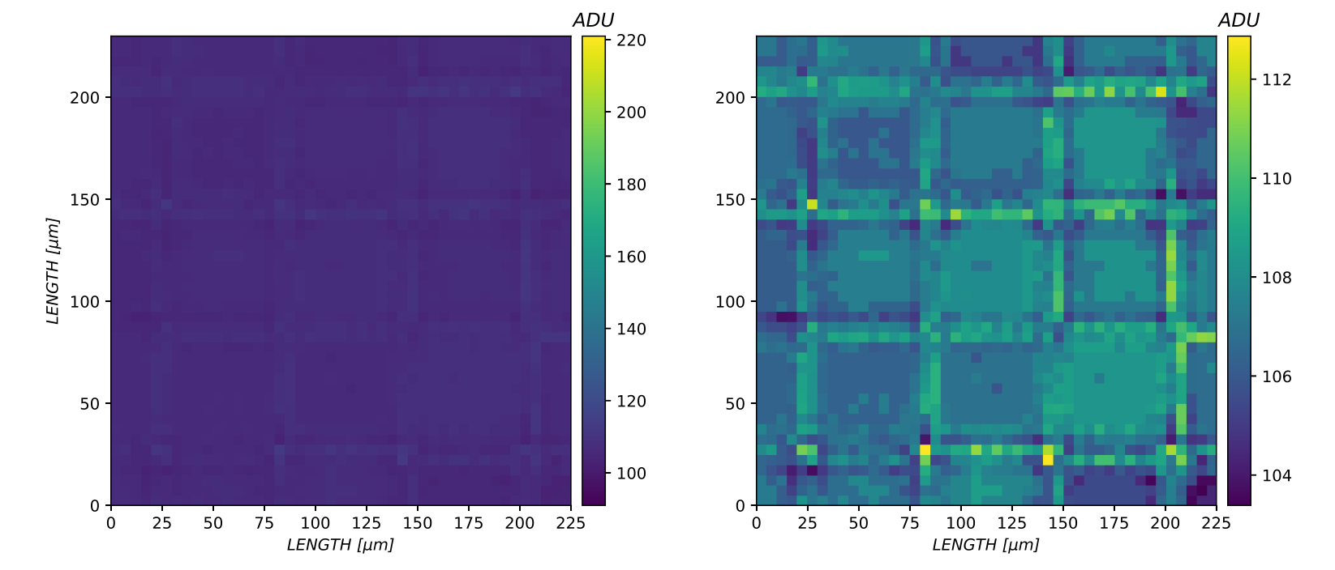
Nonlinear pixel response intensification of the calibration problem at pixel borders and edges
If laser hits a corner of 4 empty pixels, the charge is first collected in the internal gate region with a much higher amplification

Slide 6
Several methods with pros & cons
INSTRUMENT/METHOD | PROS | CONS
Radioactive sources | deliver exact, characteristic energy levels for an absolute calibration acceptable photon interaction probability capability to calibrate all pixels at once auxiliary tool for cross-calibration of other methods | radiation damage can only calibrate one point on the pixel’s charge curve at a comparably low level complex spectra (could be mitigated by monochromators)
X-ray (high energy) | scalable intensity device depending flat field | very low photoabsorption probability dominated by the Compton effect accessibility (synchrotron radiation sources)
$β^{−}$-emitter | similarity to a TEM beam no vacuum apparatus necessary | radiation damage continuous spectrum most of the electrons would leave the detector, so the escape energy has to be measured (scintillator)
$α$-emitter |  | severe radiation damage energy level too high vacuum device and corresponding interconnection hardware necessary
TEM | gradual increase of both, intensity (in 10eV steps up to 300keV) and quantity (focusing/defocusing) → build complete charge curves | vacuum device and corresponding interconnection hardware necessary Poisson noise (shot noise) due to fluctuations of emitted TEM electrons → precise intensity measurements necessary
Laser | no radiation damage intensity controllable via applied voltage and/or time (pulse width & frequency) full control of individual pixels | total energy transfer unknown (quantum efficiency) only cell-by-cell calibration lack of absolute calibration
LED | no radiation damage controllable intensity (by frequency or LED current) simultaneous calibration of all pixels possible | total energy transfer unknown (quantum efficiency) lack of absolute calibration
CLEAR backemission | simultaneous calibration of all pixels | level of original backemission not known finding optimal operation point for all pixels (process variations)

Slide 7
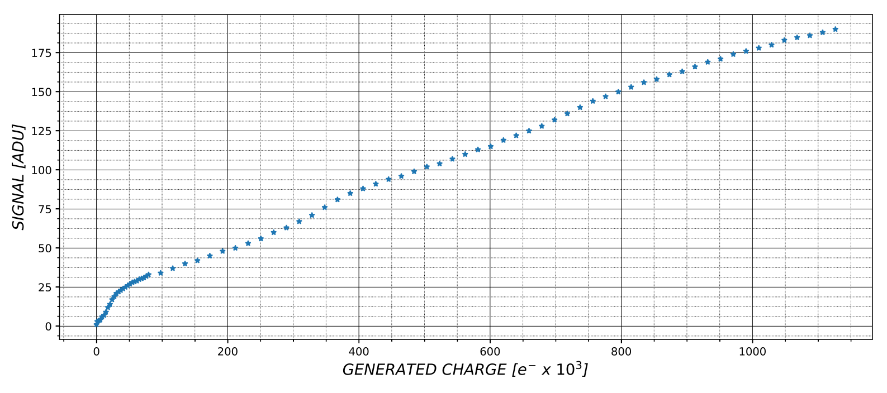
Selected method: radioactive source for basic led intensity calibration + scan
LED conditions:
Linerarity
Stability
Reproducibility
Homogeneity (flat field)

Slide 8
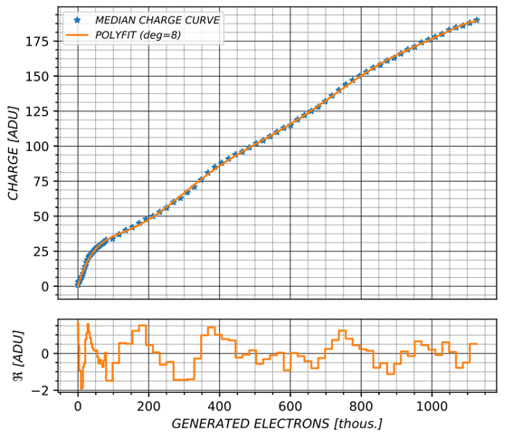
Led scan simultaneously for all pixels polynomial fit
every pixel ADU value corresponds to a certain electron reference value

Slide 9
Whole sensor calibration

Slide 10
EDET DETECTOR calibration – Suggestions
In-Situ?
Vacuum
TEM or LED?
Sloped Housing: diffusion glas?
Repetitions?
Radiation damage / Annealing: BELLE experience?
Shift offset level or change in individual pixel gain parameters
Alternative Proposals?

