Slide 1
Summary of the
Valencia Meeting and Some Recent News
Valencia meeting and thereafter
New Date for SuperKEKB Startup
Radiation Tests in Sevilla (just a slide show)

Slide 2
Sessions in Valencia
ASIC Design and Test Results (Hans Krüger)
Test Systems (Jelena Ninkovic)
DEPFET and Pixel Cells (Rainer Richter)
Tracking and Performance (Christian Kiesling)
Interconnections / Modules / DHH (Hans-Günther Moser)
Mechanics and Cooling (Hans-Jürgen Simonis)
Data Acquisition (Sören Lange)
Test Beams (Marcel Vos)
Wrap Up Session (Hans-Günther Moser)

Slide 3
ASICs
Switcher B: irradiated with 25 Mrad, working @ 80 ns row time (reference manual exists on TWIKI) next revision with decoupling cap. Etc.
DCD-B: Production finished, bump bond process working
test environment exists
power consumption as expected
JTAG interface working digital conversion and serialization working (4-5 bit !)
maximum operation speed limited to 300 ns/row
DHP: Under test, many things working, e.g. LVDS input,
HSTL-like input (from DCD), memory read/write etc. to do: DCD communication and synchronization,
more high speed testing need to develop final processing algorithm
(simulated data needed)

Slide 4
Sensors
Front side processing finished First tests with probe station on wafer level:
rather low yield: 80% for small matrices, but 1/16 of large ones (several reasons suspected, e.g. damage during outside procs.)
up to now only coarse measurements for first overview more details in the coming weeks.
future: all implantations will be done in-house.
Thin oxides:
DEPFET-like structures irradiated in Karlsruhe (~ 3 Mrad)
expectations largely confirmed: threshold shifts < 2.5 V
some details in threshold shifts a function of nitride thickness
need to be understood.

Slide 5
Interconnections and DHH
Bump bonding: DCD-B and DHP delivered with bumps, Switcher B: solder bumps plced in-hose (new machine in HD) PacTec machine delivered, first balls placed successfully Kapton Flex: need to cover 12-15 m between module and DHH (combination of Kapton and TWP, connected by passive PP) first Kapton samples delivered to Bonn time-domain-reflectometry in progress DHH: First conceptual design exists (I. Konorow, TUM)
functions: optical data transfer, trigger processing, DAQ, power, control modularized in DHH controller and DHH modules timing & clocks derived from machine RF, under discussion

Slide 6
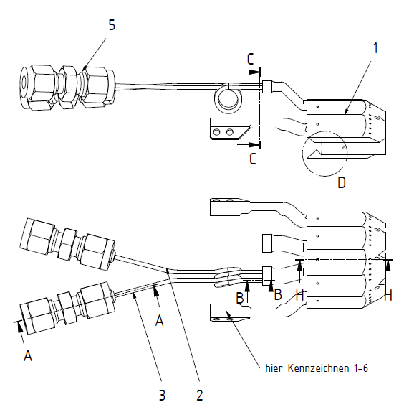
Cooling and Mechanics
Mechanical Design: New design exists, relies on CO2 cooling additional channels for air cooling (C rods) in beween layers
first real-size module in stainless steels, with CO2 cooling and
air channels delivered
Preparations for pressure tests (120 Bar) underway some problems drilling threads (M1 screws)
Connections ready for delivery to Karlsruhe / Valencia within ~ 2 weeks good progress on cold box (Valencia)

Slide 7
Interface to Belle
Power Supplies:
tests on voltage regulators over long lines promising (LMU), overshoots are acceptable PS design by SdC exists (cannot continue in 2011) Service route: possible service routes and locations for PP under study (KEK) routing critically depends on SVD design (slanted or not. this is not fixed yet) Slow Control / Database: 10-year experience with (minimal) slow control system in Belle PXD will have much more data to monitor (slow and fast) sizeable database necessary (relational DB mandatory) LMU shows interest in slow control Z. Dolezal (Prague) volunteered as slow control/database coordinator

Slide 8
Data Acquisition
Giessen group is funded by BMBF -> green light for ATCA solution
New group (IHEP Beijing, Prof. Zhen‘An Liu) has joined our collaboration, will contribute the ATCA / CN hardware for the DAQ The new Bonn group (Jochen Dingfelder) will build the „SVD concentrator“, providing SVD information directly to the IHEP/Giessen box
Decision strategy on the various options (ATCA or PC):
„Baseline“ requirement: ROI selection and minimal event building with 30 kHz
delivery date next spring if ATCA system meets the Baseline, it will be taken.

Slide 9
Test Beam
Very successful model description of DEPFET signal by the Göttingen group concerning signals from 2009 test beams
will be used in the digitizer for the BASF2 simulation framework
Discussions on test beam paper converging
New rules laid out for future DEPFET publications.
Plans for test beams in 2010/11: slot during B2GM, to be tested: thin DEPFET mini matrices
with full speed readout June 2011 (?): large matrices
Condition: TB should not bind manpower needed for the production and
test of the PXD6 prototypes and electronics

Slide 10
Tracking and Performance
Further improvements of the DEPFET digitizer (Göttingen) Tools for background admixtures implemented in ILC soltware frame
Tools for ganged pixel rows implemented First look into large occupancies of the PXD with realistic QED patterns
Strong push to get PXD and SVD into BASF2 frame (Prague group) Prague also works on integrating the most recent digitizer into the new BASF2 frame.
Tracking software to be used is GENFIT, low momentum tracking studied by Vienna group
Background studies will be carried out in the new BASF2 framework

Slide 11
Conclusion
Very good progress on the electronics side:
the three ASICs basically work
still some issue on the speed of the DCD (but reason known),
needs a resubmission soon
Good progress on the production of the DEPFETs
however, some yield problems discovered, reasons under investigation
Good progress on mechanics/cooling: First real-size structure
manufactured, now under preparation for pressure tests
New DEPFET collaborators funded by BMBF, especially Giessen
Serious issue:
Injection scheme of the machine, causing ~ 20 % deadtime,
no remedy possible from the DEPFET side

Slide 12
Injection Scheme of SuperKEKB
2 bunches, 50 Hz
mask noisy bunches: PXD deadtime = 20%
100 turns
Injected bunches
100 ns apart
= 1 ms
revolution time
= 10 µs
4 ms
„noisy“ bunches
pixel row
Problem for DEPFET:
noisy bunches cannot be
gated away
20 µs
time

Slide 13
Does a Faster DEPFET Readout Help?
2-fold ganging will not help
here: 4-fold ganging -> 5 µs R/O
„dirty“ rows
pixel row
„clean“ rows
„empty“ for FC (data
overwritten)
No FC
time
5 µs
Fast Clear (FC)
Events are always „dirty“ (= useless),
50% „empty“ with FC (=almost useless)
Trigger 1
(„clean“ for FC)
Trigger 2
(„empty“ for FC)

Slide 14
New Date for Startup of SuperKEKB
Email from Yutaka Ushiroda, Technical Coordinator of Belle II:
I've made the following proposal to the EB on the schedule of detector construction and commissioning, and haven't received any objections by now.
I therefore ask you to update the schedule of your detector
construction based on the new scenario.
Namely, you must build your detector ready (well tested) and installed in the Belle II by the time machine people start
main ring commissioning. However, the global cosmic ray DAQ can be done during the main ring commissioning (not
earlier than that). Here I assume the main ring commissioning will not start earlier than October 1st, 2014. So, our construction/installation schedule should target September 30th, 2014.

Slide 15
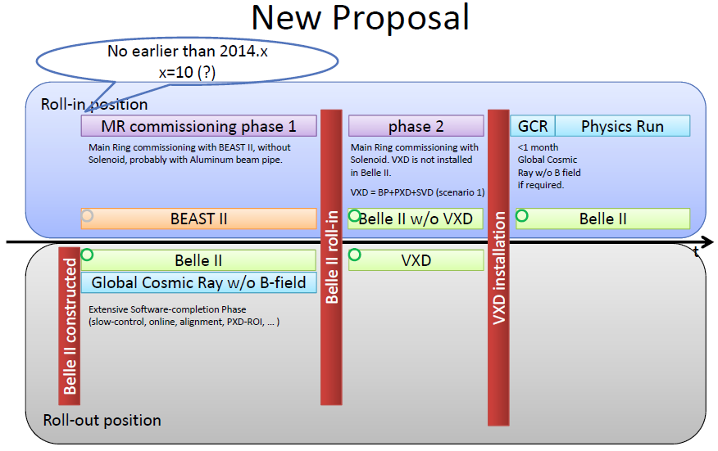

Slide 16
Irradiation of Optical Fibers in Sevilla
Date of irradiations: Oct. 4-8, 2010

Slide 17
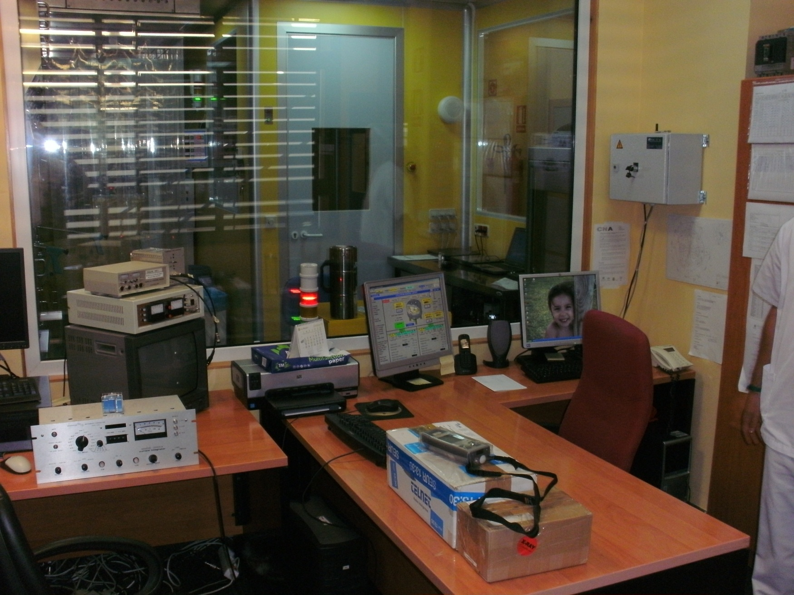
The cyclotron operation stand – controlled area

Slide 18
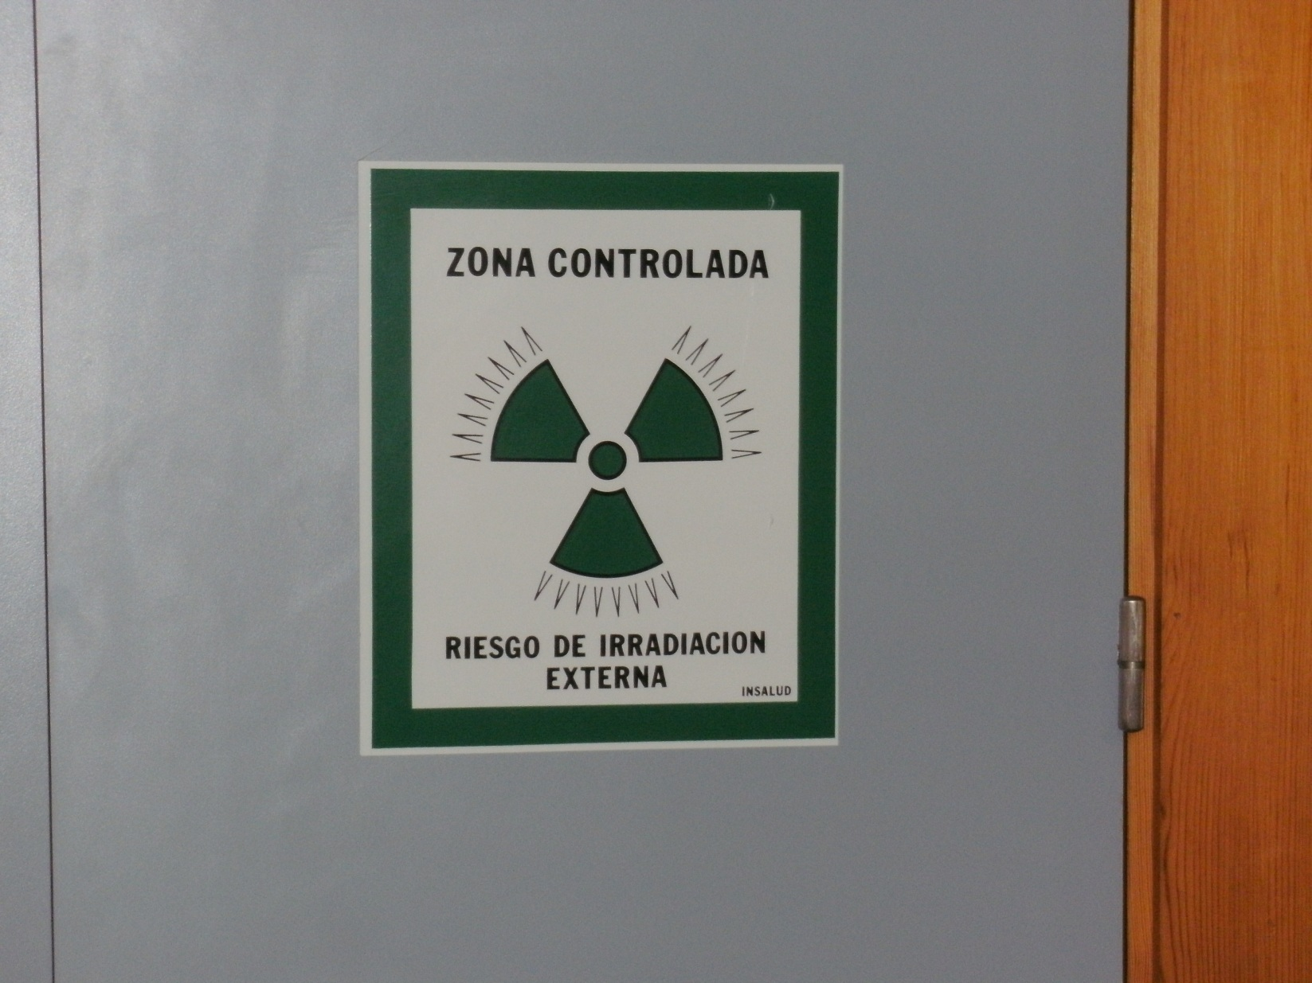

Slide 19
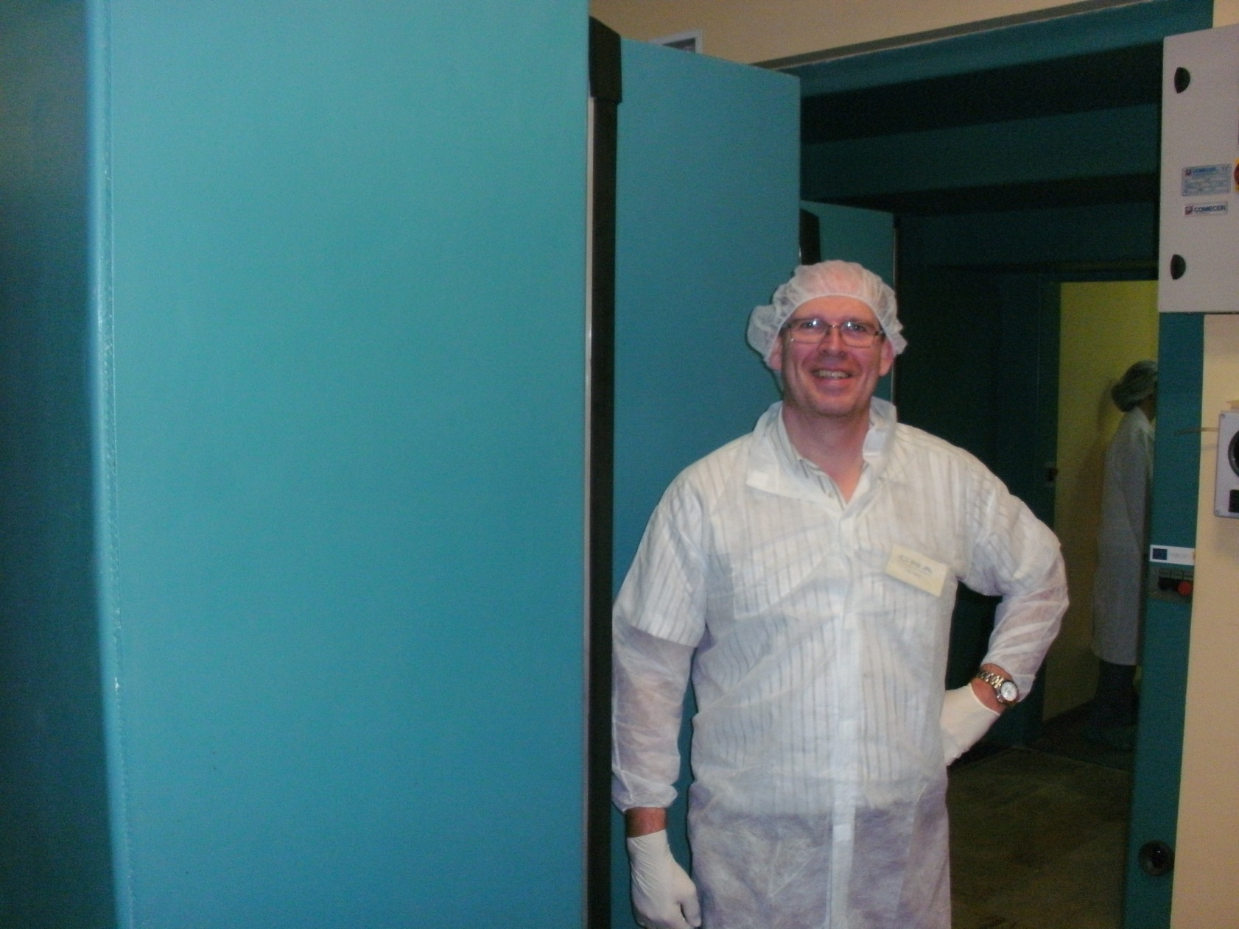
This is Malte from Madrid

Slide 20
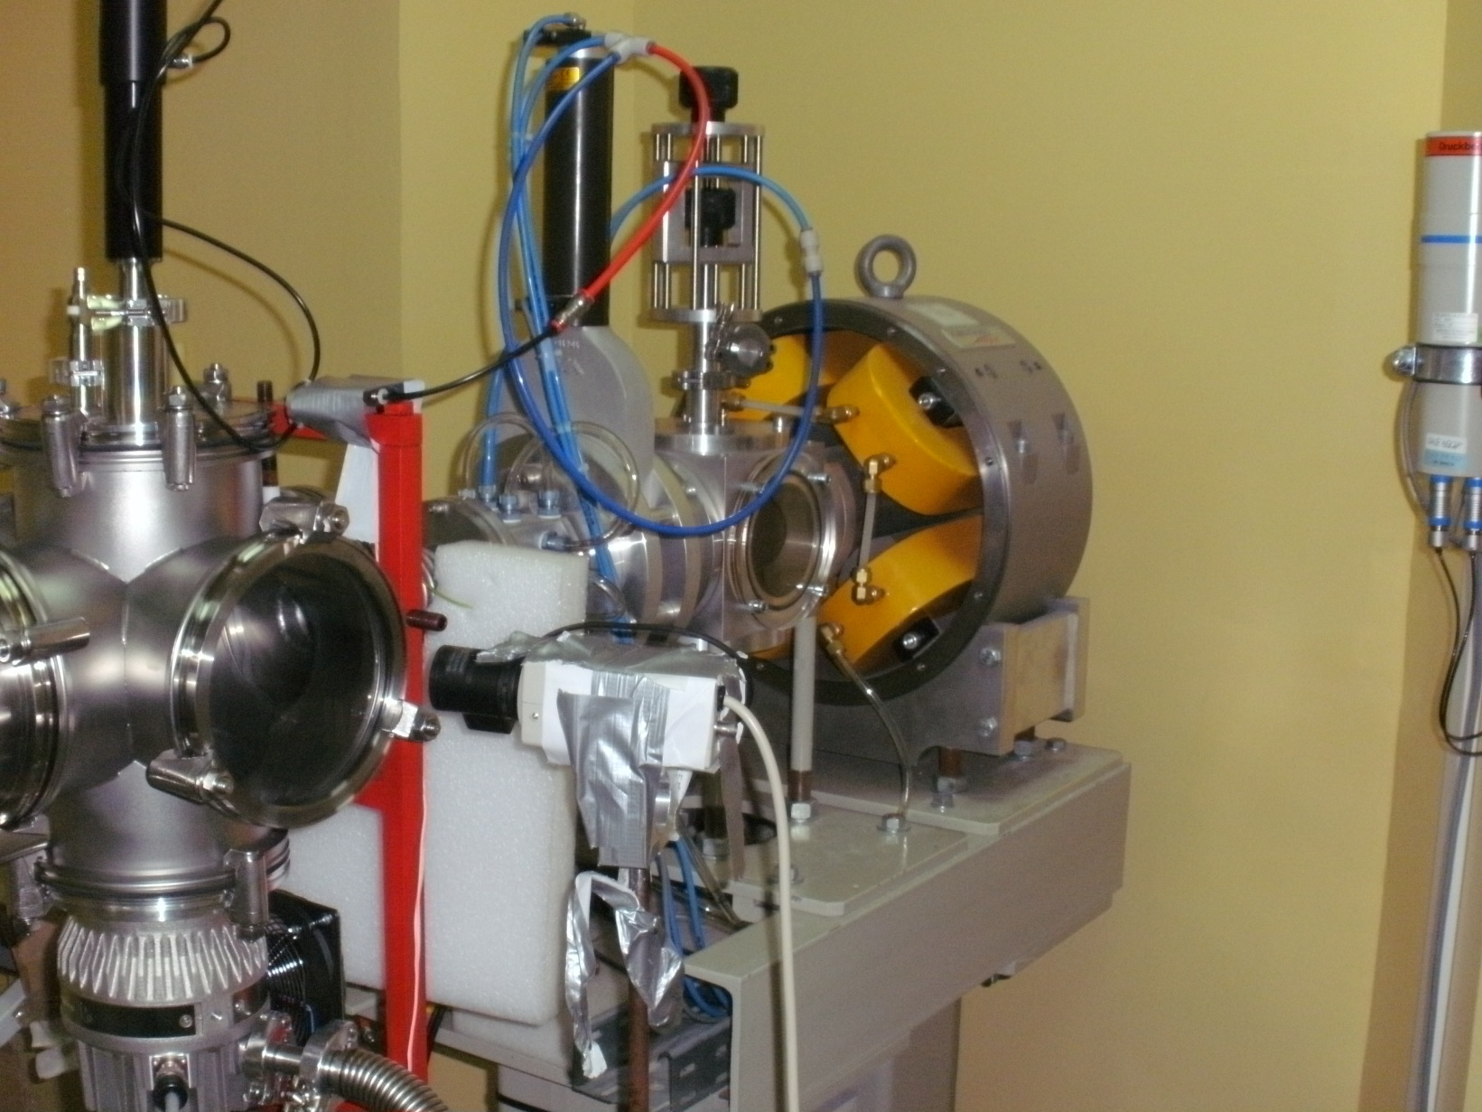
The beamline

Slide 21
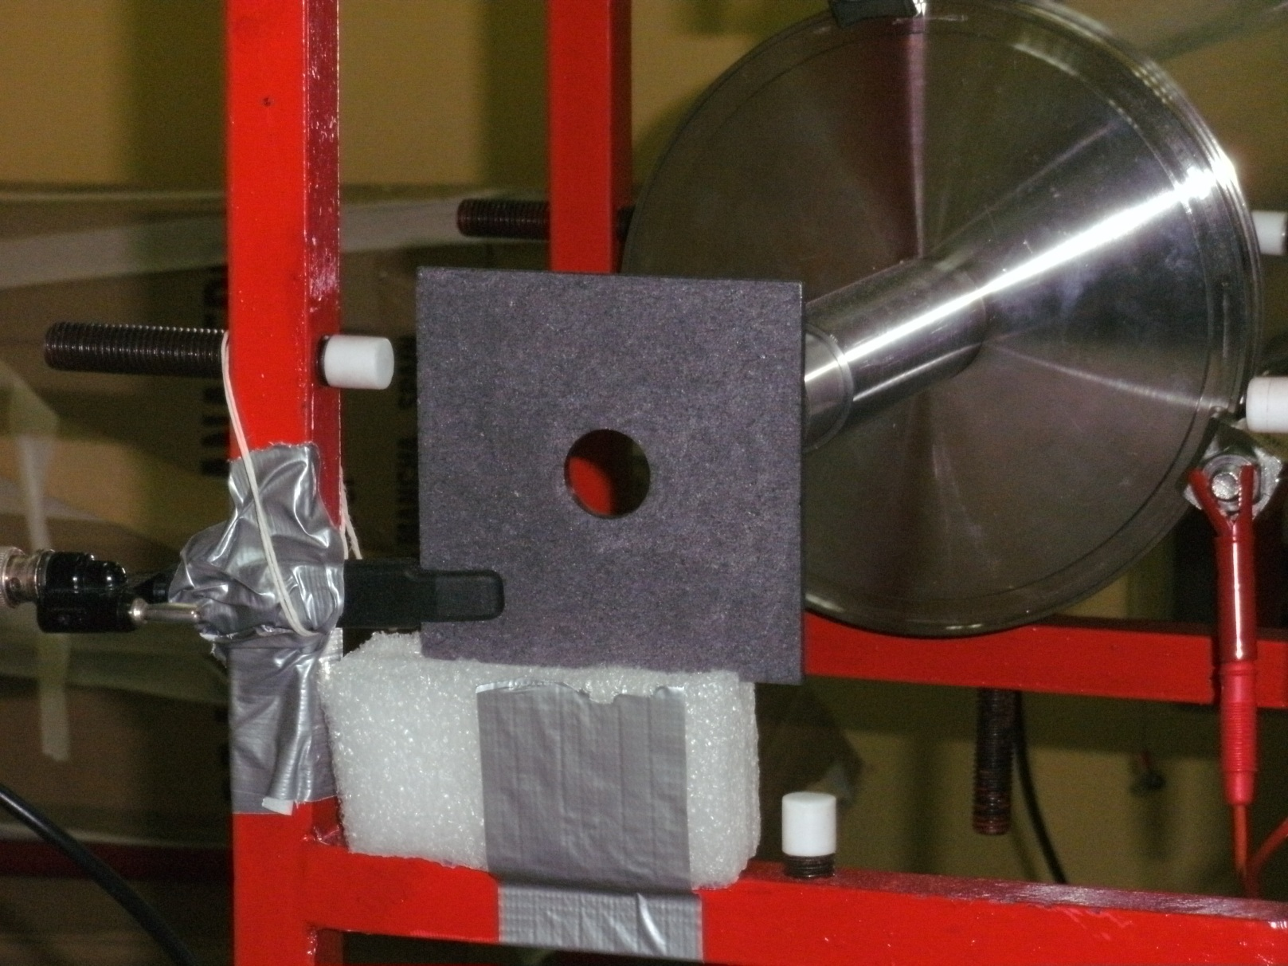
The beam pipe and exit counter

Slide 22
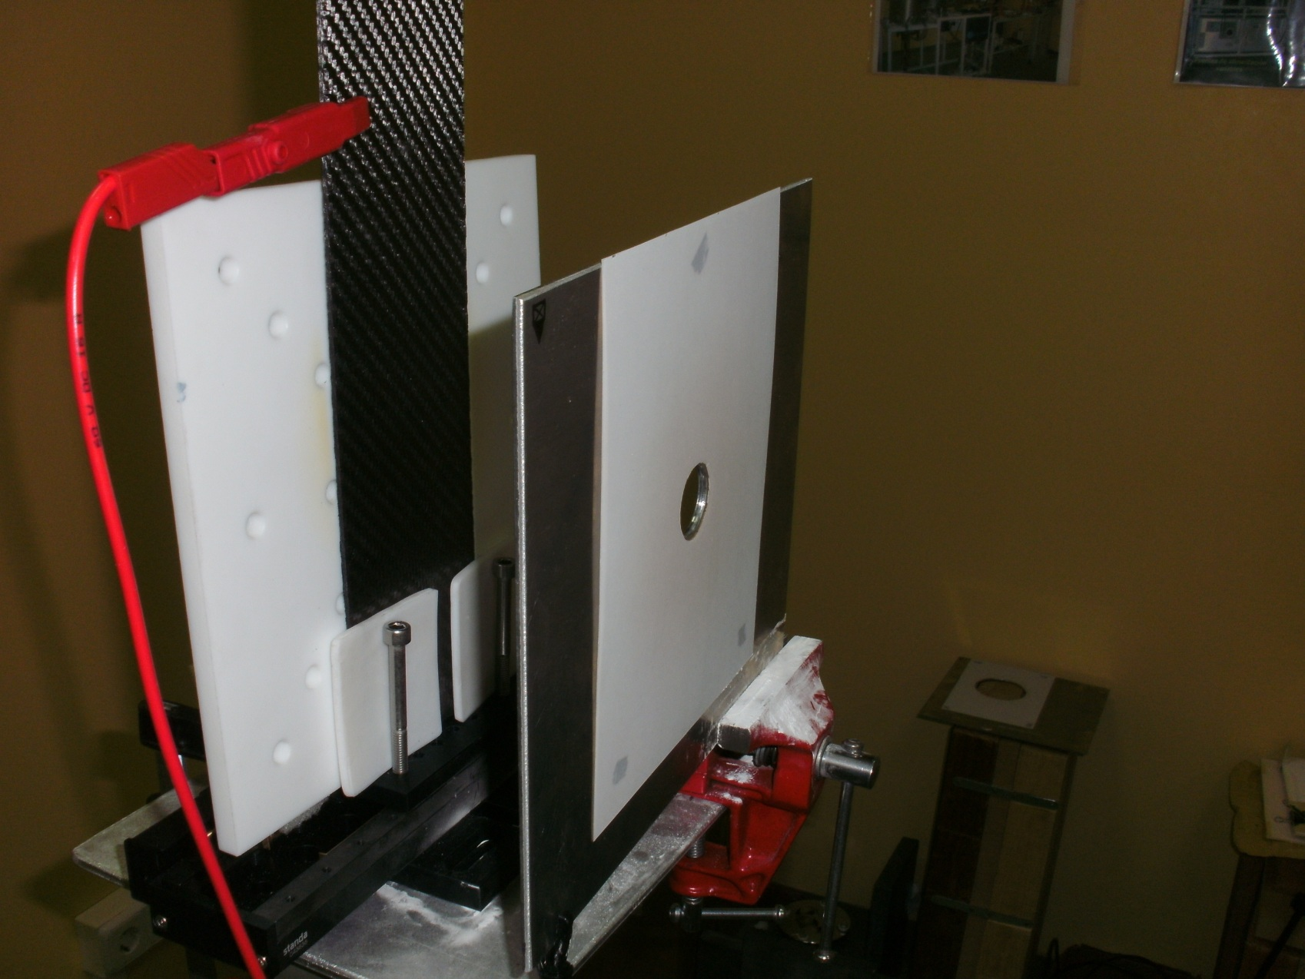
Target area

Slide 23
Adjusting the target on the beamline: Javier

Slide 24
The fiber setup

Slide 25
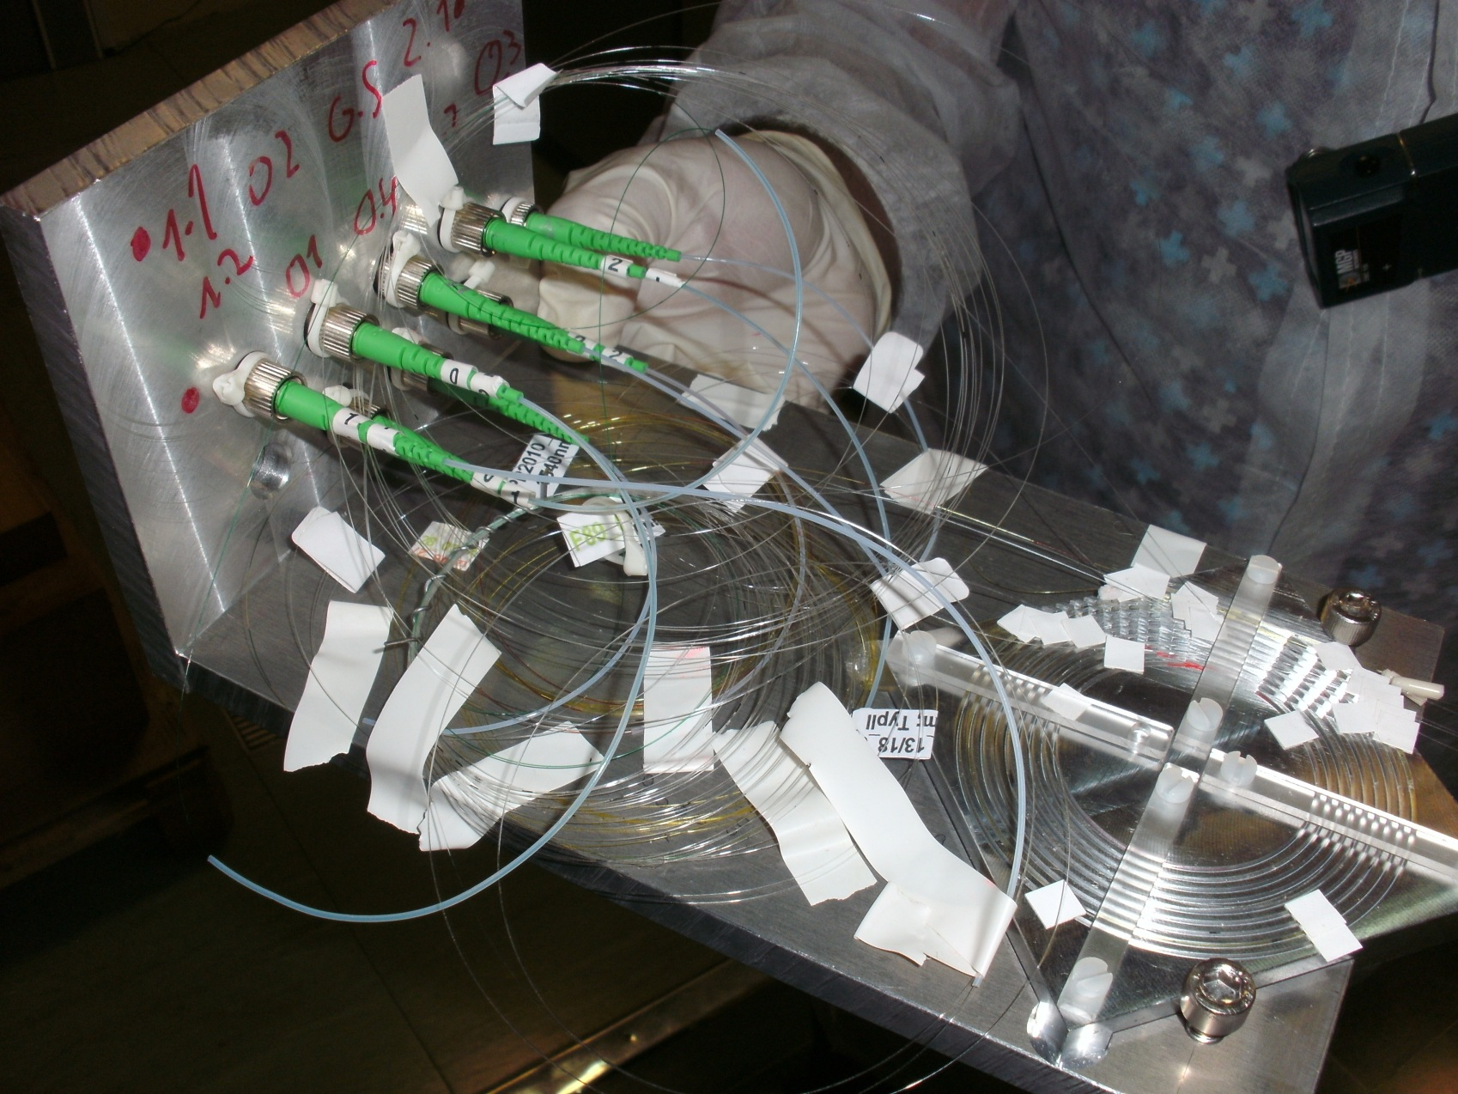
The fiber setup - closeup

Slide 26
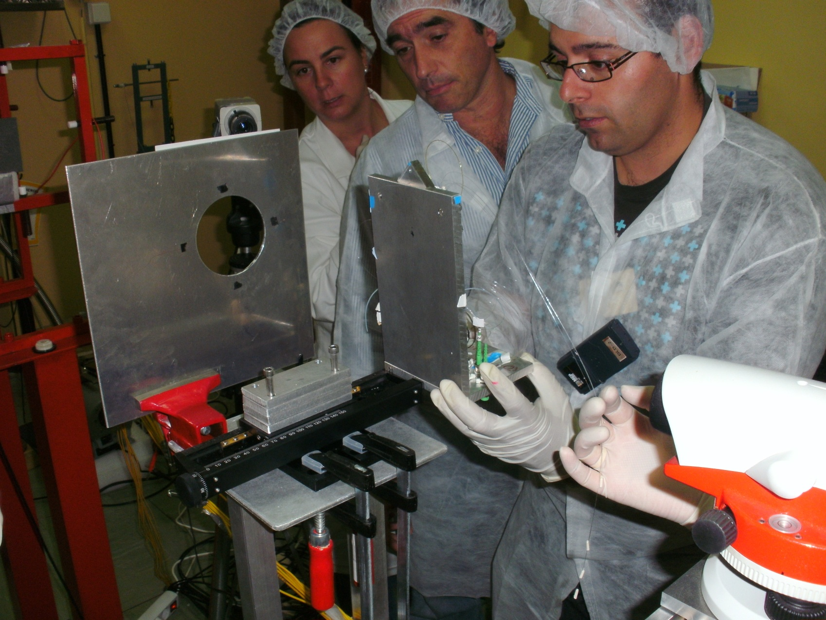
Careful operation with the fiber setup …
Carmen, Javier and David

Slide 27
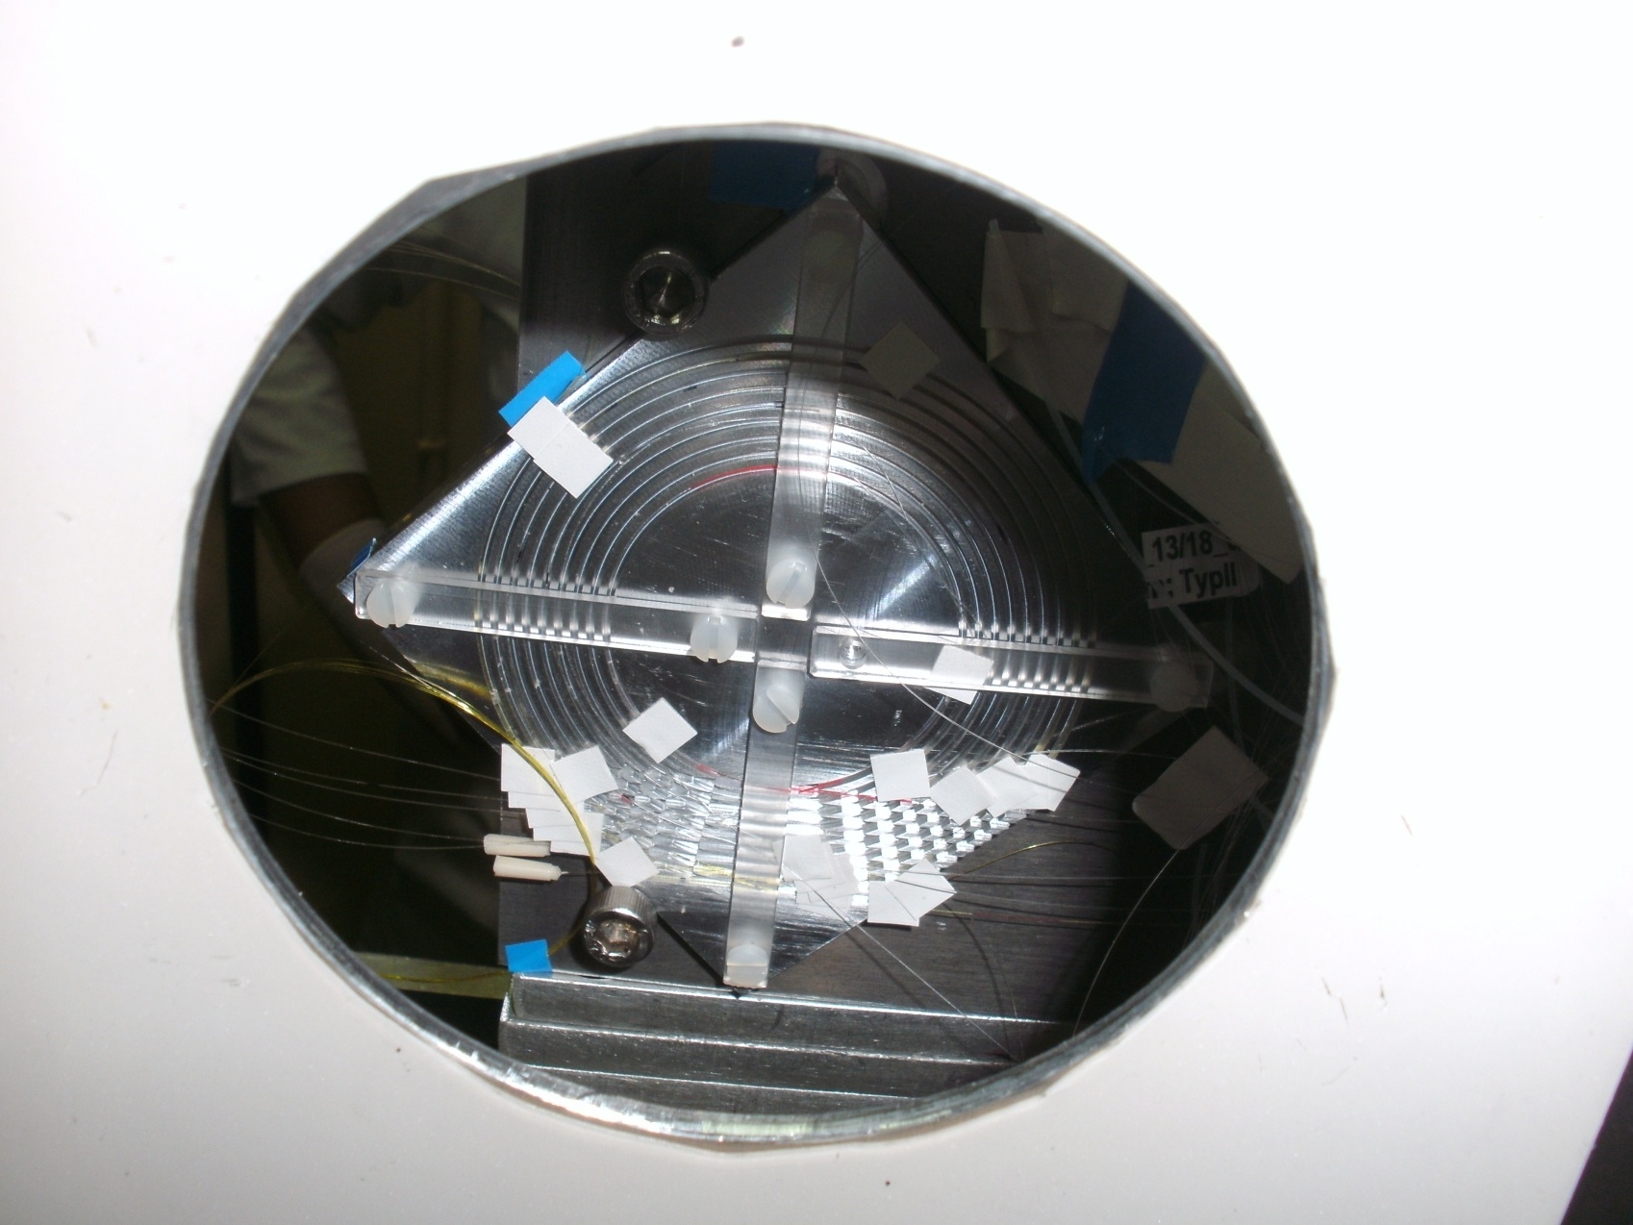
Fibers in position

Slide 28
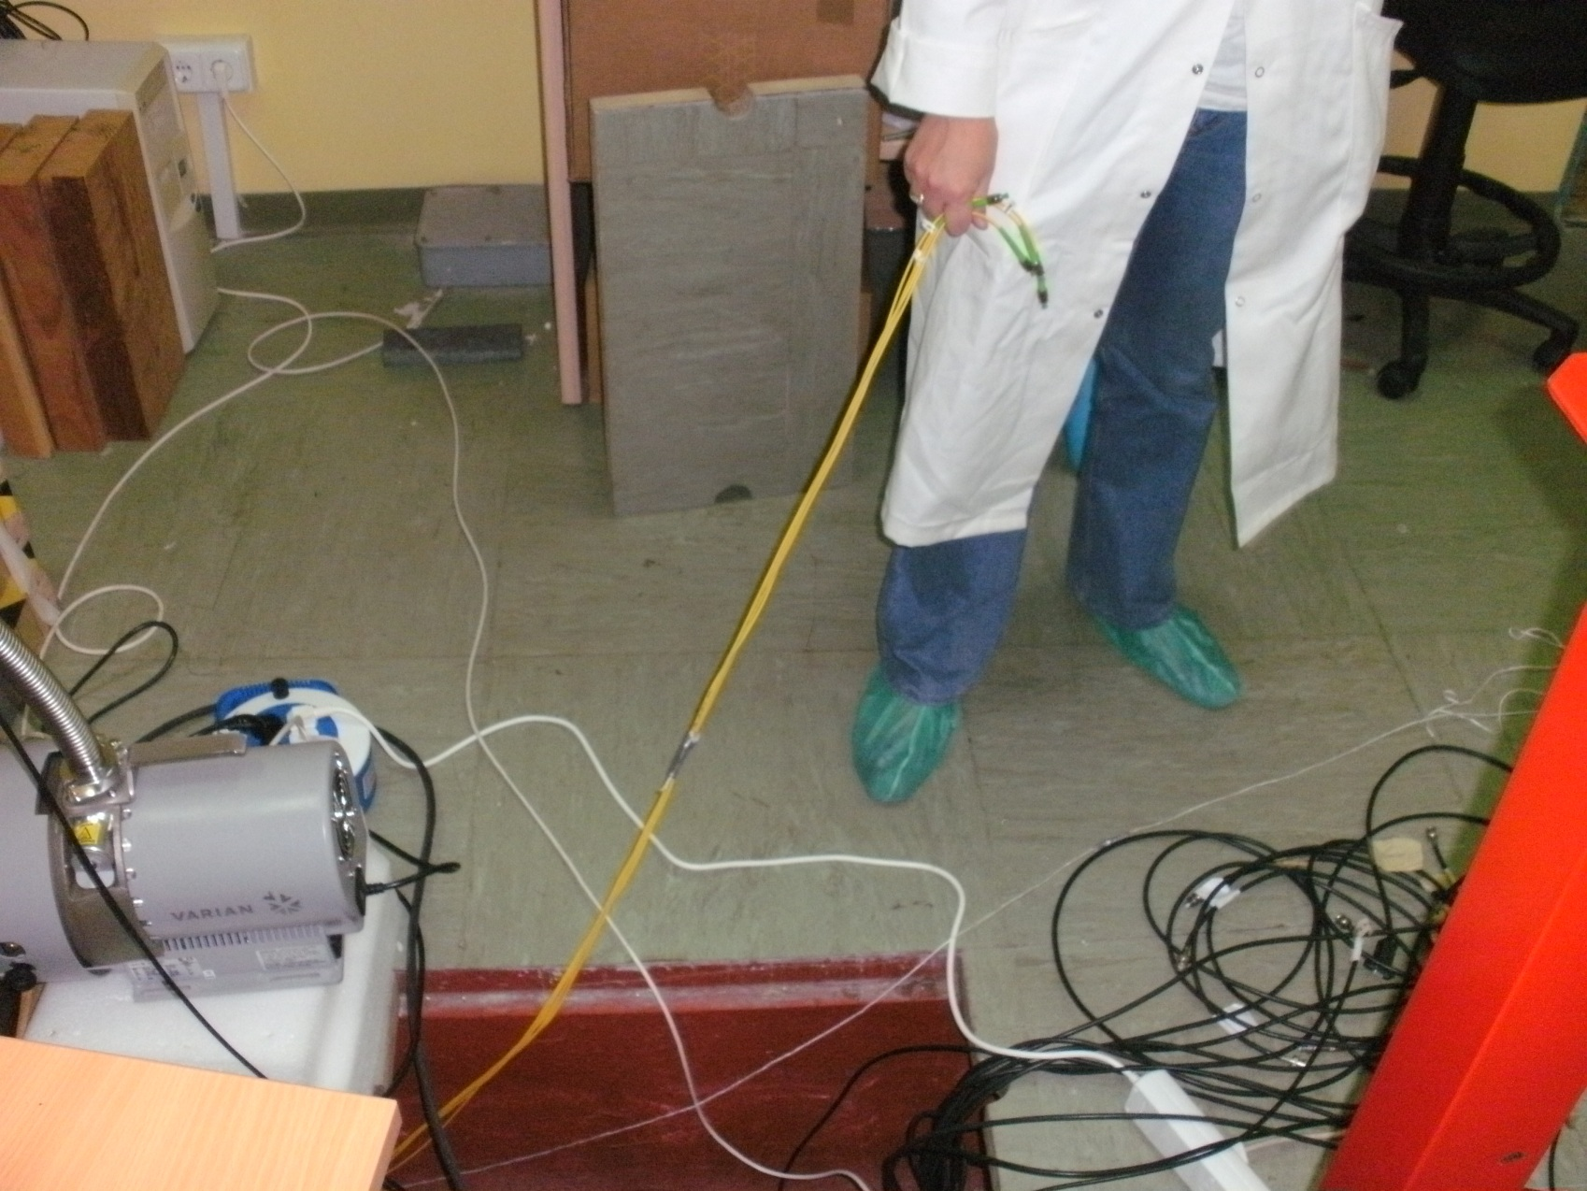
Pulling cables …

Slide 29
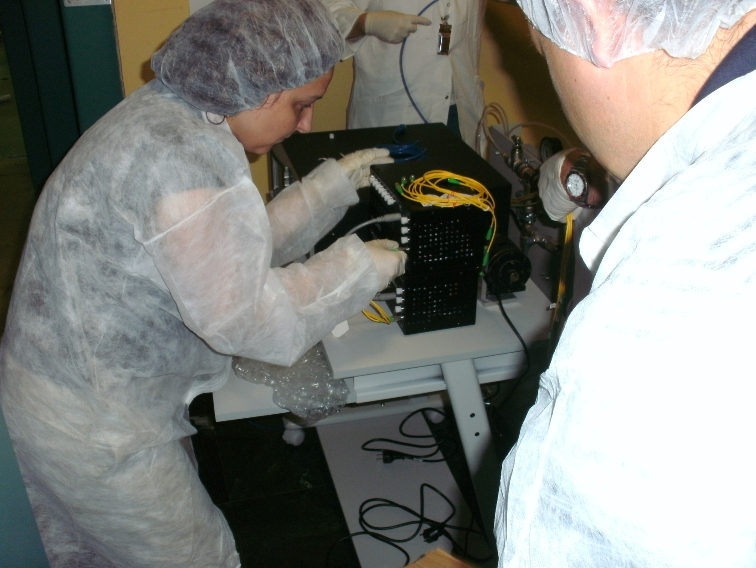
Connecting fibers to Amplifiers: Amparo from Santander

Slide 30
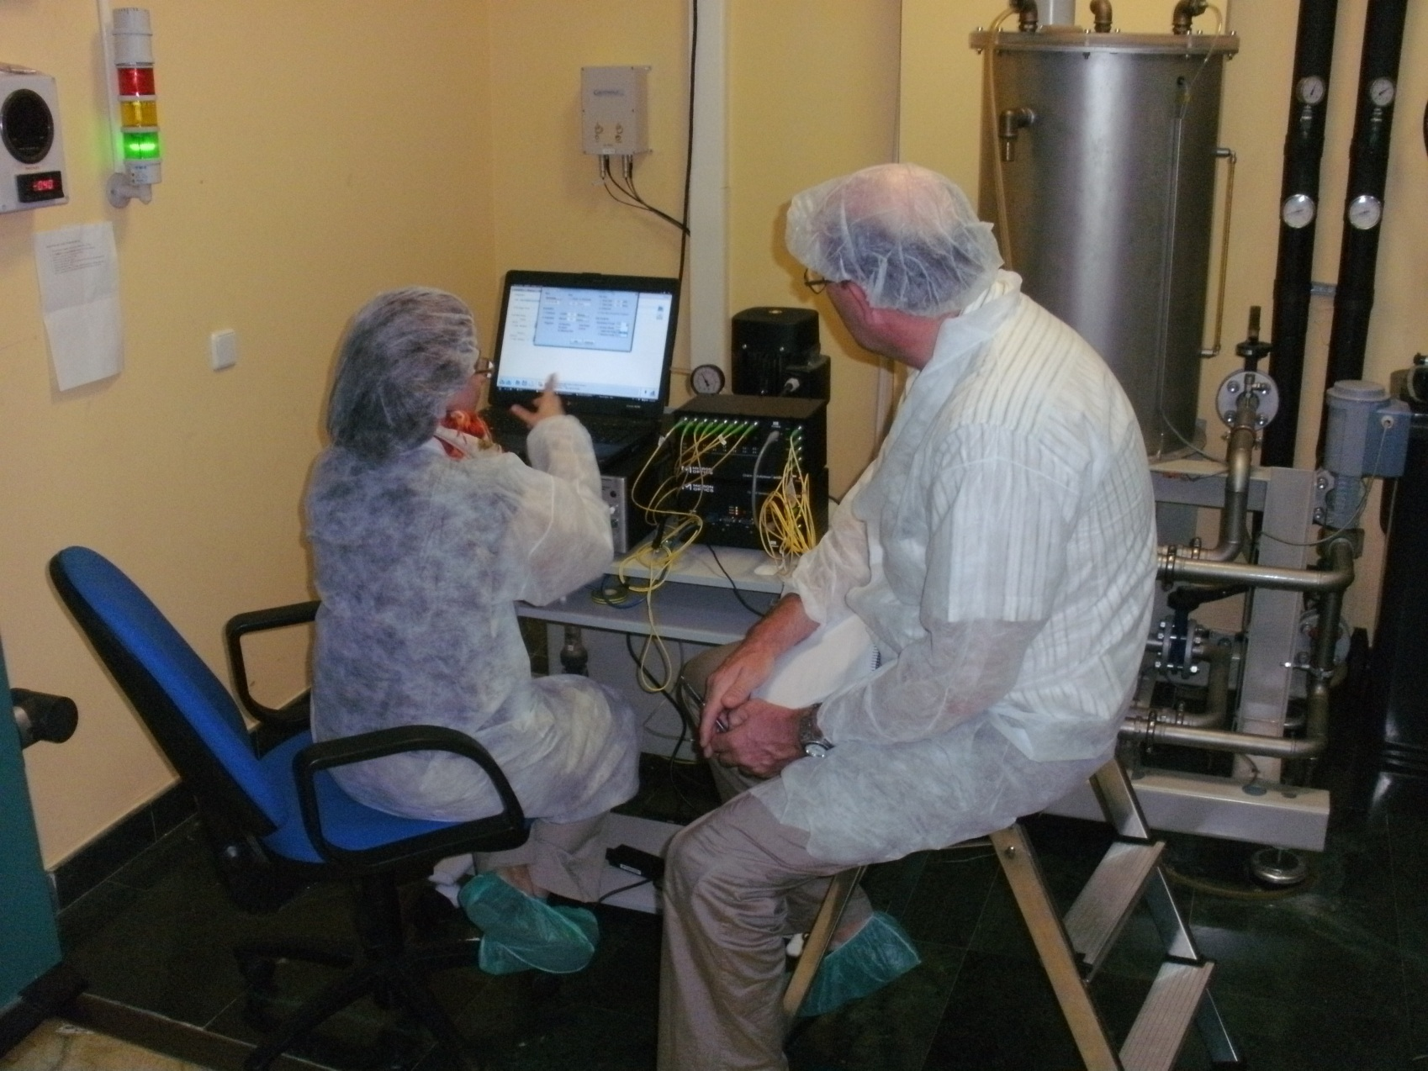
Setting up the DAQ: Amparo and Malte

Slide 31
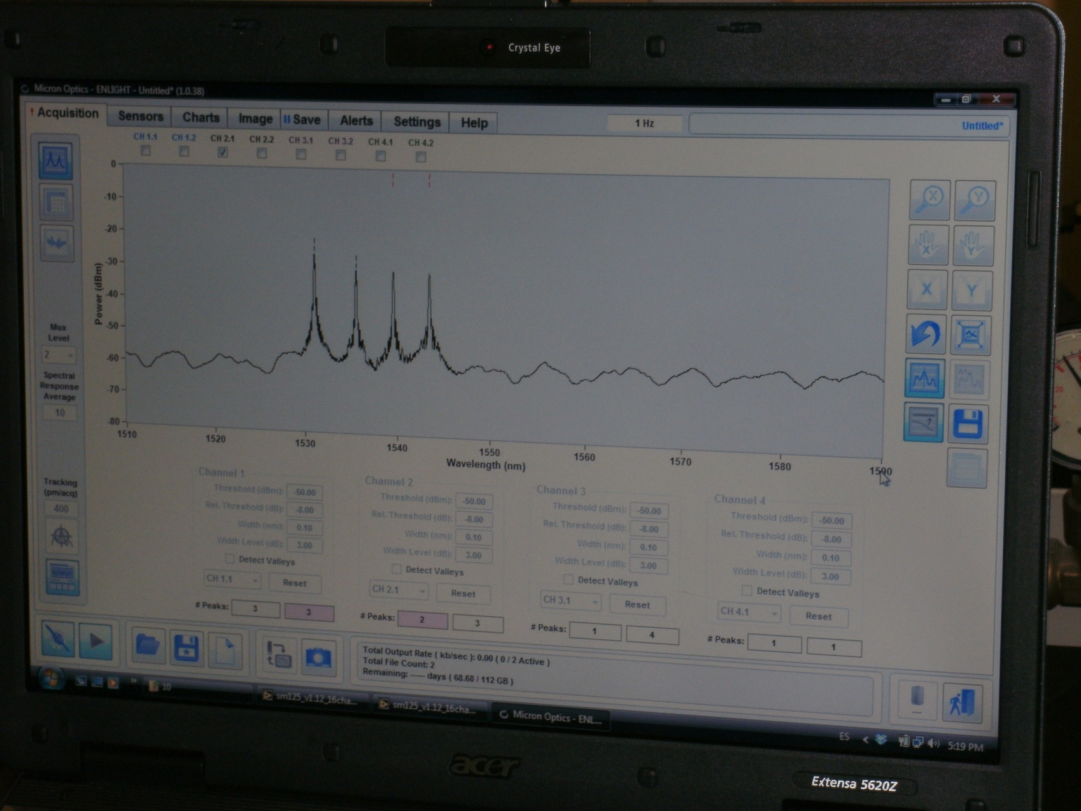
DAQ is working !

Slide 32
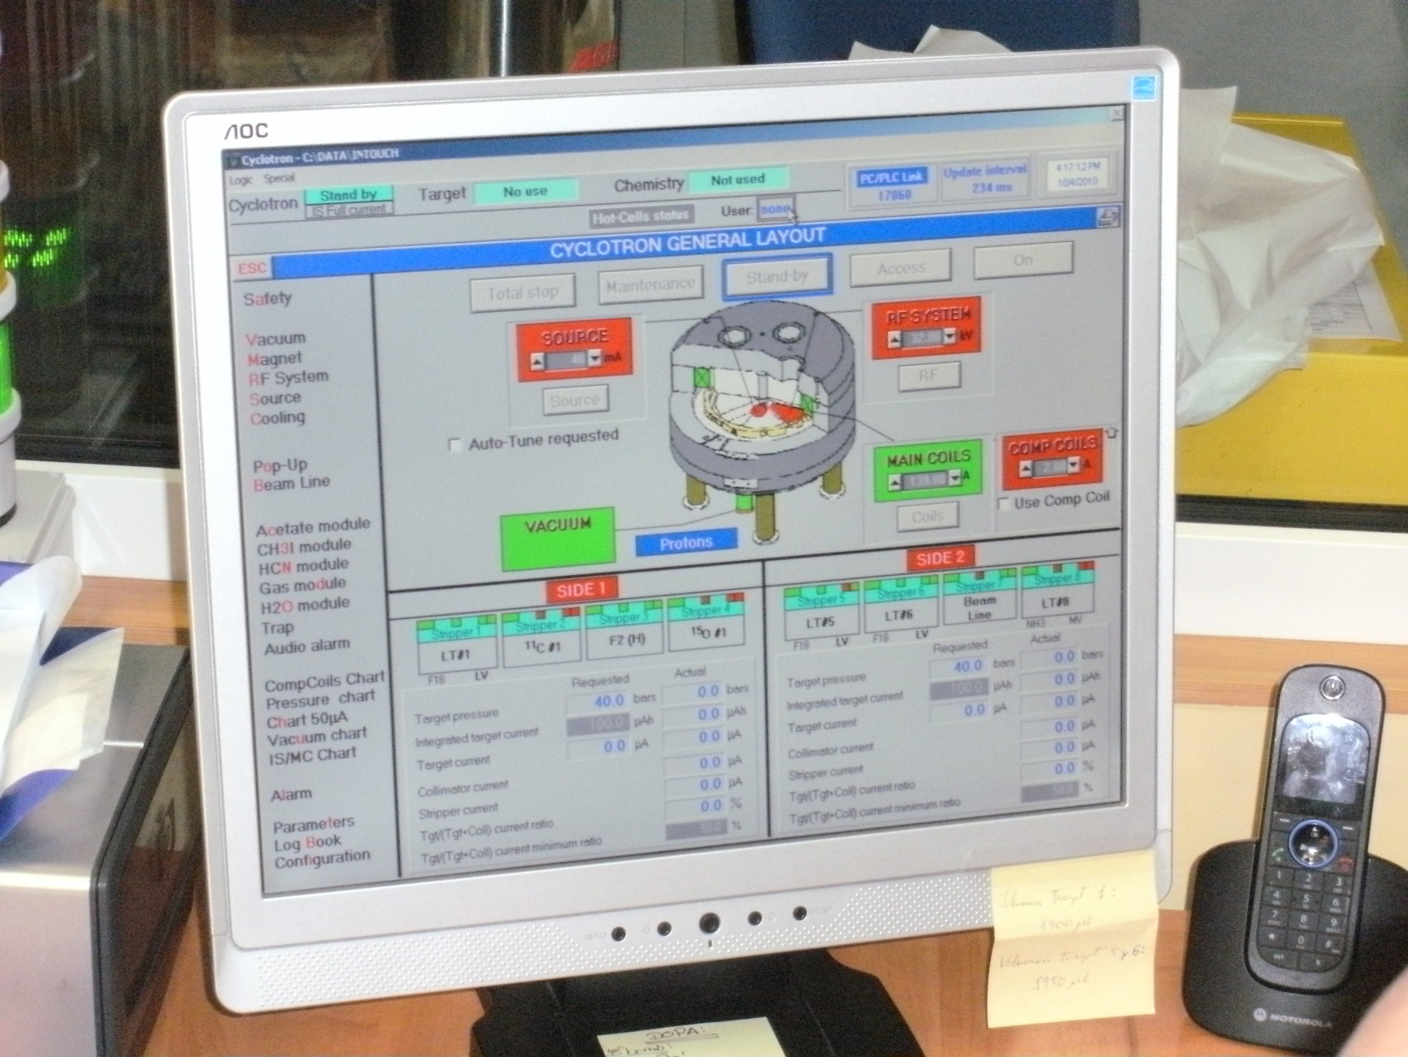
Cyclotron operation panel

Slide 33
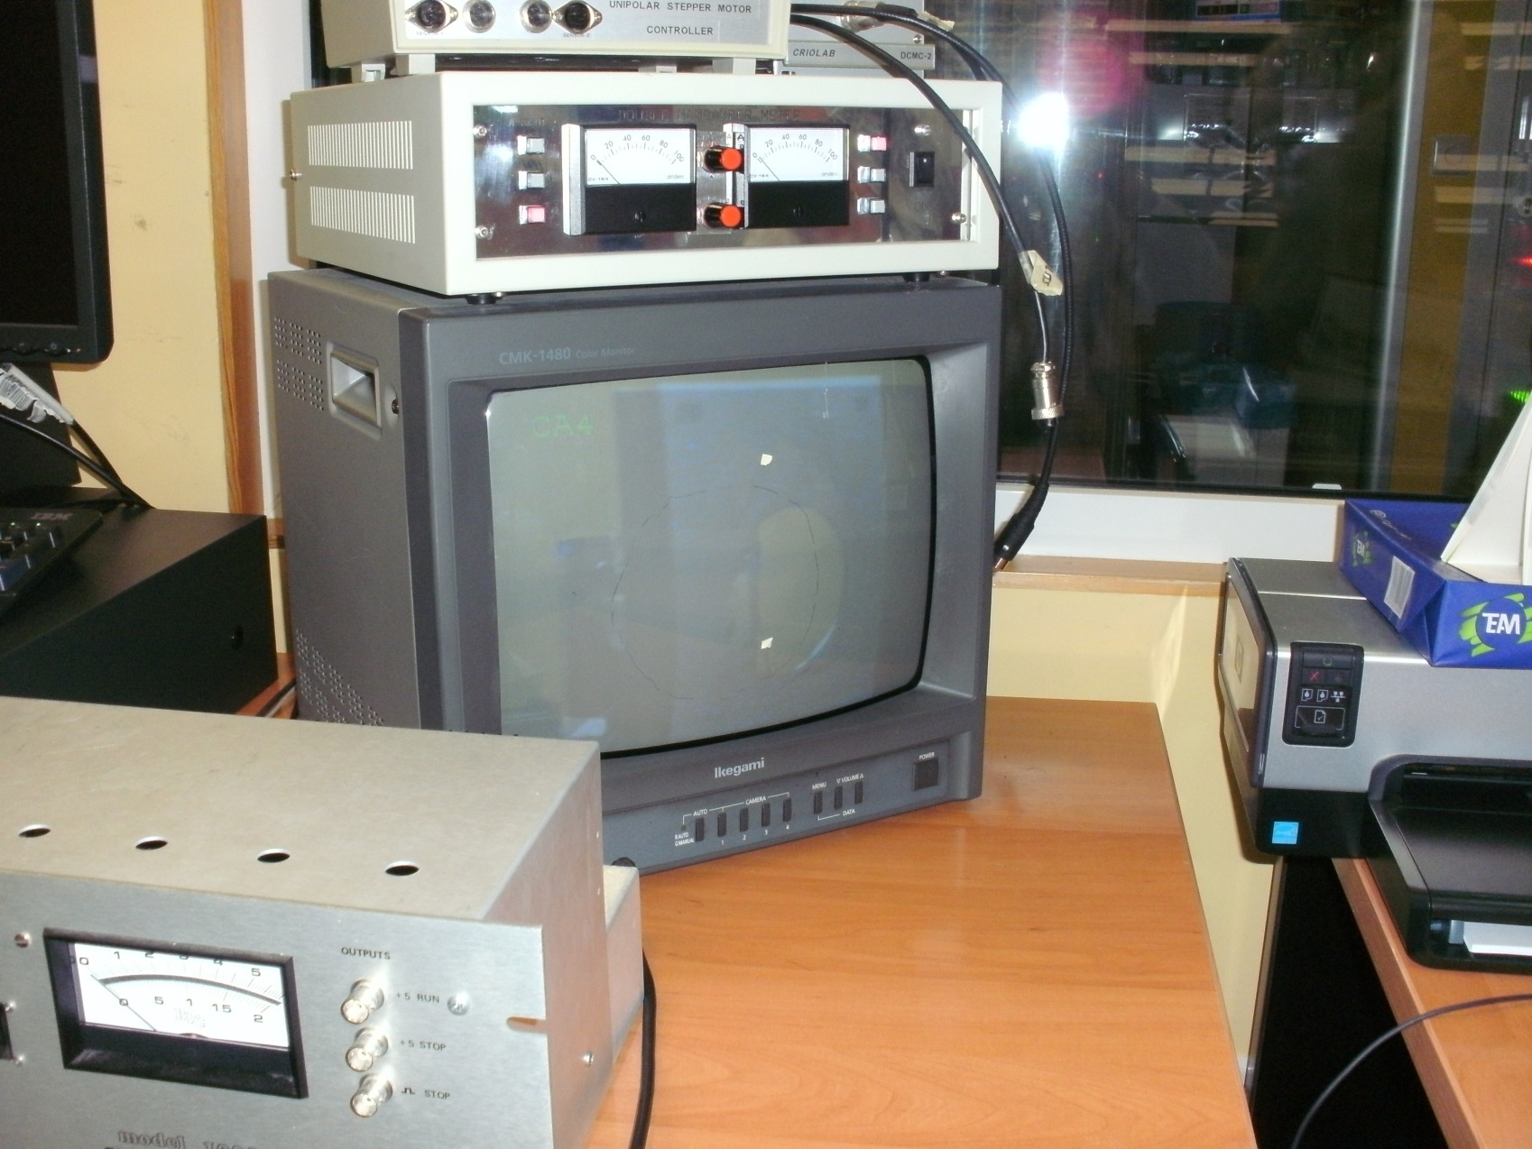
Cyclotron not yet on: Scintillator still quiet …

Slide 34
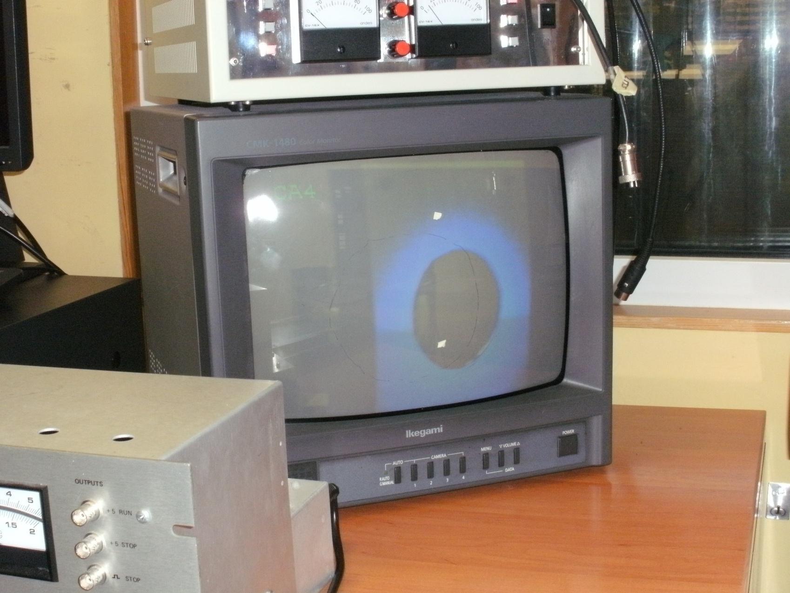
Cyclotron on: Protons on target

