Slide 1
MAGIC technical challenges, upgrades and final performance
Manel Martinez * (IFAE),
On behalf of the MAGIC collaboration
Image Credit: Urs Leutenegger (@urs.leutenegger)
*(martinez@ifae.es)
02-07 October 2023 – 20 MAGIC years –La Palma

Slide 2
MAGIC and Technology
MAGIC founders mindset: exploring uncharted VHE gamma-ray territory by a leap on state-of-the-art technology for IACTs.
Technical challenges:
(1) Building a telescope catching as much Cherenkov photons as possible for lowest energy threshold:
* Large reflector
* Highly reflective mirrors
* Very sensitive camera
(2) Building a telescope as light as possible for fast repositioning for transients -> lightweight structure
02-07 October 2023 – 20 MAGIC years
martinez@ifae.es

Slide 3
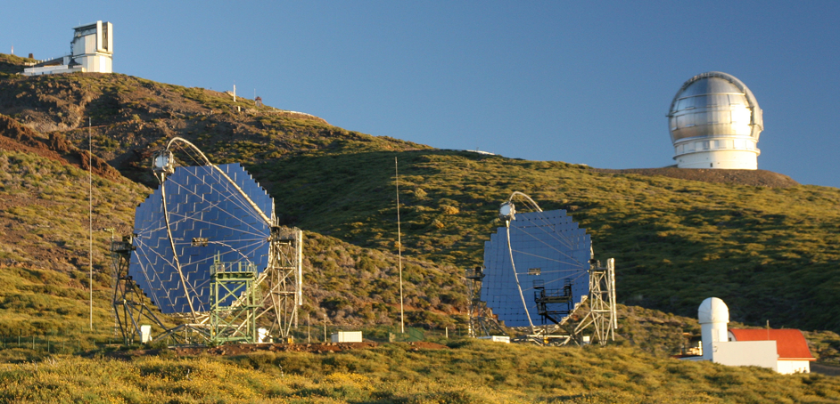
MAGIC streamlined timeline
2003: MAGIC inauguration in October
2004: First MAGIC data
2005: First scientific papers
2007: First MAGIC upgrade (DAQ)
2009: MAGIC-2 installation and first data
2011/12: Major MAGIC-1 upgrade (camera, DAQ, trigger)

Slide 4
Technical challenges
02-07 October 2023 – 20 MAGIC years
martinez@ifae.es

Slide 5
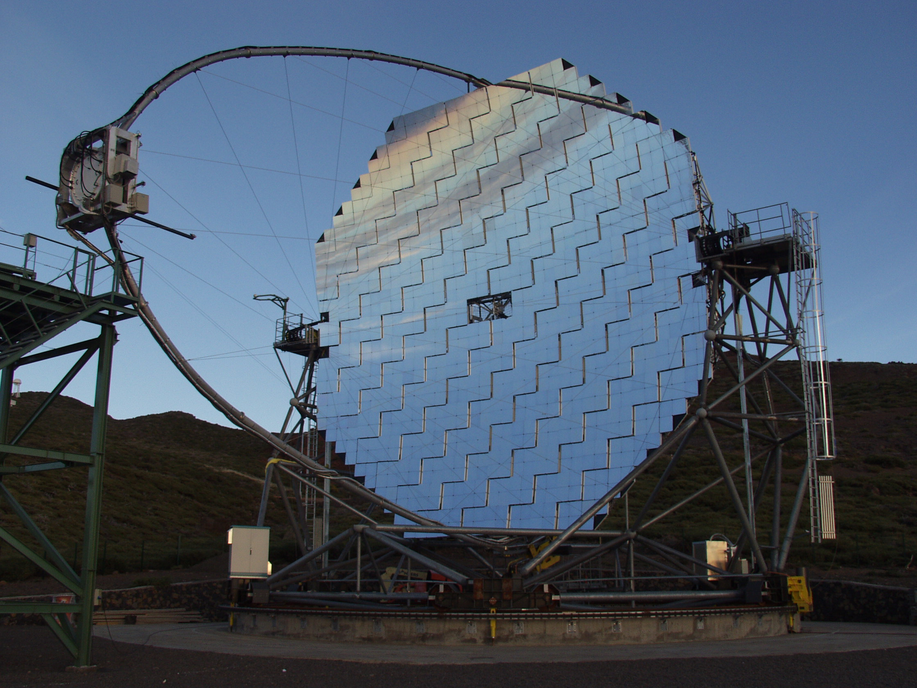
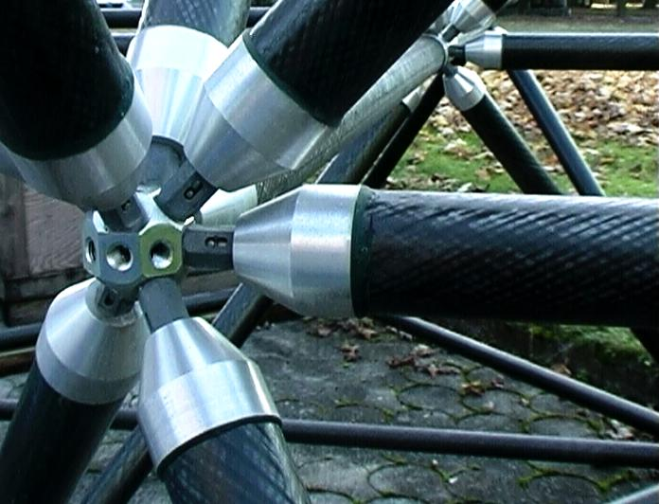
Key technological elements for MAGIC
17 m diameter parabolic reflecting surface (236 m² )
Light weight Carbon fiber structure for fast repositioning
high reflective diamond milled aluminum mirror
Active mirror control (PSF: 90% of light in 0.1º inner pixel)
-3.5º FOV camera -576 high QE PMTs (QE_{max}= 30%)
Analog signal transport via optical fibers
IPE
2-level trigger system & 300 MHz FADC system
IPE
IPE
NET
CE

Slide 6
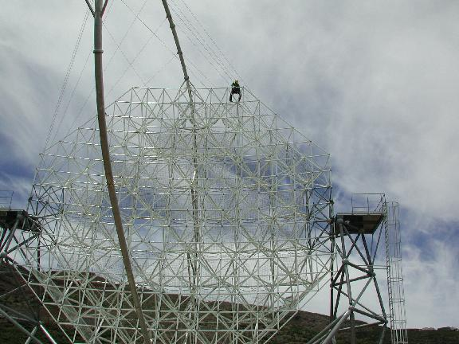
MAGIC design goal:
very fast re-pointing
to catch GRB
➔ not very rigid
➔ need continuously
realign the 234
mirror segments
➔ Active Mirror
Control (AMC)

Slide 7
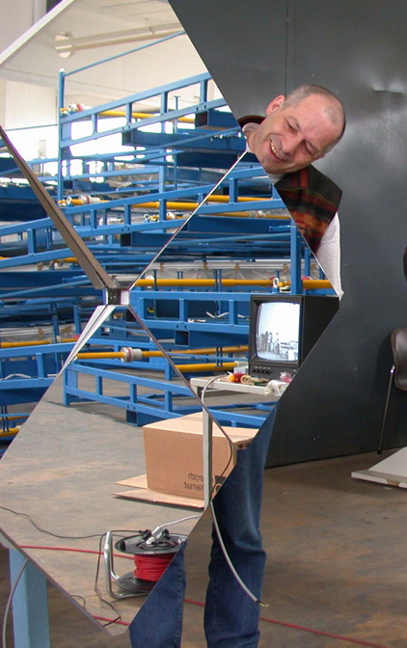
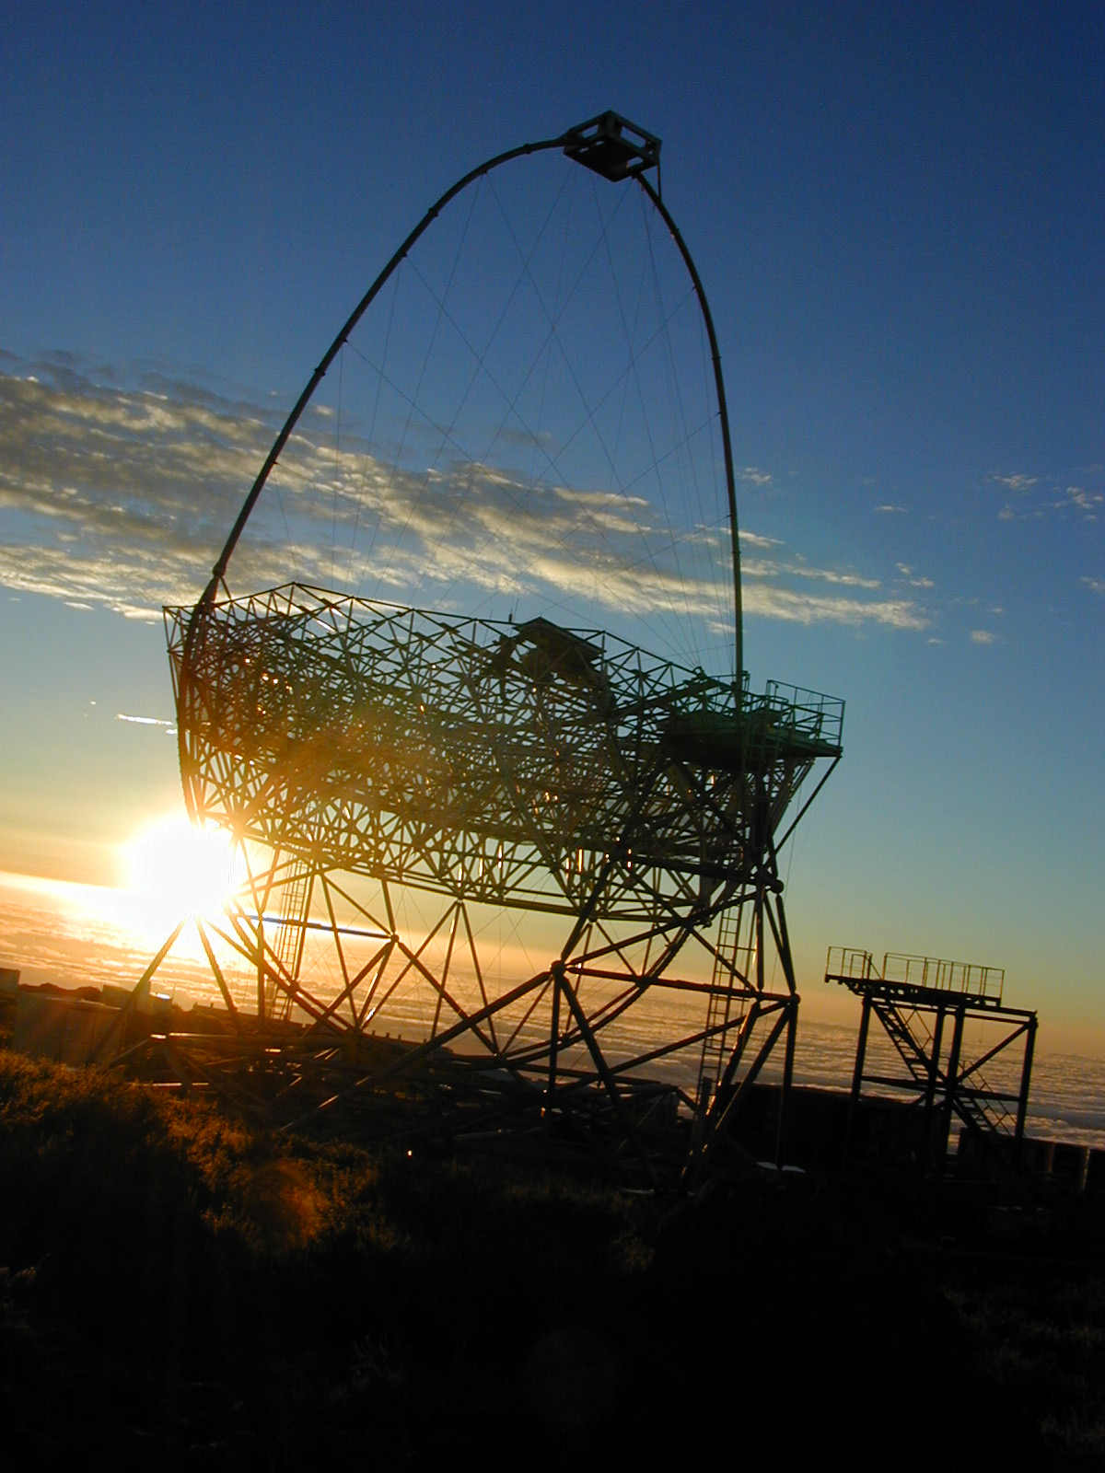
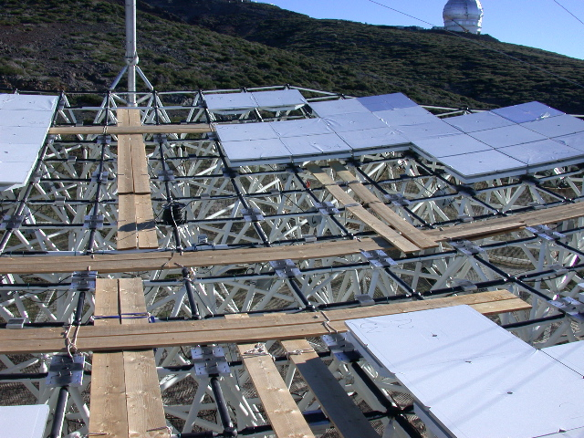
The reflector
17 m diameter!!
3 x area of 10 m IACTs
Parabolic: isochronous, allowing for bg reduction
Tesselated reflector:
~950 mirror elements
49.5 x 49.5 cm²
All-aluminum, quartz coated, diamond milled, internal heating
>85% reflectivity in 300-650nm

Slide 8
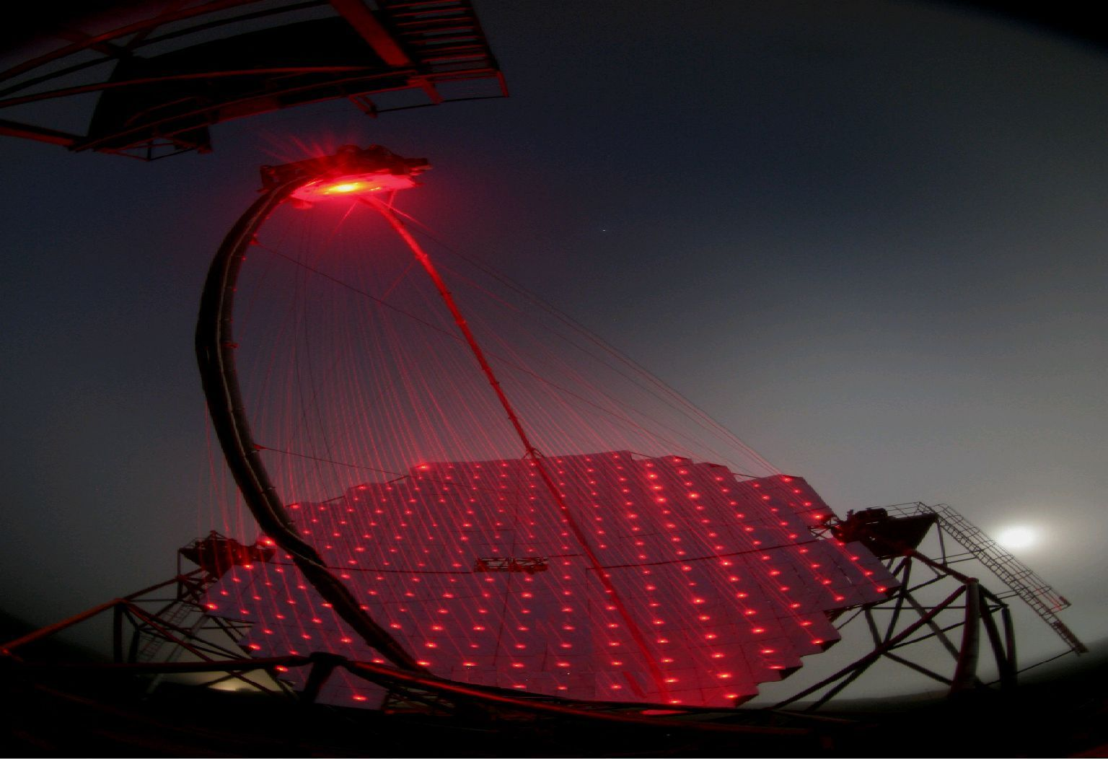
Active Mirror Control of MAGIC
( lasers used to calibrate AMC )

Slide 9
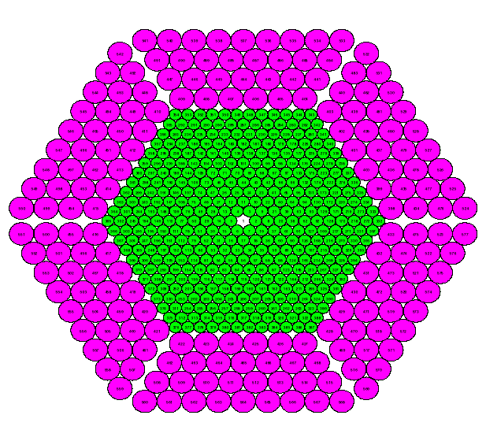
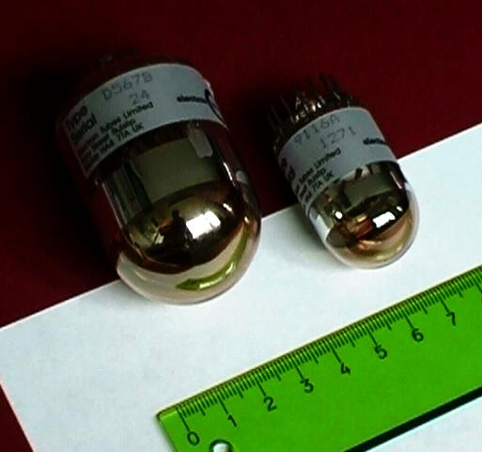
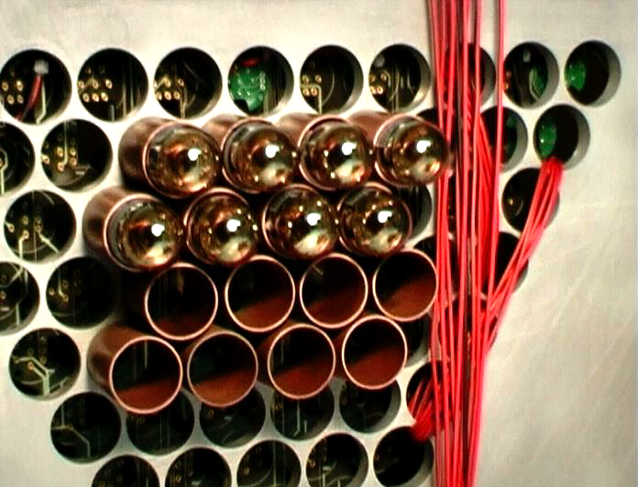
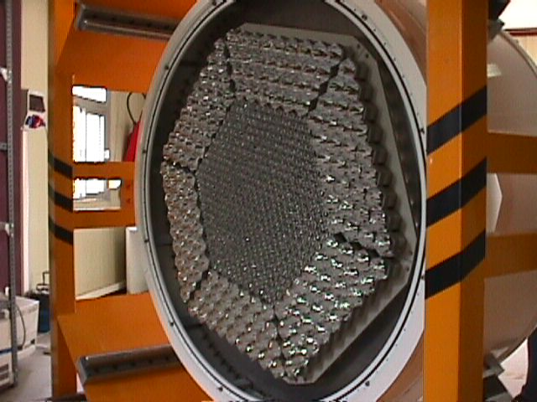
The camera
Matrix of 577 PMTs
Two sections:
Inner part: 0.1⁰ PMTs
Outer part: 0.2⁰ PMTs
Pixels
Bialkali PMTs, <QE>~26%
(330-450 nm)
Modular Pixels.
Plate of Wiston cones ⇒ Active camera area ∼100%

Slide 10
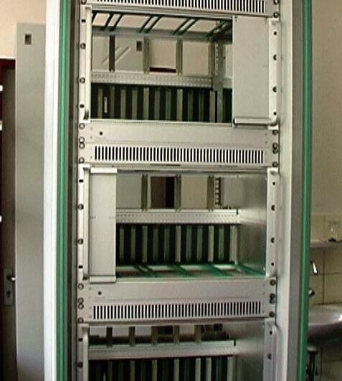
The readout
Shower cherenkov light pulses are typically ~ ns long
Pixel signal transported ~100 m over analog optical fibre using VCSELs:
Signal still short
Cable weight, optically decoupled, noise inmune.
Digitization using 300 MHz-1GHz FlashADCs:
γ/h discrimination through signal shape
Noise reduction
Event buffering, telescope system synchronization...

Slide 11
Upgrades
02-07 October 2023 – 20 MAGIC years
martinez@ifae.es

Slide 12
Upgrades on MAGIC-1:
- After inauguration for Mono:
* DAQ upgrade, from Siegen FADC to MUX,
* SumTrigger for MAGIC-1
- After MAGIC-2 already in operation (2011-2012):
* Camera of MAGIC-1,
* DAQ from Domino-2 to Domino-4 ring samplers chips

Slide 13
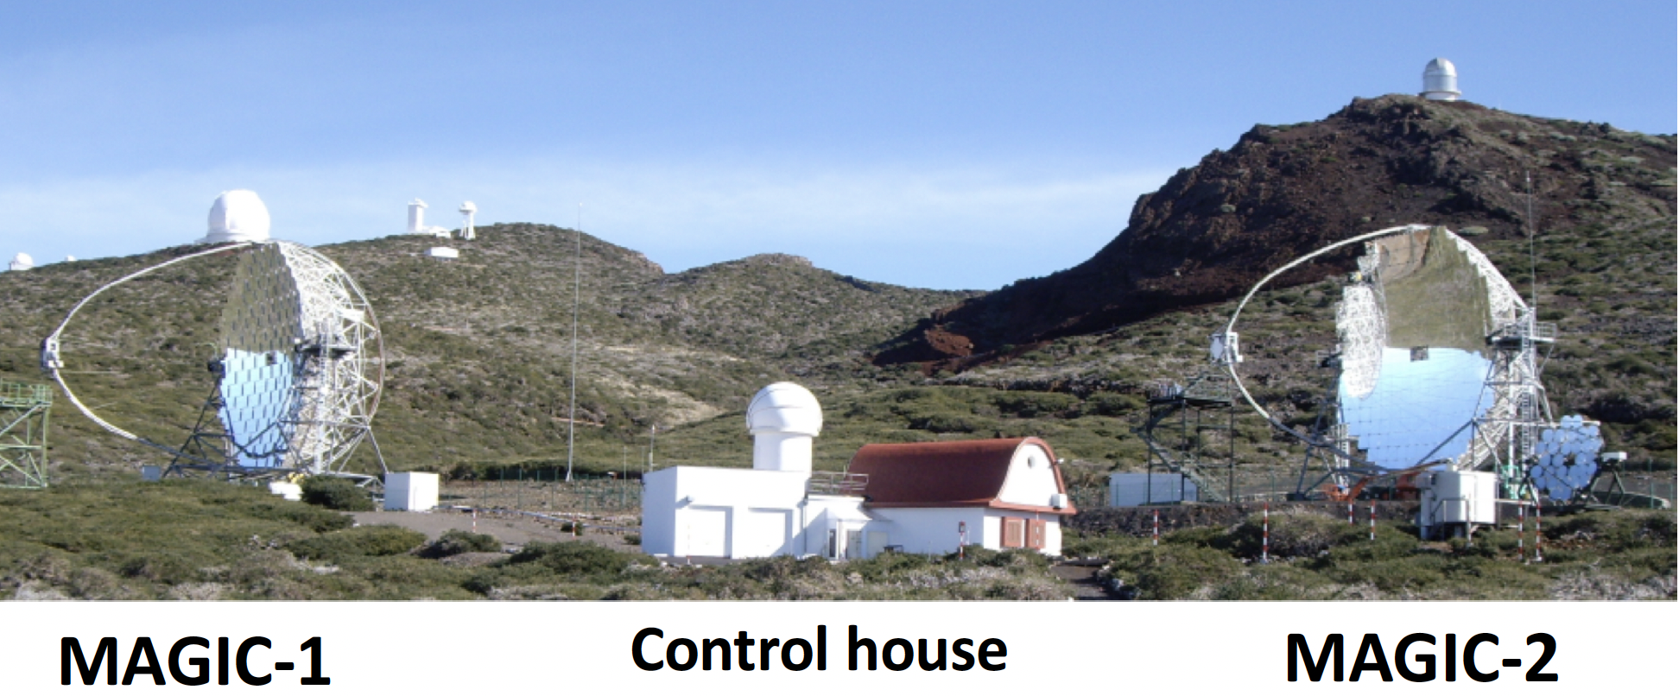
The largest upgrade: MAGIC-2 (2009)

Slide 14
Further overal improvements:
- SumTrigger for MAGIC stereo,
=> increase sensitivity at lowest gamma-ray energies
→ Detection of Geminga pulsar
- Very Large Zenith Angle observations
=> increase sensitivity at highest gamma-ray energies
→ Detection of Crab at 100 TeV
- LIDAR for monitoring atmosphere,
=> MAGIC currently only IACT using customarily this technique

Slide 15
Final performance
02-07 October 2023 – 20 MAGIC years
martinez@ifae.es

Slide 17
Final performance…?
02-07 October 2023 – 20 MAGIC years
martinez@ifae.es

Slide 19
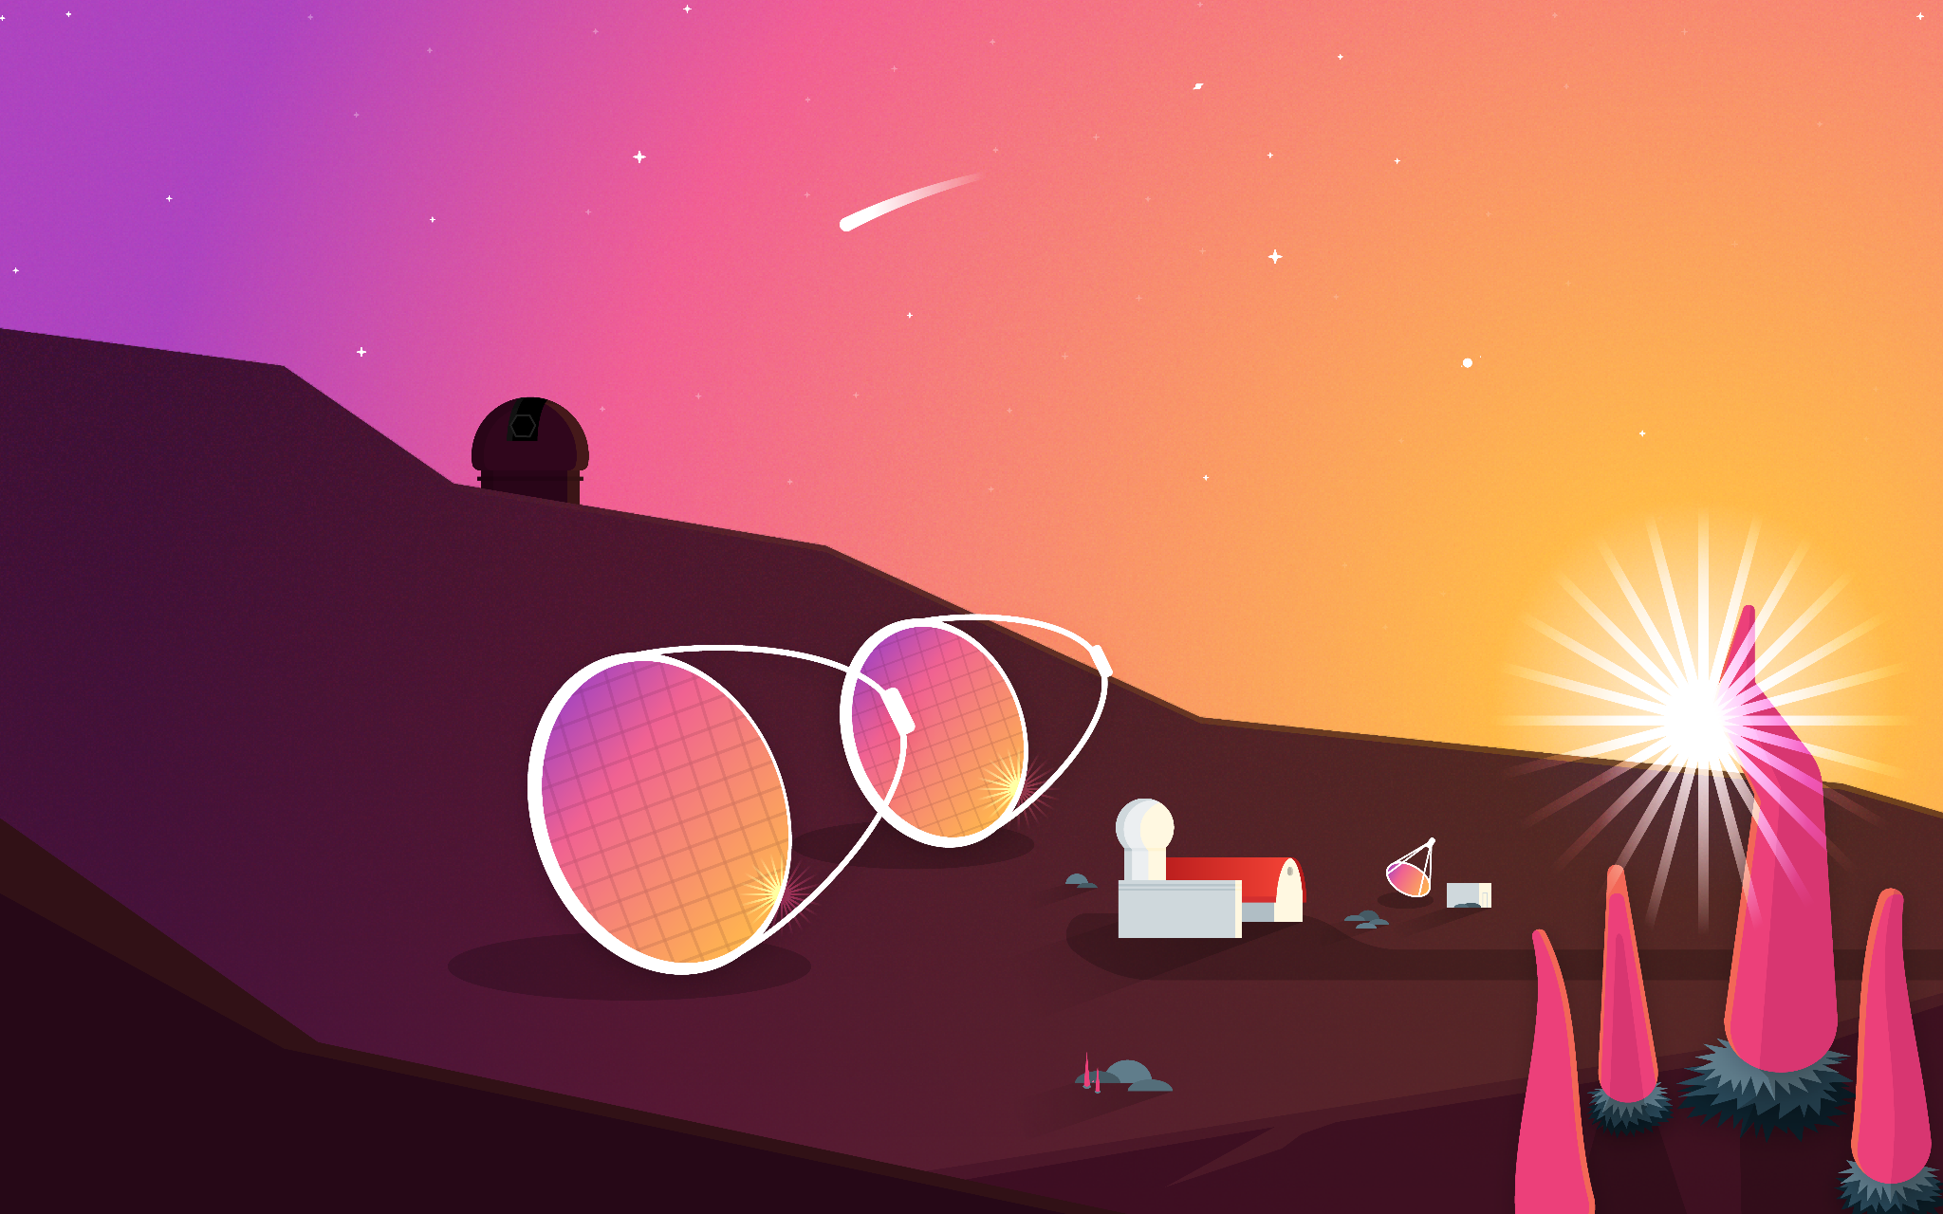
Thank you for your attention!
Image credit:: Jayant Abhir
02-07 October 2023 – 20 MAGIC years

