Slide 1

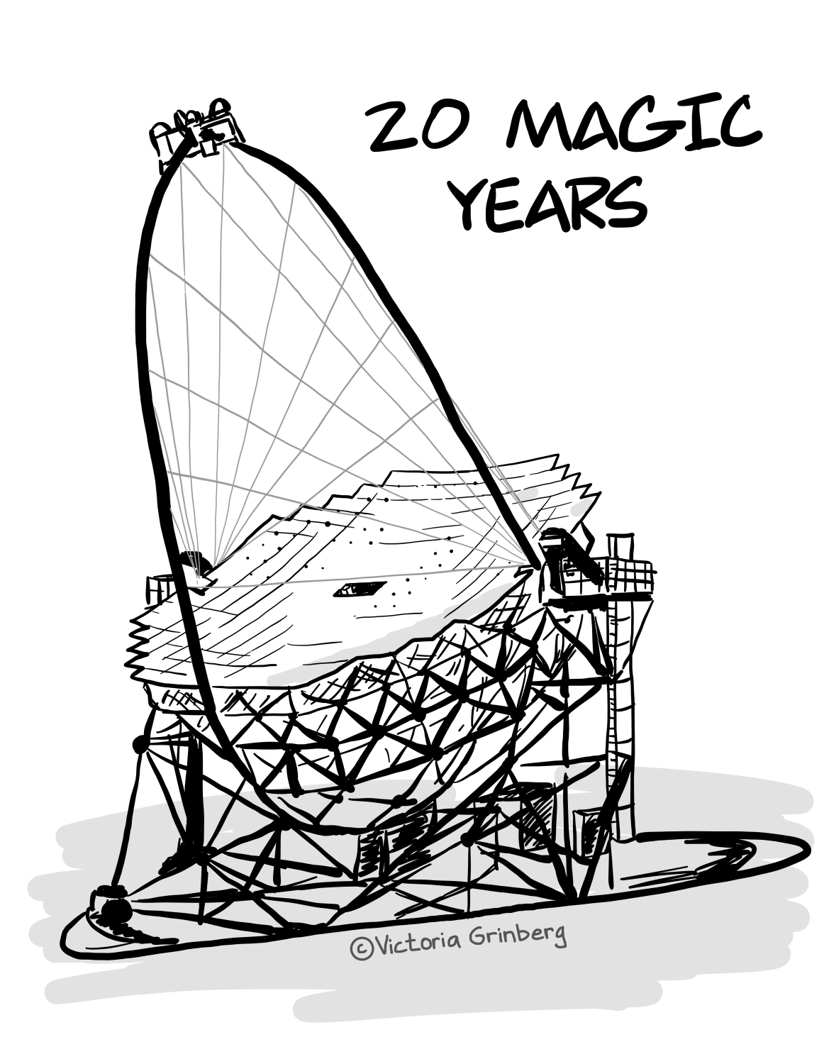
Gamma-ray bursts with MAGIC
Alessio Berti
Max Planck Insitute for Physics
MAGIC 20th Anniversary

Slide 2
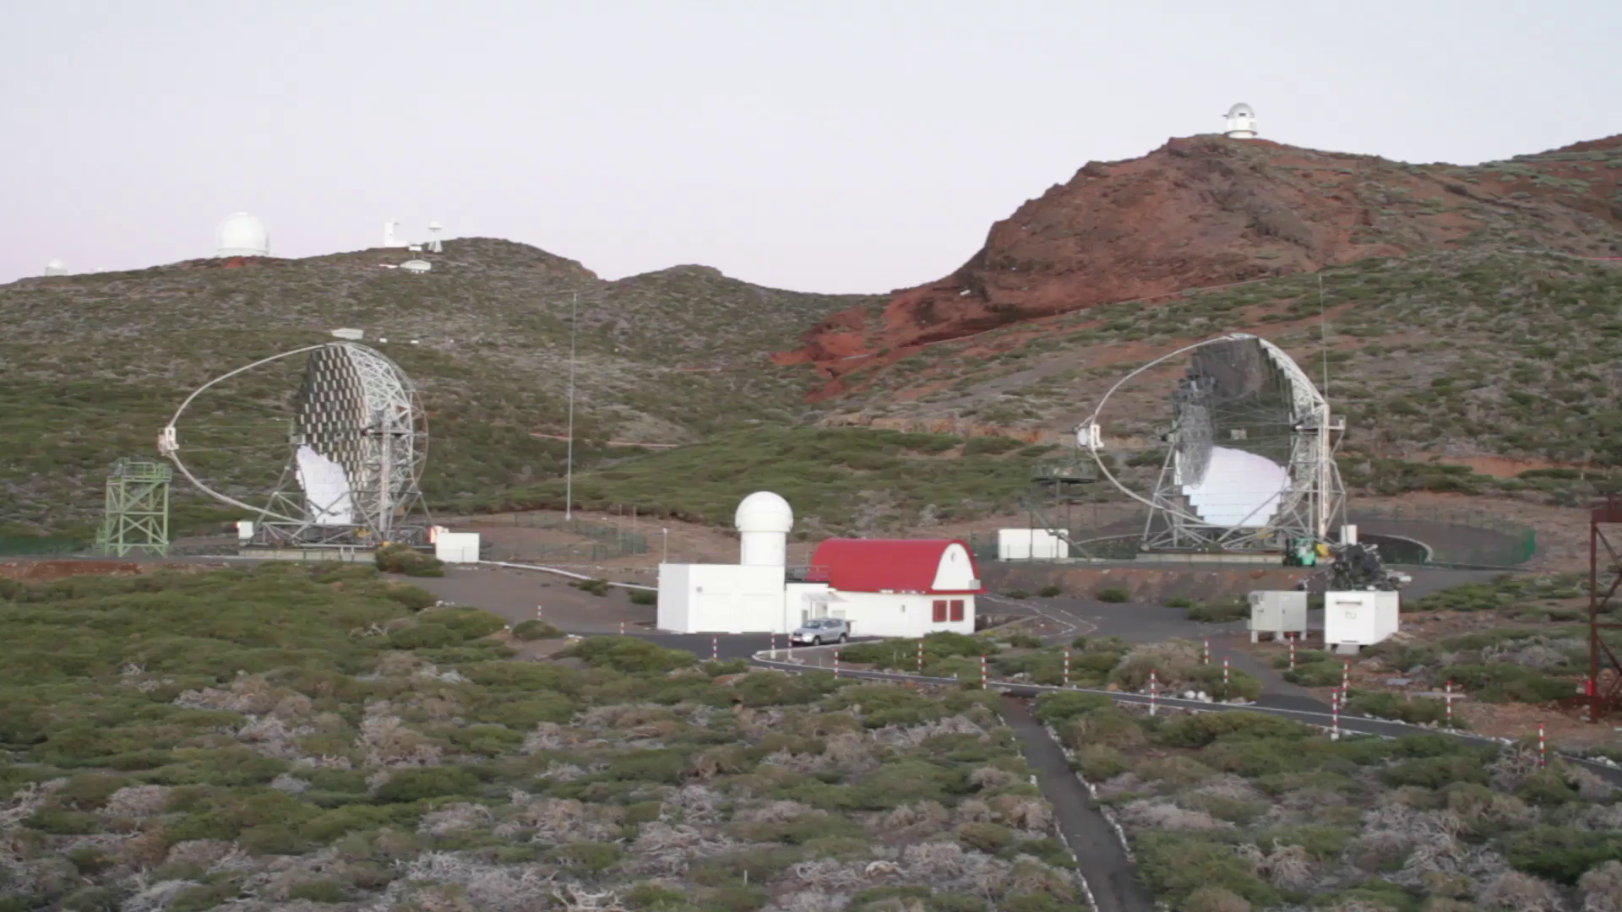
Why MAGIC?
The MAGIC telescopes have...
fast repositioning --> 7deg/s in “GRB mode”
lightweight structure --> ~64t for each telescope
high sensitivity --> 5sigma with ~20% of the Crab Nebula flux in 20min above ~100GeV
low energy threshold --> ~50GeV with standard trigger
Designed to catch GRBs!

Slide 3
Status of GRBs with IACTs before 2019
Several attempts, but no detection
  MAGIC: 2005-2006 GRBs (ApJ 667, 2007), GRB050713A (ApJ 641, 2006), GRB 080430 (A&A 517, 2010), GRB090102 (MNRAS 437, 2014)
  H.E.S.S. : GRBs observed from 2003 to 2007 (A&A 495, 2009), GRB 060602B (ApJ 690, 2009), GRB 100621A (A&A 565, 2014)
  VERITAS: follow-up of Swift GRBs (ApJ 743, 2011), GRB 130427A (ApJ 795, 2014), GRB 150323A (ApJ 857, 2018)
  Whipple: GRB follow-up (ApJ 655, 2007)
  HEGRA: search for GRB TeV counterparts (arXiv:astro-ph/9611044v1)
Only upper limits... :(

Slide 4
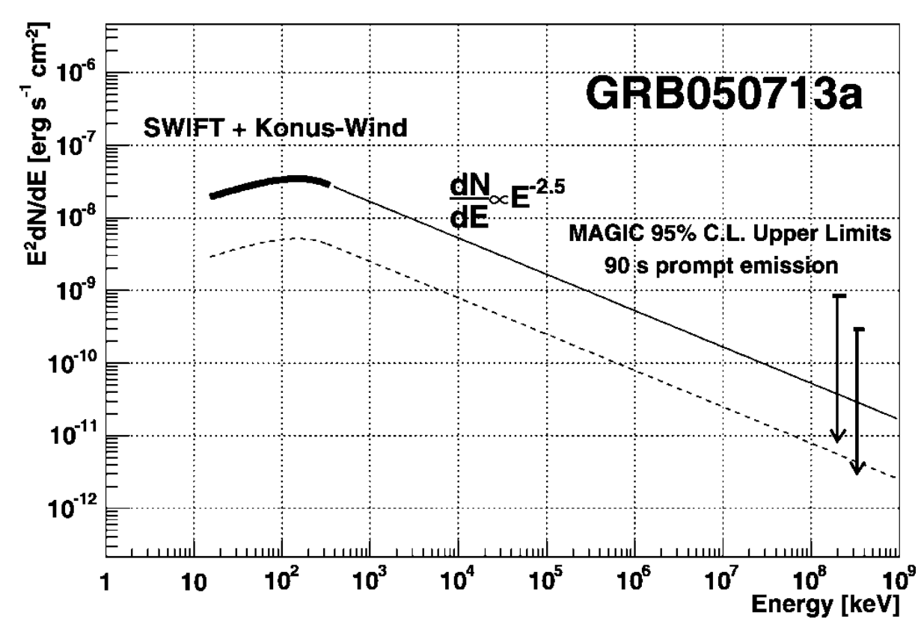
Status of GRBs with IACTs before 2019
Several attempts, but no detection
  MAGIC: 2005-2006 GRBs (ApJ 667, 2007), GRB050713A (ApJ 641, 2006), GRB 080430 (A&A 517, 2010), GRB090102 (MNRAS 437, 2014)
  H.E.S.S. : GRBs observed from 2003 to 2007 (A&A 495, 2009), GRB 060602B (ApJ 690, 2009), GRB 100621A (A&A 565, 2014)
  VERITAS: follow-up of Swift GRBs (ApJ 743, 2011), GRB 130427A (ApJ 795, 2014), GRB 150323A (ApJ 857, 2018)
  Whipple: GRB follow-up (ApJ 655, 2007)
  HEGRA: search for GRB TeV counterparts (arXiv:astro-ph/9611044v1)
Only upper limits... :(

Slide 5
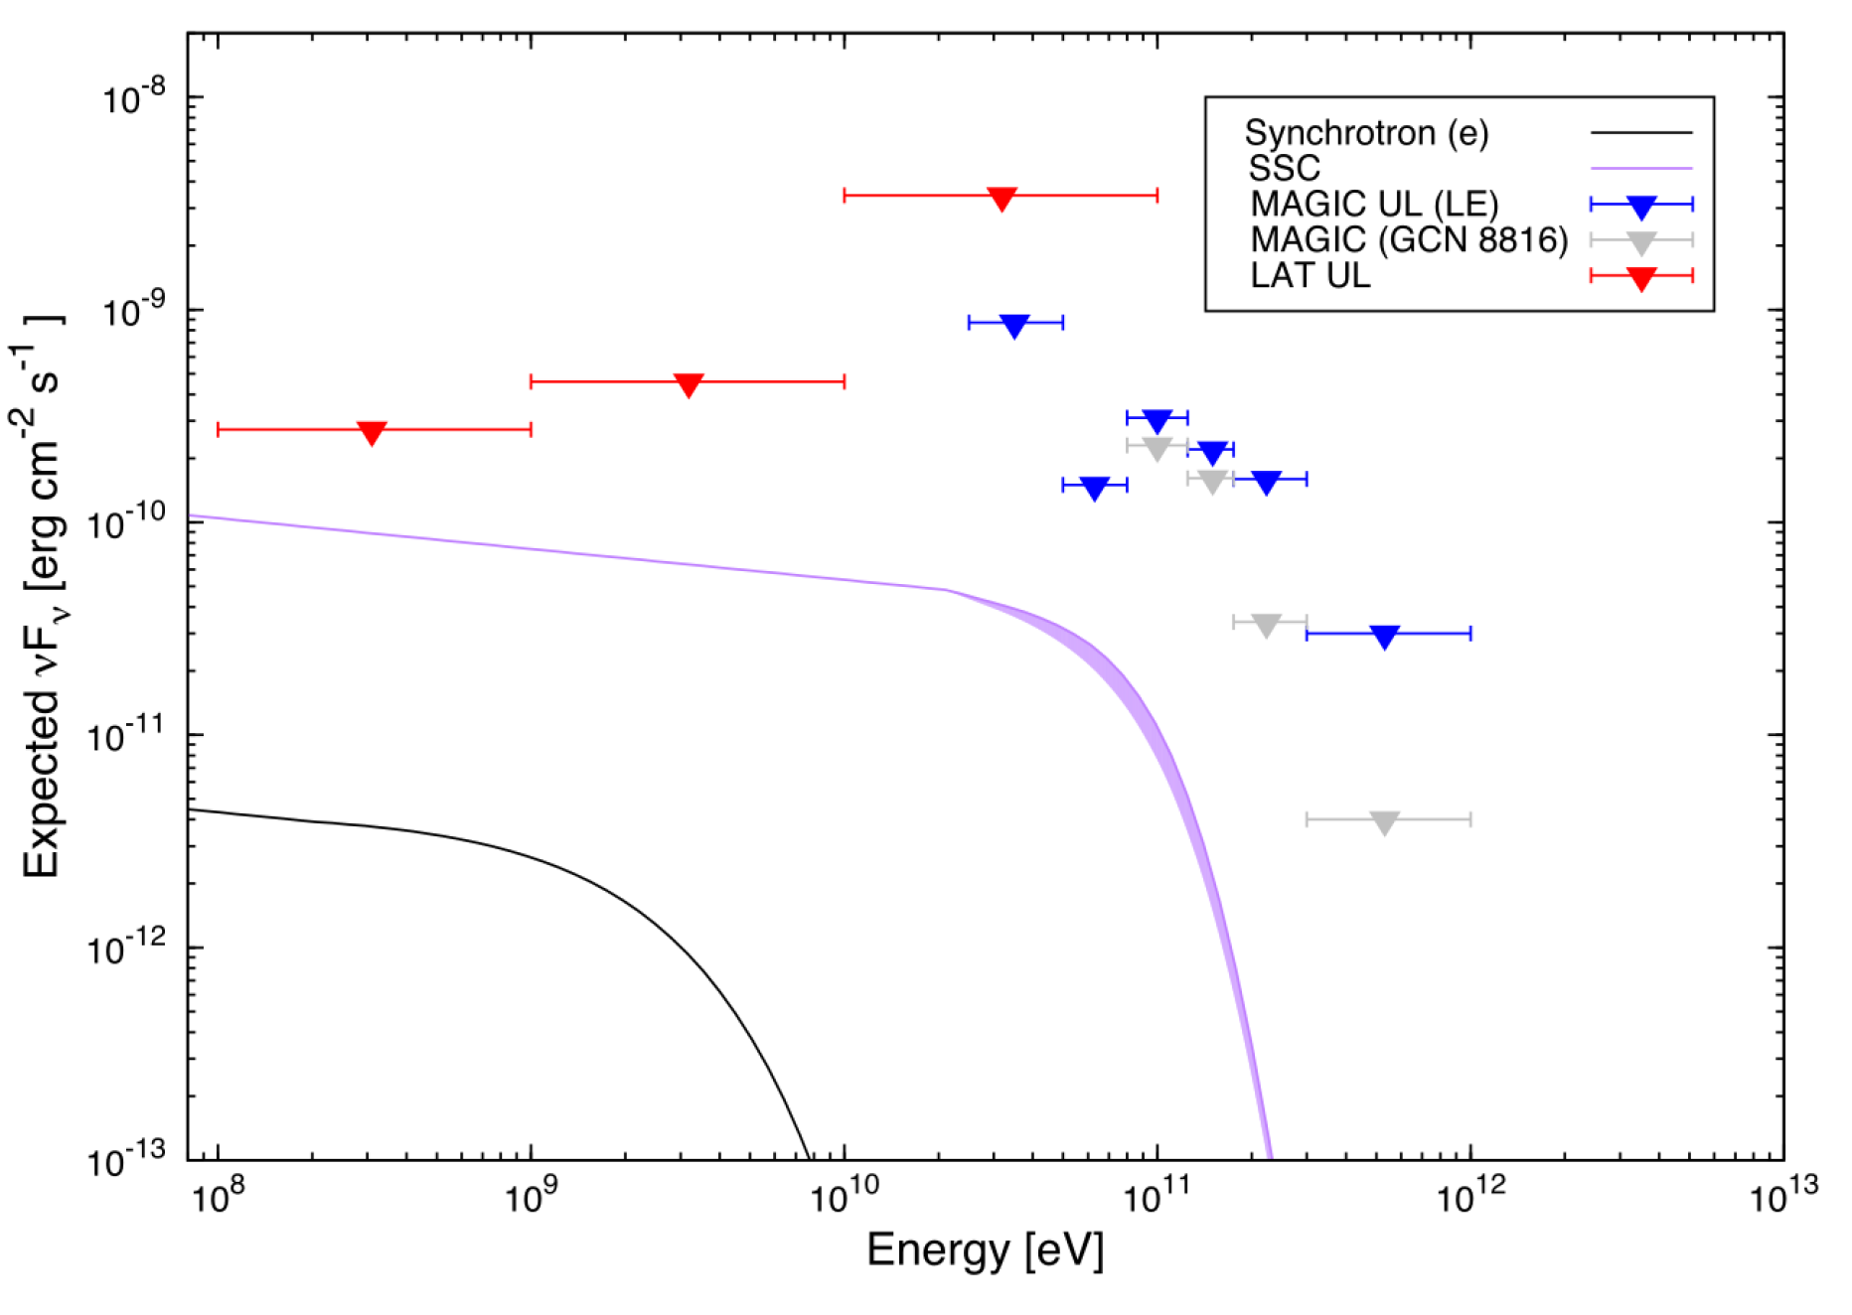
Status of GRBs with IACTs before 2019
Several attempts, but no detection
  MAGIC: 2005-2006 GRBs (ApJ 667, 2007), GRB050713A (ApJ 641, 2006), GRB 080430 (A&A 517, 2010), GRB090102 (MNRAS 437, 2014)
  H.E.S.S. : GRBs observed from 2003 to 2007 (A&A 495, 2009), GRB 060602B (ApJ 690, 2009), GRB 100621A (A&A 565, 2014)
  VERITAS: follow-up of Swift GRBs (ApJ 743, 2011), GRB 130427A (ApJ 795, 2014), GRB 150323A (ApJ 857, 2018)
  Whipple: GRB follow-up (ApJ 655, 2007)
  HEGRA: search for GRB TeV counterparts (arXiv:astro-ph/9611044v1)
Only upper limits... :(
BUT, keep trying: expect the unexpected!!!

Slide 6
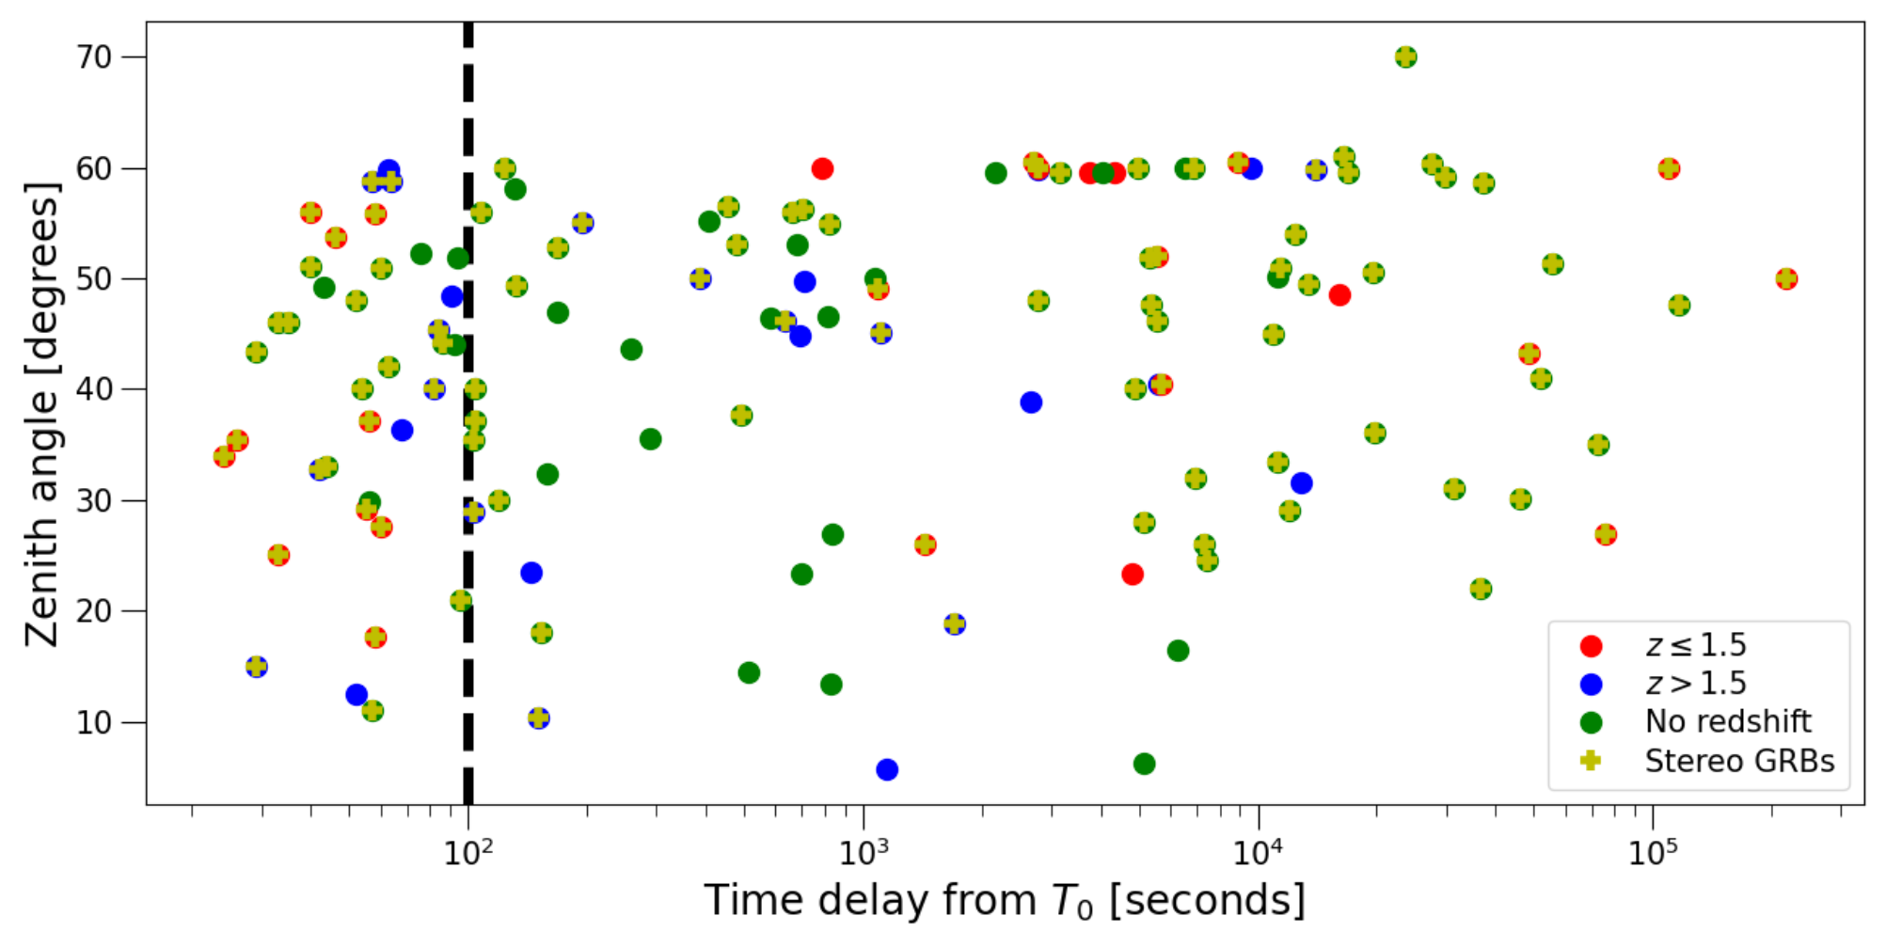
MAGIC GRBs observations
~40 GRBs with delay <100s (red box)
Fastest follow-up: GRB 160821B (24s after T₀)
All GRBs detected by MAGIC or with hints are in the red box (in the early afterglow phase)

Slide 7
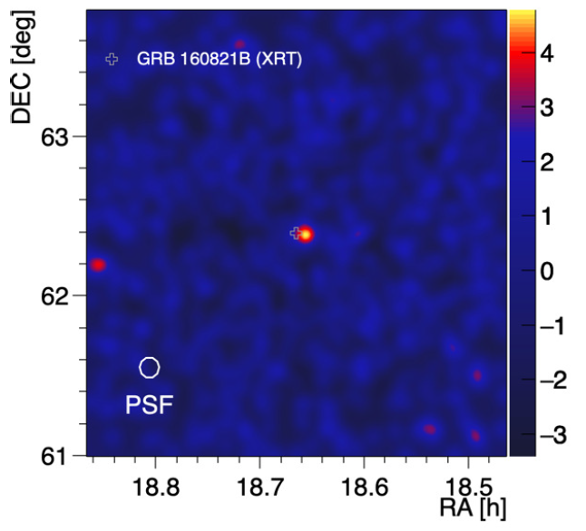
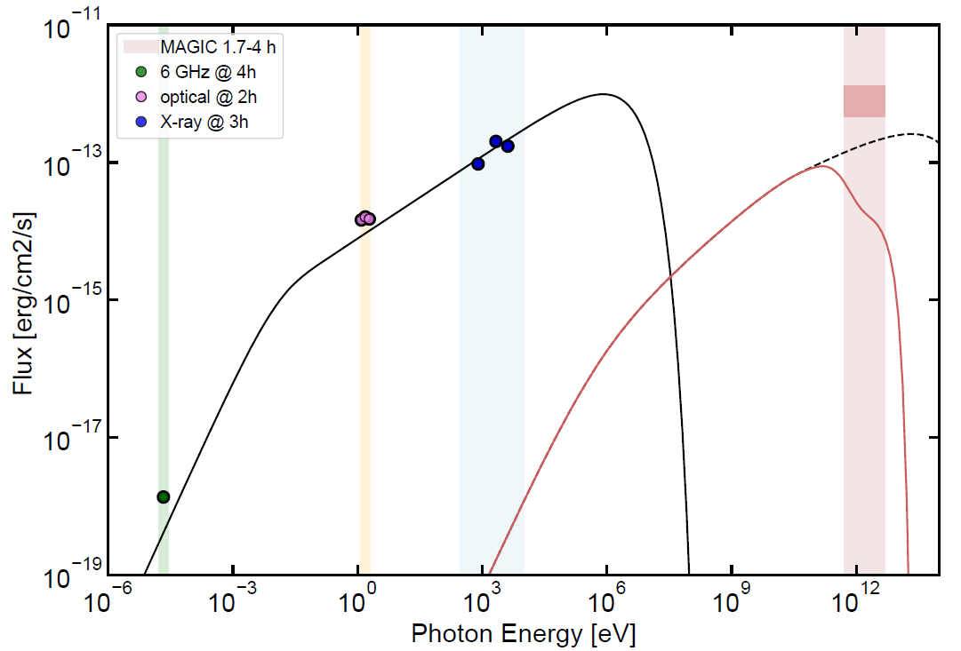
GRB 160821B
ApJ, 908 (2021), 90
Short GRB at low redshift (z=0.16), fast follow-up by MAGIC (24s)
Data affected by moon and partially by bad weather
Hint of detection at 3.1 sigma pre-trial, 2.9 post-trial
Kilonova emission confirmed --> important study in view of GW follow-ups
Simplest emission model (synchrotron + SSC at external forward shock) is in tension with the TeV predicted flux

Slide 8
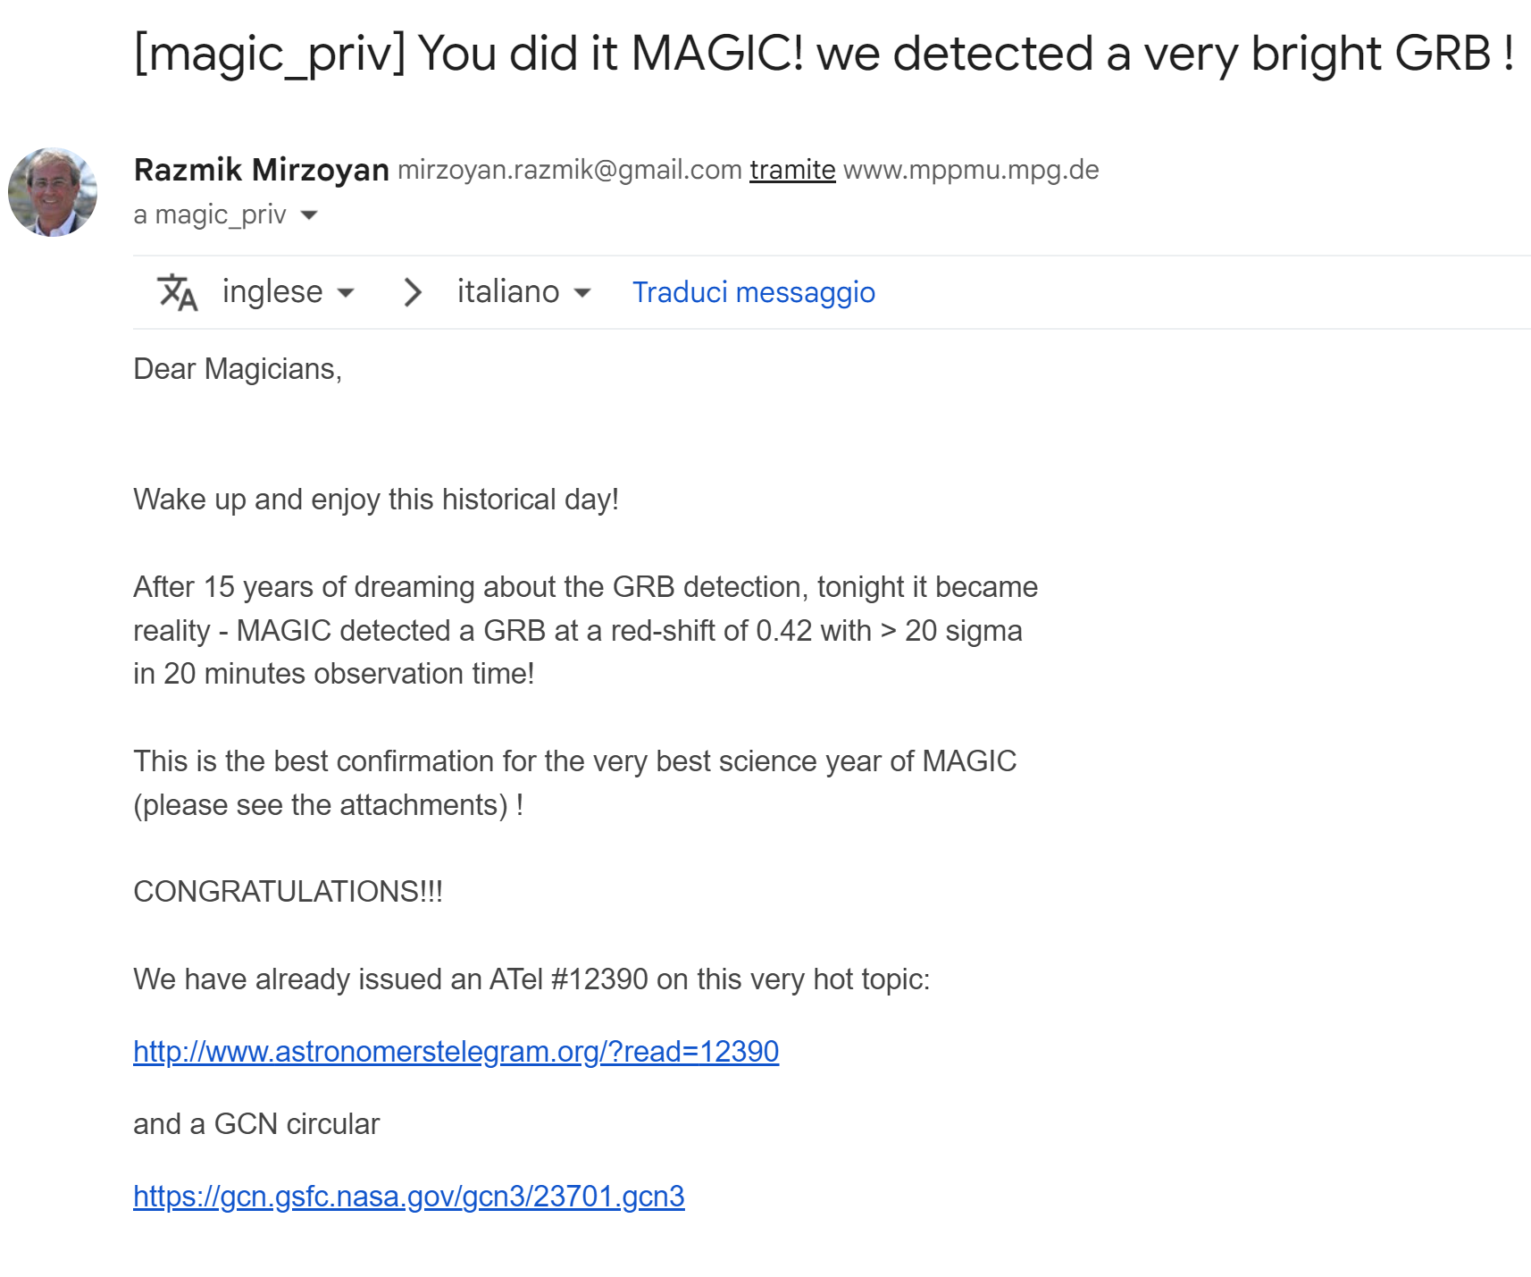

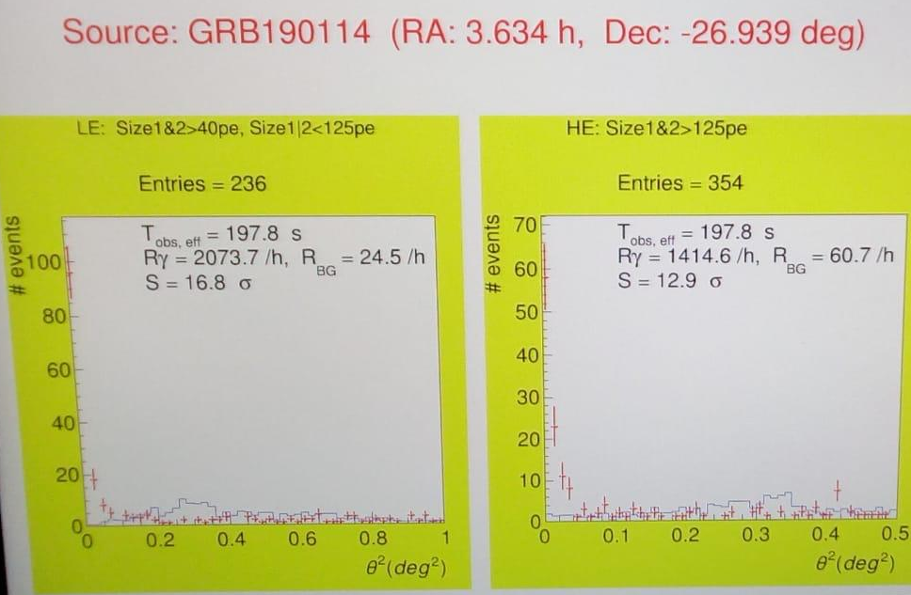
A night to remember: 14th January 2019
The first GRB detected at very-high-energies!
MAGIC real-time analysis after ~3min
Credit: Elena, Cosimo, Mitsunari

Slide 9
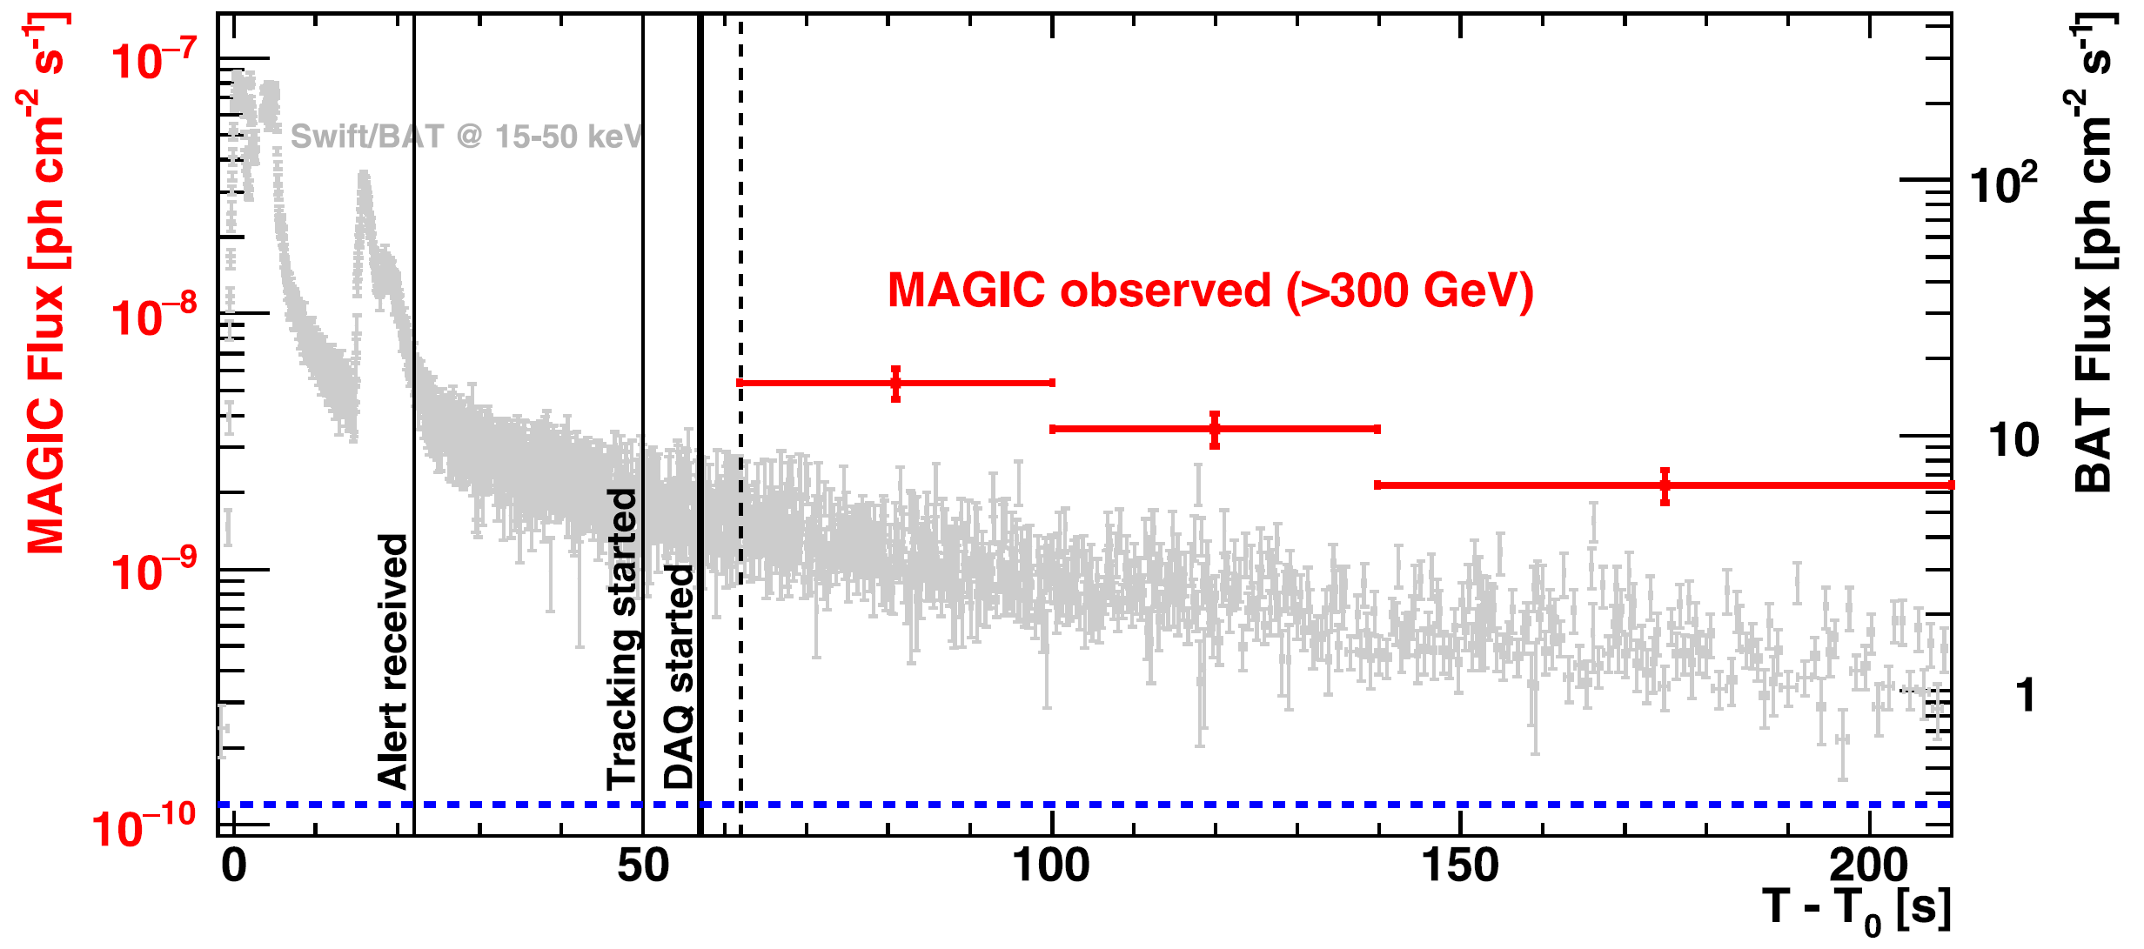
The Rosetta stone: GRB 190114C
GRB 190114C: very bright long (T90~360s) GRB first detected by Swift-BAT and Fermi-GBM, later detected by multiple instruments from radio to TeV
Quite close to Earth for a long GRB: z=0.4245
MAGIC observed with a ~50s delay, but at relatively high zenith and with moon
1 CRAB >300 GeV

Slide 10
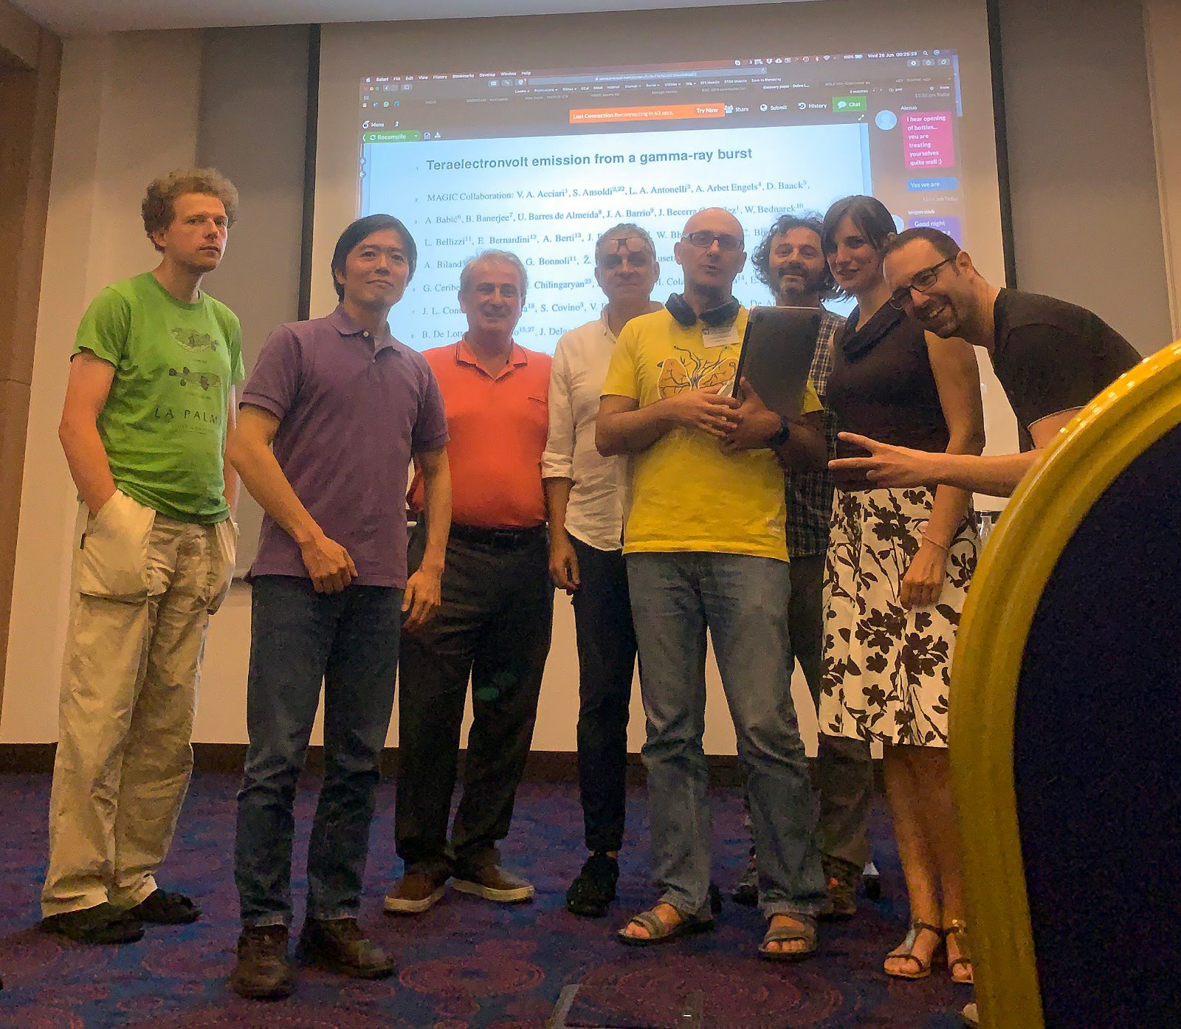
GRB 190114C: some memories
Huge work from the beginning to make sense of the data
A dozen of analyses in the following days
Weekly meetings open to all collaboration to discuss the progress of analyses and papers
Crazy months, but with some nice interludes :)

Slide 11
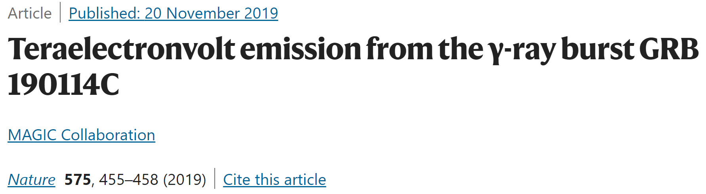
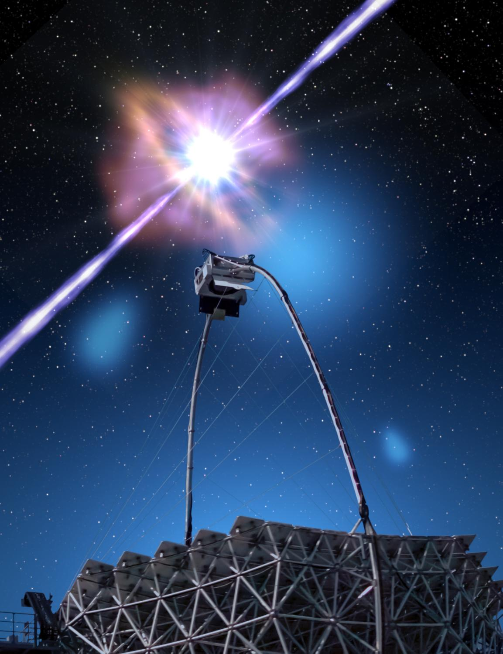
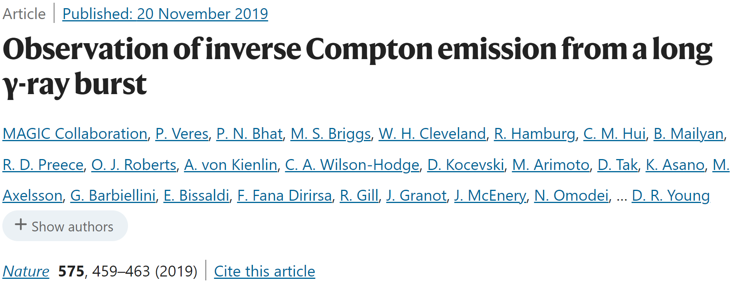
Finally out!

Slide 12
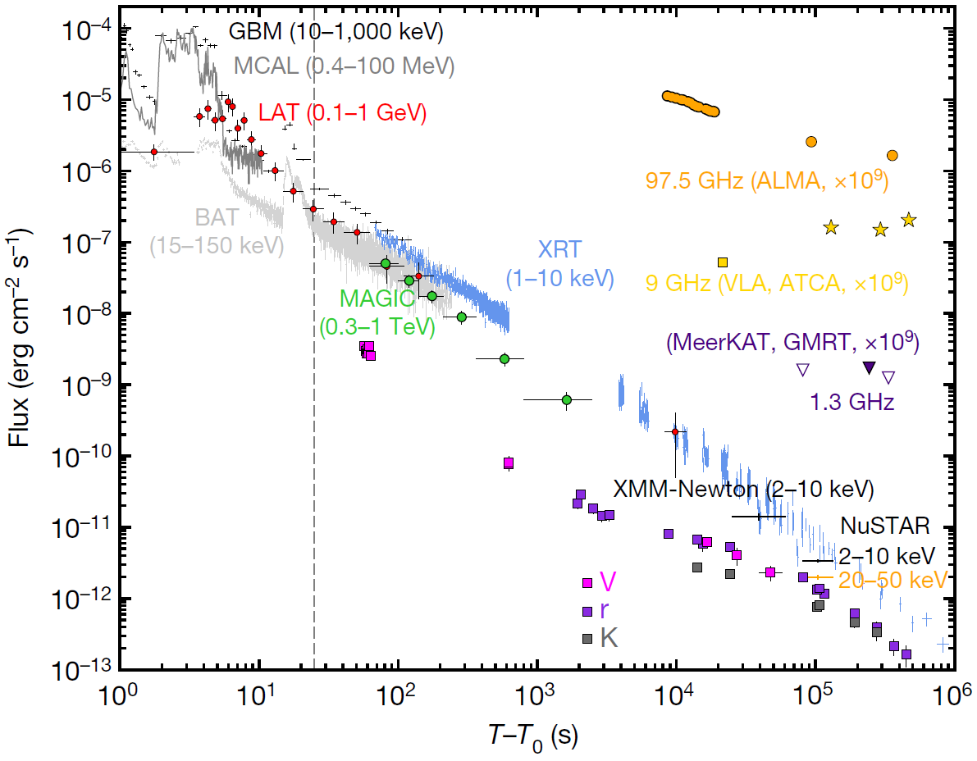
GRB 190114C: MWL light curve
MWL light curve for GRB 190114C: 17 orders of magnitude in energy
TeV light curve has similar smooth temporal decay as the X-ray one
TeV emission likely associated with afterglow phase of the GRB
+
link between processes generating X-rays (synchrotron) and TeV gamma rays
-1.36+/-0.02
prompt
-1.51+/-0.04
afterglow
MAGIC Coll. et al., Nature 575, 459 (aka: MWL paper)

Slide 13
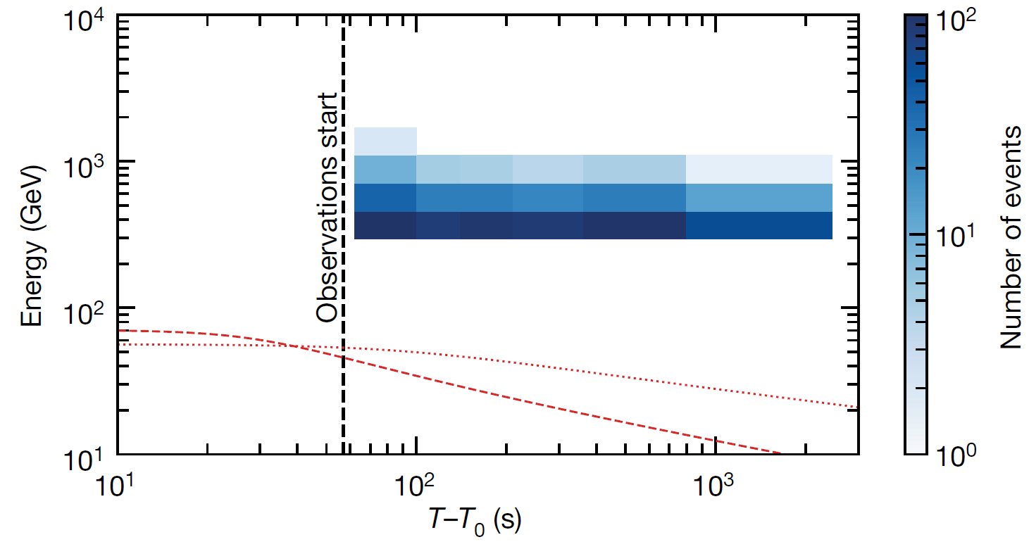
GRB 190114C: photons energy as a function of time
ε_{syn,max} (t) ≈ 100(Γ_{b}(t)/1000) GeV
MAGIC Coll., Nature 575, 455 (aka: discovery paper)
Energy of photons detected by MAGIC well above the synchrotron “burnoff limit” → the emission process cannot be the same as the one producing X-rays

Slide 14
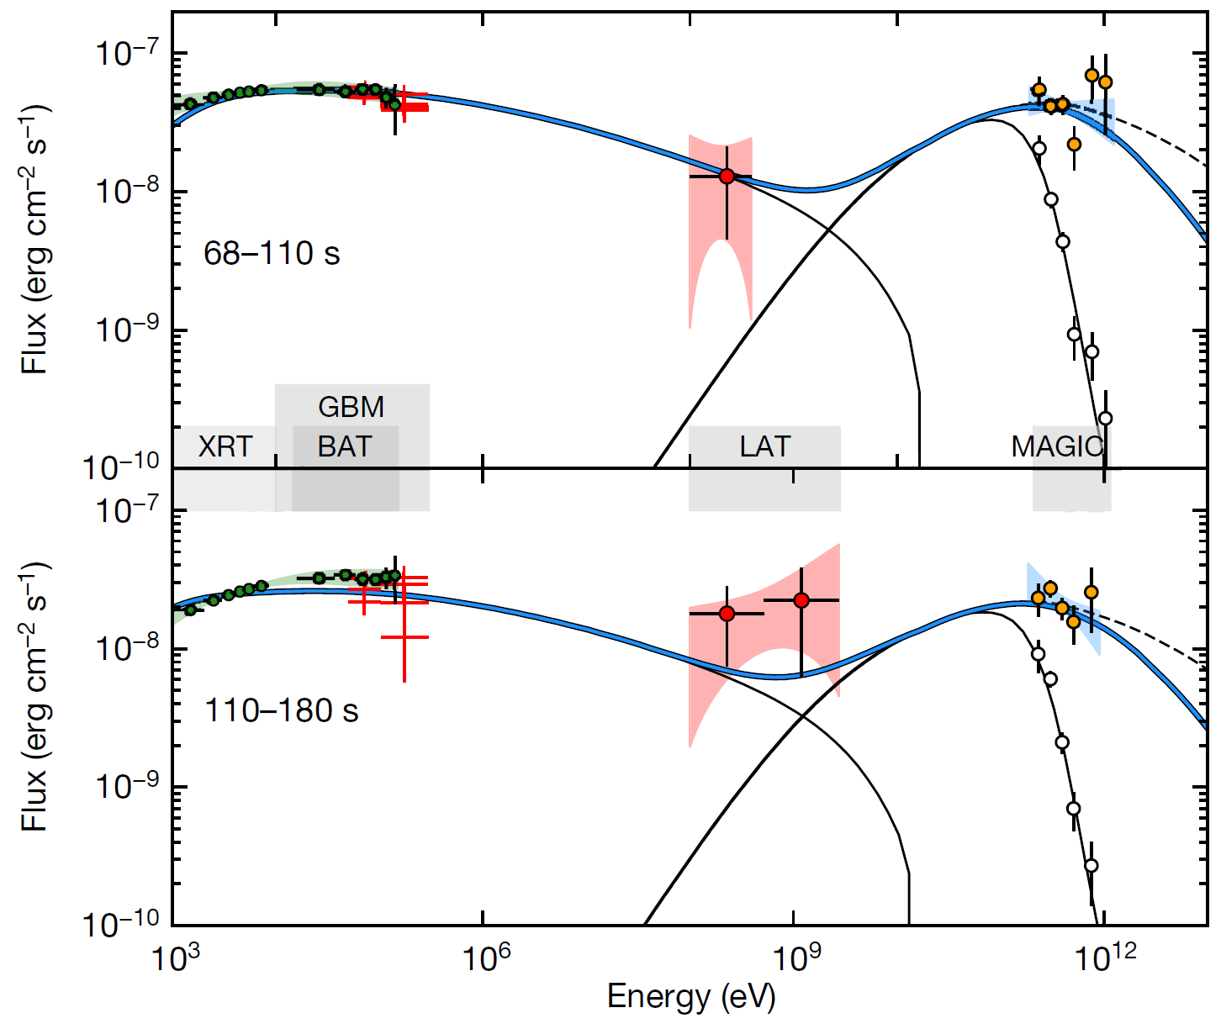
GRB 190114C: SSC modeling
SSC model parameters:
E_{k}~8x10⁵³ erg
p=2.6
n₀=0.5 (constant medium)
𝝐_{b}=8x10⁻⁵
𝝐_{e}=0.07
Efficient amplification of B (few microGauss in unshocked medium) to values of 0.5-5 G
Parameters of the modeling have values similar to those inferred from radio-to-GeV afterglow modeling for previous GRBs
Processes to take into account:
Klein-Nishina
gamma-gamma absorption
MAGIC Coll. et al., Nature 575, 459 (aka: MWL paper)
MWL broadband emission can be modeled by synchrotron self-Compton (SSC) in the forward shock → new emission component!

Slide 15
GRB 190114C: LIV studies
One can use the observed light curve and spectrum to build the likelihood of detecting a LIV effect at a given order n (n=1, 2) and use the maximum likelihood method to constrain the LIV parameters
First study of this kind using GRB data at VHE, but not so sensitive (at least for n=1):
  GRB 190114C is at moderate distance
  it was detected during the afterglow, where light curve is decaying monotonically, so no time variability
  comparable to past results for n=2 (here Mrk 501 is better given that Emax ~ 10 TeV)

Slide 16
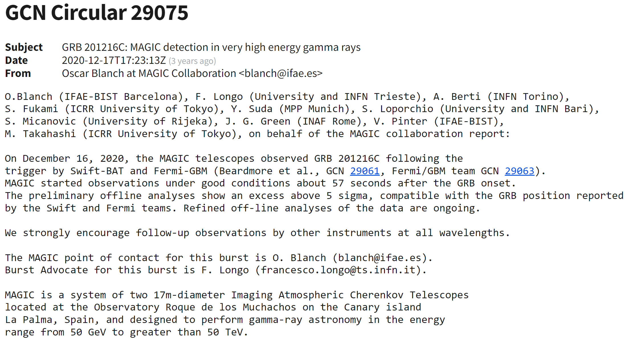
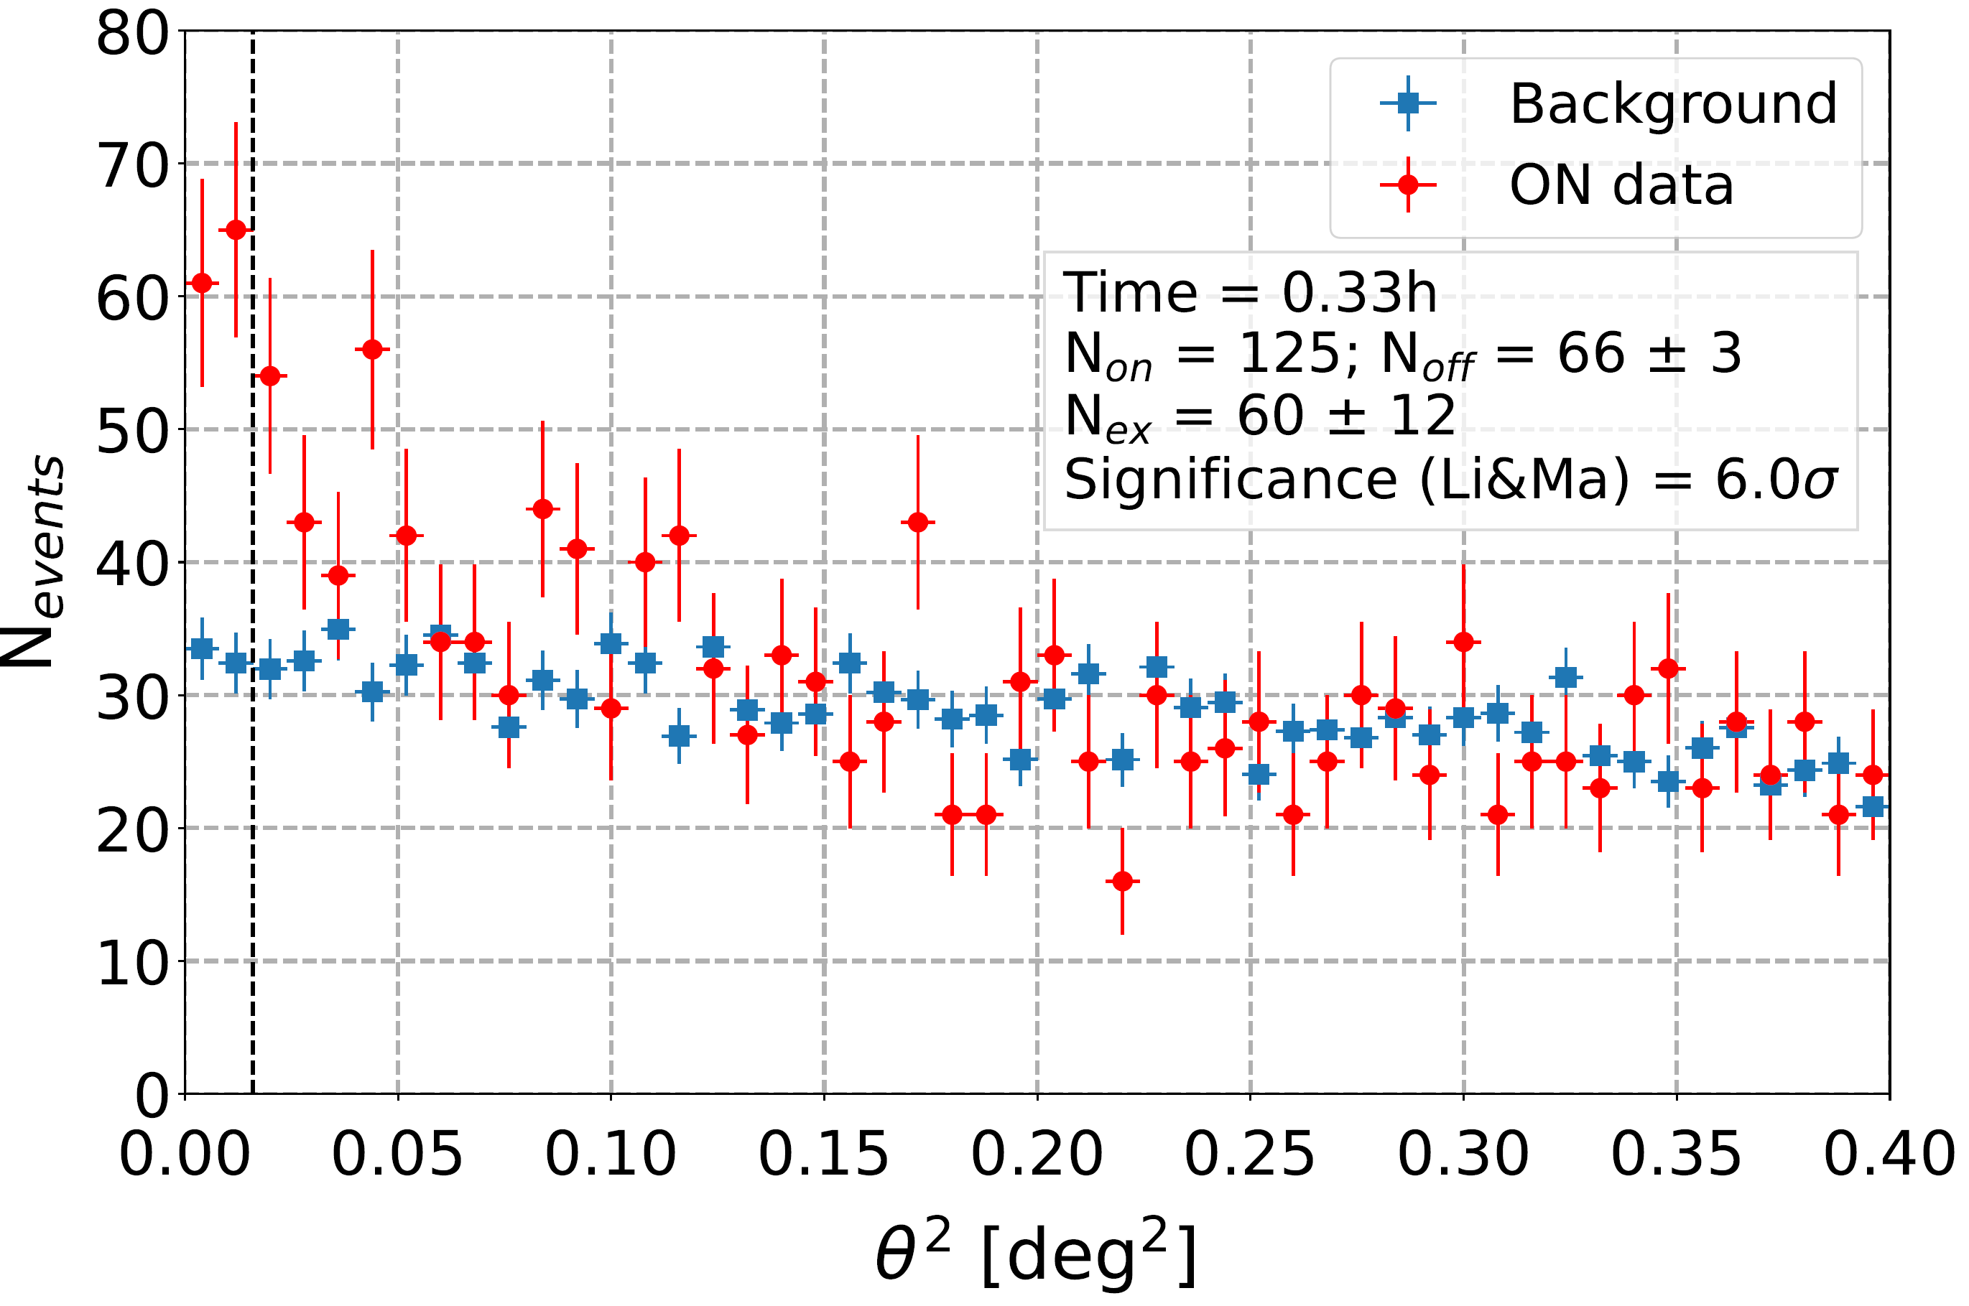
Not stopping there...
Detecting GRB 190114C was a milestone, however it is not enough
  we need more GRBs detected at VHE to understand them better!
Here comes GRB 201216C at z=1.1!
  paper accepted for publication on September 22nd: the 200th MAGIC paper! :)))
  farthest source detected by IACTs so far

Slide 17
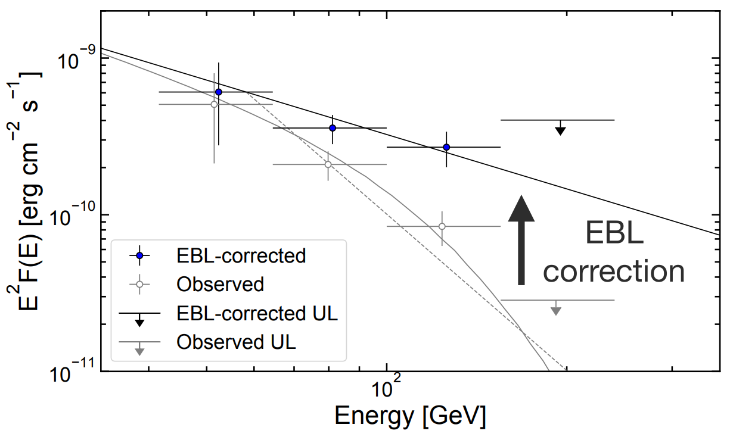
GRB 201216C: challenging analysis
Large absorption of the VHE flux by the EBL --> steep observed spectrum with index around -5.3
Studied systematics due to different EBL models and different energy scale

Slide 18
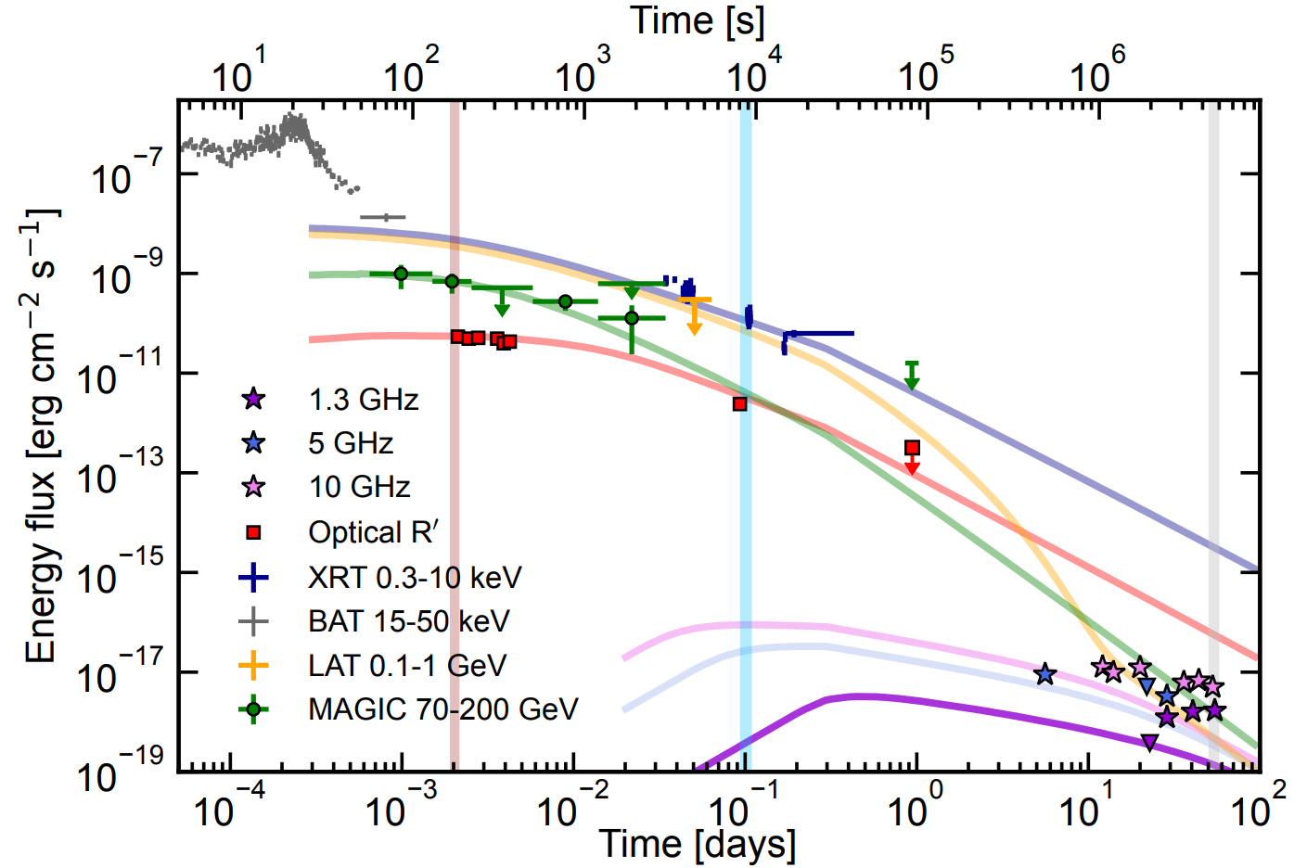
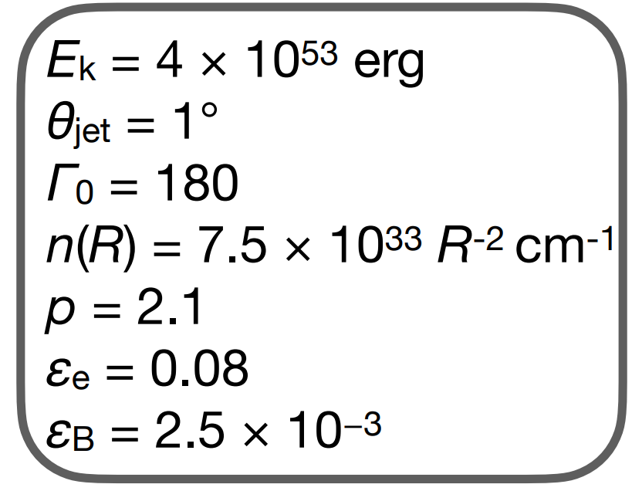
GRB 201216C: modeling
MWL fluxes are consistent with the synchrotron+SSC model (Miceli&Nava 2022)
  Sub-TeV emission is well above the maximum synchrotron energy (~10 GeV at T0+~177 s)
  No solution found with a homogeneous density medium

Slide 19
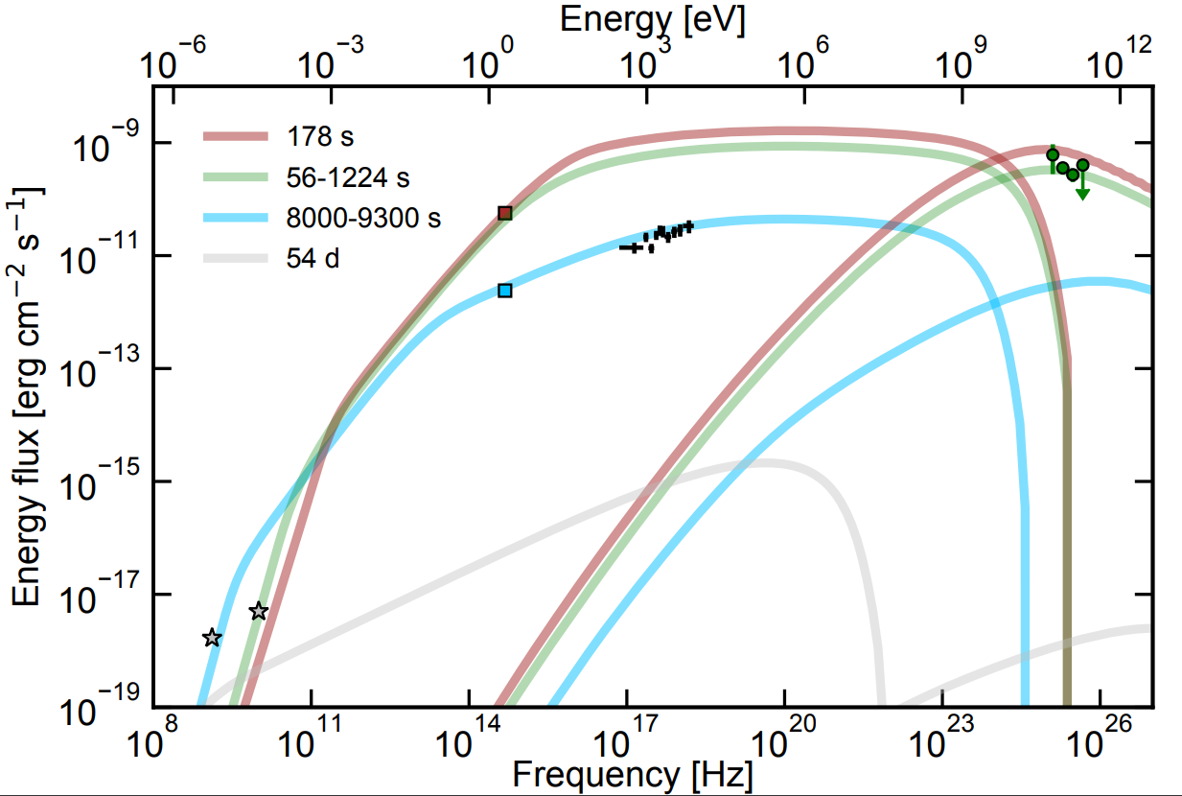
GRB 201216C: modeling
MWL fluxes are consistent with the synchrotron+SSC model (Miceli&Nava 2022)
  Sub-TeV emission is well above the maximum synchrotron energy (~10 GeV at T0+~177 s)
  No solution found with a homogeneous density medium

Slide 20
Lessons learned
Continued effort pays off at the end!
  certainly technical developments played a role (alert systems, improvement in the sensitivity, lowered energy threshold, ability to observe in diverse weather conditions)
  changes in strategies e.g. observe not only close to the onset, but also much later, especially for bright events
VHE emission is there, it can be detected if GRB is relatively close
  GRB 201216C is a (very welcome) exception
VHE emission is present both in the early and late afterglow
Similarities between flux level in X-ray and VHE bands, also similar time decay
MWL data crucial for proper modeling of the emission
  golden data set for GRB 190114C
SSC as possible universal process to explain TeV emission?
  SSC can explain GRB 180720B, GRB 190114C, GRB 201216C and possibly GRB 190829A

Slide 21
Prospects of GRB searches with MAGIC
Our understanding of the afterglow emission is still uncertain despite the recent detected events
  alternative emission models (e.g. hadronic)?
  we need more GRBs detected at VHE!
Another major breakthrough would be the detection of VHE emission during the prompt phase – crucial info on the emission process, still heavily debated
  current and new ground-based wide field of view instruments (HAWC, LHAASO, SWGO...) may be better suited for this task --> see GRB 221009A example aka the BOAT
VHE emission from short GRBs? Strong hint from GRB 160821B by MAGIC
  interesting in relation to GW searches
New physics?
  Lorentz Invariance Violation (we would need a distant GRB detected in the prompt)
  Axion-like particles (search for signatures in the spectra; GRBs detected at high redshift)
  EBL studies?

Slide 22
Summary
It took 15 years, but feasability of GRB detection with IACTs was finally proven with MAGIC!
Even with two events detected by MAGIC, a wealth of information on emission mechanism
  additional component
  preference for wind-like scenarios?
  jet opening angle
  magnetic field
  ....
We keep continuing the follow-up, we want/need more GRBs at VHE!
  however, also non detected GRBs can be used for constraining models
A GRB+GW+neutrino event in the future?

