Slide 1
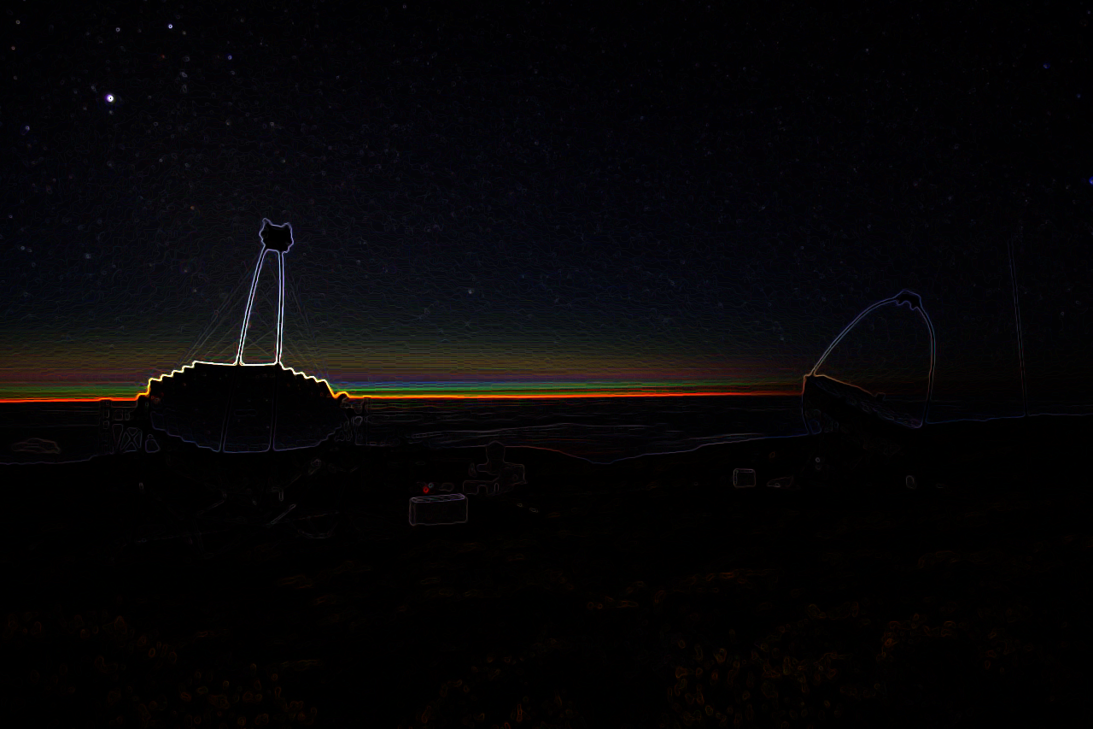
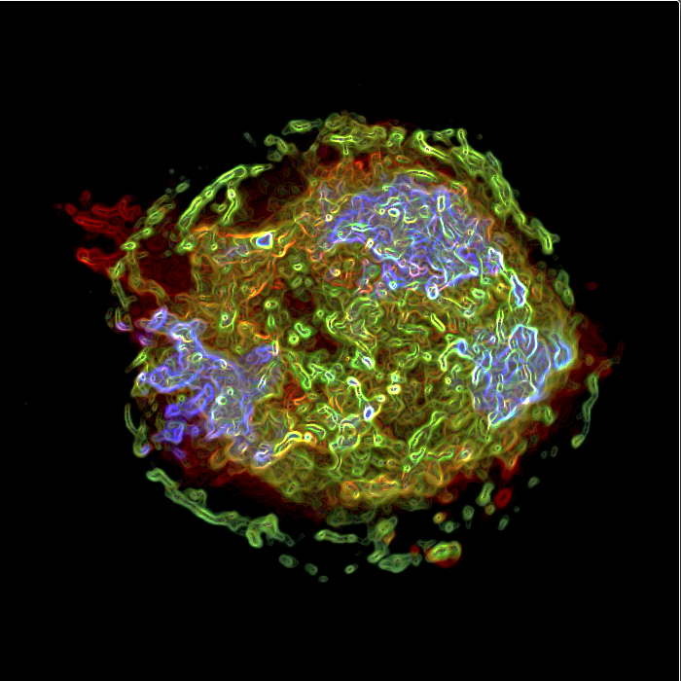
Supernovae as PeV CRs Accelerators
The MAGIC telescopes at the Roque de los Muchachos Observatory Credit: Daniel López/IAC
20 MAGIC Years Conference and Symposium
NASA Marshall Space Flight Center (NASA-MSFC)
Emma de Oña Wilhelmi - DESY-Zeuthen, Germany

Slide 2
The Cosmic Rays Dilema
Origin of CRs
knee
2nd knee
Galactic Origin
ankel
dOW, L-C et al, 2023
Credit: Ruben Lopez-Coto
Notes:
3. Spectral features:
Power-law up with index 2.7 up to the knee, then steepening to 3.1.
Knee at 10¹⁵−10¹⁶ eV (second knee at 10¹⁷ eV) indicated maximum energy of Galactic accelerators.
Ankle at 10^{18.5} eV indicates the transition from galactic to extra-galactic cosmic rays.
Cutoff at 10^{19.5} eV could indicate the maximum energy of the extragalactic accelerators or the GZK cut-off

Slide 3
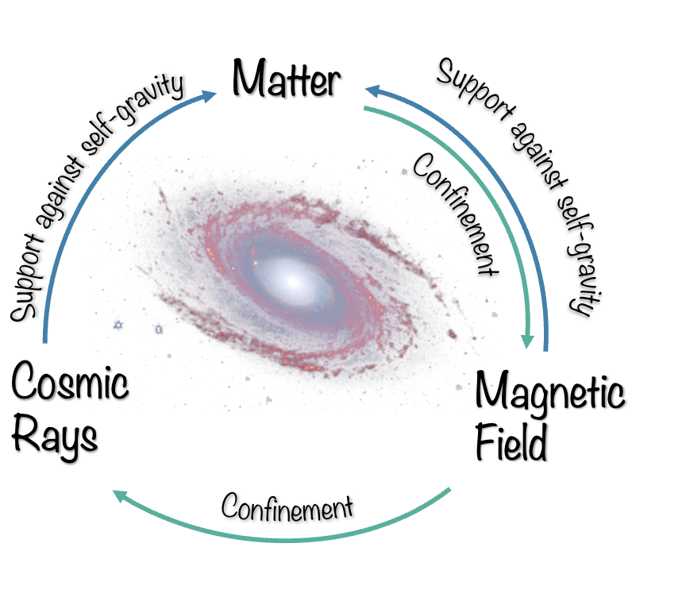
Why are CRs important
The role of CRs in the Galaxy dynamics
Dynamic balance processes trigger instabilities in the Galaxy structure
ωCR ~1 eV/cm³
ωB = B²/8π ~1 eV/cm³
ω^{turb} gas = ρgas v²turb ~1 eV/cm³

Slide 4
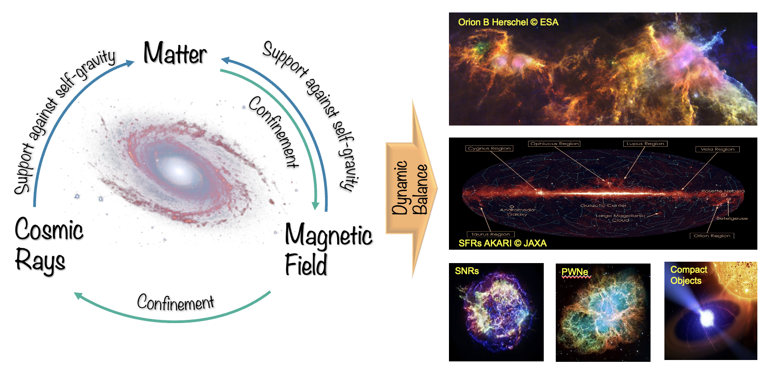

Slide 5
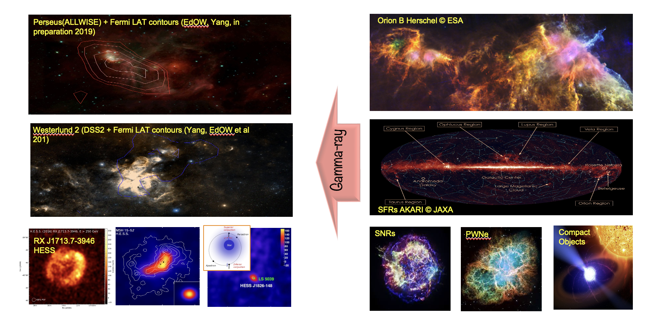
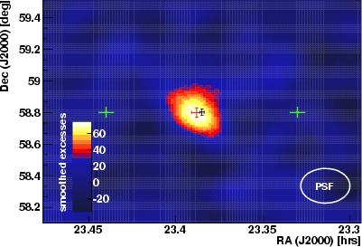
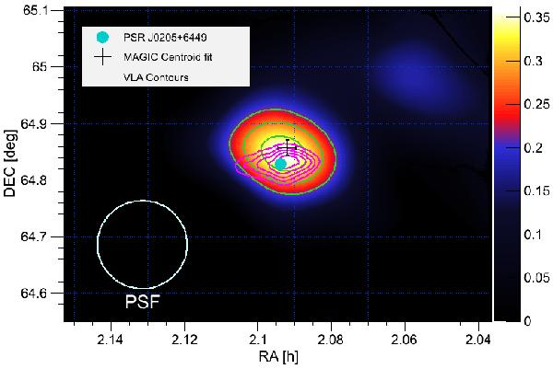
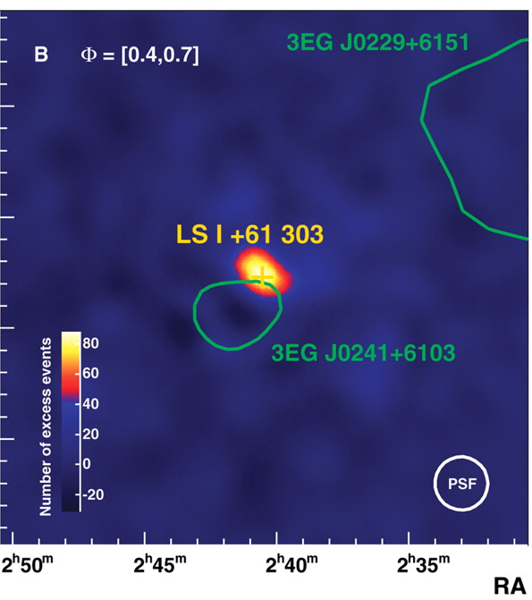
Bright Gamma-ray Sources
MAGIC Col. 2007
MAGIC Col. 2014
MAGIC Col. 2006

Slide 6
The Cosmic Rays Dilema
Origin of CRs
knee
2nd knee
Galactic Origin
ankel
dOW, L-C et al, 2023
Credit: Ruben Lopez-Coto
Notes:
3. Spectral features:
Power-law up with index 2.7 up to the knee, then steepening to 3.1.
Knee at 10¹⁵−10¹⁶ eV (second knee at 10¹⁷ eV) indicated maximum energy of Galactic accelerators.
Ankle at 10^{18.5} eV indicates the transition from galactic to extra-galactic cosmic rays.
Cutoff at 10^{19.5} eV could indicate the maximum energy of the extragalactic accelerators or the GZK cut-off

Slide 7
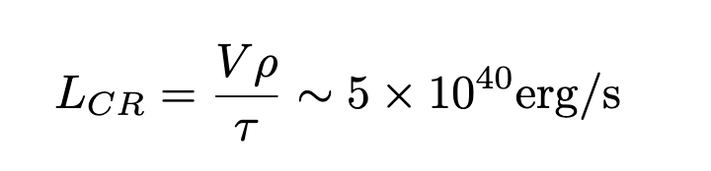
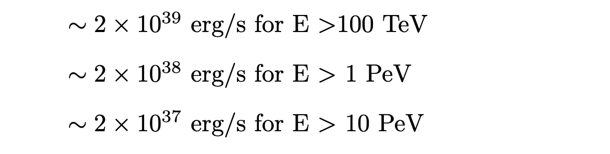
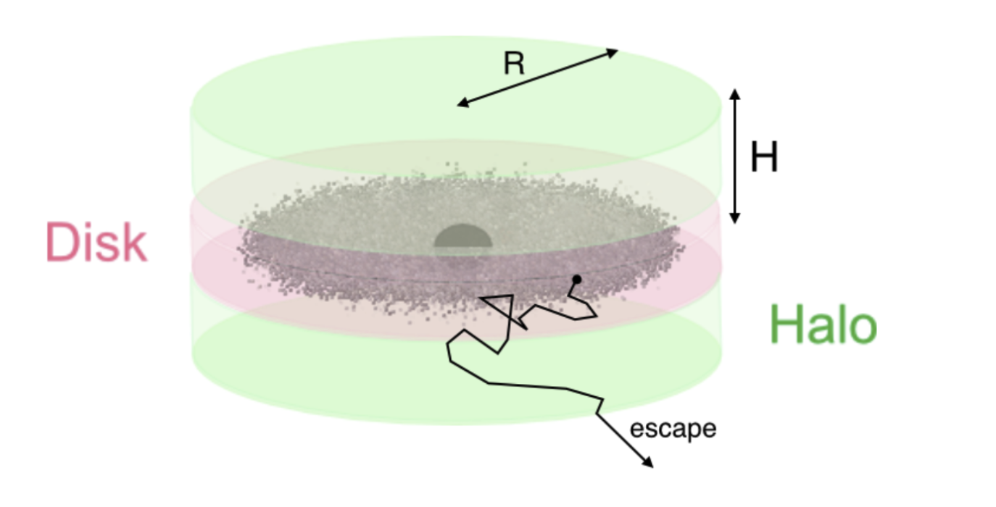

The Cosmic Rays Dilema
Origin of CRs
PeVatrons should:
Provide conditions to reach PeV energies (obviously)
Provide enough luminosity
dOW, L-C et al, 2023
Credit: Ruben Lopez-Coto
Notes:
3. Spectral features:
Power-law up with index 2.7 up to the knee, then steepening to 3.1.
Knee at 10¹⁵−10¹⁶ eV (second knee at 10¹⁷ eV) indicated maximum energy of Galactic accelerators.
Ankle at 10^{18.5} eV indicates the transition from galactic to extra-galactic cosmic rays.
Cutoff at 10^{19.5} eV could indicate the maximum energy of the extragalactic accelerators or the GZK cut-off

Slide 8


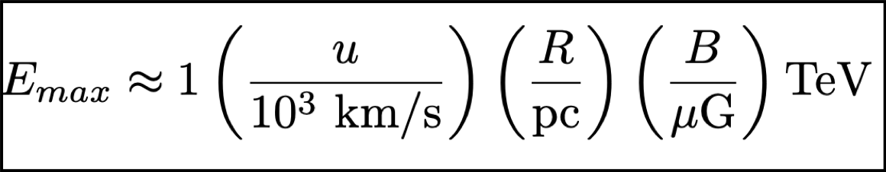
The candidates
Hillas Plot: Maximum Energy
Confinements condition:
dOW, Lopez-Coto et al, 2023

Slide 9
The candidates
Hillas Plot: Maximum Energy
Confinements condition:
dOW, Lopez-Coto et al, 2023

Slide 10
The candidates
Hillas Plot: Maximum Energy
Confinements condition:
Young SNRs can:
Provide right acceleration conditions
v_{sh}~10³ km/s, B ~ mG
Provide enough luminosity.
Explosion energy (2-3 century)
E_{kin} = 10⁵¹ erg => L = 10⁴² erg/s = 10xL_{CR}
dOW, Lopez-Coto et al, 2023

Slide 11
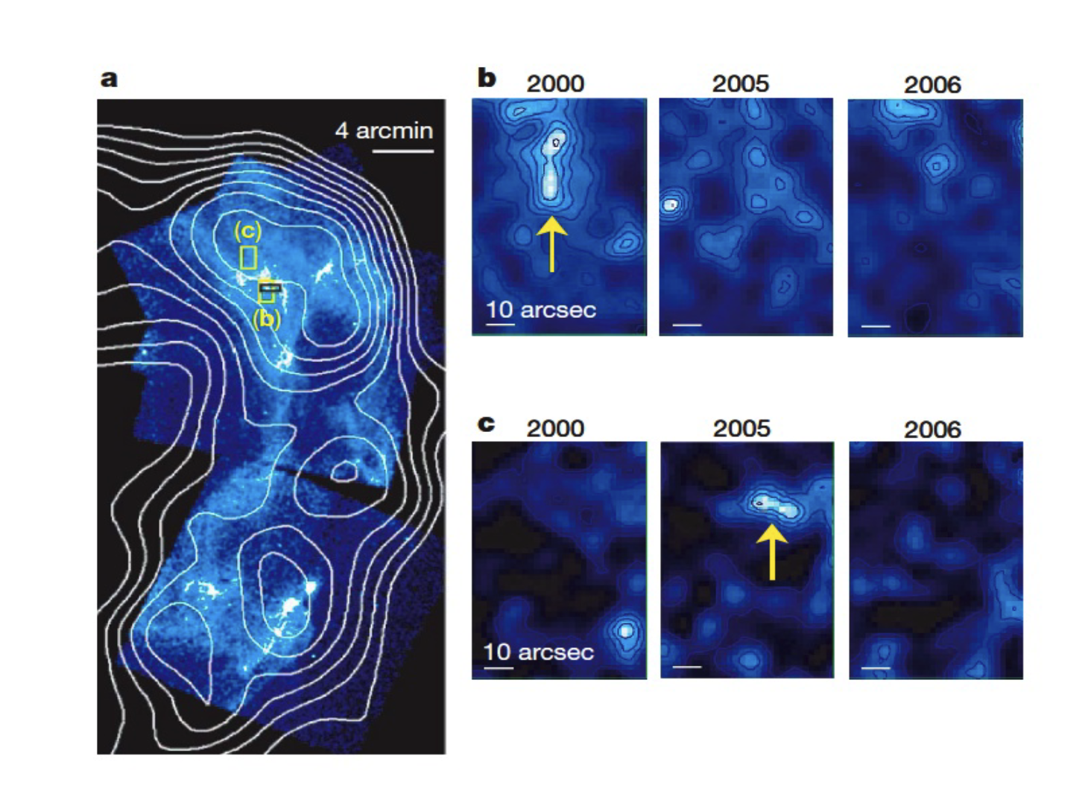
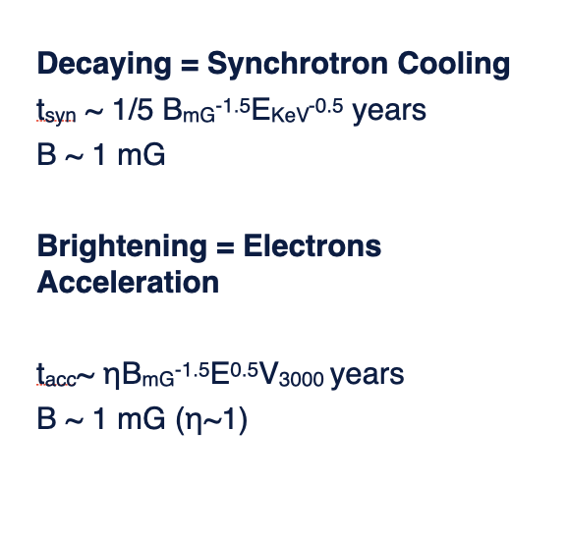
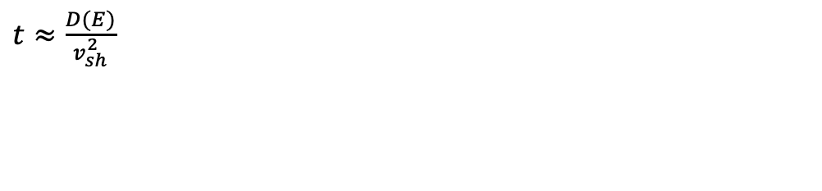

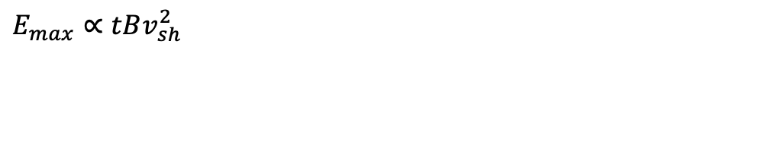
Diffuse Shock Acceleration in SNRs
Maximum Energy
The diffuse shock acceleration scale is given by
$t≈\frac{D(E)}{v_{sh}^{2}}$
$E_{max}∝tBv_{sh}^{2}$
$D∝r_{L}∝E/B$
Uchiyama et al, 2017

Slide 12
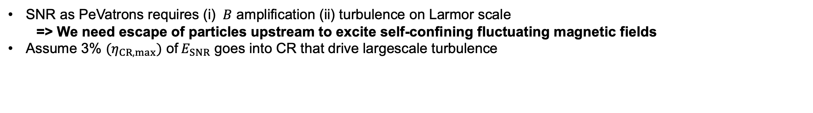
Supernova as PeV accelerators: theory
The maximum energy attained in SNRs
SNR as PeVatrons requires (i) $B$ amplification (ii) turbulence on Larmor scale
=> We need escape of particles upstream to excite self-confining fluctuating magnetic fields
Assume 3% $(η_{CR,max})$ of$E_{SNR}$ goes into CR that drive largescale turbulence
Bell et al 2013

Slide 13
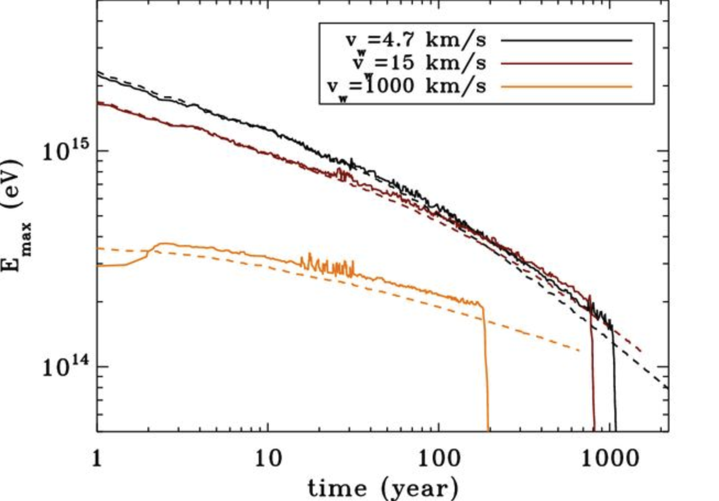
Supernova as PeV accelerators
The maximum energy
SNR as PeVatrons requires (i) $B$ amplification (ii) turbulence on Larmor scale
=> We need escape of particles upstream to excite self-confining fluctuating magnetic fields
Assume 3% $(η_{CR,max})$ of$E_{SNR}$ goes into CR that drive largescale turbulence
With wind profile density
Bell et al 2013
SNRs can accelerate to PeV only when they are young, and the shock is fast
PeV
Schure, Bell 2013

Slide 14
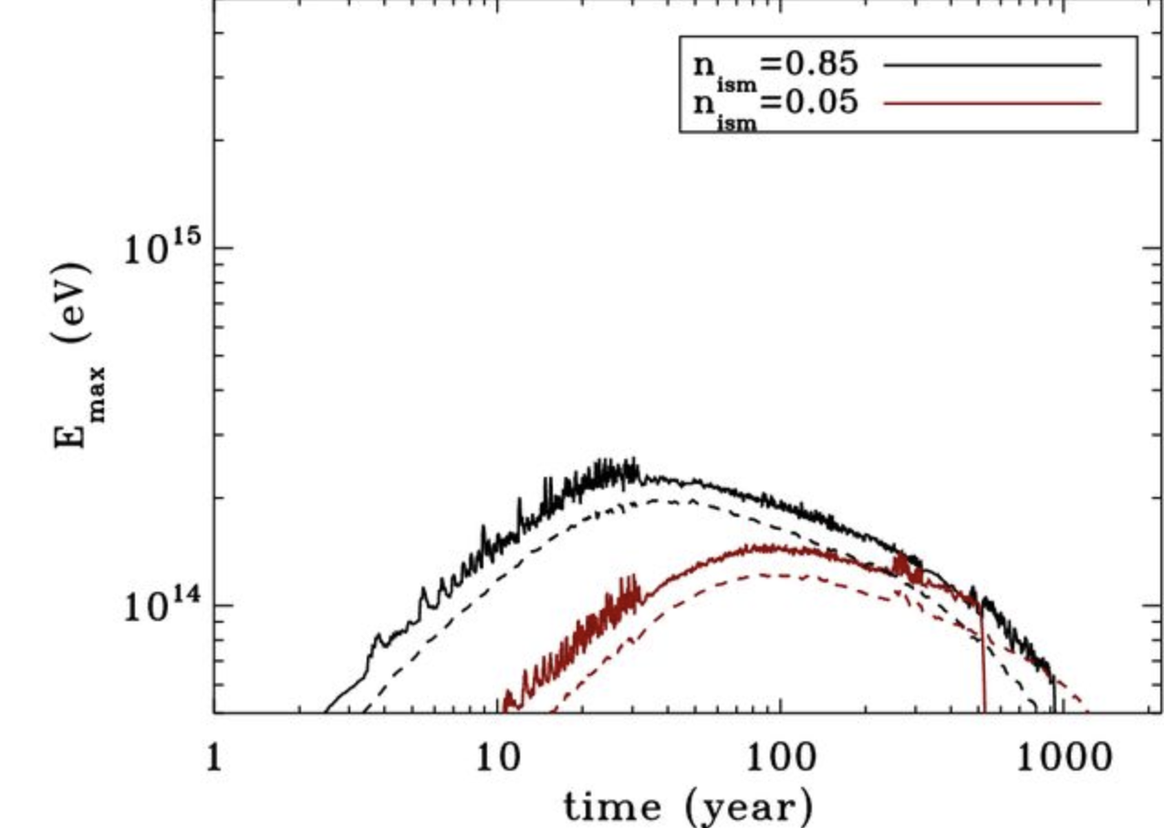
Supernova as PeV accelerators
The maximum energy
SNR as PeVatrons requires (i) $B$ amplification (ii) turbulence on Larmor scale
=> We need escape of particles upstream to excite self-confining fluctuating magnetic fields
Assume 3% $(η_{CR,max})$ of$E_{SNR}$ goes into CR that drive largescale turbulence
With ISM
Bell et al 2013
SNRs can accelerate to PeV only when they are young, and the shock is fast
SNRs in dense winds (type II/Ib/c) are better candidates

Slide 15

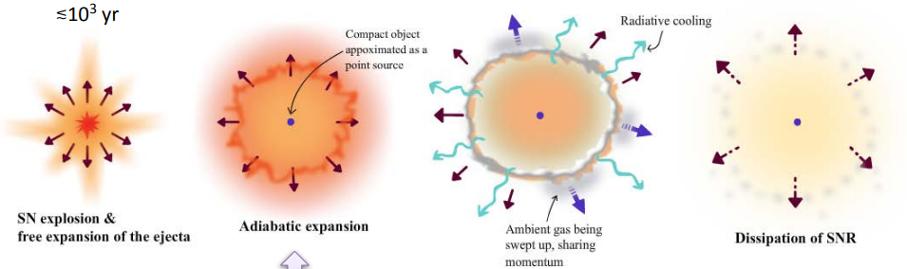
Summary of 20 years of observational results
Are SNRs PeVatrons at some point of their evolution?
Decreasing shock velocity
(Sedov-Taylor, or atomic bomb)
t_{cool} >> t_{dyn}

Slide 16
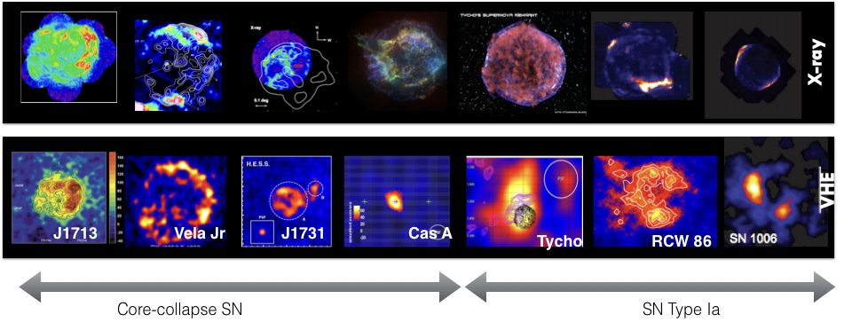
Shell-like SNRs
TeV SNRs
Sedov-Taylor phase: Maximum of the gamma-ray luminosity?

Slide 17
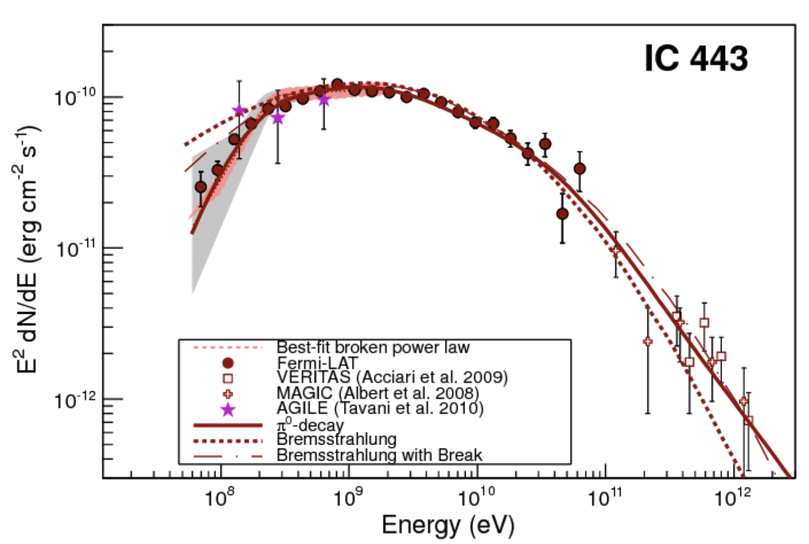
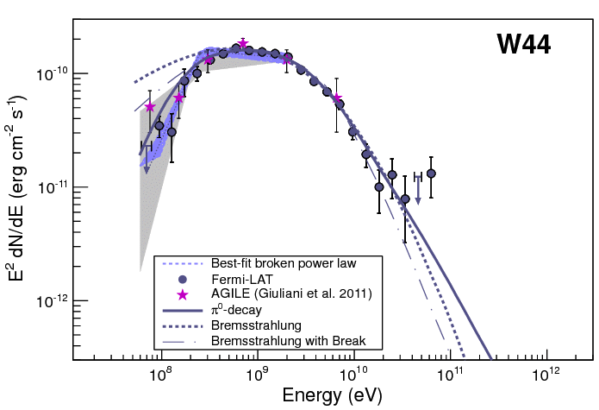
Evolved SNRs
TeV SNRs
Hadronic feature in evolved SNRs, but very steep spectra

Slide 18
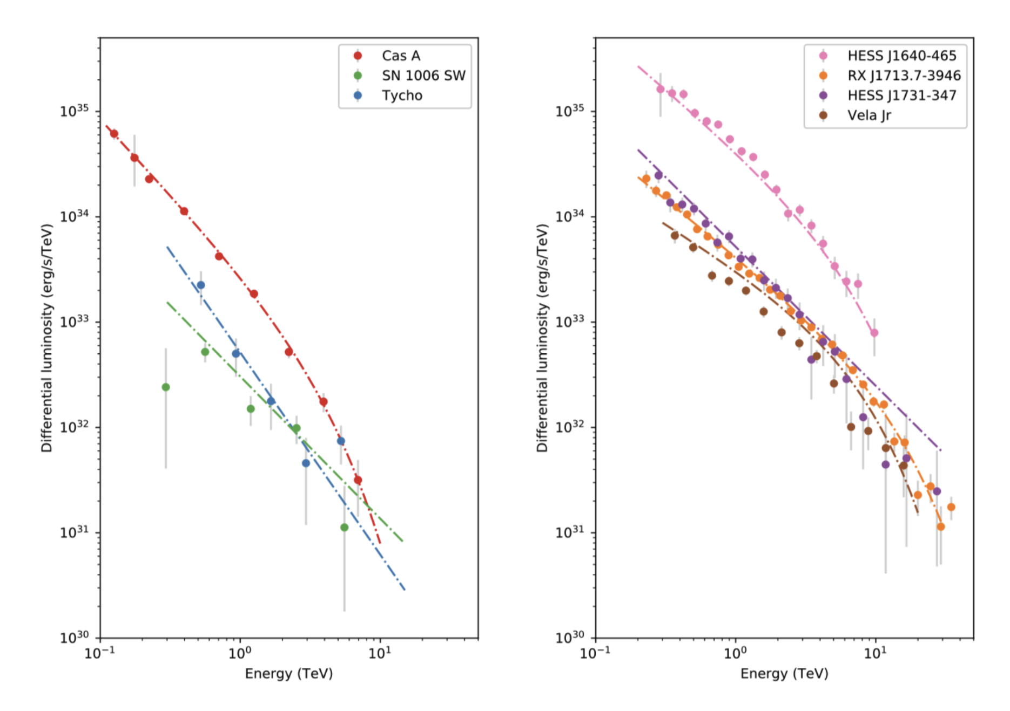
spectra of young SNRs above 1 TeV - steep with Γ= 2.3-2.6

Slide 19
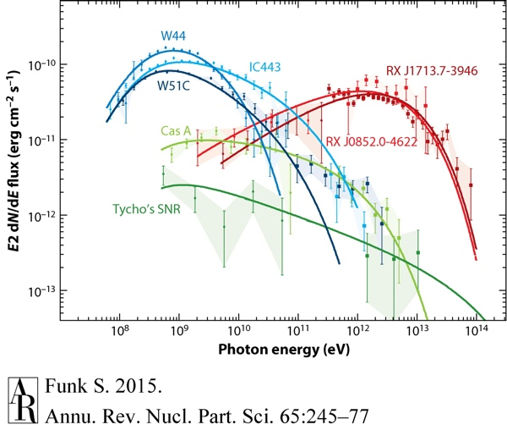

Slide 20
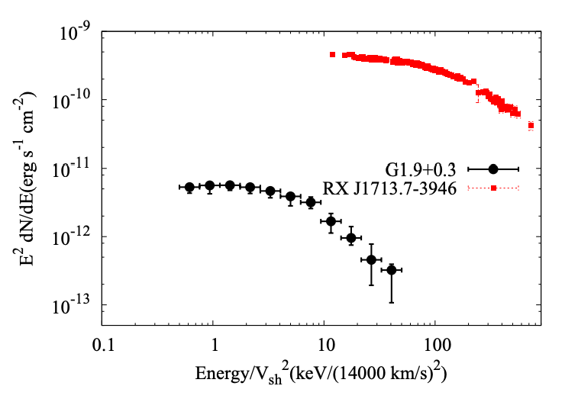

Shell-like SNRs
TeV SNRs
No convincing evidence has been found yet re. PeV acceleration in young SNRs
=> What about the very young SNRs in free expansion?
For B>>10 uG, the cutoff of the synchrotron is determined only for v²_{sh}
In the Bohm diffusion limit, syn peak ~20 keV
SNR G1.9+0.3
See also Tsuji et al 2022
E_{c} ~ 1.5 keV
Not now!
Aharonian, Sun, Yang A&A 2017
τ ~150 yrs, v_{sh} ~ 14000 km/s

Slide 21
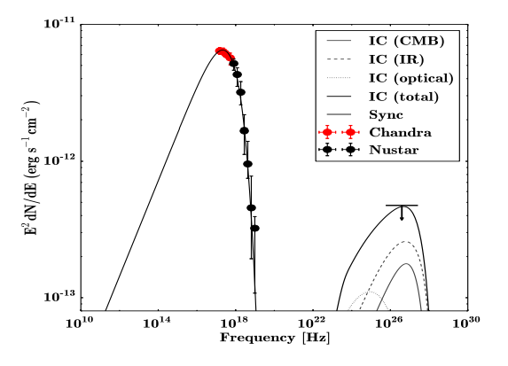
Shell-like SNRs
TeV SNRs
No convincing evidence has been found yet re. PeV acceleration in young SNRs
=> What about the very young SNRs in free expansion?
R(D=10³⁰cm²/s) <~30pc => 10’
W_{p}(n~100 cm⁻³)<10⁴⁵ erg/s
SNR G1.9+0.3
Not then
τ ~150 yrs, v_{sh} ~ 14000 km/s
Yang & Aharonian, A&A 2018

Slide 22
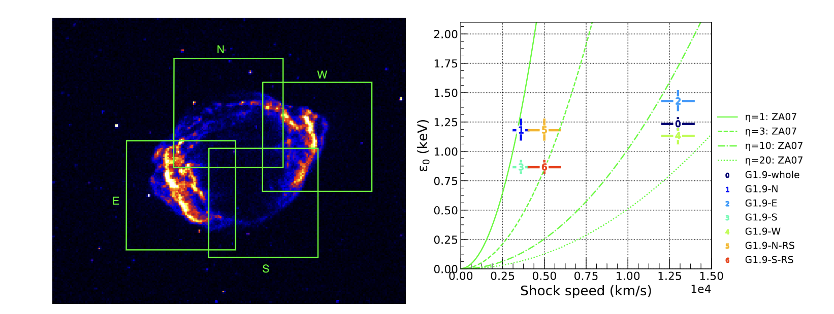
Shell-like SNRs
Caveat
BUT !!! SNRs are very large, complex objects
Tsuji, A&A 2021

Slide 23
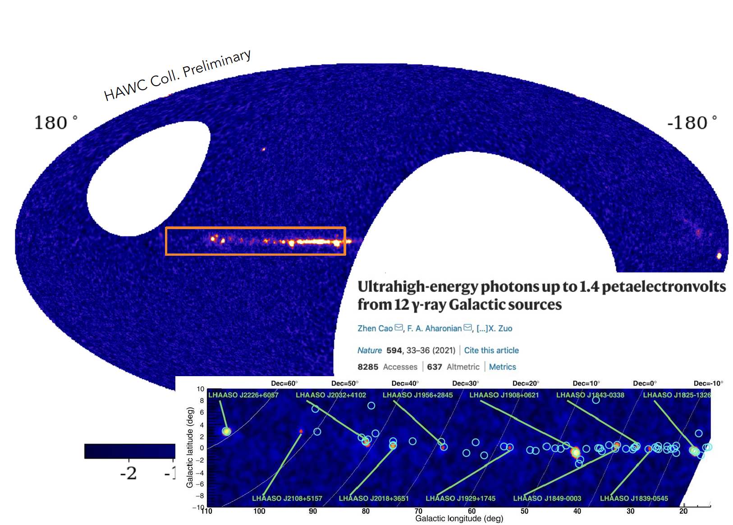
LHAASO
Opening the PeV sky

Slide 24
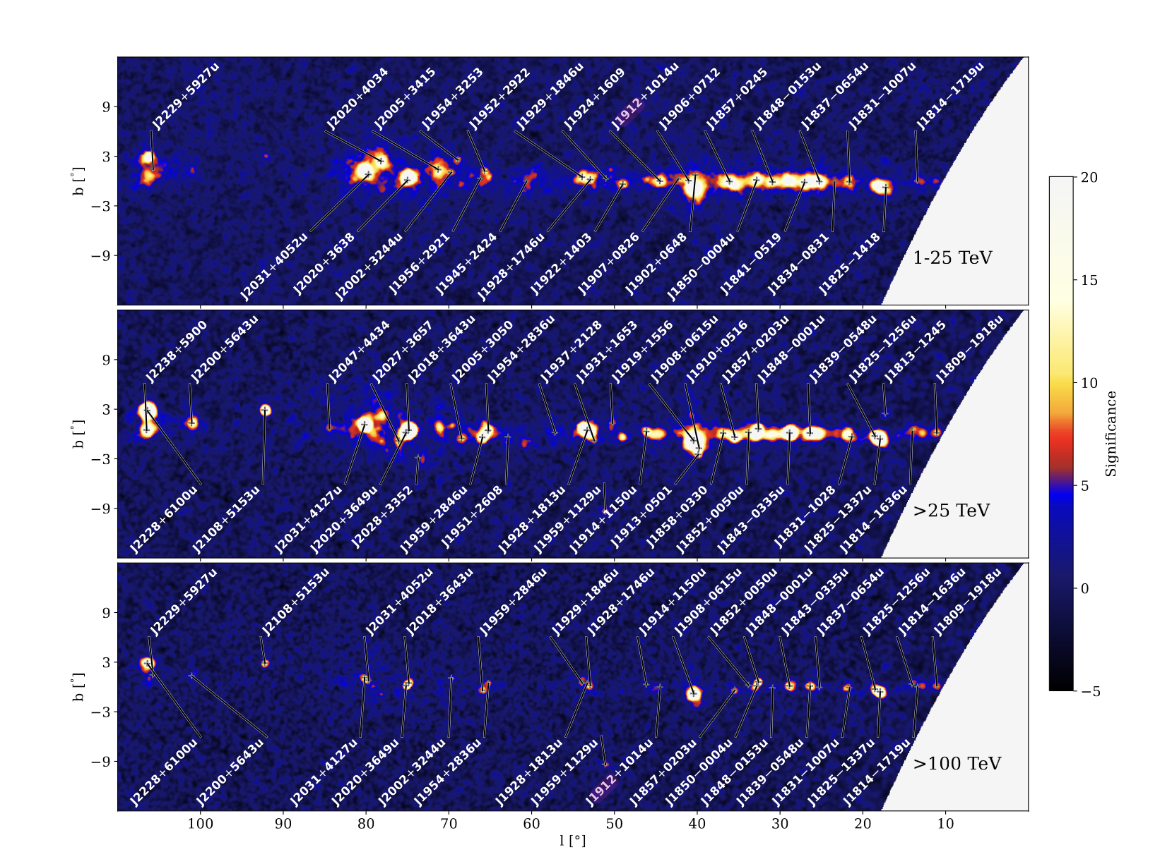
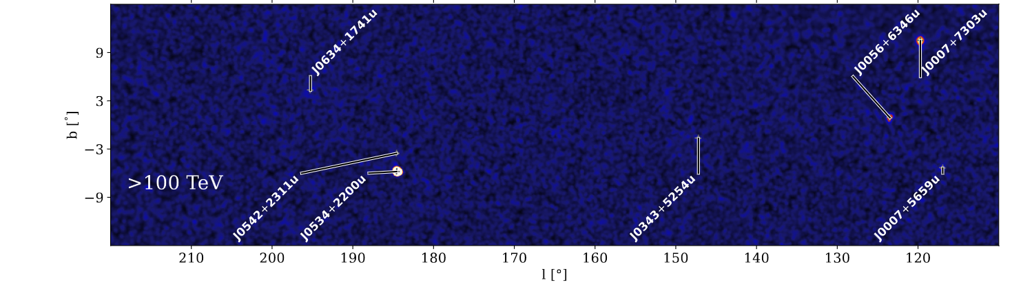
LHAASO
E_{γ} > 100 TeV
Opening the PeV sky
No obvious shell
LHAASO Col, 2023

Slide 25
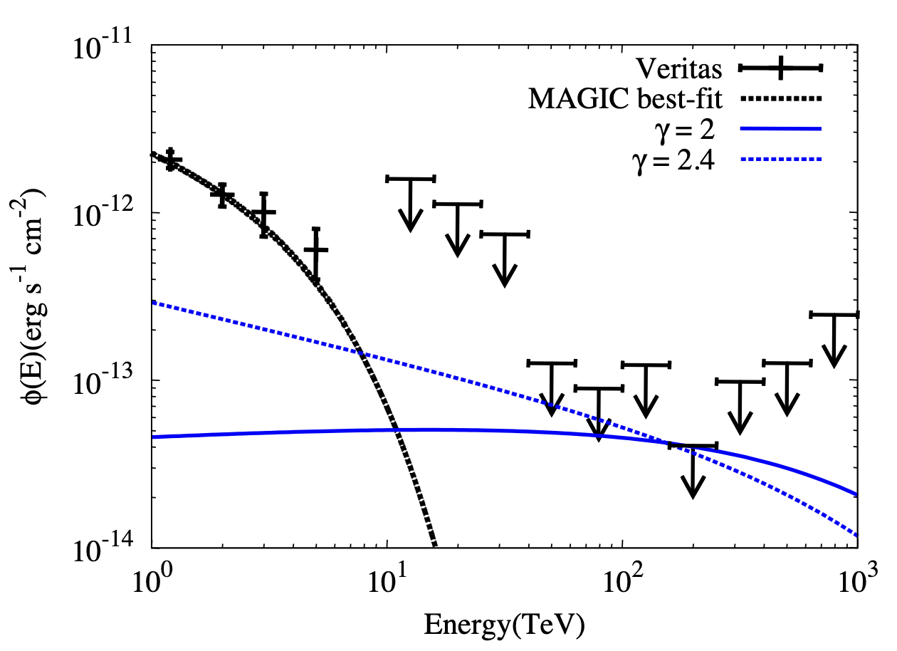
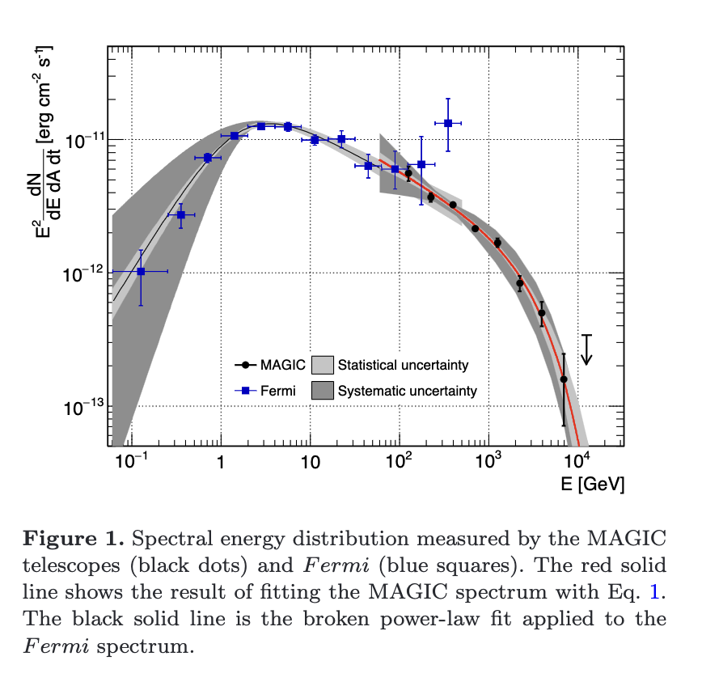
Cas A
Yang (LHAASO), 2023
LHAASO
MAGIC Col. 2017
LHAASO Col, 2023

Slide 26
LHAASO
E_{γ} > 100 TeV
Opening the PeV sky
LHAASO Col, 2023

Slide 27
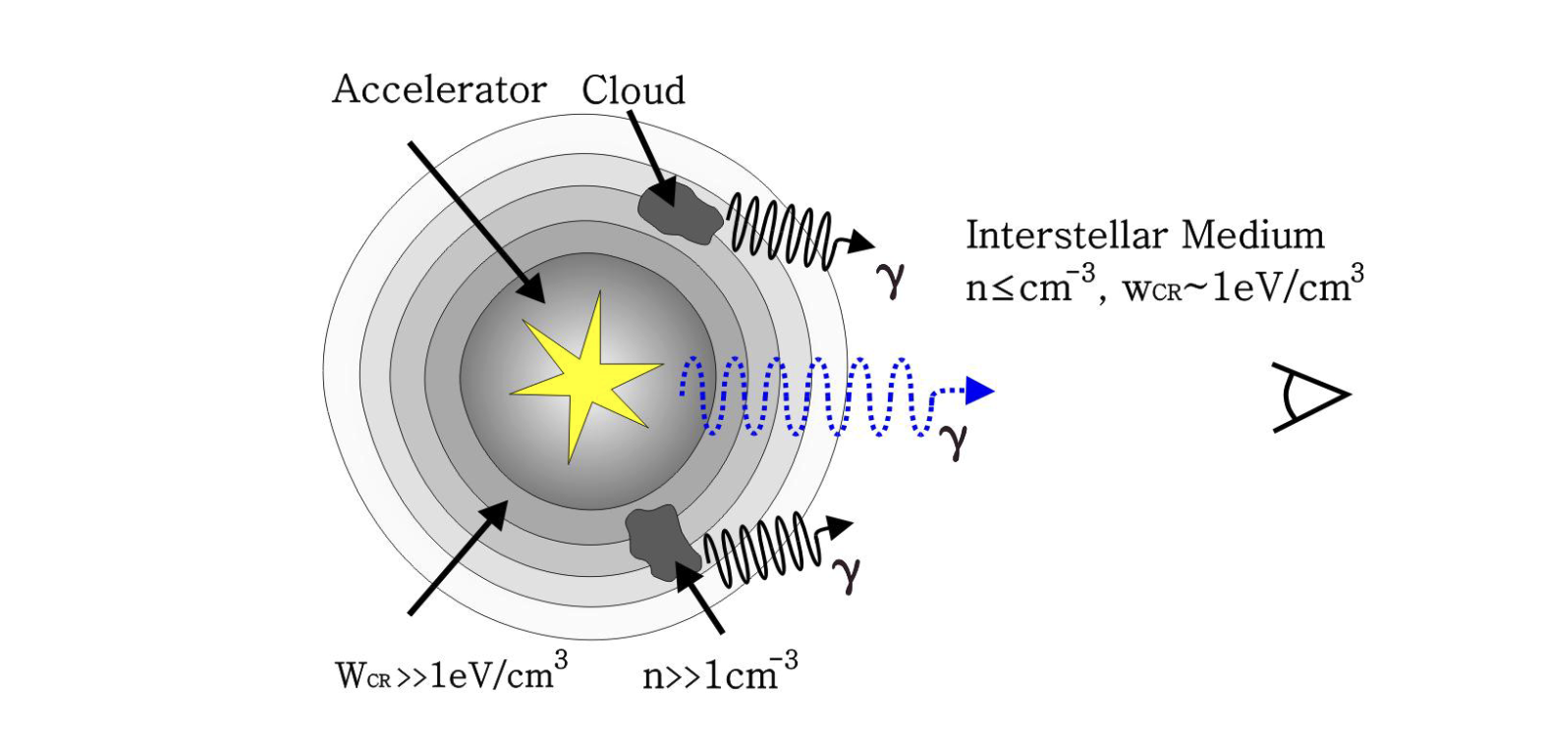
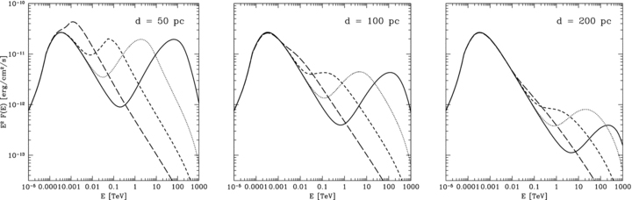
Run-away PeV CRs?
SNR/MC Interactions
Highest energy protons escape the accelerator and do not significantly contribute to gamma-ray production inside the proton accelerator-PeVatron.
Mol. clouds amplify the emission produced by escaped CRs
Gamma rays from nearby Mol. cloud can probe the highest energy protons
Total gamma–ray emission from a molecular cloud of mass 10⁵ M⊙ located at a distance of 1 kpc
500 yrs
Gabici & Aharonian 2007
32000 yrs
8000 yrs
2000 yrs

Slide 28
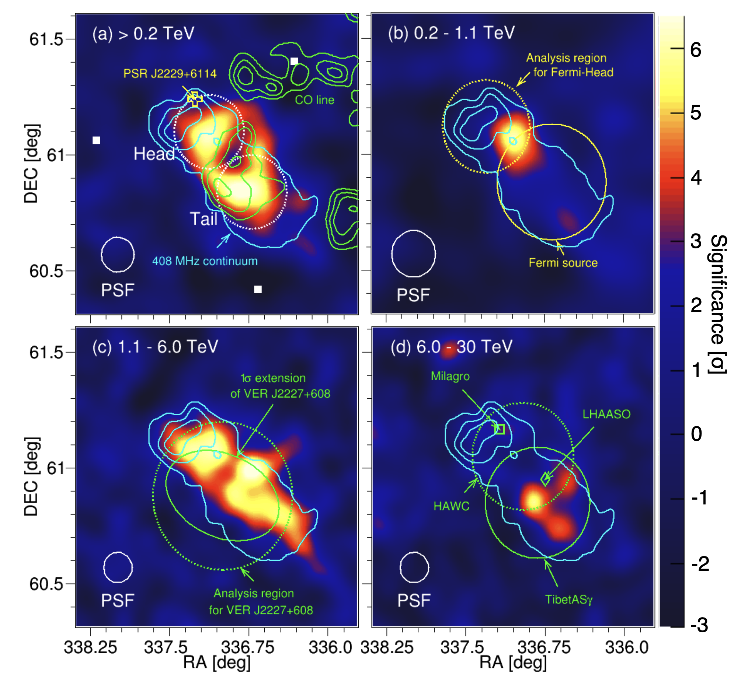
MAGIC Collaboration 2023
LHAASO

Slide 29
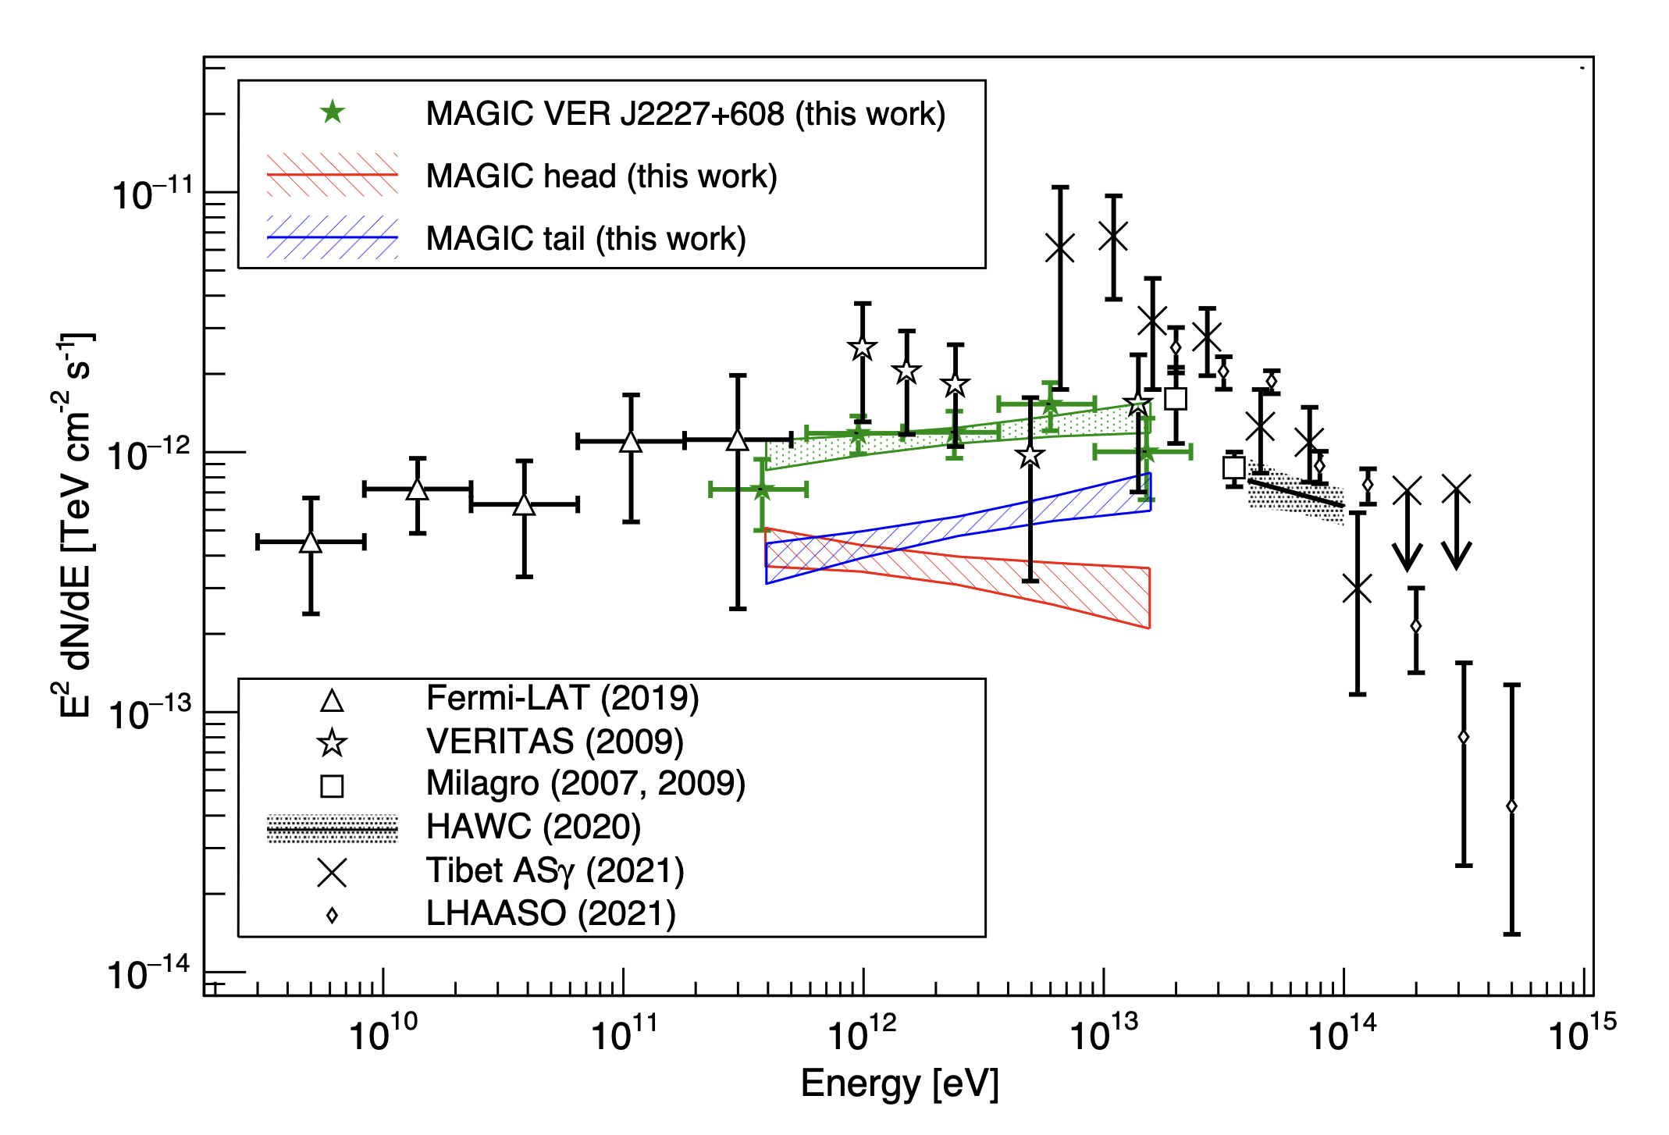
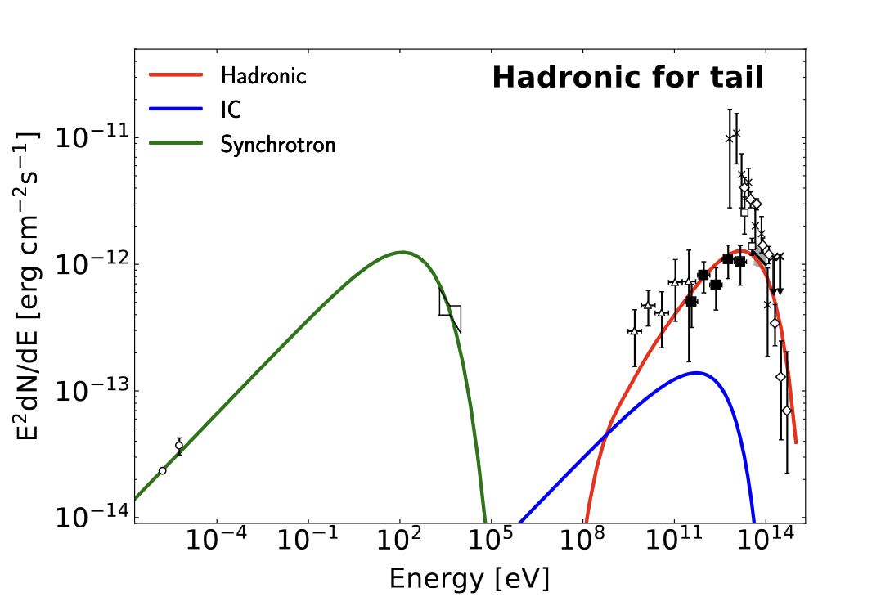
MAGIC Collaboration 2023
HEAD seems to be well fitted by leptonic emission (energetic, spectrum, softening of the X-ray)
TAIL extends > 100 TeV in LHAASO/HAWC/gTibet
=> Running away CRs?
“A cloud with a radius of a few pc located at 40–60 pc away is a plausible target considering the energetics of the supernova.”

Slide 30
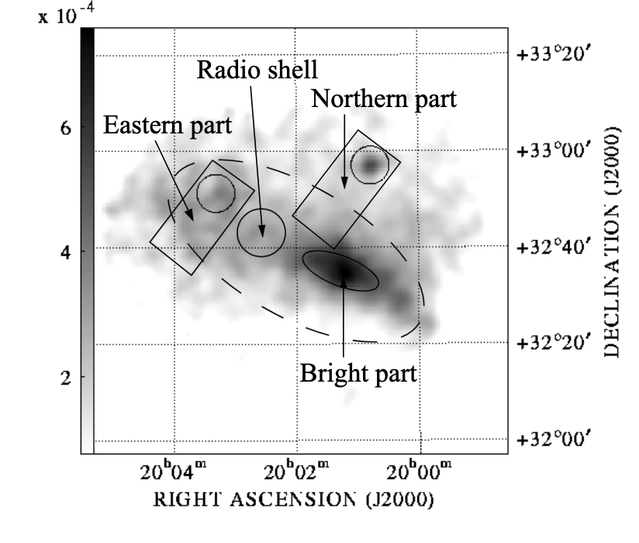
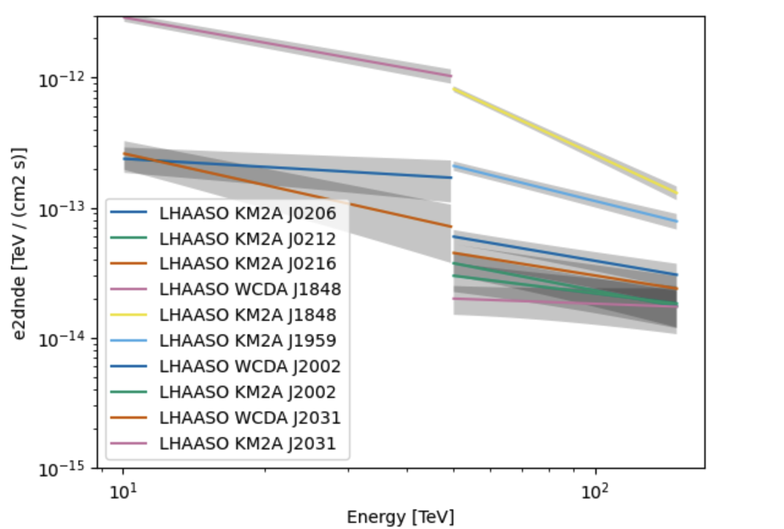
LHAASO sources detected at 100 TeV with spectrum harder than 2.8: SuperPeVatrons
LHAASO Col, 2023
1LHAASO J0206+4302u + 1LHAASO J0212+4254u UNIDs
1LHAASO J0216+4237u PWNe?
1LHAASO J1848-0001u PWNe?
1LHAASO J1959+1129u UNID
1LHAASOJ2002+3244u SNR G69.7+01.0
1LHAASO J2031+4052u Stellar Cluster?
0.7–1.5 keV band

Slide 31
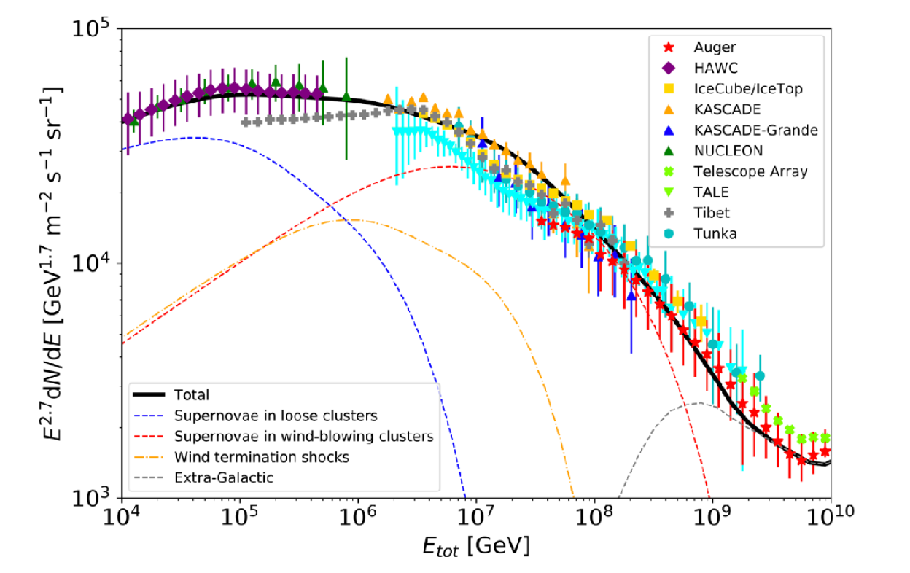
SNRs in stellar clusters
Alternatives to isolated SNRs
Vieu, Reville 2023
SNRs in dense turbulent regions can reach PeV energies
Other possible PeVatrons candidates
=> Stellar clusters
1 + 1 = Supernovae in massive stellar clusters

Slide 32
To conclude
HAPPY MAGIC BIRTHDAY
20 years of IACT observations, in which the MAGIC telescope had a leading position, has provided many clues about the origin of hadronic CRs up to PeV
SNRs, the most (known) luminous burst-like injection source population in the Galaxy
=> Natural PeV candidate
But energy cutoffs, escape? => MAGIC looking into the first SNR PeV emission
Detection of neutrinos would give a definitive answer
Looking forward to 20 years more

Slide 33
HAPPY MAGIC BIRTHDAY

Slide 34
Backup
HAPPY MAGIC BIRTHDAY

Slide 35
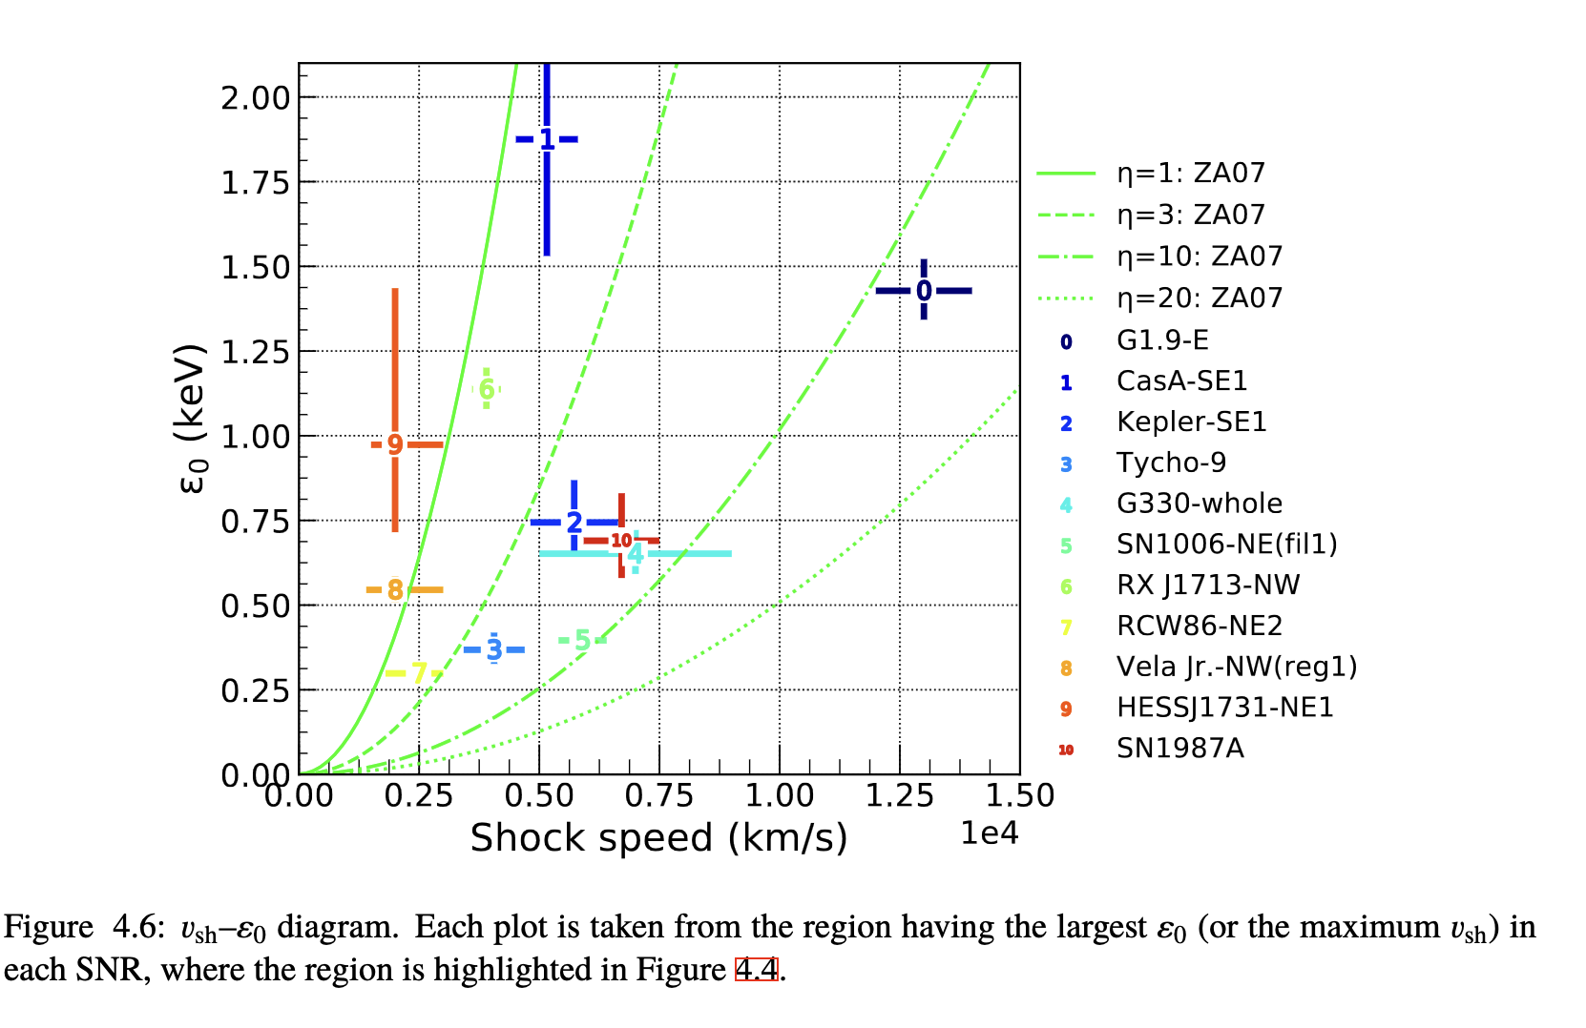

Shell-like SNRs
Caveat
BUT !!! SNRs are very large, complex objects
Tsuji, A&A 2021
Particles are accelerated at a greater rate with time => Magnetic field becomes more turbulent and self-generated
Tsuji, A&A 2021

