Slide 1
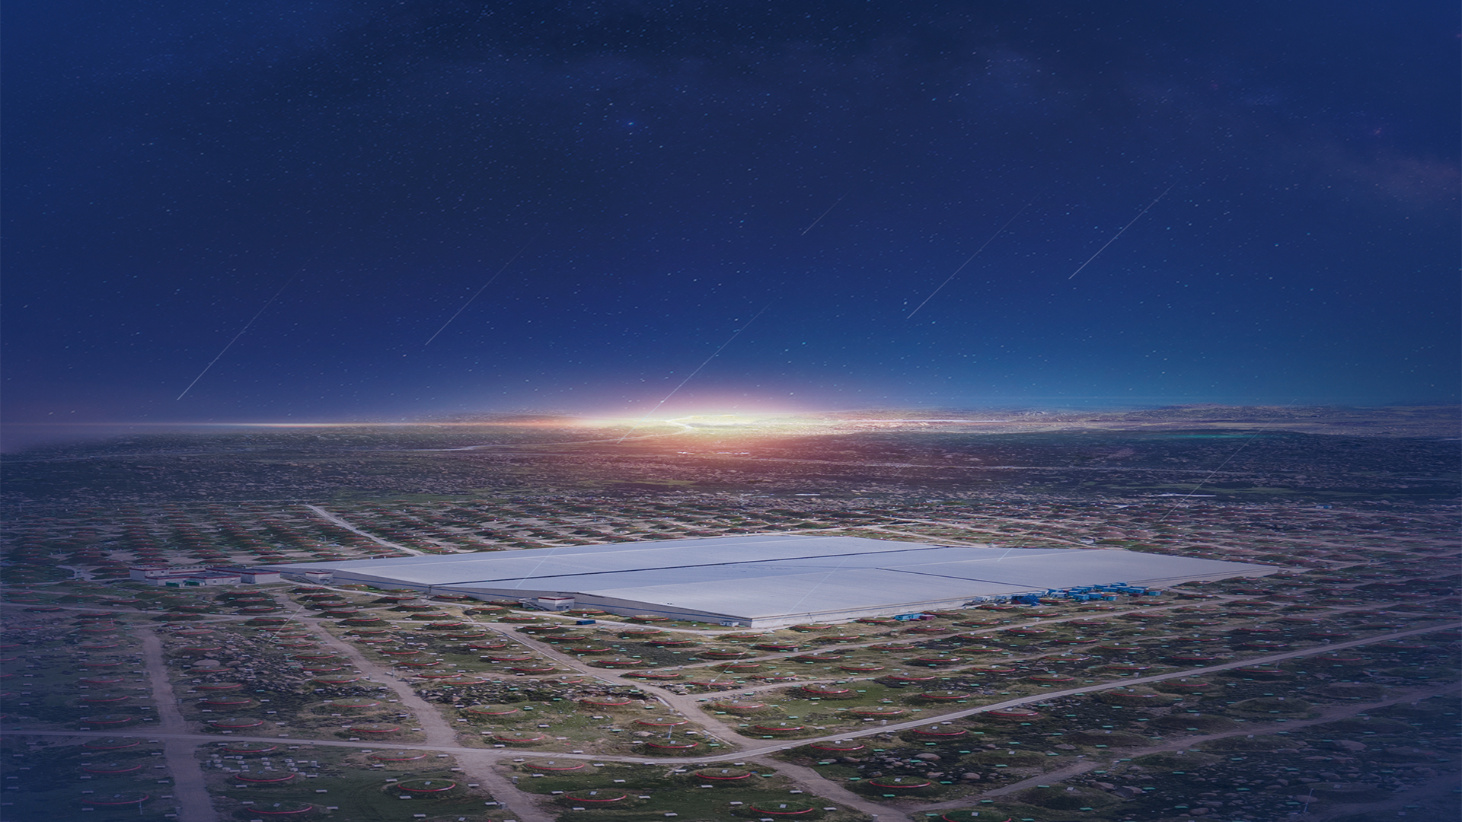
New results from LHAASO
Min Zha
On behalf of LHAASO Collaboration
Institute of High Energy Physics, CAS, China
Oct. 4 – 7, 2023 @ 20 MAGIC Years Symposium

Slide 2

Outline
LHAASO detectors and status
Science results
Summary and prospects

Slide 3
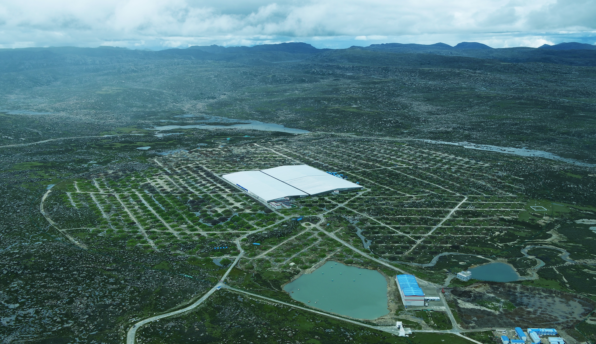
Large High Altitude Air Shower Observatory (拉索)
Haizi Mountain 4410 m a.s.l. Daocheng, Sichuan Province, China
Location：29º21’ 27.6” N , 100º08’19.6” E
2021-07 completed built and in full array operation

Slide 4
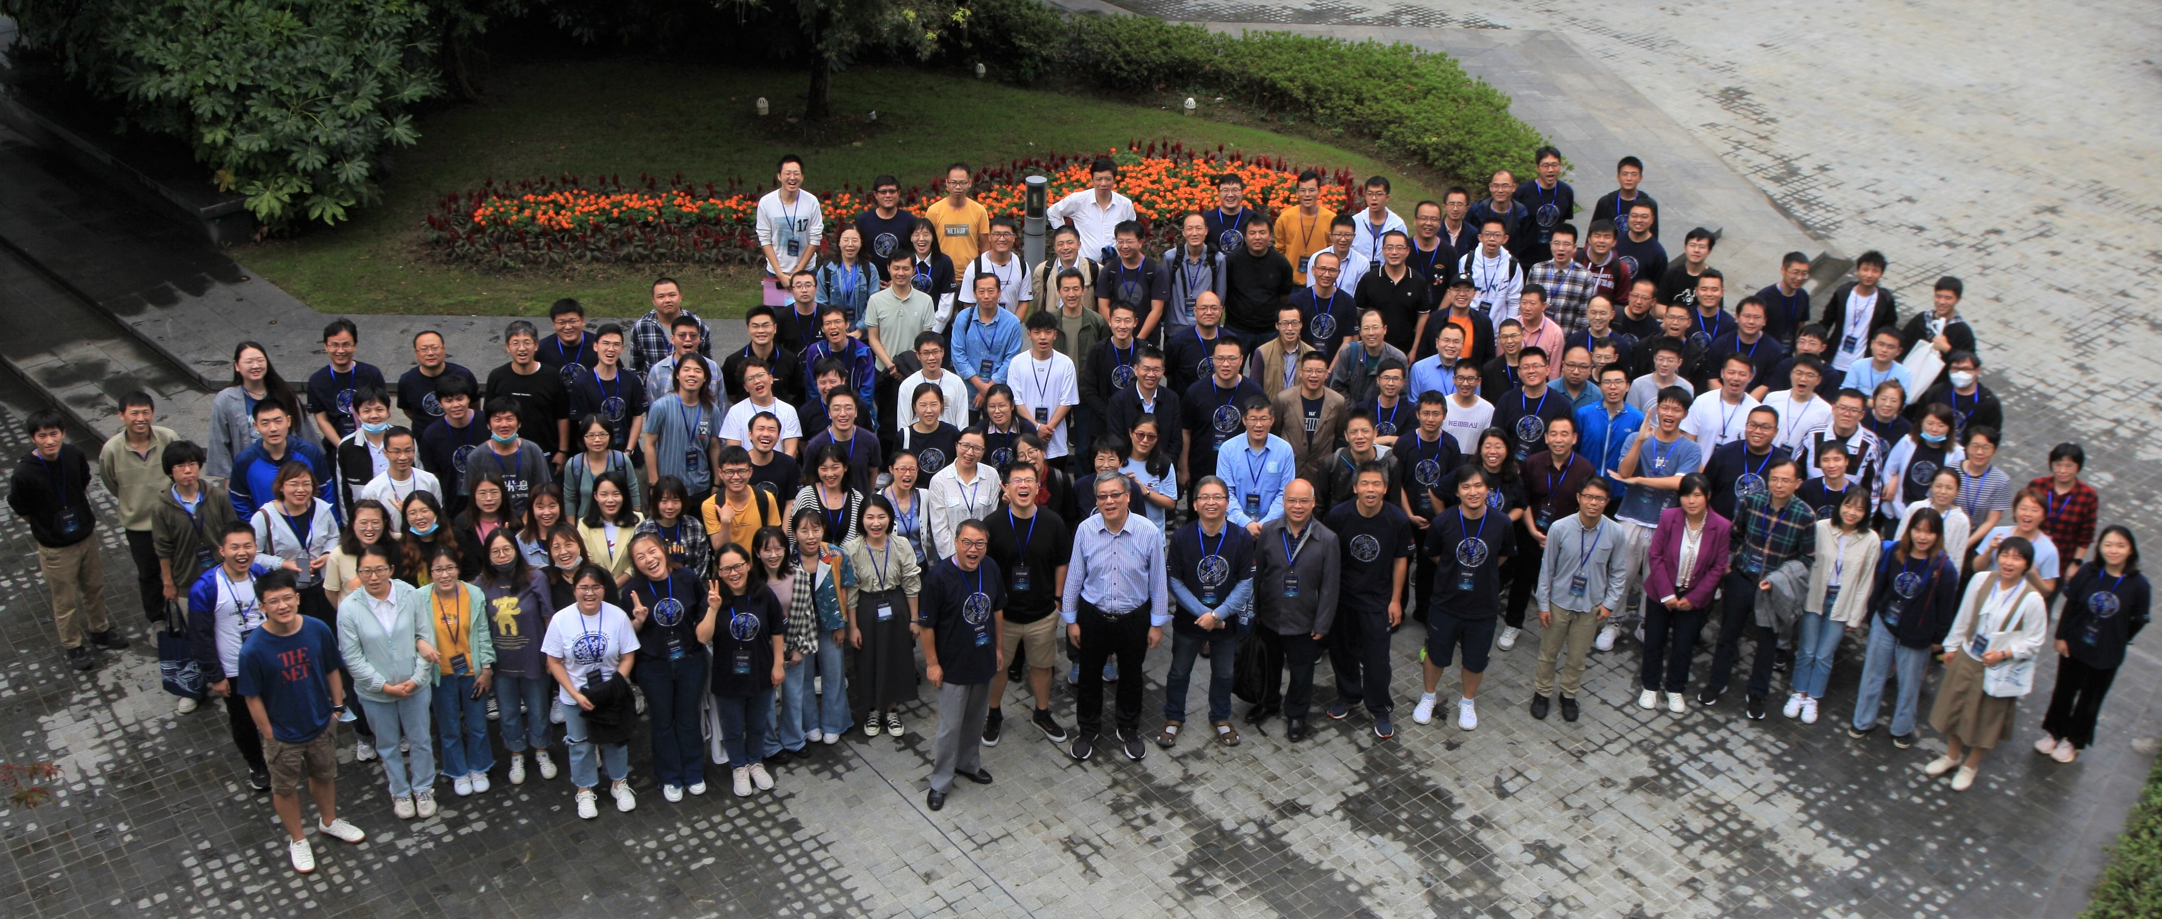
LHAASO collaboration
280 Researchers 32 Institutions from 6 countries

Slide 5
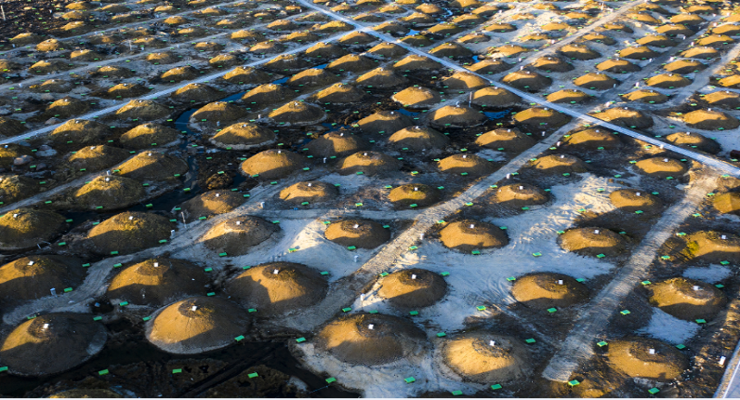
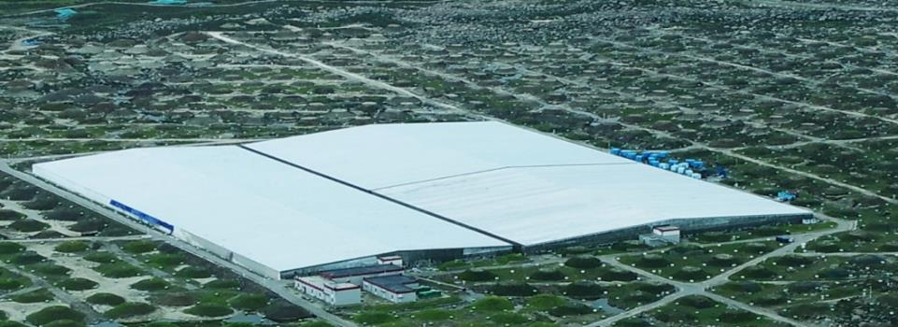
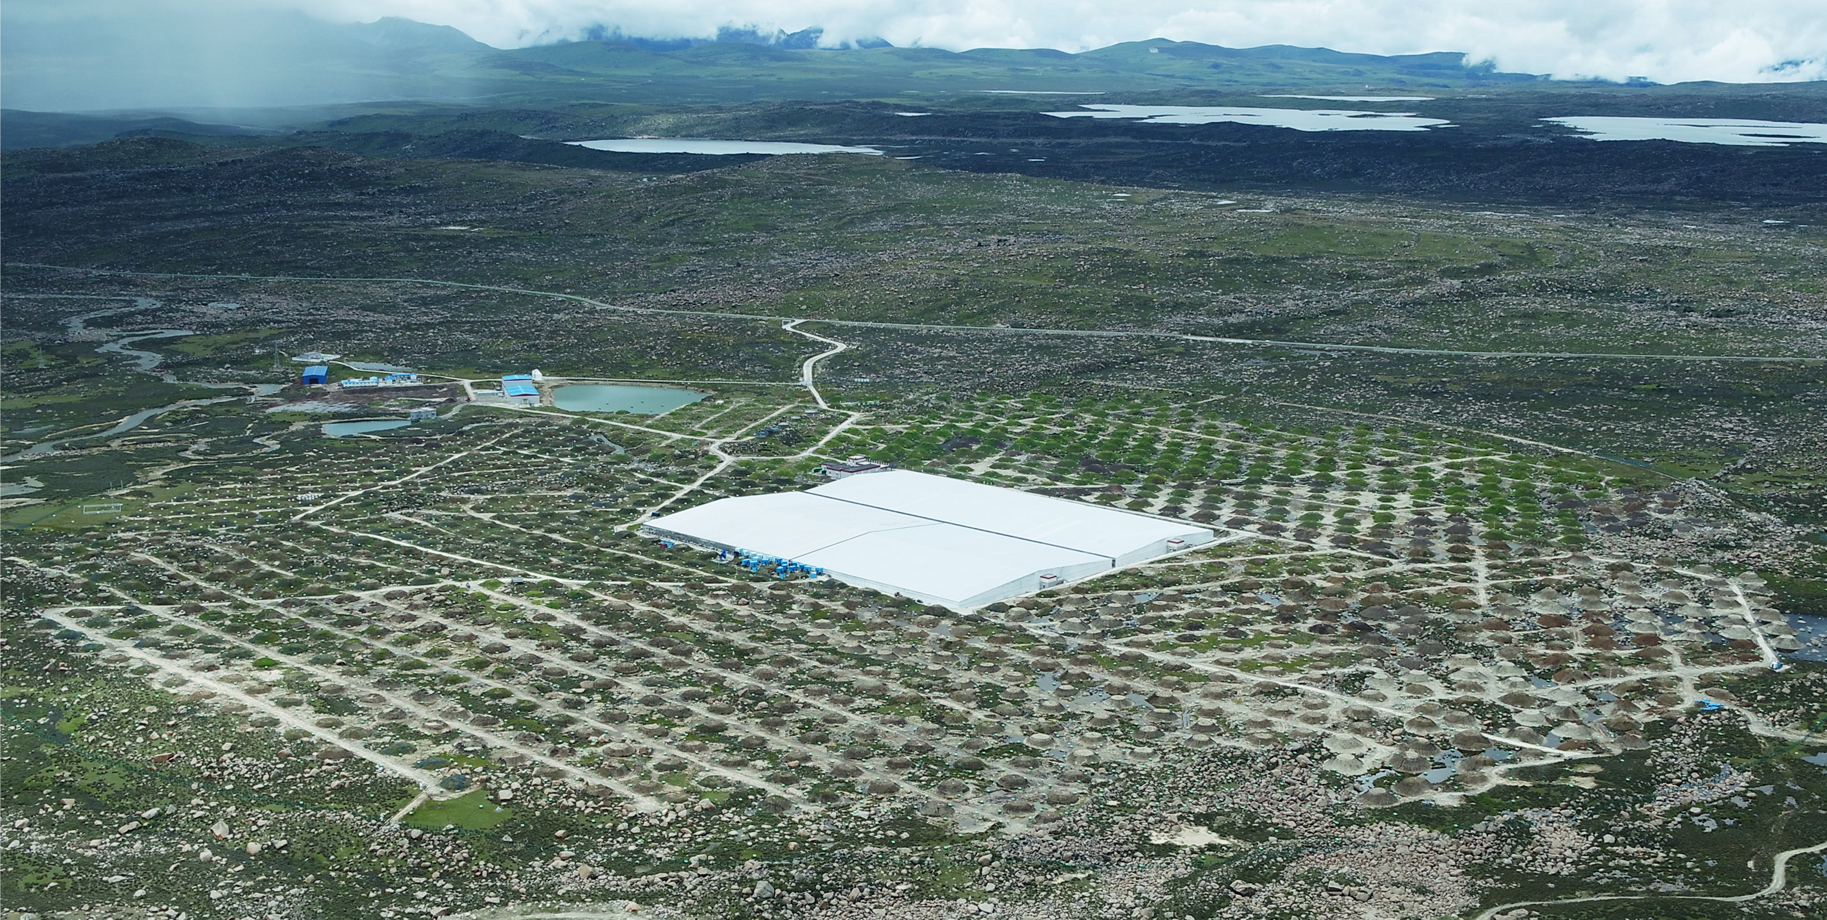
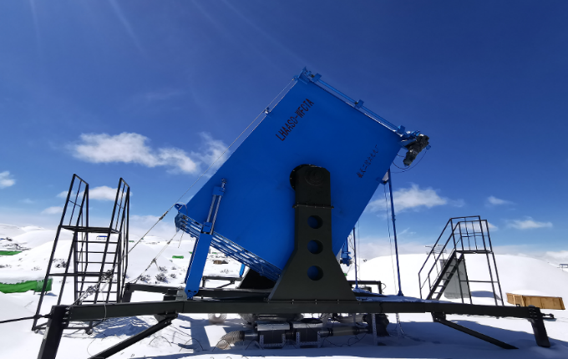
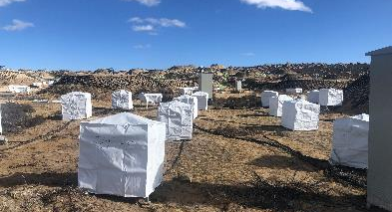
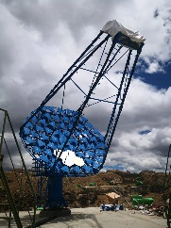
LHAASO
KM2A:
5216 ED/1m² + 1188 MD/36m²
Area: 1.3 km²
UHE gamma ray astronomy
WCDA:
3 pools，3120 cells/25m²
area: 78,000 m²
VHE gamma ray astronomy
WFCTA:
18 telescopes
CR individual spectrum…
Some planed detectors
Neutron detectors
High energy IACTs
…
……

Slide 6

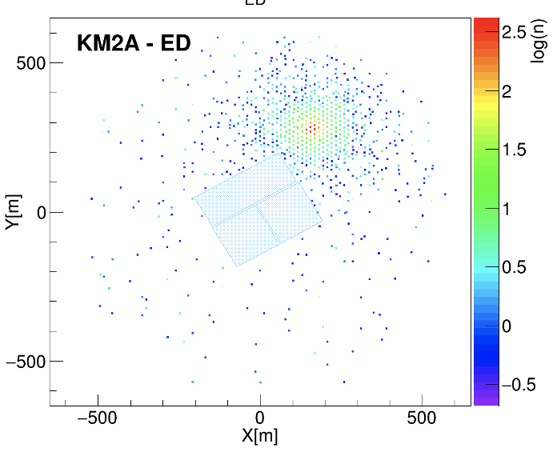
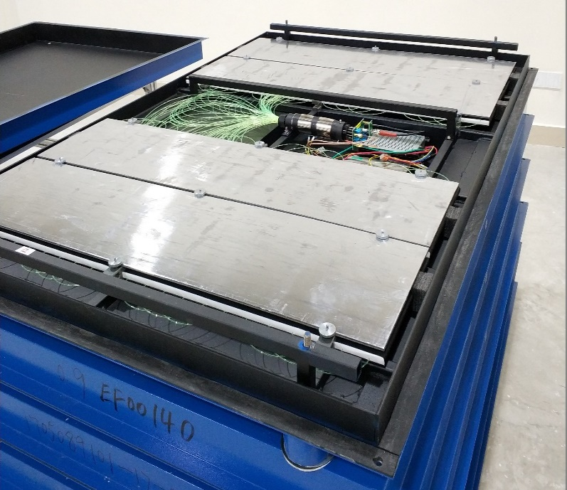
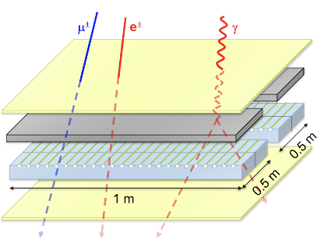

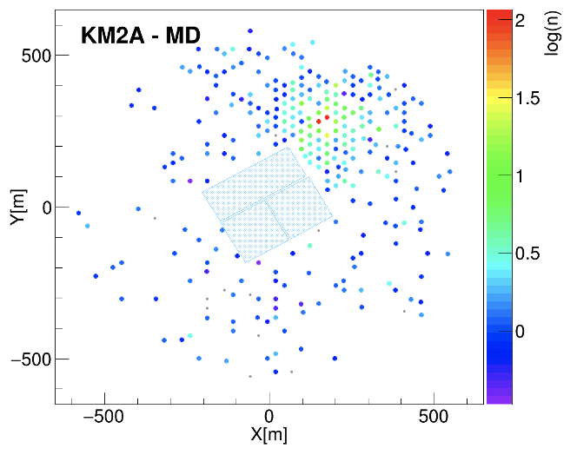
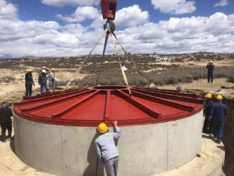
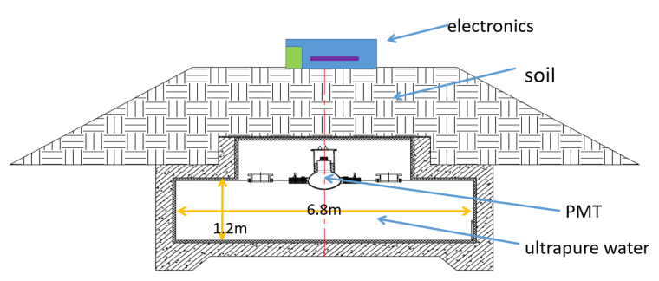
Electromagnetic Detector (ED)
Muon Detector (MD)

Slide 7
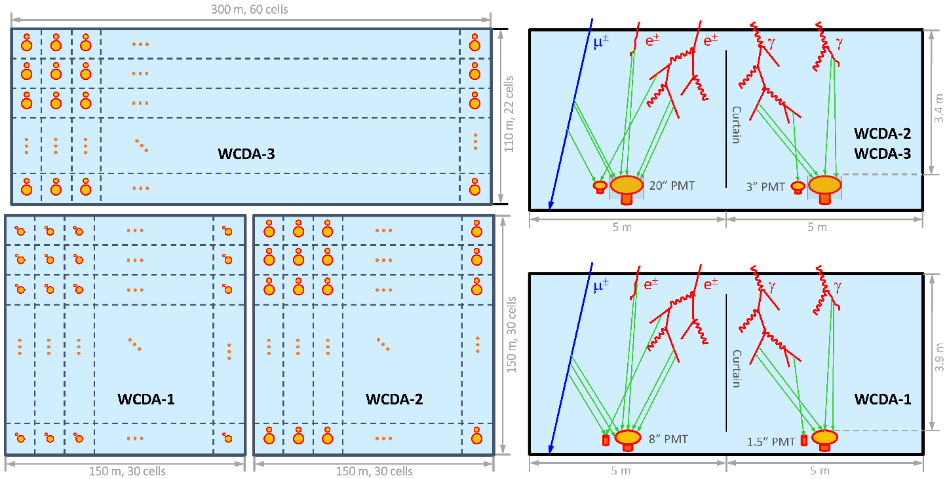
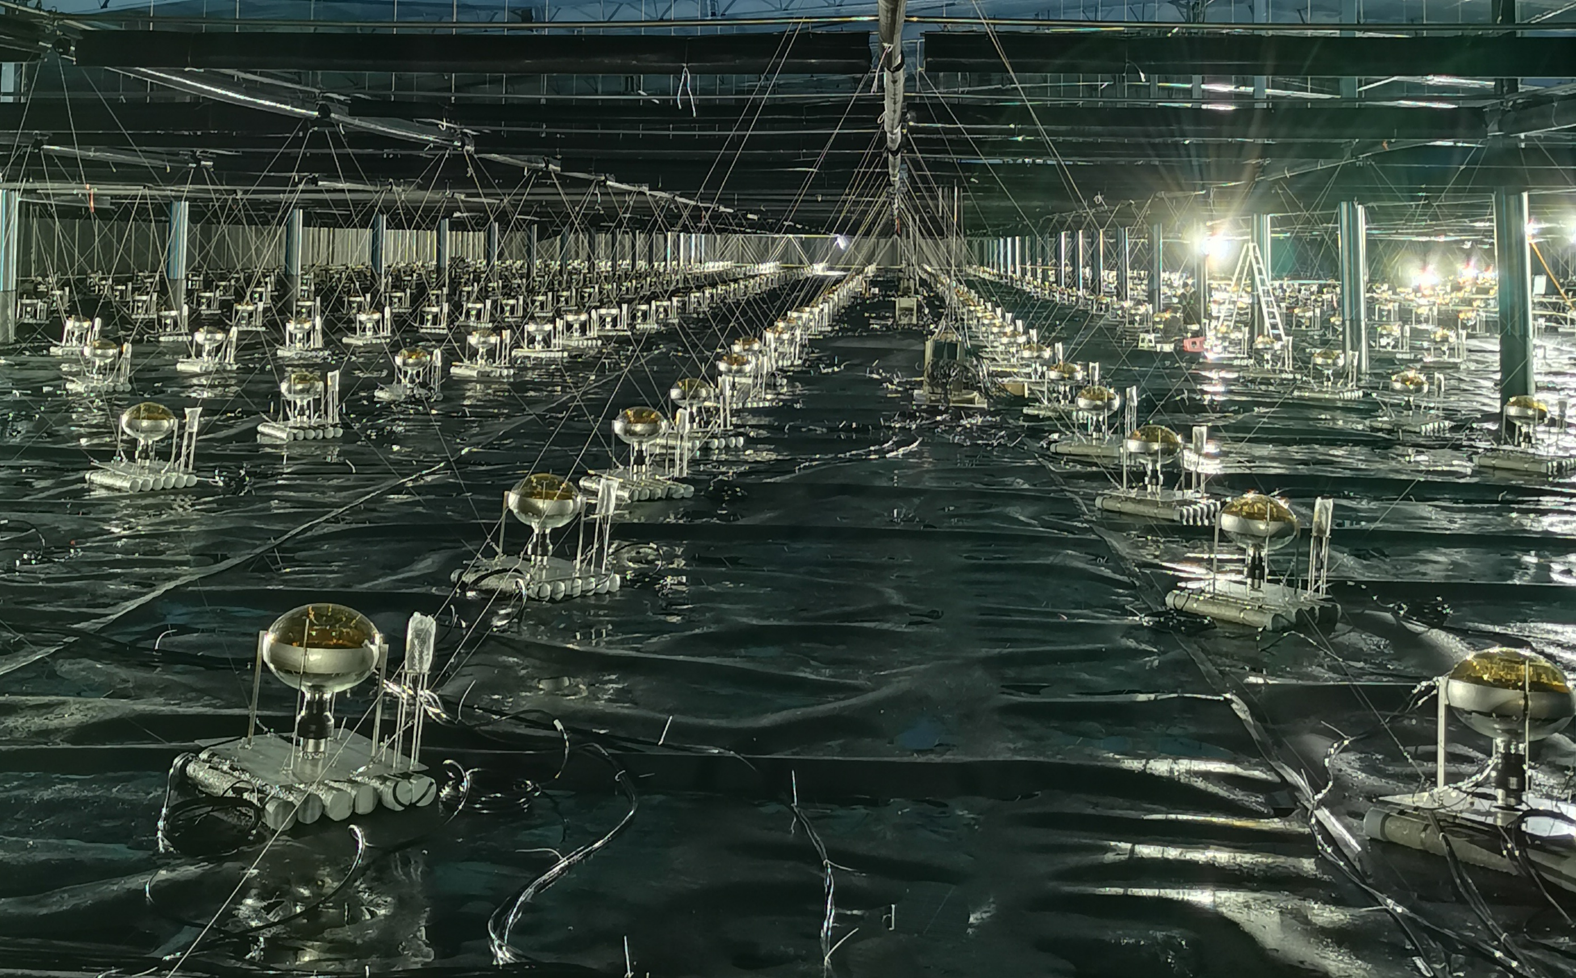
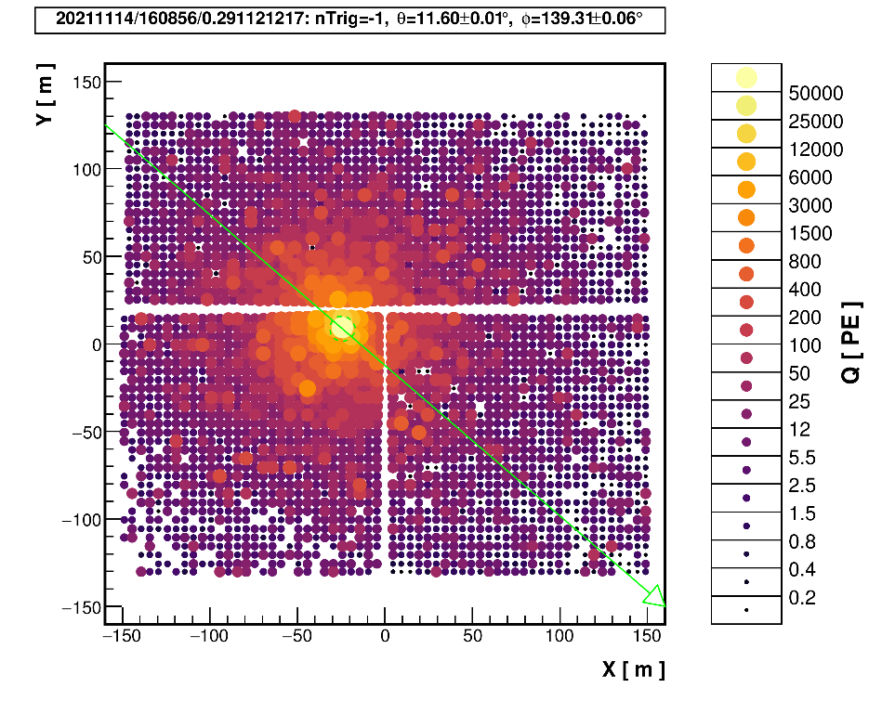
WCDA
Time resolution of a cell: ~2 ns;
Dynamic range: 1 – 50000 PEs;
Charge resolution: <50% (@ 1 PE), <10% (>2000 PE)

Slide 8
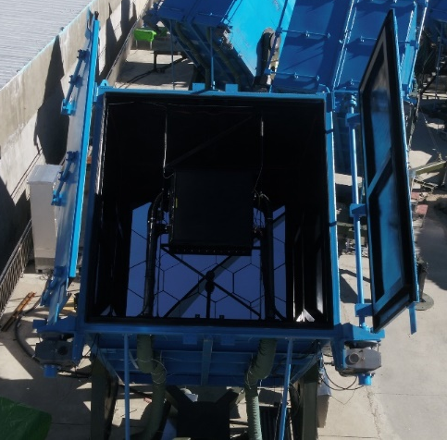
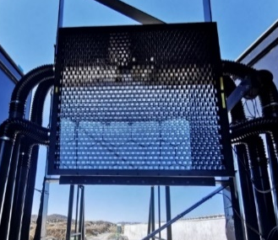
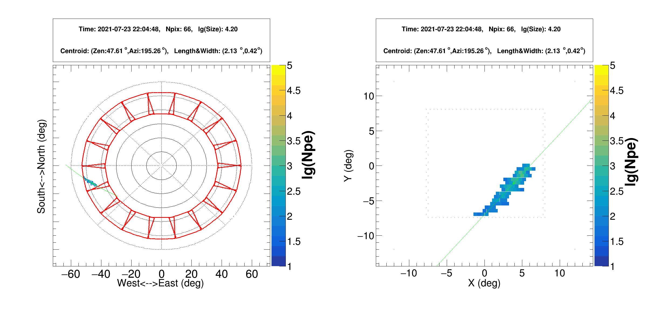
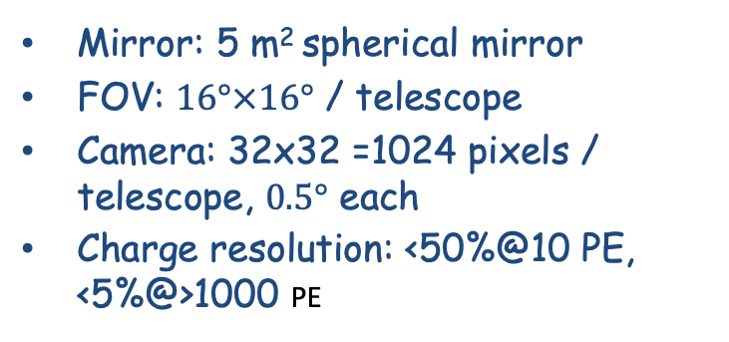
Wide Field of View Cherekov Telescope Array
(WFCTA)
Mirror: 5 m² spherical mirror
FOV: $16°×16°$ / telescope
Camera: 32x32 =1024 pixels / telescope, $0.5°$ each
Charge resolution: <50%@10 PE, <5%@>1000 PE

Slide 9
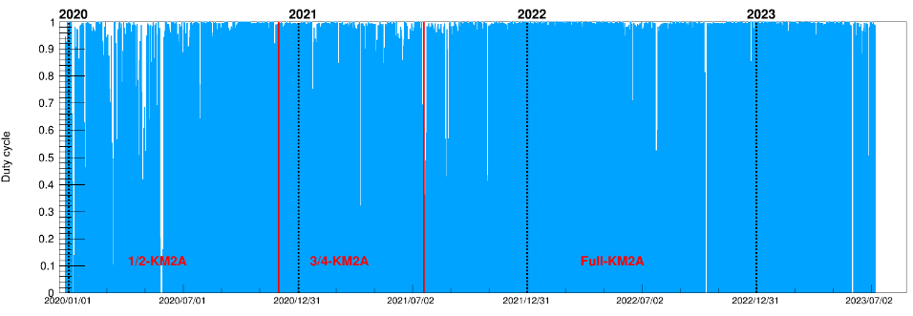
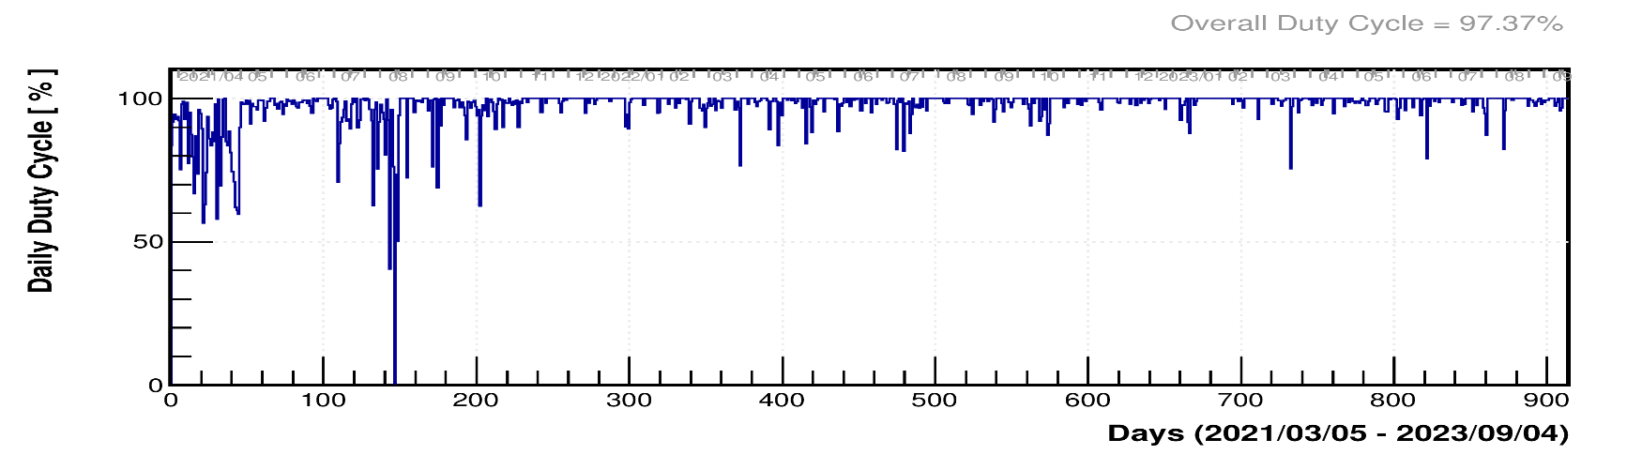
Features: full duty cycle
KM2A
96.8%
WCDA
97.3%

Slide 10
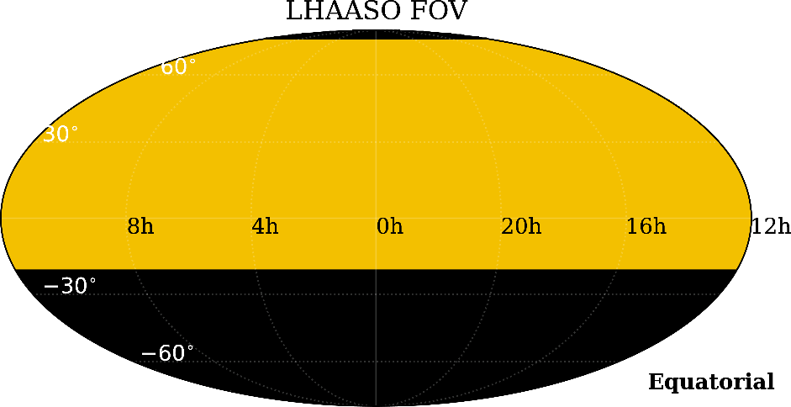
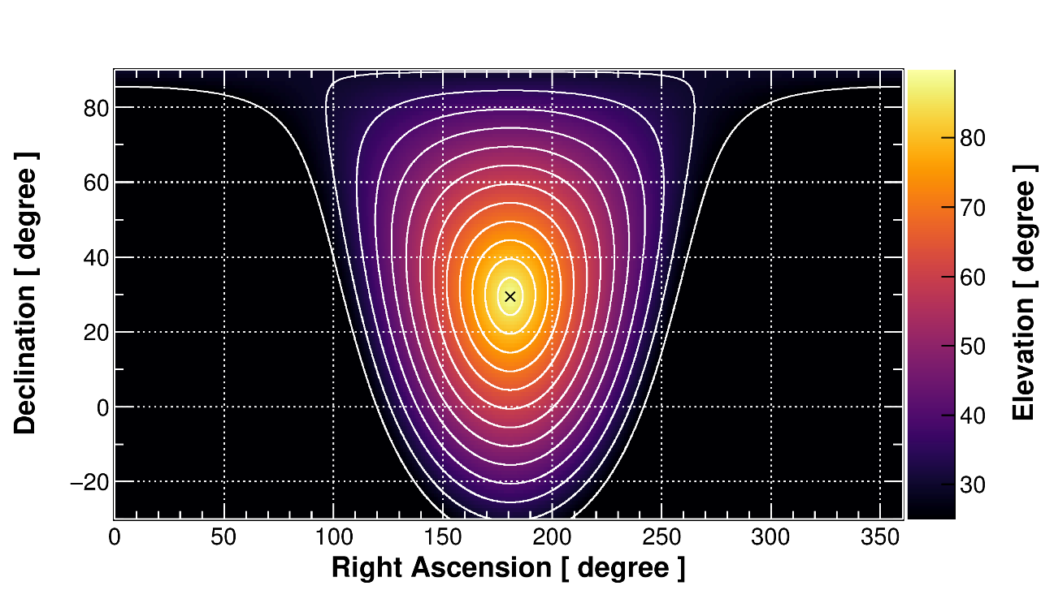
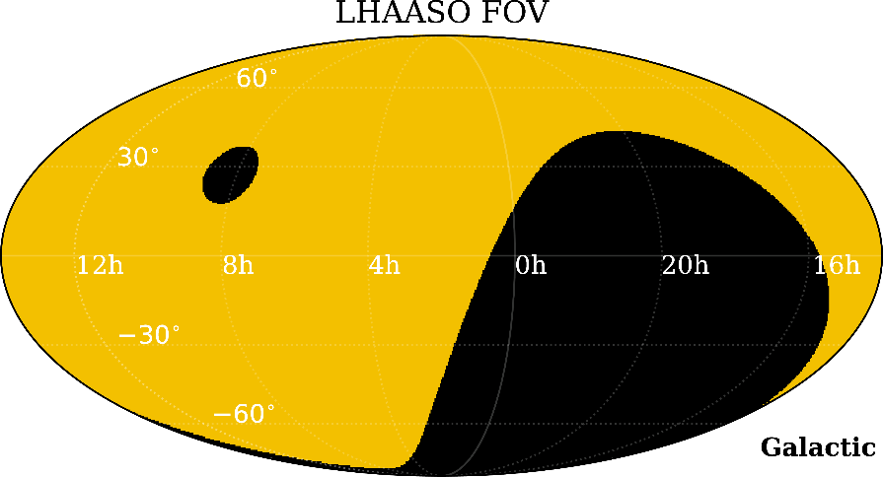
Features: wide field of view
Daily/yearly FOV
Instant FOV
1/6 of the entire sky at any given moment.
The Earth's rotation further enables a 3/4 sky coverage

Slide 11
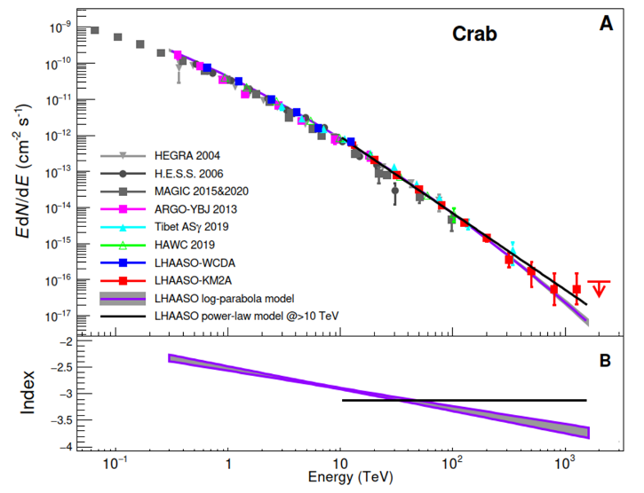
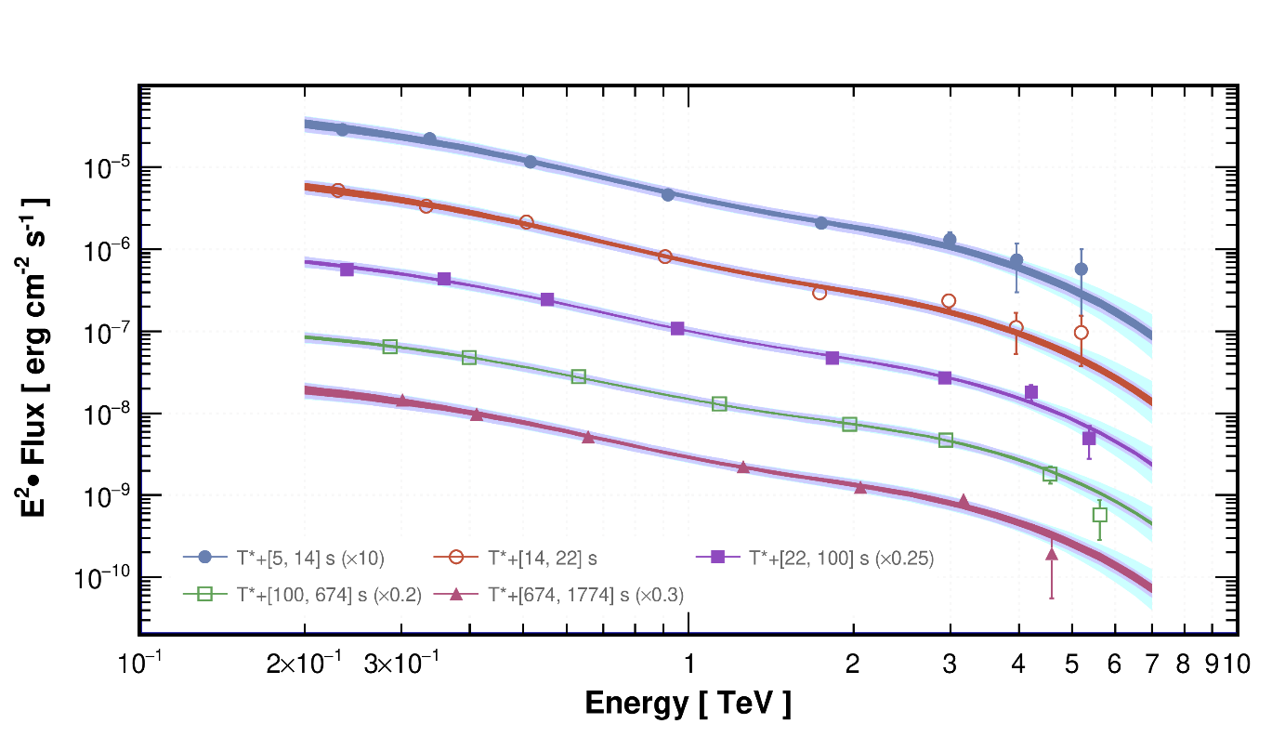
Features: wide energy range coverage
GRB 221009A
Overlap: 10—50 TeV
WCDA
KM2A
Crab
The lowest can reach < ~100 GeV?
For the first time covering 3.5 ~ 4 decdades of energy (300 – 1.5 PeV)
  Consistent with others < 100 TeV
  Self cross-check between WCDA and KM2A; KM2A and WFCTA

Slide 12
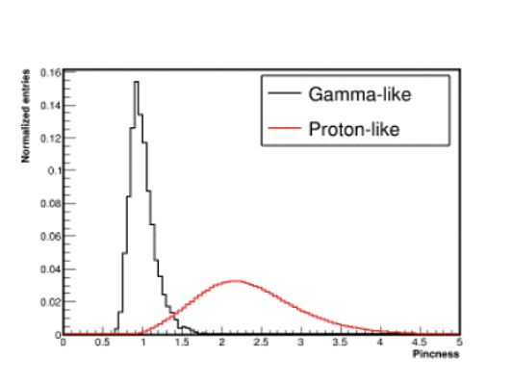
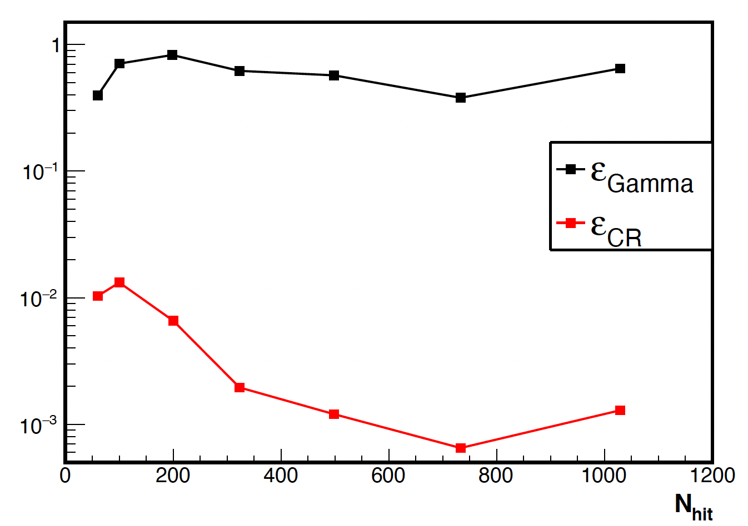
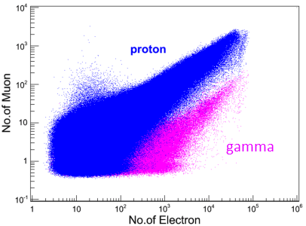
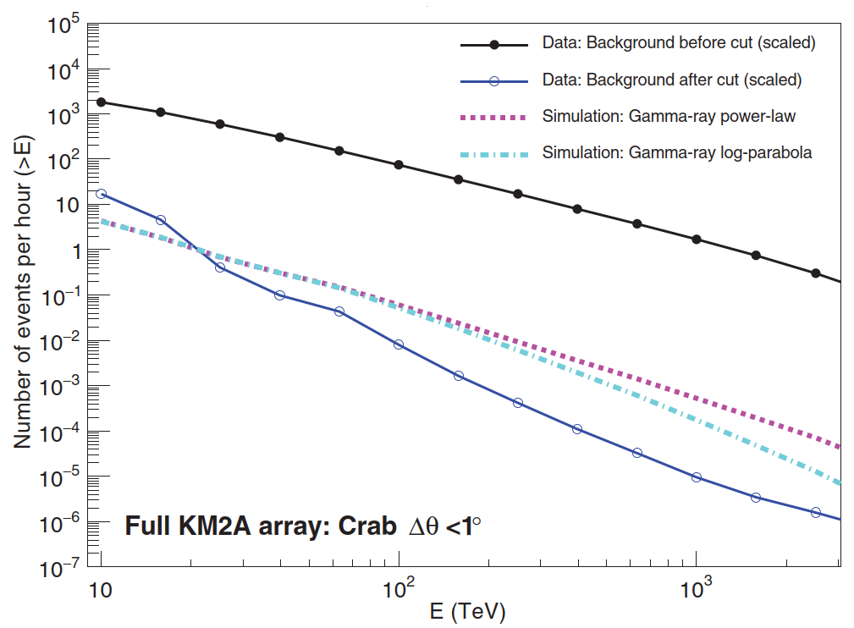
CR Background Rejection Power
10⁻³
10⁻³
10⁻⁴
10⁻⁵
A good facility to do sky survey and monitor transient phenomena

Slide 13
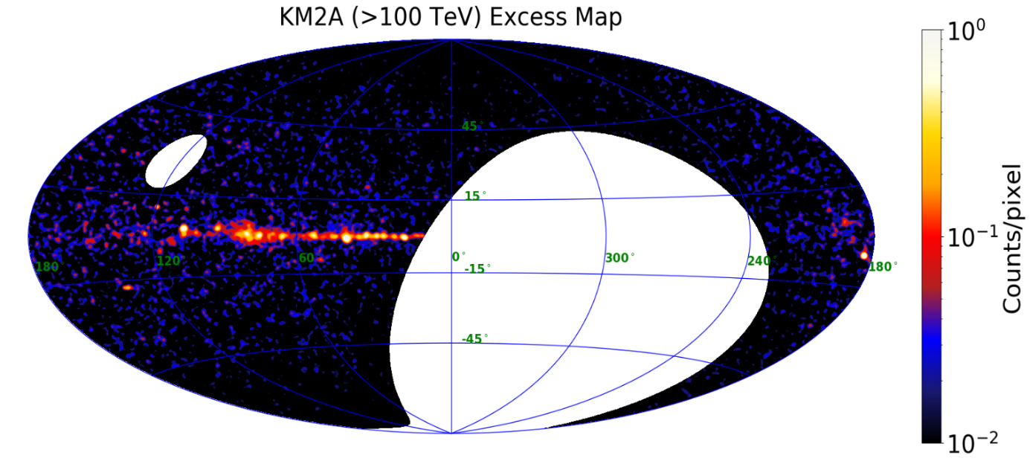
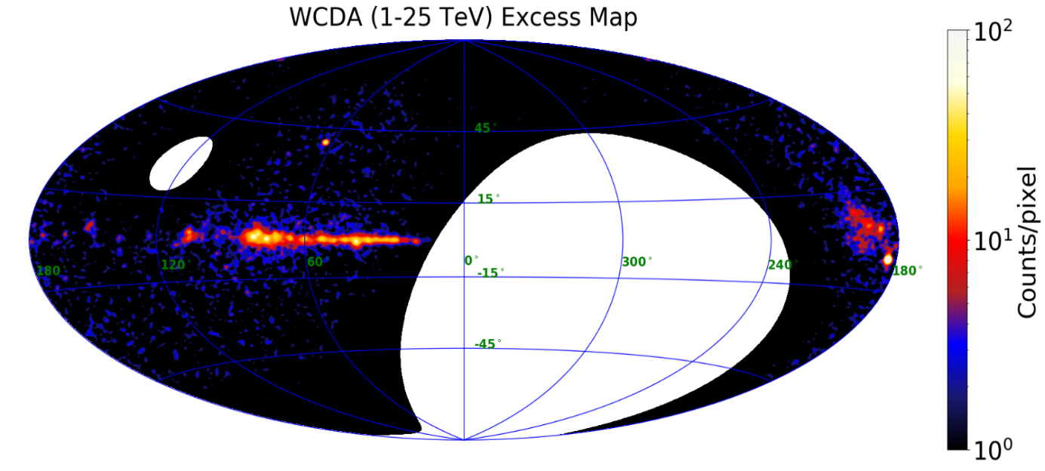
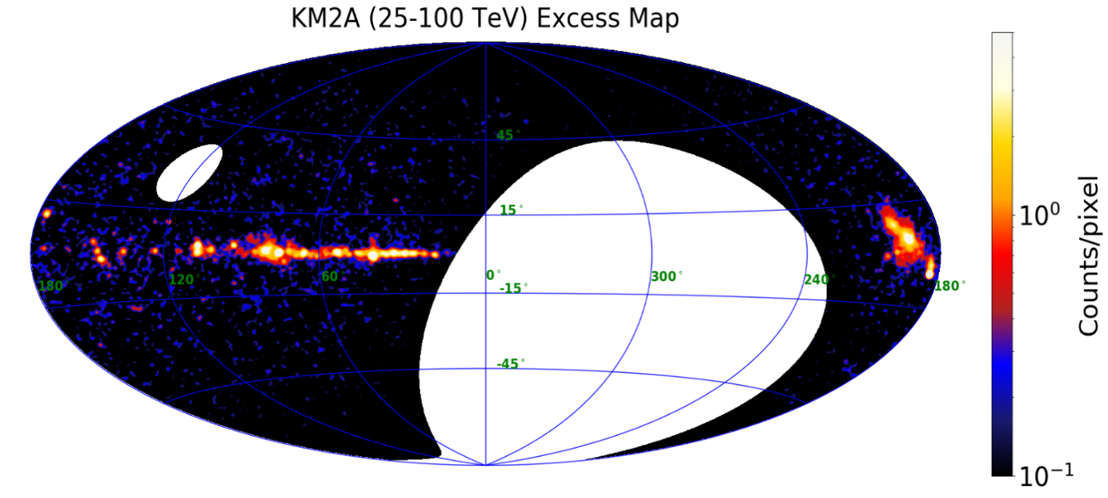

The 1st LHAASO Catalogue
KM2A：933 days (eqv. ~730 days full array)
WCDA：508 days (full array)
90 sources with extension <2º
Released: May 2023 arXiv/2305.17030.
43
Pixel size: ${0.1}^{∘}×{0.1}^{∘}$
> 100 TeV (KM2A)
69
75
25—100 TeV (KM2A)
1—25 TeV (WCDA)

Slide 14
KM2A^{u} ➔ KM2A UHE (>4σ @ >100 TeV)
KM2A
(>25 TeV)
75
Broad band SED fit
WCDA&KM2A
&KM2A^{u}
35
WCDA
（<25 TeV)
69
KM2A^{u}
(>100 TeV)
43
WCDA&KM2A 54

Slide 15
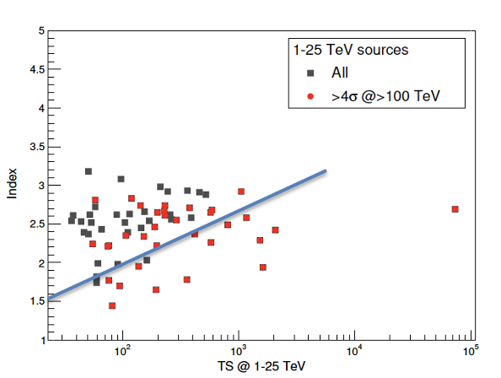
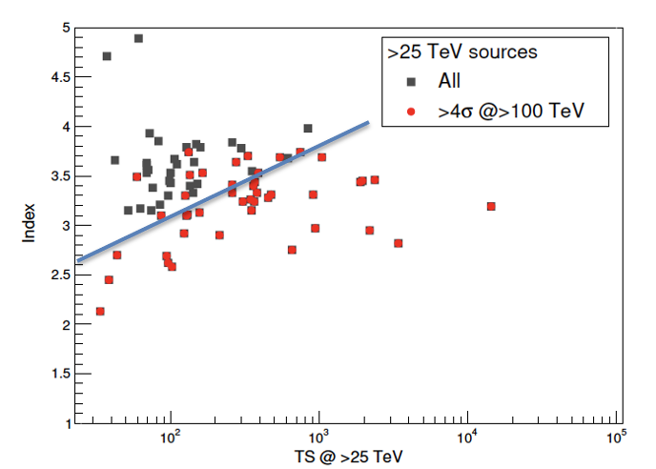
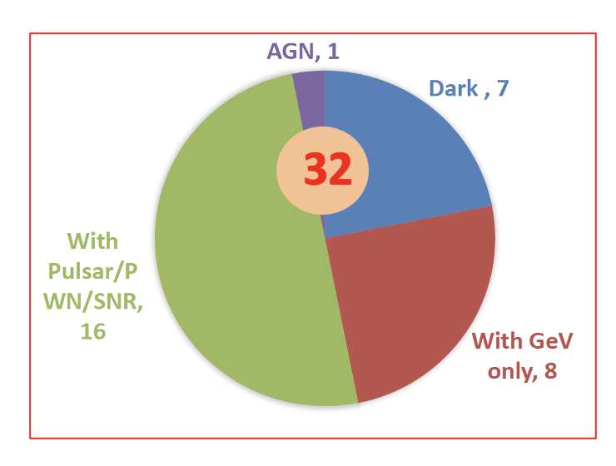
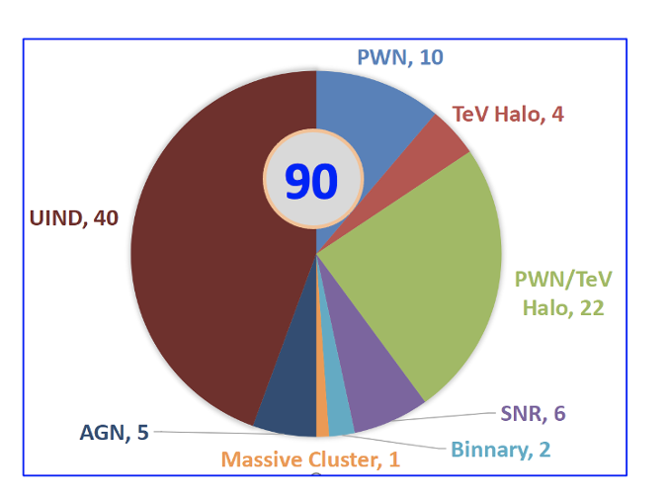
First LHAASO catalog: 90 sources
Association with known TeV Sources
  58 sources with TeVCat+3HAWC association
  32 new sources ( 25 + 7 ‘dark sources’)
PeVatrons
  51% @ 1-25TeV sources are UHE sources.
  57% @ >25TeV sources are UHE sources.
  19% @ UHE sources are not detected at 1-25TeV (new class?).

Slide 16
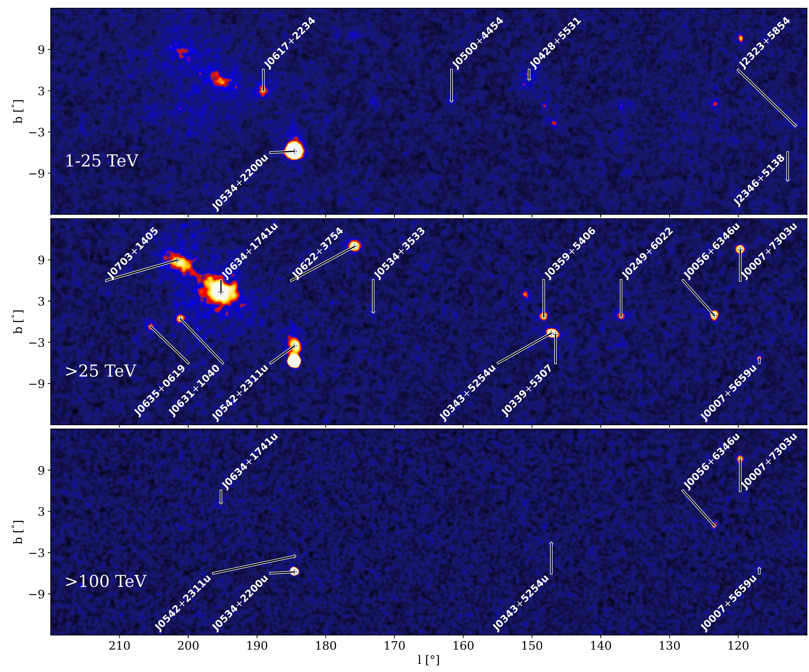
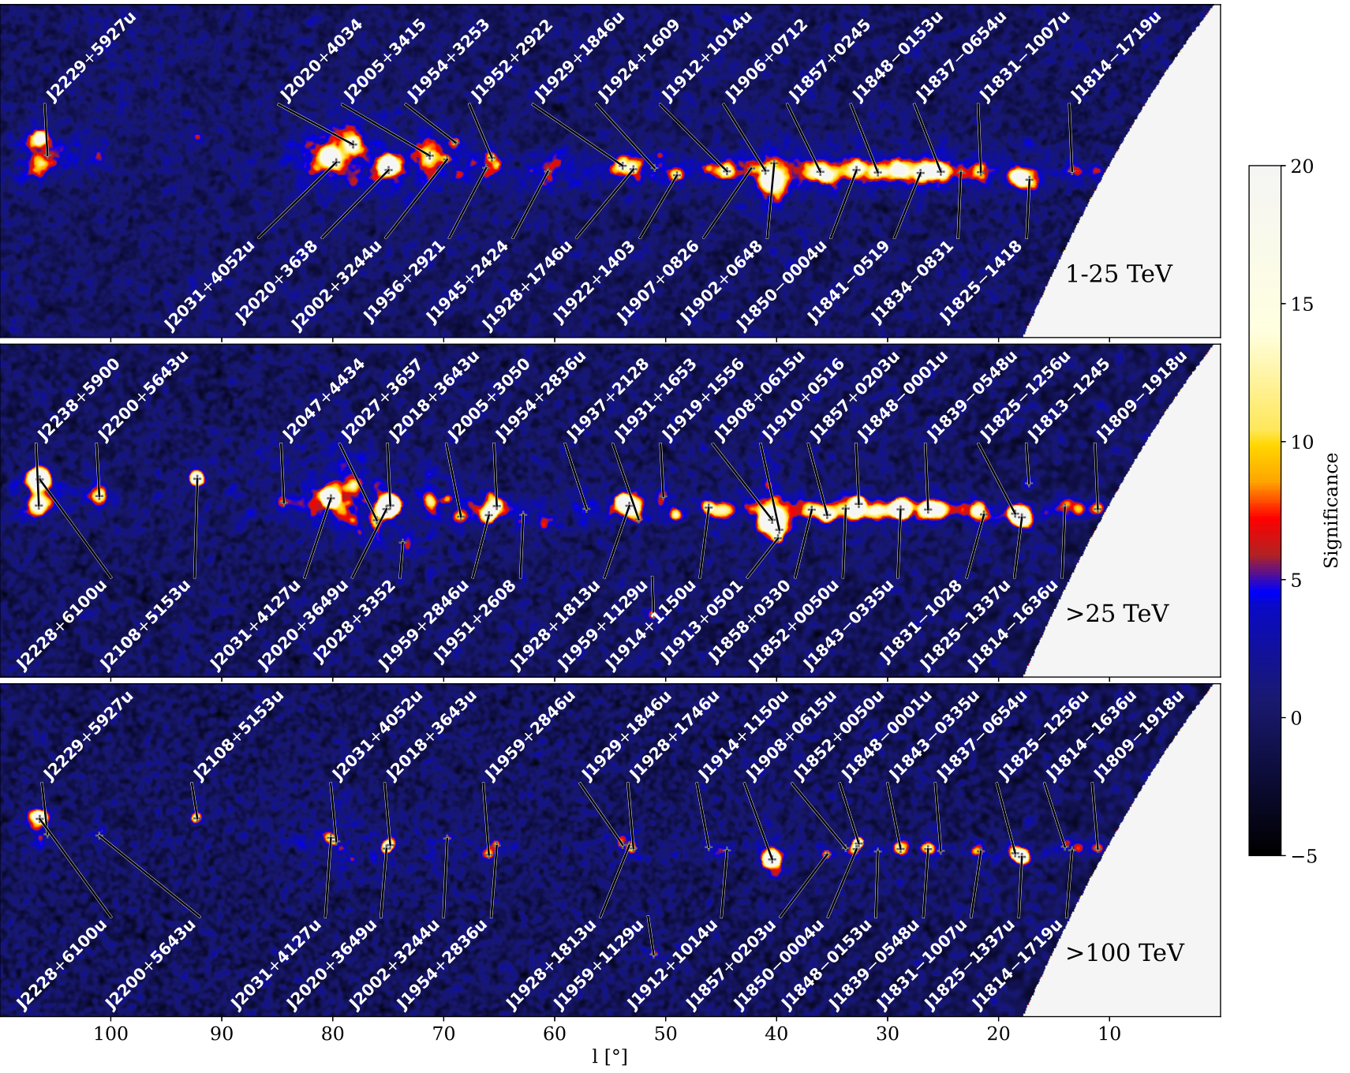
82 sources with the Galactic latitude |b|<12º

Slide 17
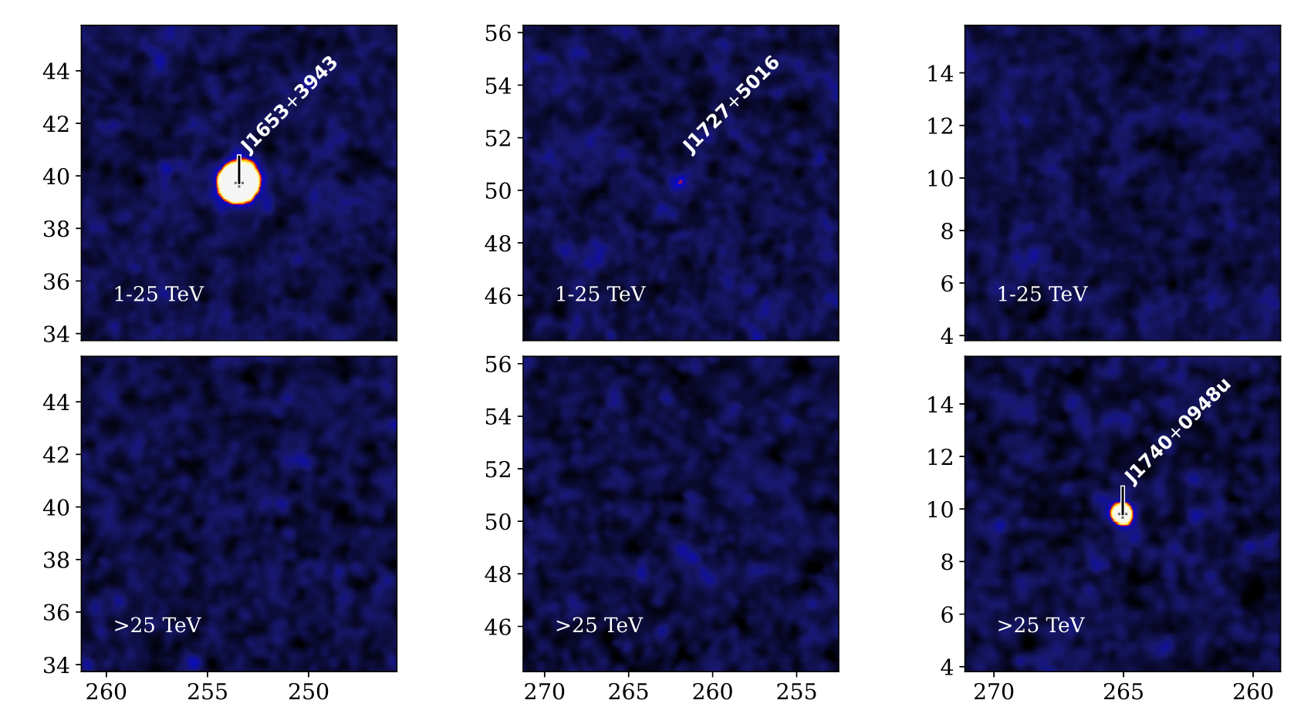
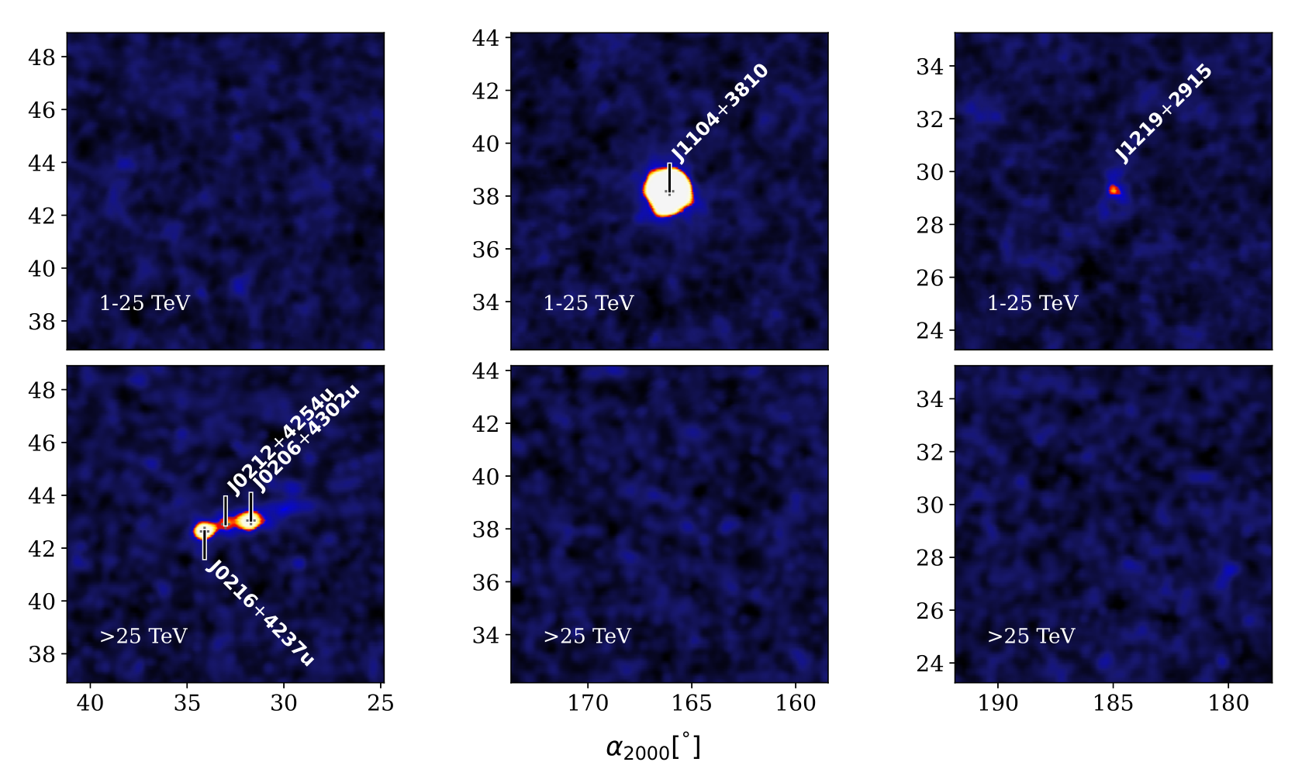
8 sources with the Galactic latitude |b|>12º
Mrk 421
z=0.031
1ES 1727+502
z=0.055
4AGNs
Mrk 501
z=0.034
NGC 4278
z=0.002

Slide 18
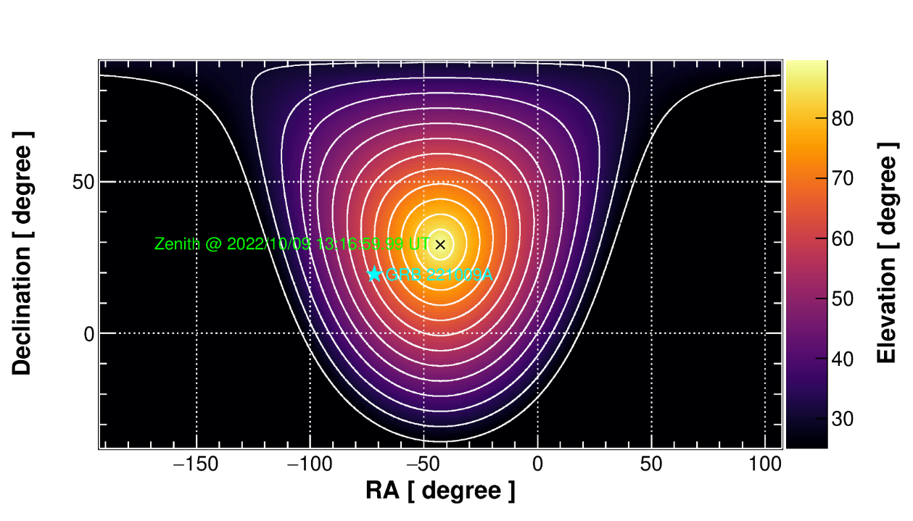
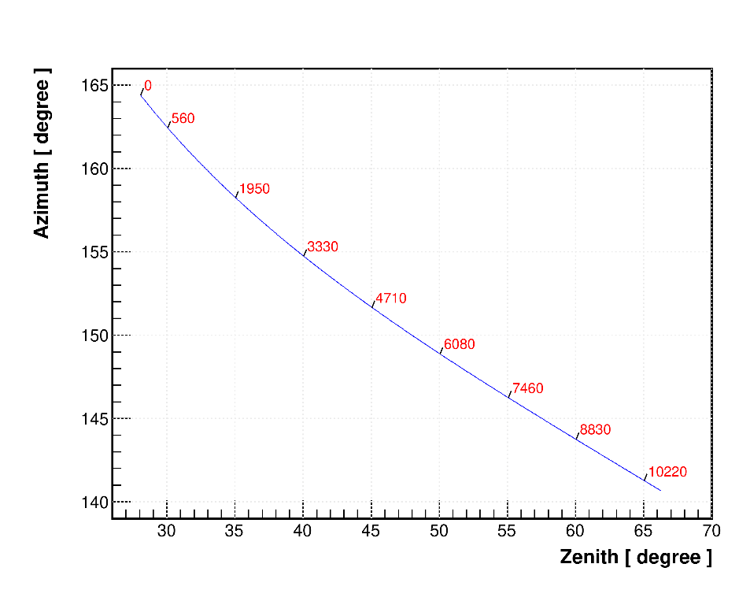
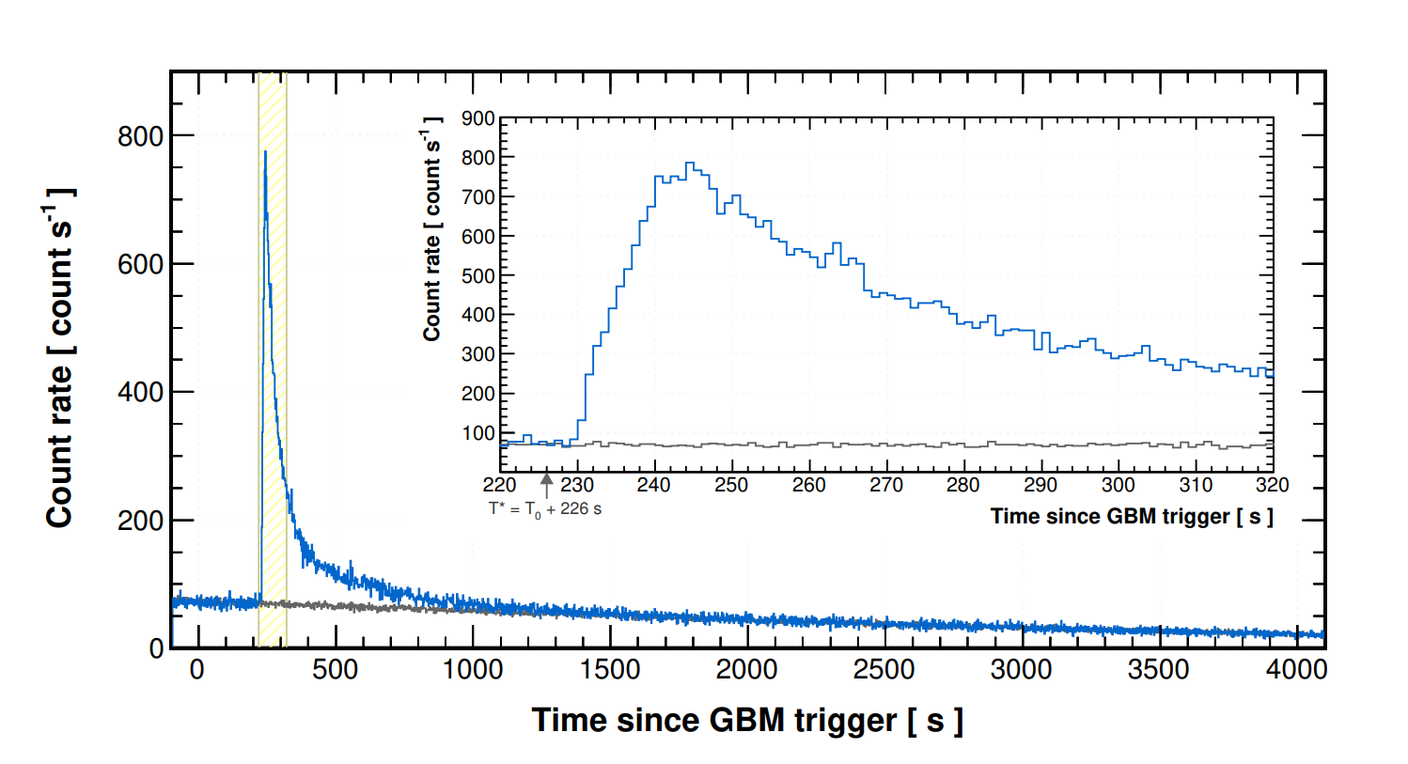
BOAT GRB221009A @ LHAASO
first GRB observed by ground based EAS detector;
High statistics: > 65,000 photons above 0.2 TeV
TeV count rate light curve
  Smooth temporal profile
    External shock origin;
  Precisely measured the entire LC from a GRB afterglow
  First time detection of the TeV afterglow onset
FOV
KM2A, ~140 events

Slide 19
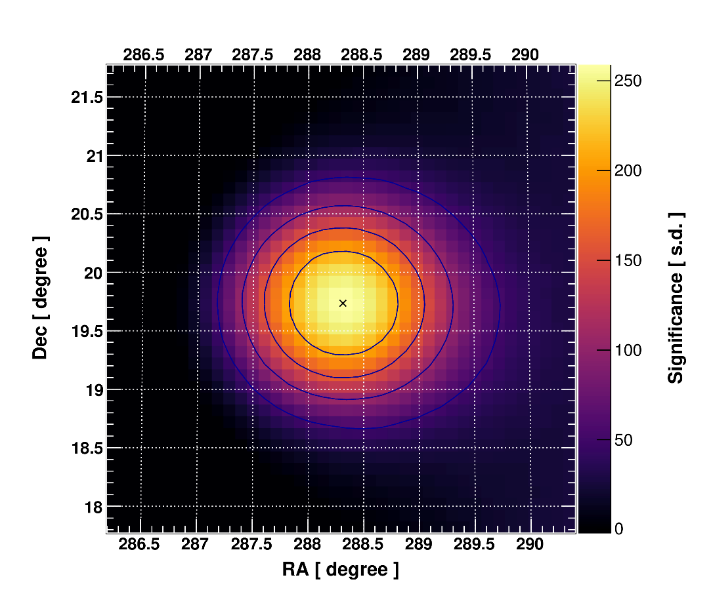
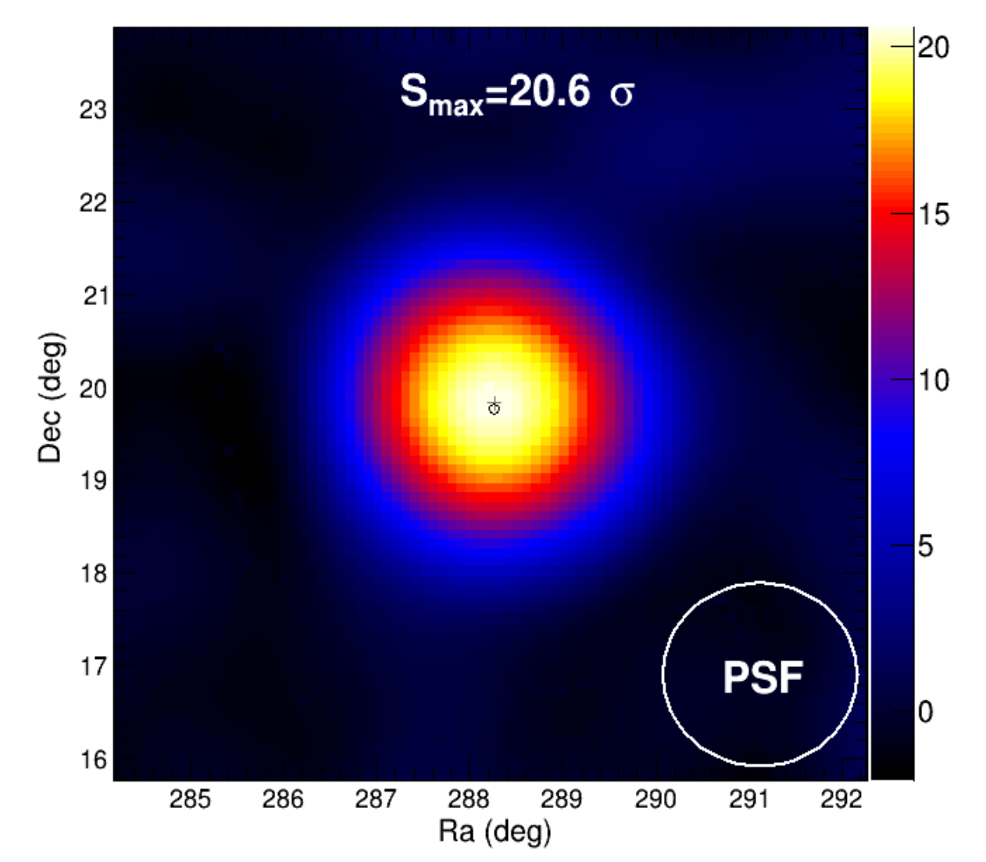
BOAT GRB221009A @ LHAASO
Time: 200 seconds
WCDA, > 65,000 events
KM2A, ~140 events

Slide 20
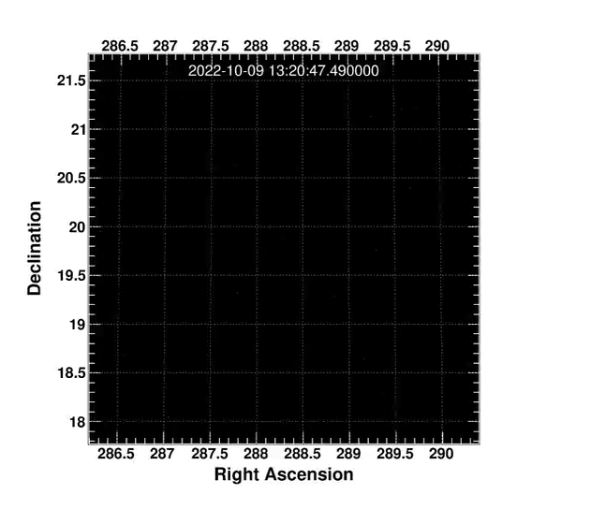
BOAT GRB221009A
WCDA raw data

Slide 21


Slide 22




Spectral Energy Distribution

Slide 23



Light Curves
4 segments power-law
  Finding an unusually fast rise phase
    A rapid enhancement process
  Finding a jet break in the TeV light curve in its decay phase;
    The narrowest jet of 0.8 deg;
WCDA, > 65,000 events

Slide 24


Multi-wavelength modelling for the first 10⁴ s afterglow synchrotron + SSC
?
to touch few tens of GeV Photons?

Slide 25
Other sources under active analyses
SNR
  γ-cygni
  IC443
  W44
  Cas A
  J2002/SNR G069.7+01.0
  SNR G106.3
  …
Young star cluster
  Cygnus (cocoon)
  W43
  …
PWN/Pulsar halo
  Geminga
  CTA 1
  J1825
  …
Extragalatic
  Mrk 421
  Mrk 501
  NGC 1275
  M87
  …
KM2A only
  LHAASO peanut
  1LHAASO J1740+0948u
  J1740+1000
  1LHAASO J1959+1129u
  …
Dark sources
  1LHAASO J0343+5254u
  1LHAASO J2108+5153u
  1LHAASO J2200+5643u
  …
Unidentified
  1LHAASO J1809−1918u
  1LHAASO J1908+0615u
  1LHAASO J2018+3643u
  …

Slide 26




Diffuse ϒ-rays emission
Fluxes higher than predictions (local CR flux $×$ gas column) by a factor of 2—3: additional diffuse source exist or propagation effect, or contributions from sub-threshold sources.
From TeV to PeV with new preliminary results from WCDA
PRELIMINARY

Slide 27


Deep observation at Cygnus Region
PRELIMINARY
indicating a hadronic super-PeVatron @ Paper in submission

Slide 28


A real-time flare monitoring @ WCDA
154 selected candidates
  + Crab as a reference example
Alarming threshold
  Around 5 sigma
Time ranging from hours to 4 days;
After 5 hours, a report will be released
  Processing time can be shorter
A daily report @ 20230905

Slide 29



Multiwavelength observation @ Mrk421

Slide 30



1TeV – 10 PeV anisotropy @ LHAASO
Local CR sources → another flip around 200 GeV ?
B.Q. Qiao, et al. arXiv:2201.06234
Cosmic ray anisotropy from 1 TeV to 10 PeV is preliminarily measured by LHAASO, with higher accuracy than other experiments.
LHAASO-WCDA could testify the local source model.

Slide 31




all particle energy spectrum and mean lnA
PRELIMINARY
A complex variable $N_{eμ}$ is constructed with weak dependent on primary CR mass
Energy reconstruction with $N_{eμ}$
  better resolution, less bias between components
  R: 12% + B: <5% @ 1 PeV
The all-particle energy spectrum knee is dominant by the knee of light components, instead of the medium-heavy components
$${N_{eμ}=N}_{e}+a∗N_{μ}$$

Slide 32




Iron spectrum expectation
by 18 telescopes of WFCTA with zenith angle of 45$°;$
Accumulated ~2200 hours good data since Oct. 2021;

Slide 33



New updates from WCDA + KM2A
PRELIMINARY
Improved the angular resolution, and extended the low energy SED.
Number of sources: 69 ➔ ~100.
Number of extra-galactic sources: 8 ➔ 15
Optimization in Q/P discrimination power can reach 20%

Slide 34

Summary and Prospect
LHAASO is in full operation since July 2021 and will continuously monitor north sky in the coming 20 years.
1st LHAASO catalogue including 90 sources has been released.
LHAASO collaboration is currently conducting detailed analysis on these sources and we anticipate more interesting results are on the way.
Thanks for your attention !

Slide 35
Backup

Slide 36


SED of the Crab: Extreme E-accelerator
LHAASO, Science 373: 425-430, 2021
Observation
  For the first time covering 3.5 decdades of energy (300 GeV – 1.1 PeV)
  Consistent with others < 100 TeV
  Self cross-check between WCDA and KM2A; KM2A and WFCTA
Interpretation
  Perfect interpretation of one-zone electronic origin up to 50TeV
  Maximum photon energy 1.12±0.09 PeV→ primary electron energy 2.3 PeV
  Acceleration rate η≈0.16 to balance the synchrotron losses rate for maximum energy.

Slide 37

LHAASO sensitivity

Slide 38

Cosmic Ray Anisotropy @ WCDA
One year data
TeV ~ hundred TeV
Anisotropy patterns do not vary with energy <100 TeV
Above 100 TeV, significance is not enough

Slide 39

Cosmic Ray Anisotropy @ KM2A

Slide 40


P + light spectrum expectation
Using six telescopes of WFCTA with zenith angle of 30$°$

