Slide 1
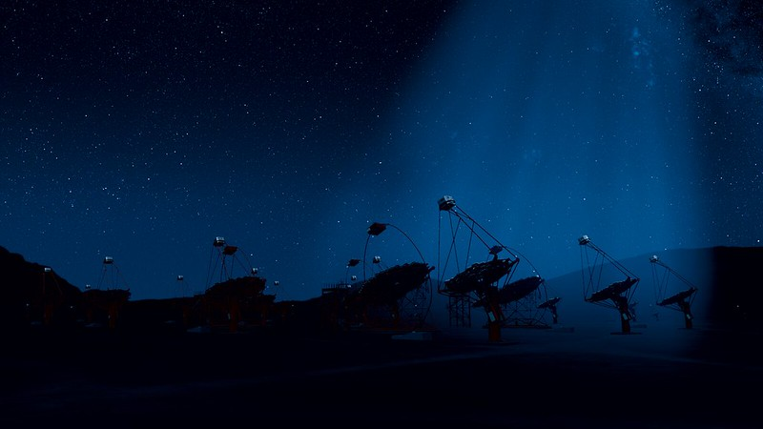
MAGIC Celebration
October 6th, 2023
Cherenkov Telescope Array Observatory
- Building Upon MAGIC
Stuart McMuldroch

Slide 2
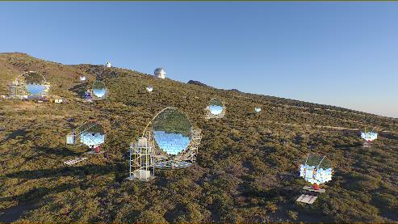
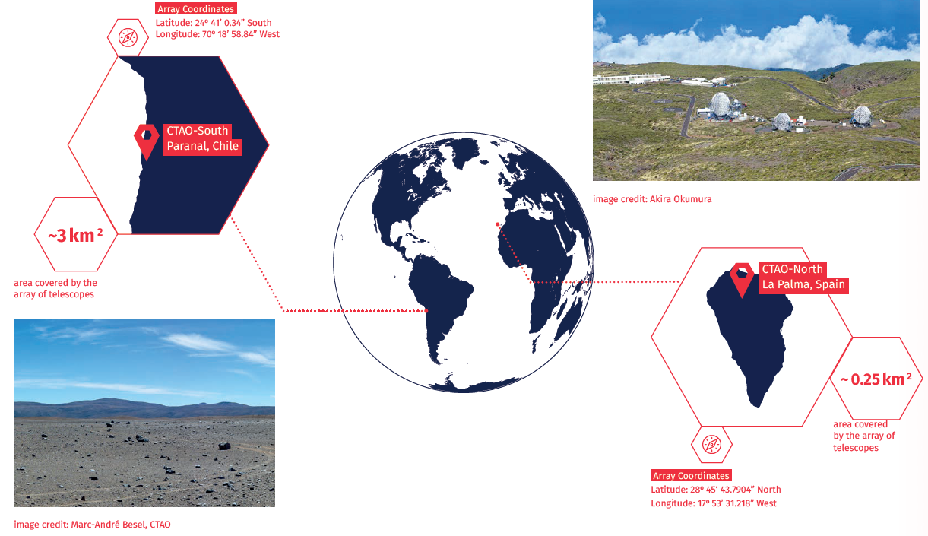
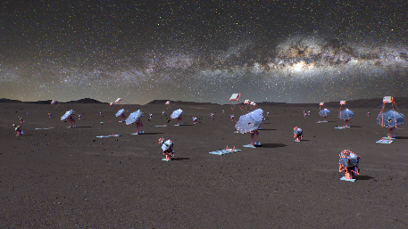
Two CTA Arrays in One Observatory
Alpha Configuration: 51 telescopes spread out over ~3 km² (37 SSTs &14 MSTs plus…).
It will span CTAO’s mid- and high-energy range (150 GeV – 300 TeV).
Alpha Configuration: 13 telescopes
spread out over ~0.25 km²
It will focus on CTAO’s low- and mid-energy ranges with 4 LSTs and 9 MSTs.

Slide 3
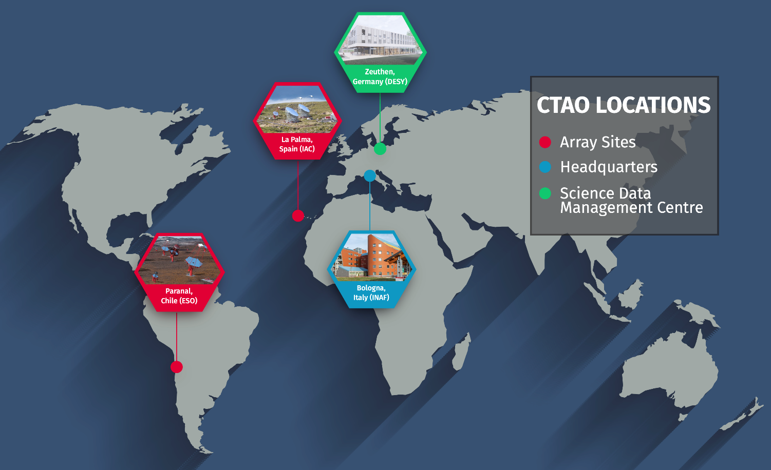
CTAO Locations with Full Team Spread Worldwide
Full team includes partners/IKCs from all over the world

Slide 4
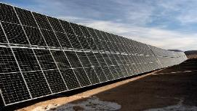
CTAO is Moving Forward
Many partner groups making progress, albeit limited by funds.
CTAO central project is moving forward
South site infrastructure (Paranal) starting
Design reviews with multiple IKC
Software real-world testing – ACADA on LST-1 in earnest next week!
South site road –
need a destination
Power systems and eventual
link to existing ESO PV plant
Camera images from LST-1 ACADA test

Slide 5
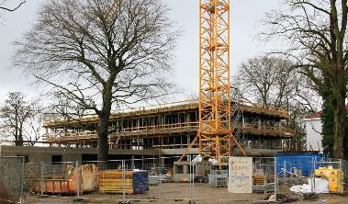
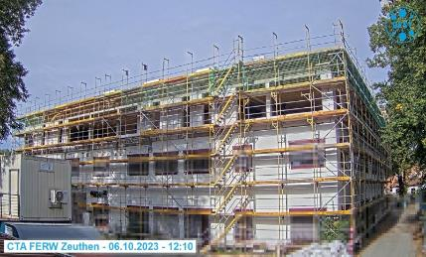
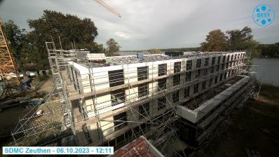
SDMC Continues To Advance
SDMC in March 2023
SDMC now
DESY is making excellent progress
Building expected to be complete in summer 2024

Slide 6
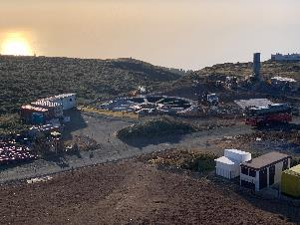
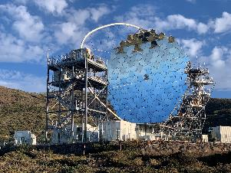
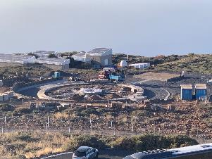
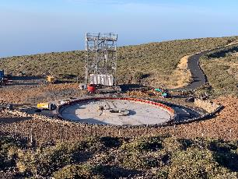
LST Getting Ready
IAC currently managing the construction of three sets of foundations and camera towers
LST-2
LST-1 first of four telescopes
LST-4 foundation, furthest along
LST-3

Slide 7
CTAO gGmbH Historically Has Been Waiting – No More
At top levels, emphasis appropriately on getting new ERIC organization in place
Facilitates funding
VAT exemption
Current organization’s goal is to prepare for ERIC with only limited construction focus
Minimal funding with limited staff leading to inadequate progress and IKC support
Recent delay in ERIC, coupled with desire to complete the observatory, has led to increased new funding next year
CTAO gGmbH efforts will now progress in parallel

Slide 8
CTAO gGmbH Focussed on Construction
Focussing on construction enabled by increased funding
Infrastructure development in the south
Even more importantly, doubling the staff size
South site infrastructure – earthing grid, power systems, trenches, foundations
But what about the north site and the current LSTs under development?
General support from a larger team– systems engineering, software…
New emphasis on increasing interaction with IKC groups – having dedicated internal leads including for LST
Goal of leading to LST-1 acceptance readiness by end of 2024

Slide 9
Hiring is Everything – People Make a Project
Goal to hire 29 people this year
Timing for job announcements:
Now
PM, Lead systems engineer, Senior HR
Autumn
Legal officer
Requirements jockey, systems engineer
South and North Site staff - start
IPT leads - start
Software engineer
December/January
South and North Site staff remainder
Software engineers
IPT engineers
February
Deputy PM, deputy PS
Many of these will support the North site and LST efforts
LST Internal Lead
Software engineers
LST systems engineer
Site staff
Work with LST team so they can deliver a telescope to CTAO
A major milestone for everyone

Slide 10
The Next 12 Months Are A Critical Team Effort
Form a new team with a different focus on working with IKCs and science
Change in organization (hopefully) so more countries can support the project and IKC groups get increased funding from their countries
Lead to LST-1 acceptance
Maintain construction focus while not forgetting science is our eventual goal
Meeting in Berlin in November – more hardware/software than science in a workshop topic specific style
Science symposium in April - includes substantive science portions in addition to more public events

