Slide 1
MAGIC Astrophysics with Very High Energy Gamma Rays
Razmik Mirzoyan
For the MPI MAGIC Team
Max-Planck-Institute for Physics
Munich, Germany

Slide 2
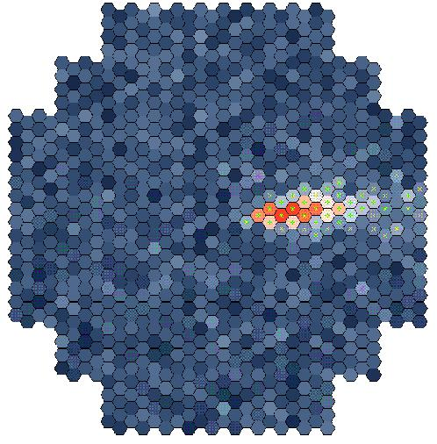
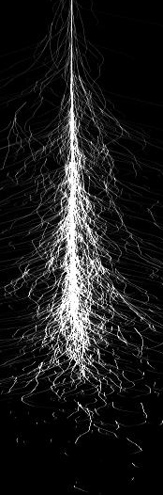
Detection of VHE γ radiation
Particle shower
Original photon
~ 10 km
~ 1º
Cherenkov light emission at ~ 1°
Detection area ≥ 5 x 10⁴ m²
for a single telescope
For large arrays detection area could be ≥ 1 km²
~ 120 m

Slide 3
Detection of VHE γ radiation
Particle shower
Original photon
~ 10 km
~ 1º
Cherenkov light emission at ~ 1°
Image intensity ~ shower E
X-point - impact
Image shapes ~ particle type
~ 120 m
Notes:
.

Slide 4
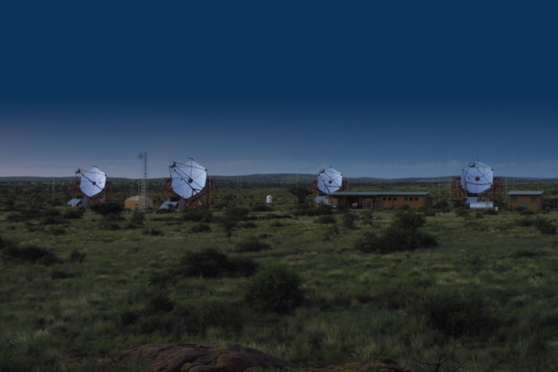
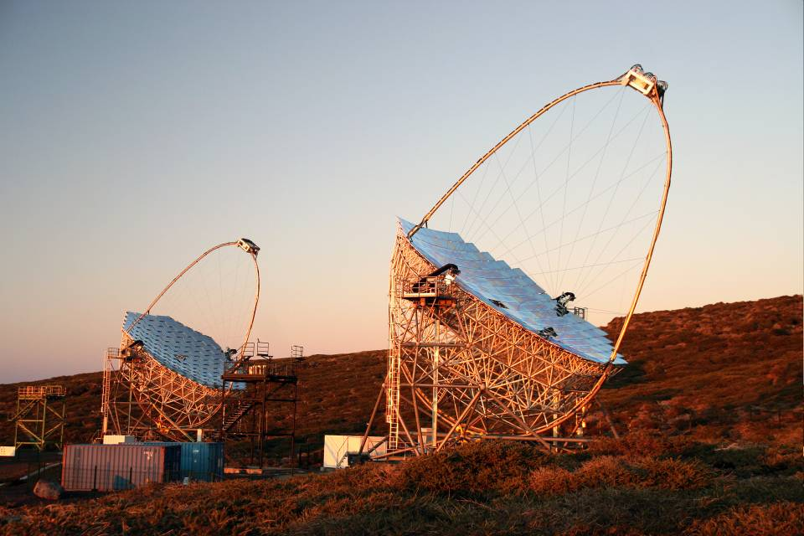
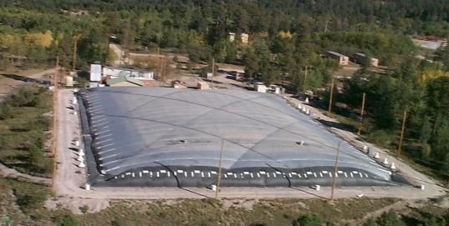
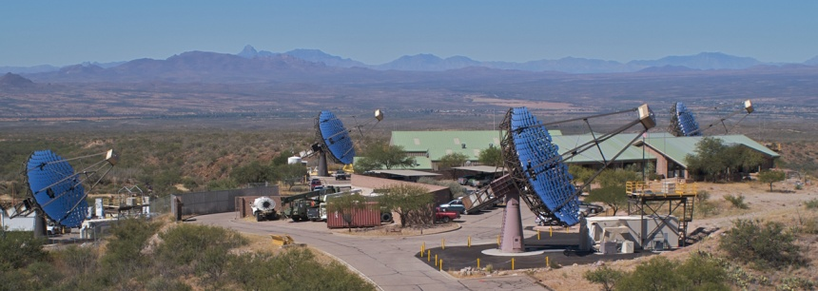
H.E.S.S., VERITAS & MAGIC
H.E.S.S.
MILAGRO
Parameters of VERITAS almost
matching those of H.E.S.S.
H.E.S.S. MAGIC
# telescopes 4 2
Field of view 5° 3.5°
Reflector diameter 12 m 17 m
Energy threshold 160 GeV 55 GeV (25 GeV – special trigger)
Sensitivity: 1.0 % Crab (25 h) 0.8 % Crab (50 h, E ≥ 260 GeV)

Slide 5
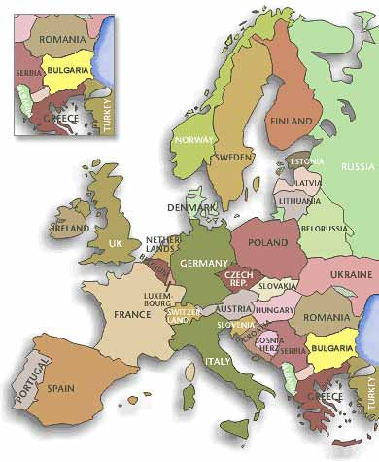
The MAGIC collaboration
~150 Scientists from 8 countries
Bulgaria Sofia
Croatia Consortium
Finland Tuorla Observatory
Germany DESY, Dortmund
MPI Munich, Wuerzburg
Italy INFN Padova, INFN Siena
INFN Udine, INFN Como, INAF Rome
Poland INRNE Lodz
Spain U. Barcelona, UAB Barcelona
IEEC-CSIC Barcelona
IFAE Barcelona, IAA Granada
IAC Tenerife
U Compultense Madrid
Switzerland ETH

Slide 6
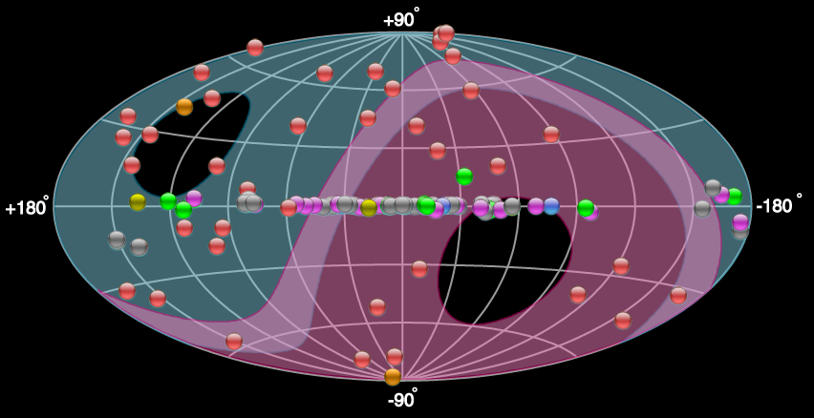
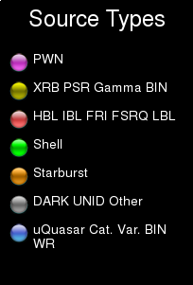
Where are we in ground-based VHE γ-astrophysics ?
The 1st strong signal (9σ) reported by the Whipple team in Arizona was
measured from the Crab Nebula in 1989
The 1st Extragalactic source (and the 2nd source at all) Mkn-421 was
reported by the Whipple team in 1992
Today, after ~ 20 years, there are ~120 VHE gamma sources reported
(this number, as of yesterday, was taken from http://tevcat.uchicago.edu/)
H.E.S.S., VERITAS, MAGIC

Slide 7
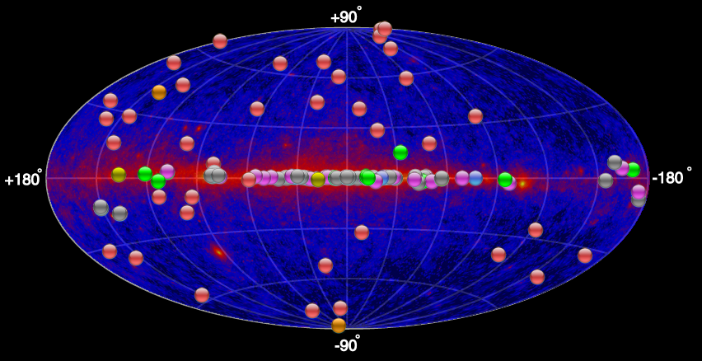
Where are we in GeV - TeV γ-astrophysics ?
The FERMI satellite mission has revolutionized the > 100 MeV γ sky,
after 2.5 years of flight some 1500 sources are reported

Slide 8
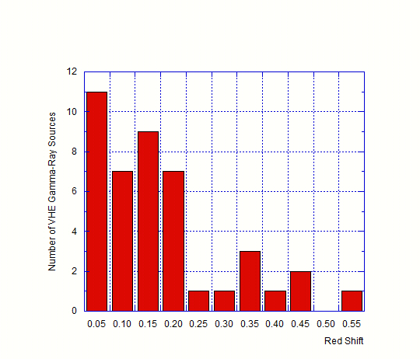
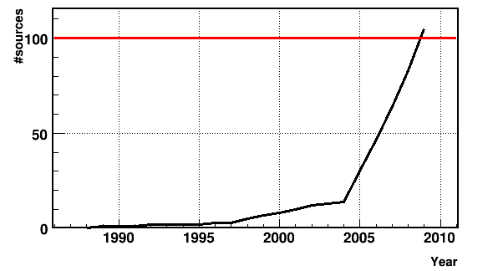
Number of known VHE extragalactic
sources versus the
red shift
Number of VHE discovered
Sources vs. time

Slide 9
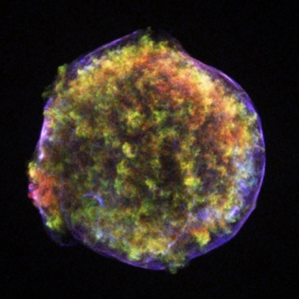
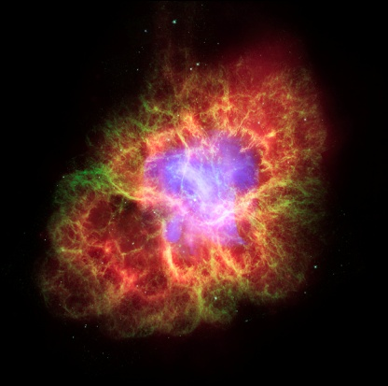
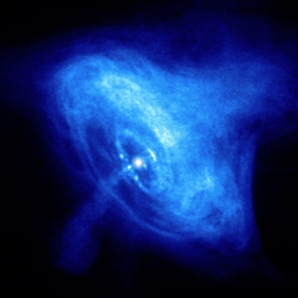
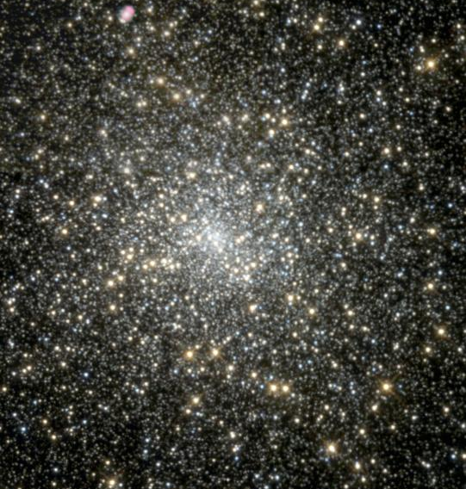
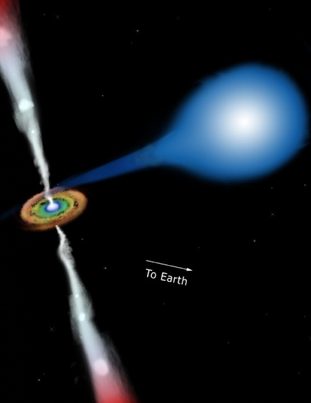
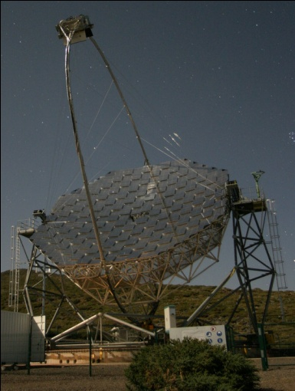
Galactic Source Targets
SNR
PWN
Pulsars
Globular Cluster
MAGIC mainly pointed at candidate sources
Microquasar, HMXB

Slide 10
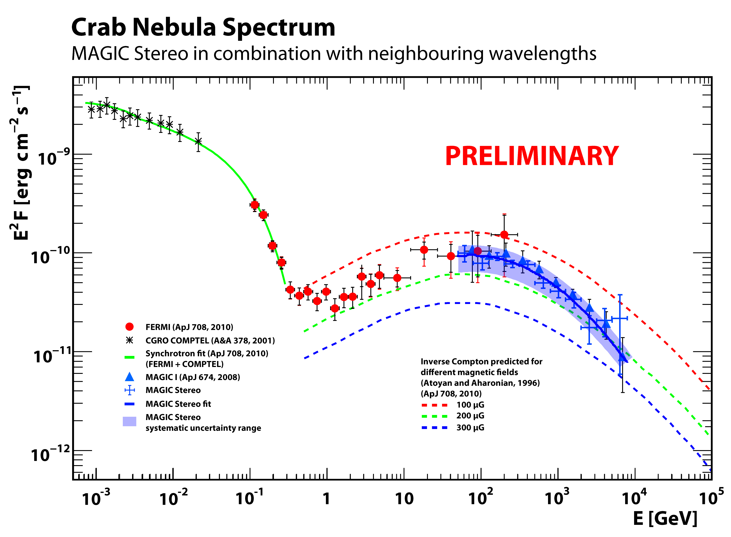
Crab Nebula observed with 2 MAGICs
3.5 h of data

Slide 11
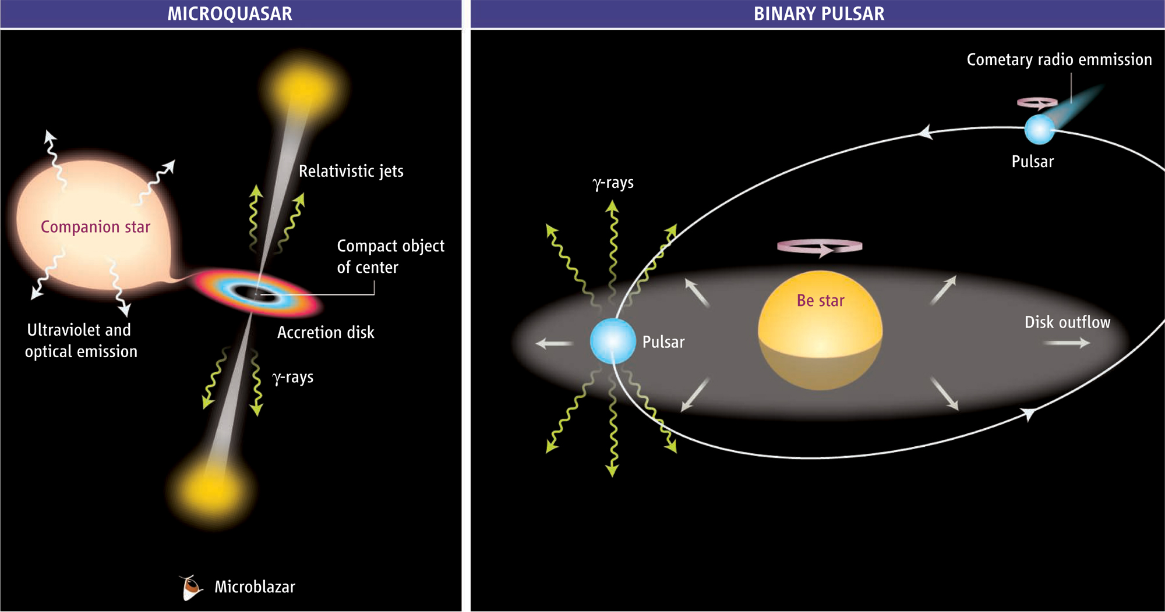
γ-ray emission from binaries
accretion powered
rotation powered
Mirabel 2006

Slide 12
The binary system LS I +61 303
Compact object still unknown
Periodic emission with orbital
period (P = 26.496 d)
Difficult to study for IACTs since period close
to Moon period
Periastron at phase 0.275
Eccentricity e = 0.55
Orbital parameters were modified during
VHE observations
Periastron
to observer

Slide 13
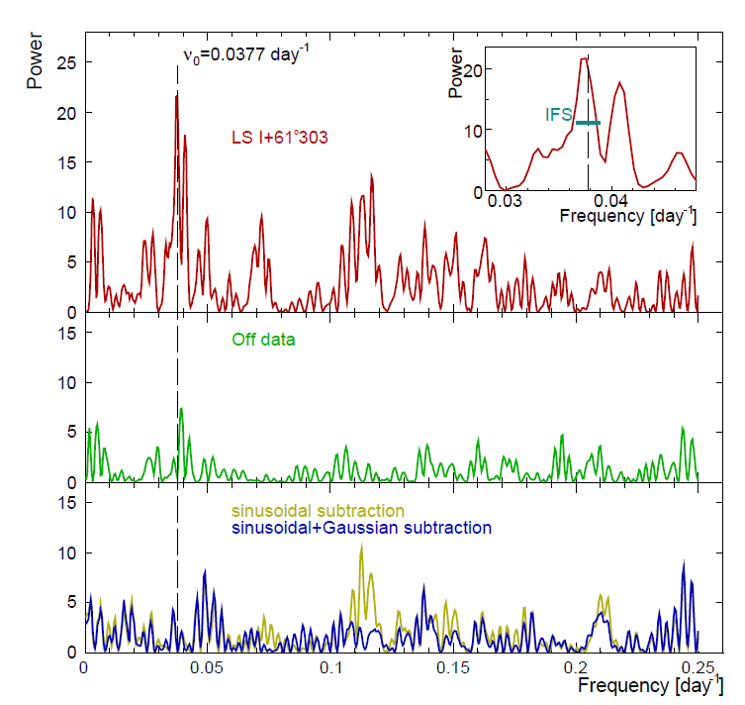
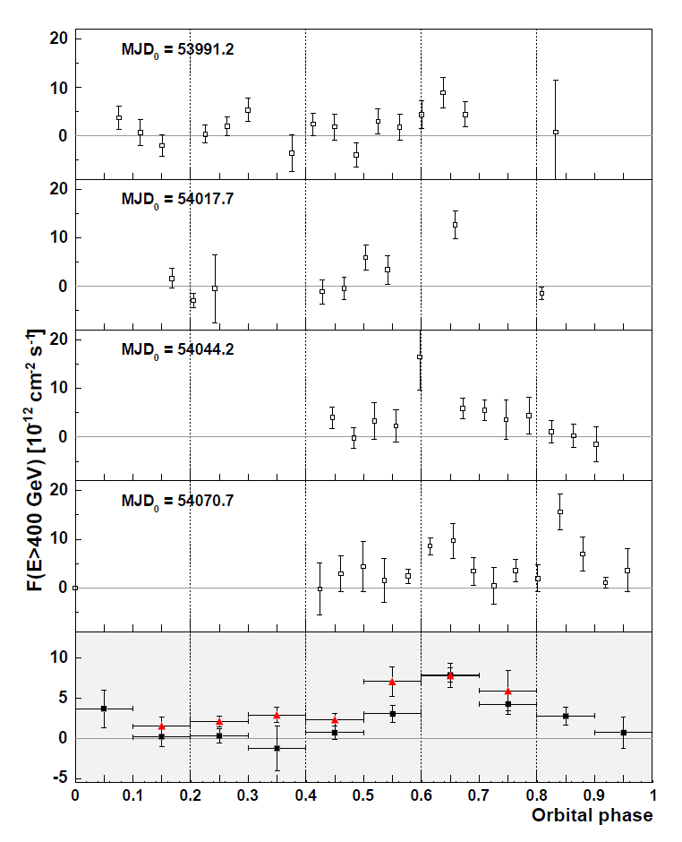
LS I +61 303 observations
Effective observation time T_{obs}= 225 h
13 orbits covered between 2005 and 2008
Zenith angle between 32° and 55° (Energy threshold ~ 300-400 GeV)
Large fraction of the data (~ 20%) taken under moonlight conditions
Several multi wavelength campaigns in X-ray, radio and VHE gamma-rays
VHE MAGIC LC
periodic

Slide 14
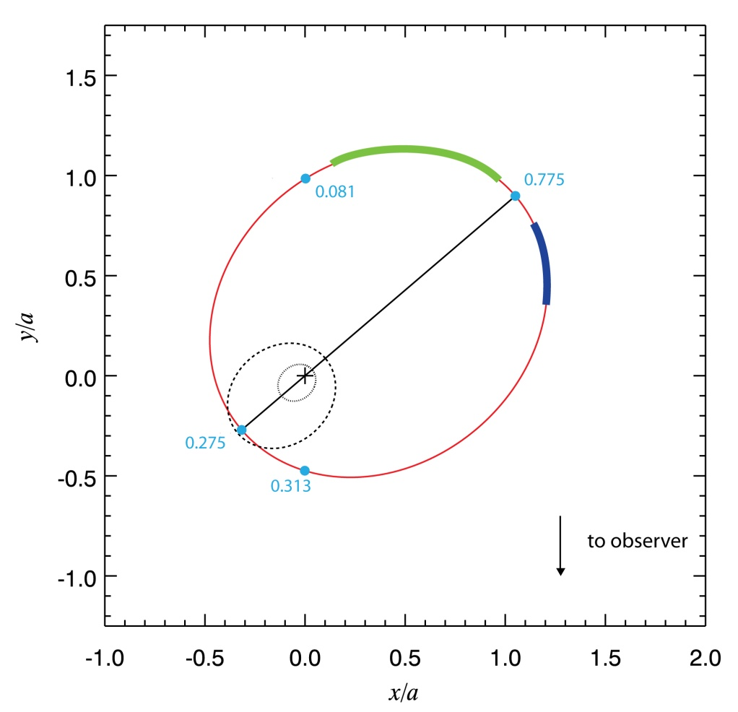
Summary of “mono” LS I +61 303 observations
Periodic outburst in phase 0.6-0.7
modulated with orbital period
Additional fluxes phase 0.8-1.0
not modulated with orbital period
Spectrum in periodic outburst is a power law and stable within all observations
X-ray/VHE flux correlation found in strictly simultaneous measurements
non periodic fluxes
periodic
outburst
Periodic emission in phase 0.6-0.7 and additional emission varying from orbit to orbit and stable spectral shape!

Slide 15
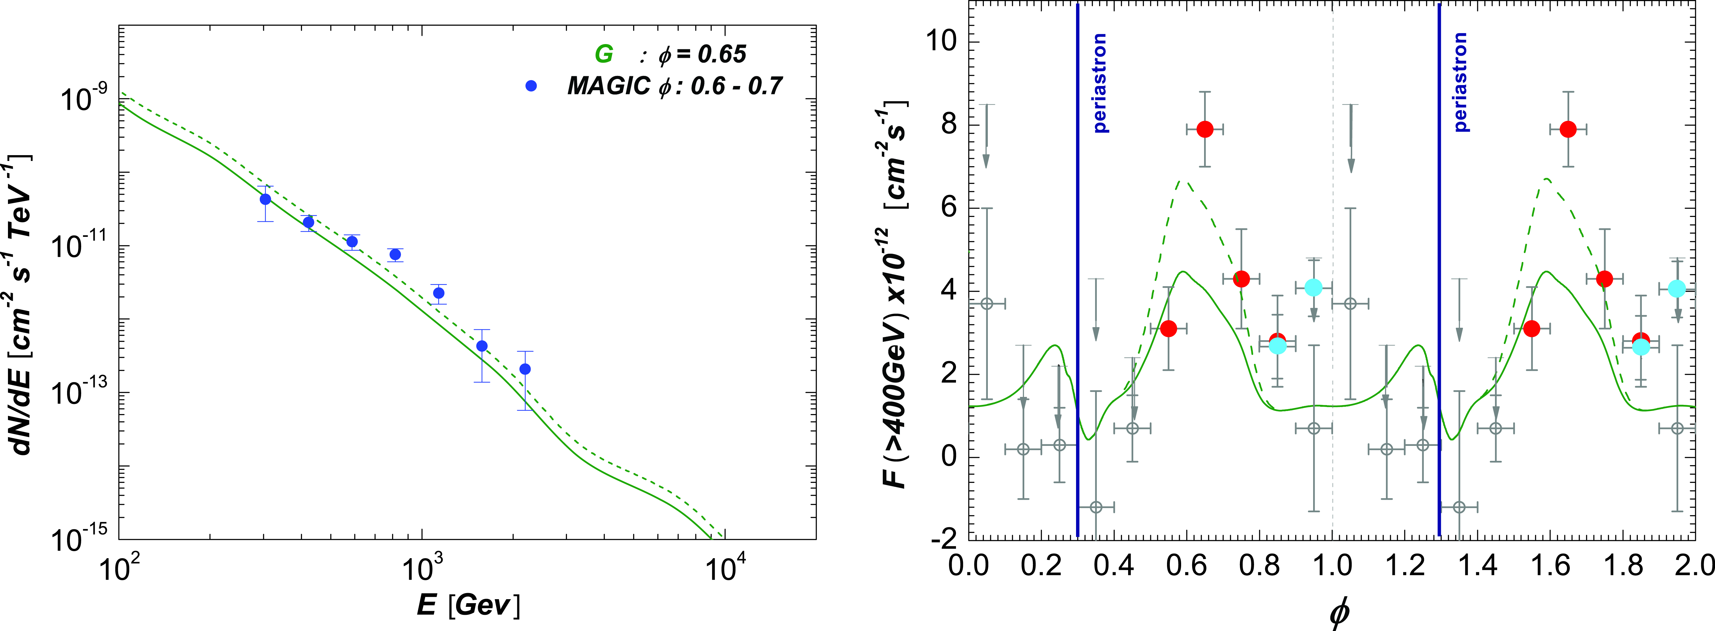
Explanation of the VHE emission
Model assumes free pulsar wind
with power law distribution of electron energies
Sierpowska-Bartosik & Torres 2009
Reasonable agreement

Slide 16
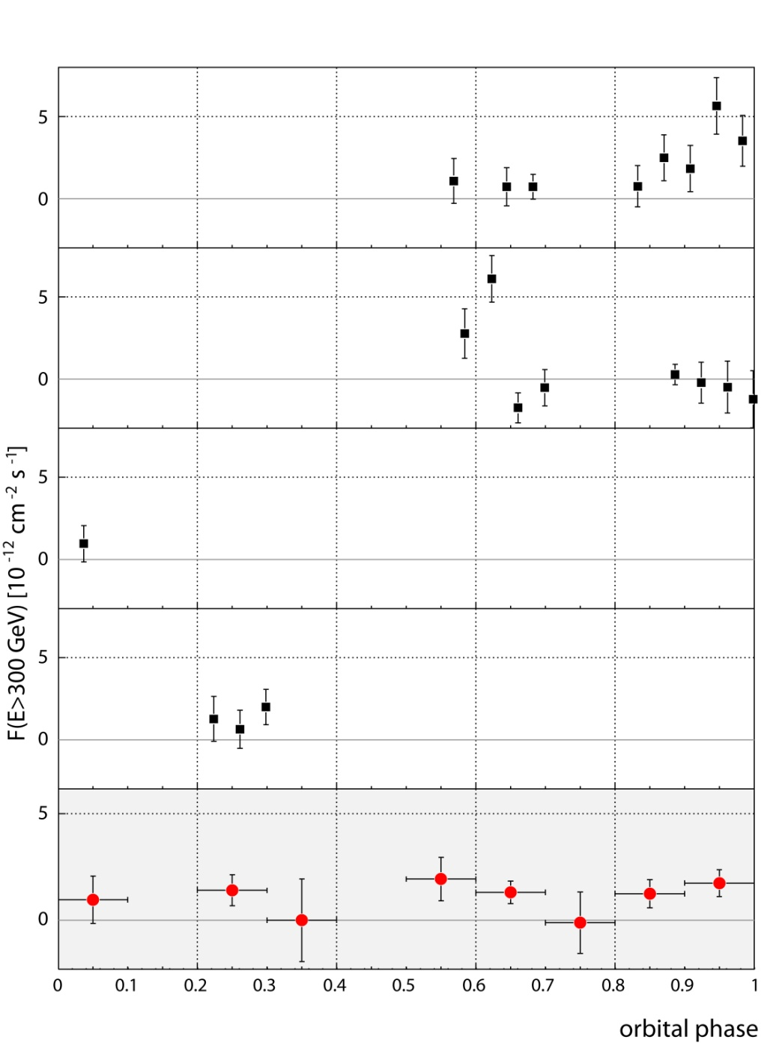
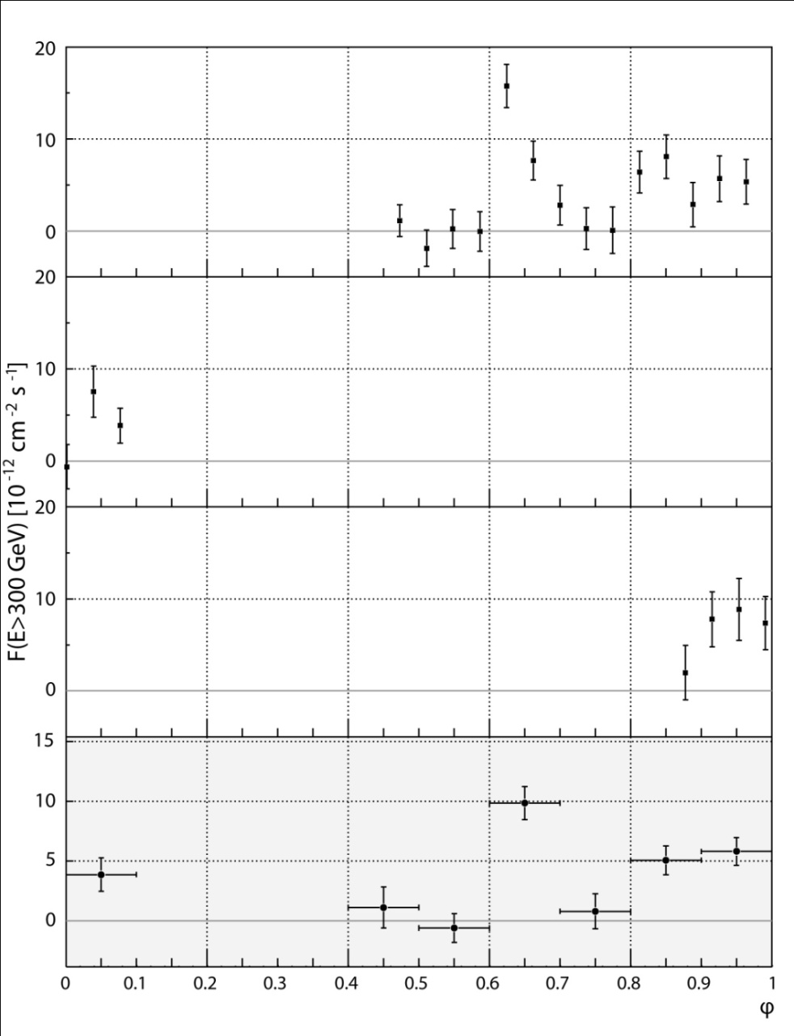
New measurements show different picture !
stereo 2009
mono 2007
Preliminary
~ 4% Crab
~ 4% Crab

Slide 17
Implications for LS I+61 303
Overall flux level significantly reduced
Still emitting VHE gamma-rays
No spectral change compared to old measurements
No clear periodic feature seen, averaged fluxes in phase bins indicate irregular behavior
Geometrical interpretation by previous pulsar wind model very difficult
Still very new results but clearly difficult to explain in the standard
scenarios. More complicated models taking Stellar cycles into account
needed.

Slide 18
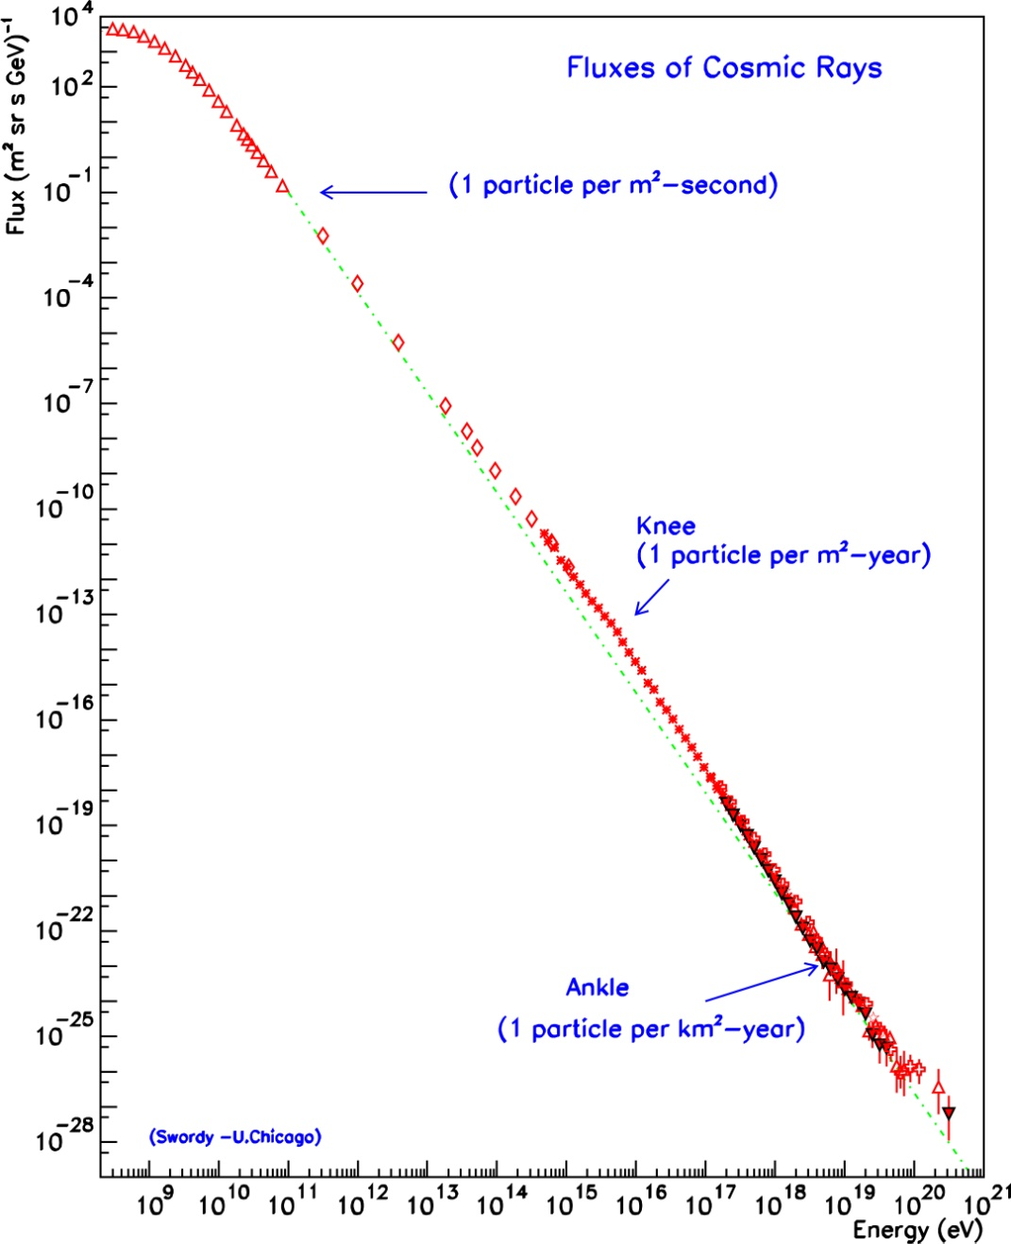
Origin of cosmic rays
Doscovered in 1912 but their sources are not yet identified!
Which object(s) in our galaxy can
provide the right amount of CR?
galactic origin
Supernova remnants could
accelerate swept up particles in
their magnetic shock waves
extragalactic
origin
Signature: Hadronic generated Gamma-rays from SNRs

Slide 19
Interesting candidate SNR W51
Infrared image of W51
SNR expanding into a complex
environment
Distance ~ 6 – 7 kpc
Age ~ 3x10⁴ years (Sedov – Phase)
Molecular clouds (CO – emission lines)
VHE protons probable
Enough target material
A bit too large distant

Slide 20
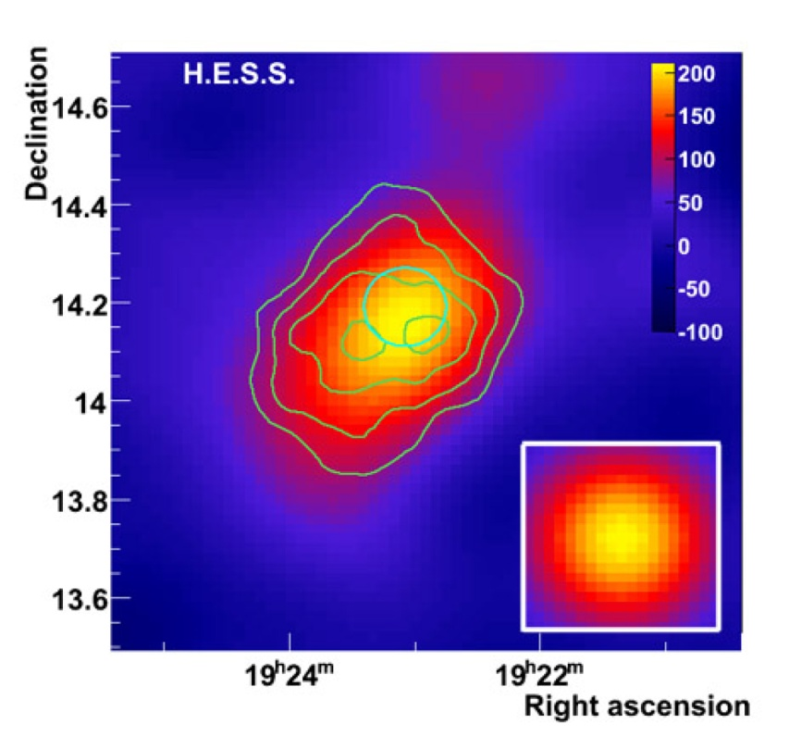
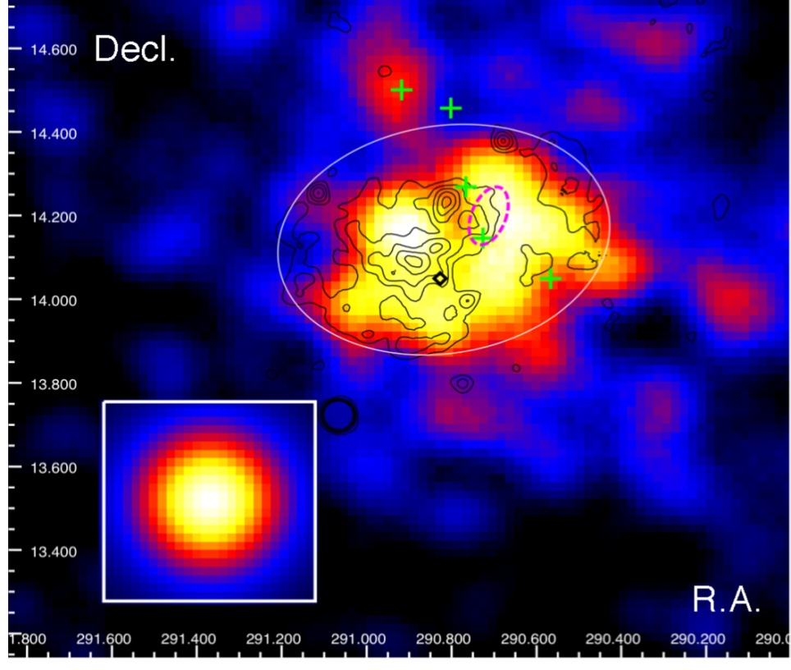
Supernova remnant: W51
2-10 GeV Photons detected by FERMI
0.22 deg extension
HESS reported detection
no spectrum
Flux E > 1 TeV ~ 3% Crab
FERMI E = 2-10 GeV
E > 800 GeV

Slide 21
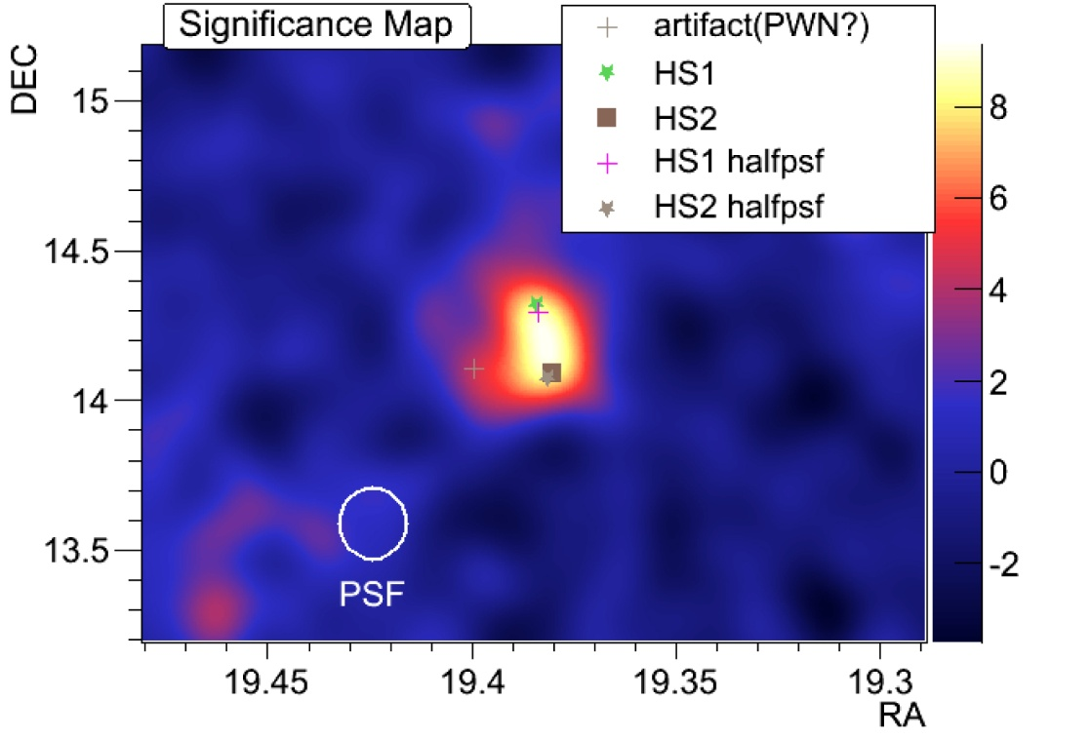
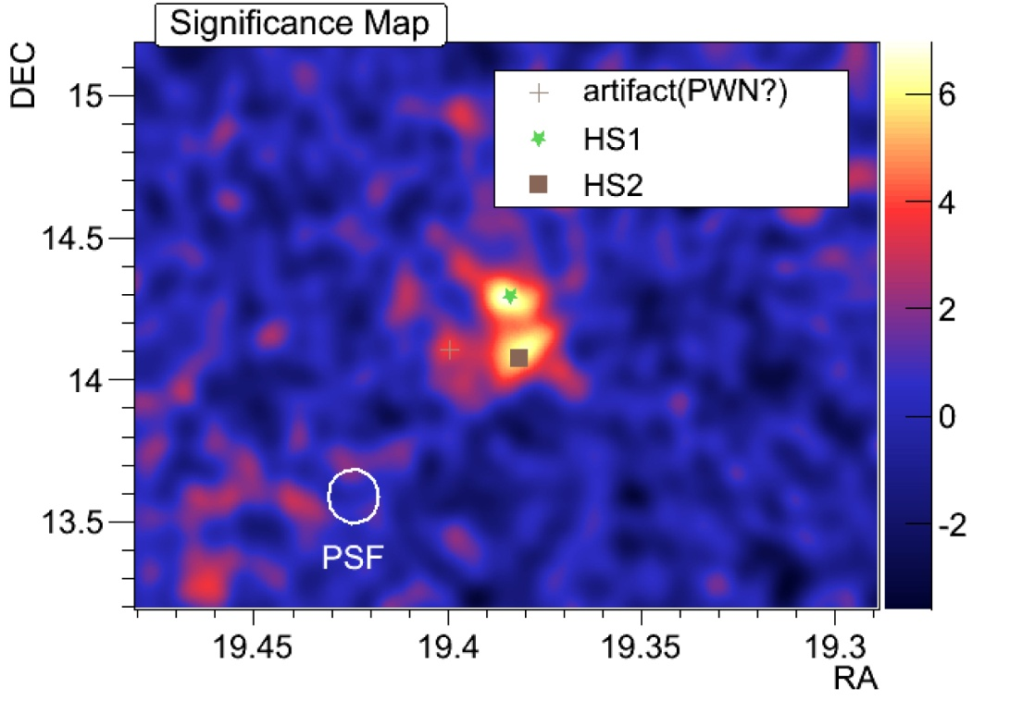
W51 as seen by MAGIC
MAGIC observations of W51 in 2010 : ~ 40h (selected good quality data)
Energy threshold of the sky-map analysis ~ 130 GeV
Preliminary
Preliminary
Morphology? Angular resolution is very good but further tests needed!

Slide 22
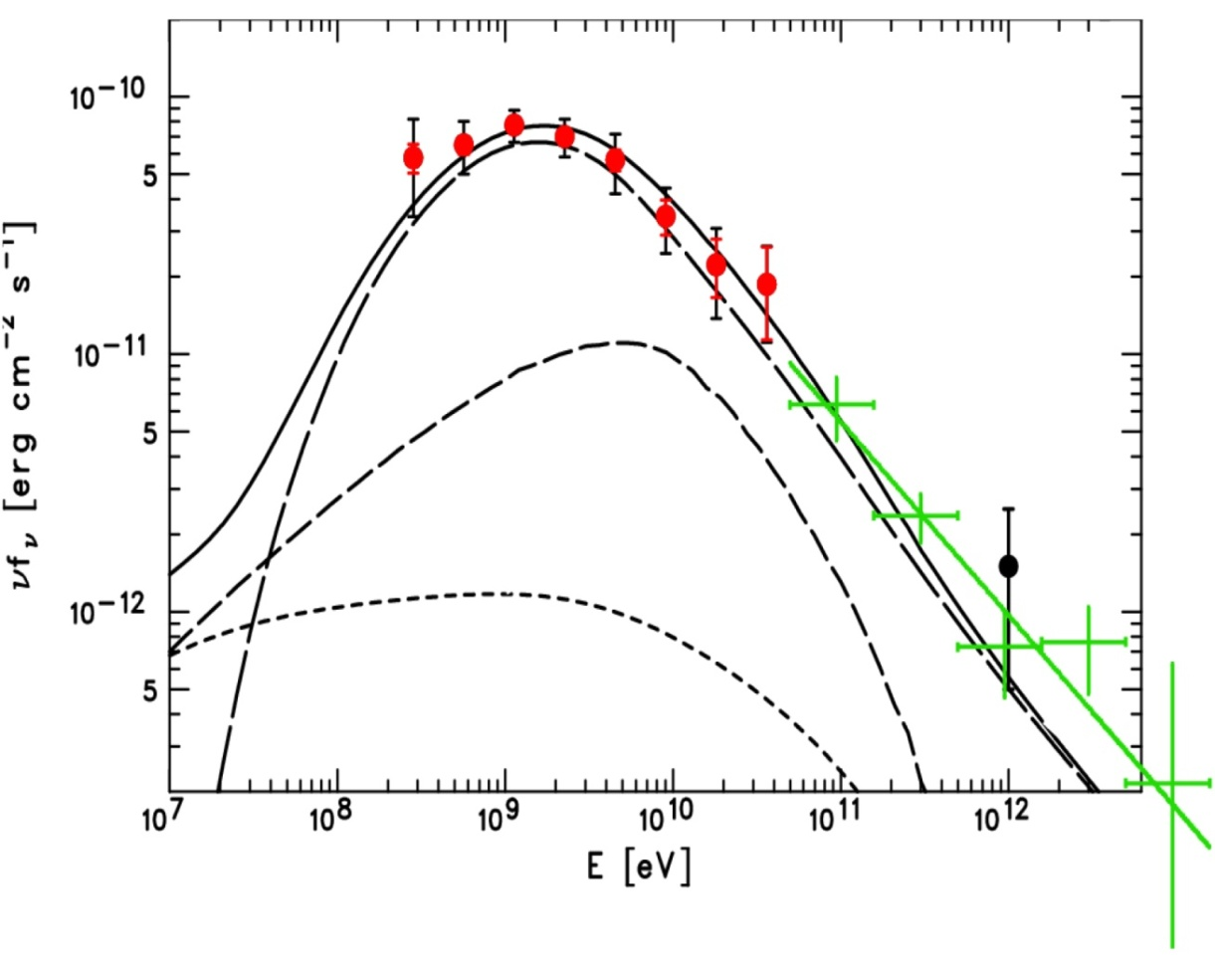
Proton accelerator could make a good match
Spectrum of the complete
extended source
MAGIC spectrum well
described by a power law
Fermi
π⁰-decay
MAGIC
Brems.
IC
Preliminary
Candidate cosmic ray accelerator

Slide 23
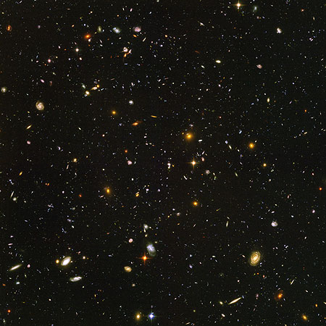
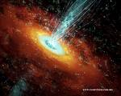
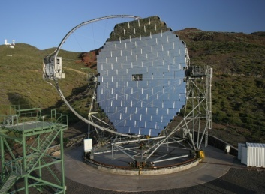
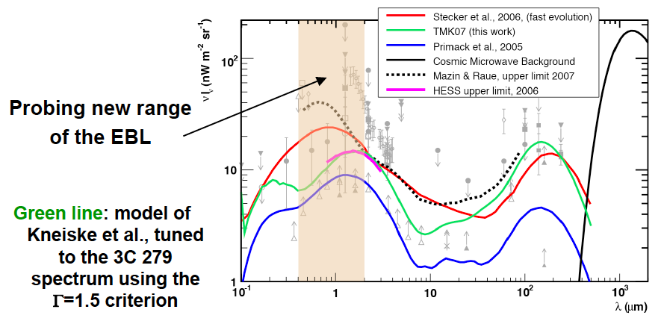
EBL studies
Extragalactic Background Light
blazar
IACT
γ_{VHE}
γ_{EBL}
e⁺
e⁻

Slide 24
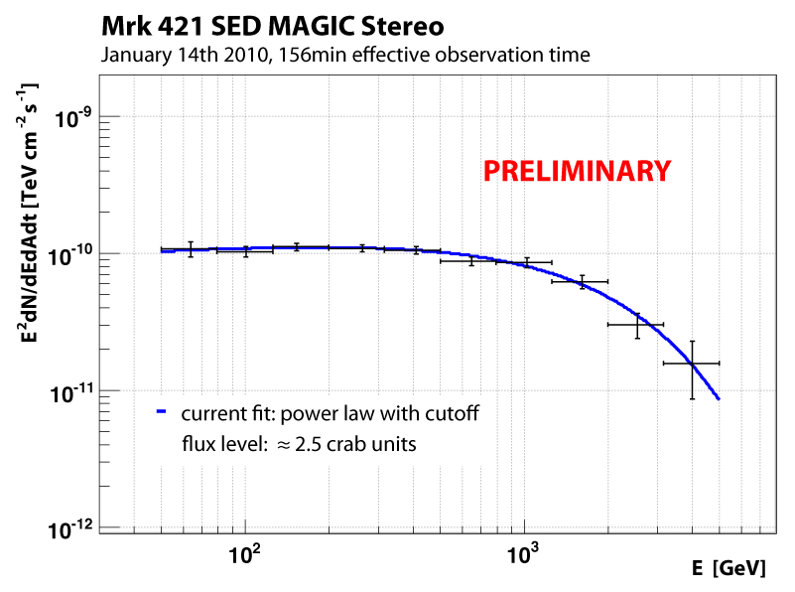
Mkn-421 Flare on Jan. 14 2010
MAGIC could measure
the spectrum of a
strong source at
energies as low as
~ 50 GeV providing an
overlap with a space-
born g instrument
(FERMI)

Slide 25
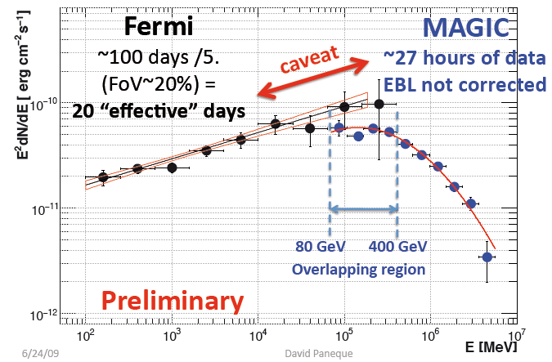
„Full energy“ coverage by FERMI & MAGIC
This is a new quality
that many of us were
dreaming since long
ago
One needs still to
clarify some
calibration issues
between the very
different techniques

Slide 26
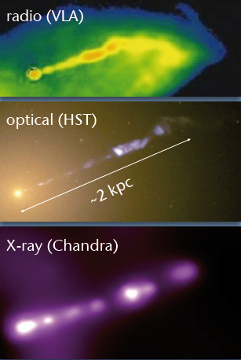
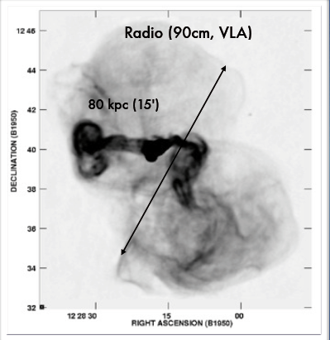
Radio Galaxies
„Mis-aligned“ blazars
  (FR I = BL Lacs, FR II = FSRQ)
Radio galaxies that are measured in VHE γ‘s:
  M-87, Cen A, IC 310, NGC 1275
M87
M87

Slide 27
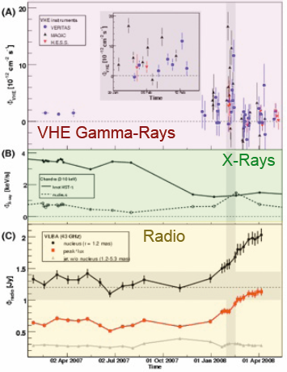
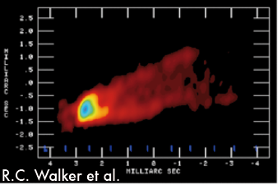
M87: Radio + VHE Instruments
Science (2009)
VLBA observes M87 jets @ 43 GHz; jet formation of
30 x 60 Schwarzschild radii
VHE flare accompanied by radio
flare from the really close vicinity
of the Black Hole vicinity

Slide 28
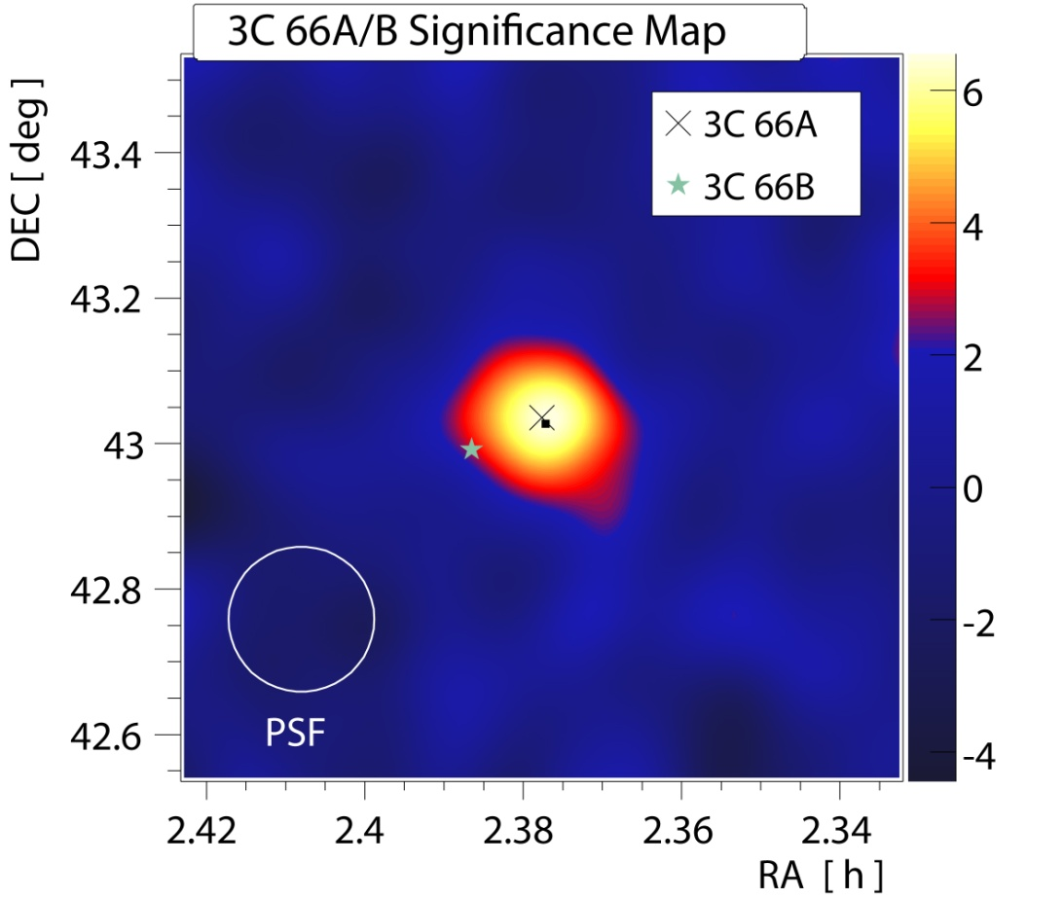
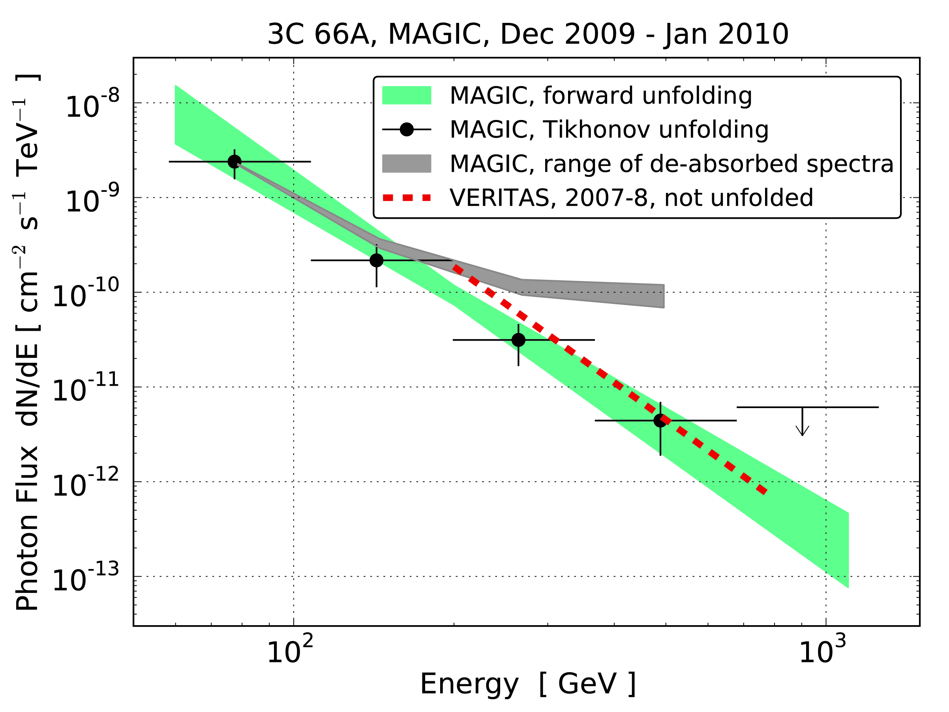
3C 66A
3C66A: intermediate frequency
peaked BL Lac
3C66B: nearby Radio Galaxy
Signal from A or B (separation 6’) ?
Thanks to Improved angular
resolution of stereo: clearly A
z = 0.444
z=0.444 (but not certain)
Spectrum is soft and compatible
with VERITAS

Slide 29
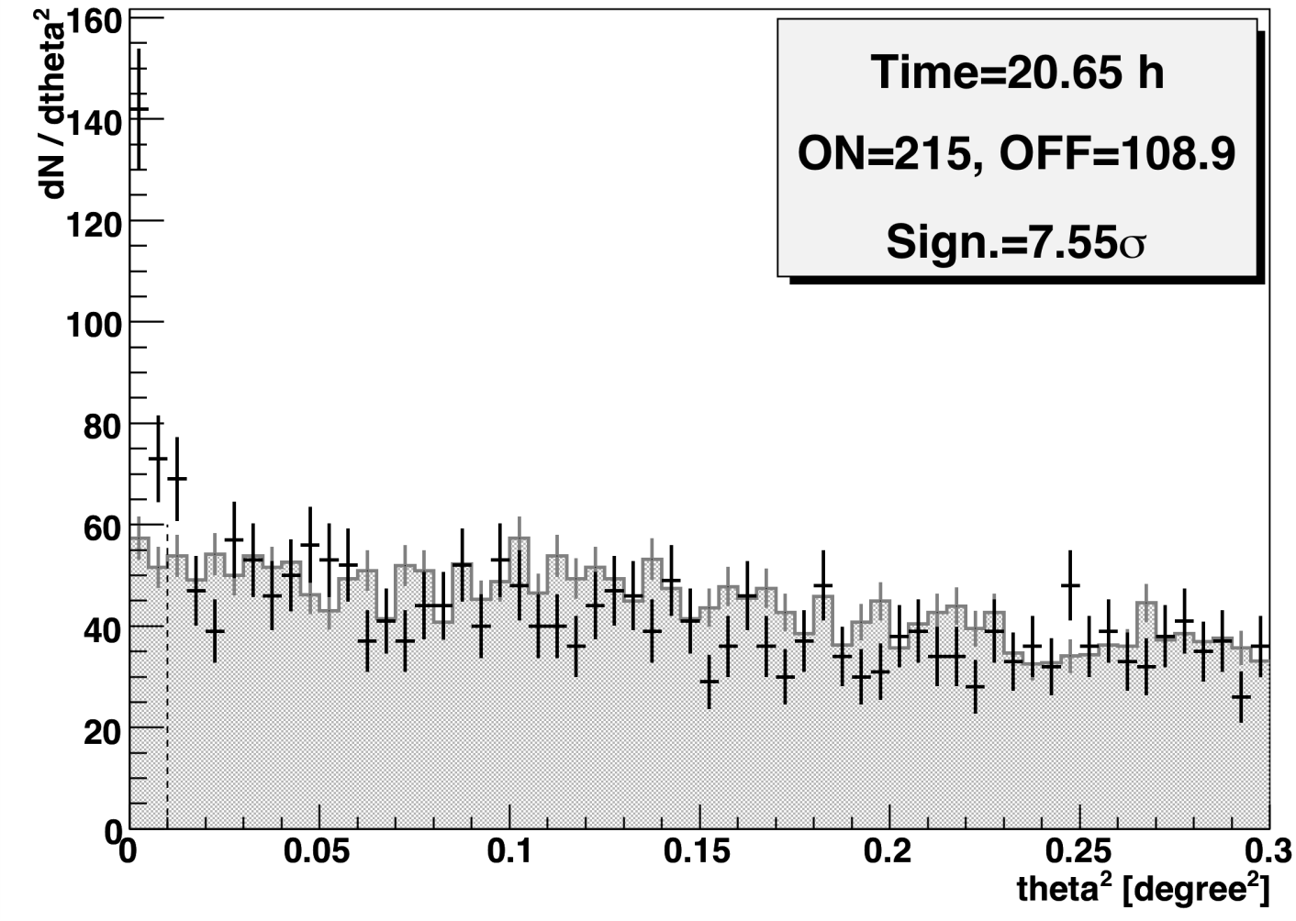
New Discoveries
IC310 (J. Aleksić et al. (MAGIC Coll.), Astrophys. J. Lett. 2010 )
Two Radio Galaxies
NGC 1275 (ATel #2916, October 2010)
Flat Spectrum Radio Quasar
PKS 1222+216(4C +21.35)
(ATel #2684, June 2010)
High Frequency peaking BL Lac
B3 2247+381(ATel #2910, October 2010)
Unknown Fermi source
MAGIC J2001+435 (ATel #2753, July 2010)

Slide 30
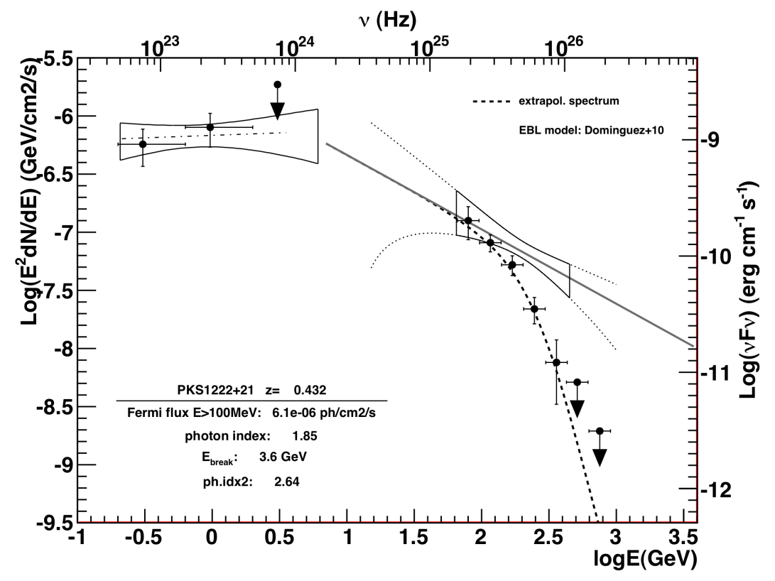
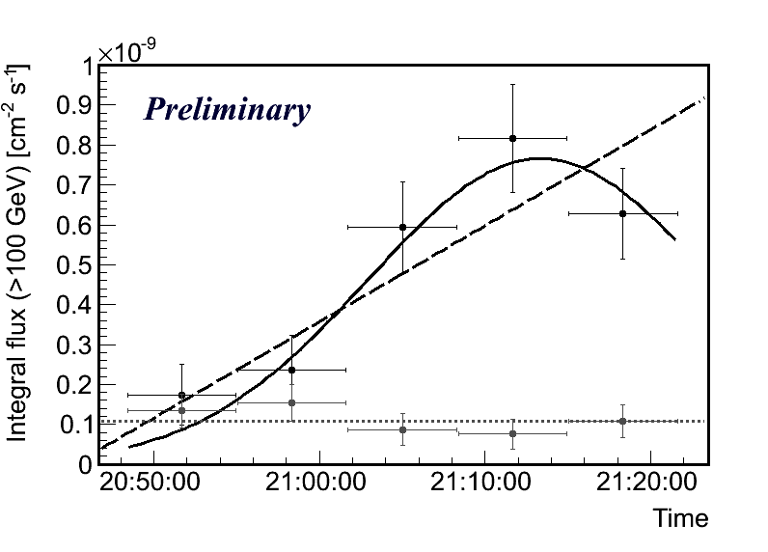
Flat Spectrum Radio Quasar
PKS 1222 +216 (4C 21.35)
Discovered recently by MAGIC
z = 0.432 (after 3C279 2nd most distant (reliable z) measured source)
measured signal strength
~ 8.5σ in 0.5^{h}
Along with 3C279 and PKS 1510-089 this is the 3rd FSRQ
Variability time scale: ~ 10’
Short-time variability conflicts with external Compton model
FERMI & MAGIC data: 0.1 – 400 GeV

Slide 31
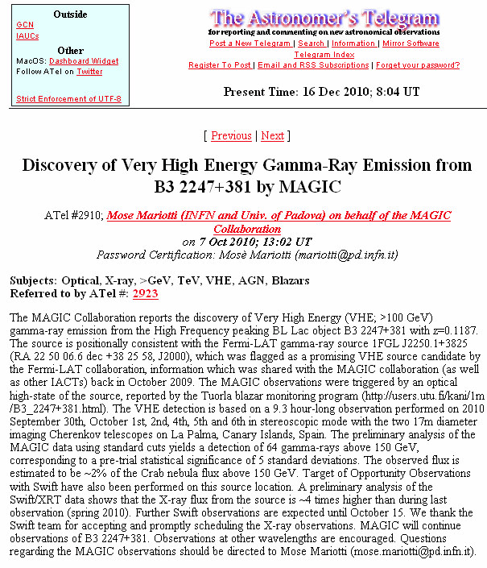
Optical trigger for Blazars
New discovery thanks to optical
trigger
Why only some AGN are optical
trigger able ?

Slide 32
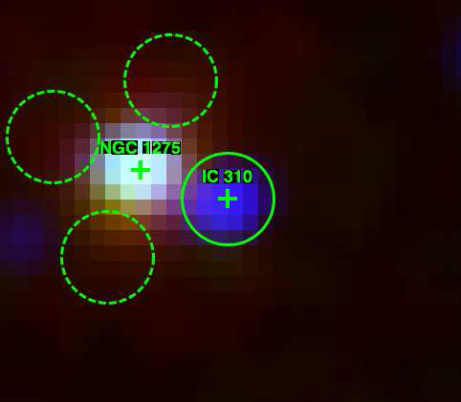
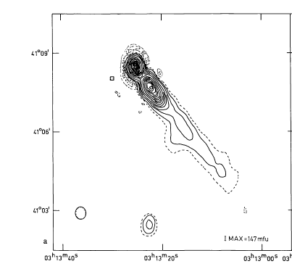
Radio Galaxy: IC 310
In Perseus cluster @ 80 Mpc
Emission level: ~ 2.5 % Crab
Detected by FERMI/LAT >100 GeV (2-days earlier than MAGIC)
Gammas could be produced as
  Close to central BH (like M87)
  Intercation of relativistic outflow with intra-cluster medium ?
  Source variable, but the detailed time behavior needs to be studied

Slide 33


Radio Galaxy: IC 310
Discovery while observing
NGC 1275!
Very hard spectrum!

Slide 34


Dark Matter Search (indirect)
DM candidate source could be
Dwarf spheriodals Draco, Ursa Minor, Wilman 1, Boötes 1, Canis Major, Sagittarius Dwarf, .. (high light/mass ratio)
Galactic center
Globular clusters
Local group galaxies M32, M33
Clusters of galaxies: Perseus, ...
Though the estimated IACT sensitivity fails by few orders of magnitude for detecting the assumed type „classical“ DM, still it is a challenge to measure the candidates
Intermediate mass black holes in Milky Way

Slide 35

Gamma Ray Bursts and afterglow
Very interesting for studying the rapid variability of the most luminous objects in the Universe
Interesting for LIV studies
Could help in modeling the high-energy end of GRBs
Propagation and absorption effects could be studied
2 populations: < 1 sec. and few tens of seconds; even the latter need very fast reaction time
Also afterglow has a high chance
GRB050713A
The telescope started measuring in 27s
after the GCN signal arrived; no signal
Observed at T₀+4753s; z: 0.76;
GRB080430; T=16s; energy > 80 GeV
No detection, upper limit

Slide 36

Halo Around AGN Sources

Slide 37

Halo Around AGN Sources
VHE γs cascade on EBL/CMB
The trajectories of created
e⁺e⁻ pairs bend in the
extragalactic magnetic field
(EGMF) → an additional,
extended emission
component can appear
around the projected
direction of the source
A low-level signal may
appear as a quiescent one
Mrk-501
Mrk-421
MAGIC data
MAGIC data
Both checked sources are compatible with a point-like
source. Upper limit on 4 % Crab level for Mrk-421. Some
Constraints on the EGMF strength.

Slide 38
MAGIC Upgrade plans
MAGIC-I Upgrade camera is almost completed in our institute. Final checks are planned in early spring 2011. Could be shipped to La Palma in coming April
Both MAGIC telescopes are planned to obtain a new, same 2GSample/s readout based on DRS4 chips, under preparation in Pisa, Italy. Depending their production rate the upgrade can start in mid-summer 2011.
The above upgrades will somewhat improve the sensitivity
We are testing the GaAsP based HPD modules and plan to start their cluster production in a few months. The central part of one of the cameras in La Palma will obtain HPD-based clusters and will be operated at a twice lower threshold (becoming comparable to a 23m diameter telescope) and practically in the absence of afterpulsing ➔ ideal for pulsar studies
We have entered the stable performance phase of the instrument
Several next years are very promising in new physics harvest!

Slide 39

Cherenkov Telescope Array (CTA) Project
The array is currently under
design and prototyping.
~ 100 telescopes of 3 different
sizes are planed to be built.
Sensitivity should be 5-10
higher compared to current
mini-arrays, much weaker
sources could be measured

Slide 40
Conclusions
In 2010 MAGIC has reached a very good sensitivity, very comparable to 4-telescopes of H.E.S.S. and of VERITAS above the energy ~250 GeV
Below 200 GeV currently MAGIC is the only and the most sensitive instrument for energies down to 50 (25) GeV
Many extragalactic sources are discovered and several more are monitored revealing newer physics facets
Several galactic sources are monitored revealing great details
The project has entered its stable phase
Cooperation with FERMI very beneficial
Planned upgrades will improve further the performance

Slide 41
Spare slides

Slide 42

IC310: 1st Head-Tail Galaxy in TeVs

Slide 43


Blazar modeling
MWL data is mandatory, best from radio till VHE gammas
The sources are highly variable, SED changes
Which model fits best, leptonic or hadronic , which types ?
It became usual to start a MWL with LAT, SWIFT, AGILE,
Chandra, XMM, RXTE, many other optical and radio telescopes
3C279

Slide 44
M87 – Giant Elliptical Radio Galaxy
Distance: 16.7 Mpc
Jet angle: 30° (in inner region
< 19°)
Black Hole: 6 x 10⁹ Solar mass
Giant outer lobs: 0.2° x 0.2°
High polarisation in radio
Superluminal motion
A very interesting „nearby laboratory“ for studying

Slide 45
M87 Plasma Jet
Highly structured jets with knots
(shocks ?) in Radio, optical, X-rays
Radio-optical similar polarisation (also X-rays ?)
Variability scale: weeks – years
Inner jet: superluminal motion ~ 2 x c (relativistic particles)
Jet can flare, from radio to X-rays

Slide 46


VHE Active Galactic Nuclei
I could count 27 HBL, 3 LBL, 4 IBL + 4 radio galaxies
The sources appear faster than their classification happens
~ 70 % are HBL (non-HBL could „catch“ mostly when flaring)
Due to EBL absorption, threshold and sensitivity issues mostly sources are observed < z=0.2
Distant blazars harden than expected (hint on low EBL-level)
Variability time scale ≥ 2 min.
Fossati 98

