Slide 1
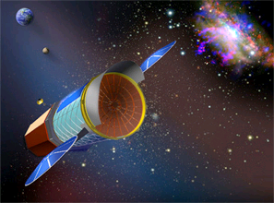
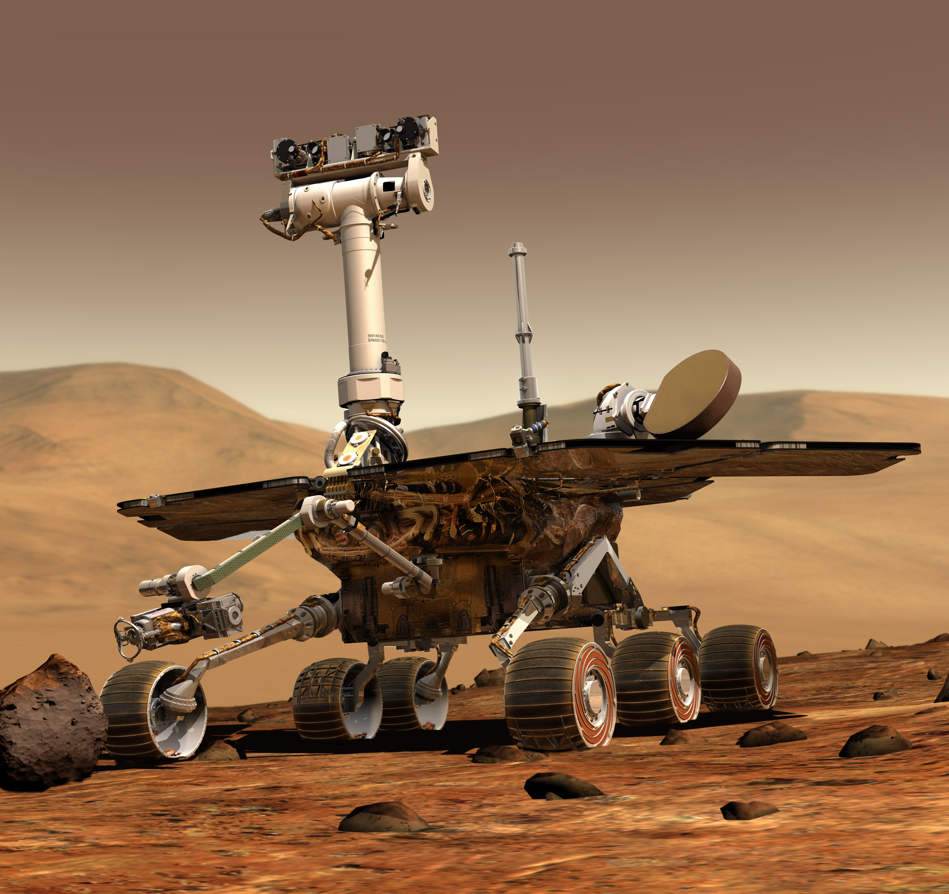
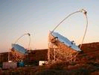
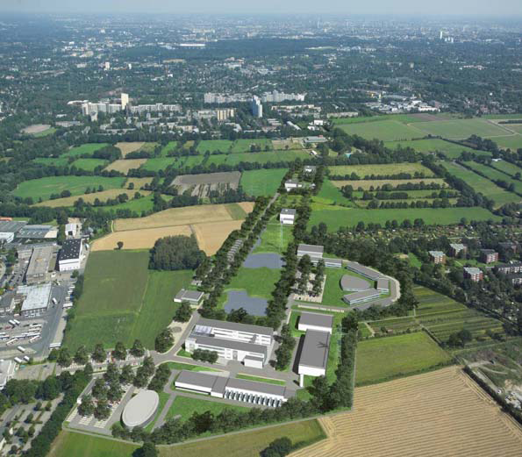
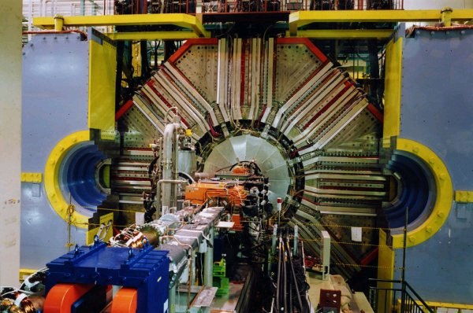

IXO, eRosita,
BepiColombo
The MPI Semiconductor Laboratory
Projects - Devices - Technology
Mars Rover
MAGIC, CTA
XFEL, FLASH, LCLS, Spring8
Belle II
The MPP HLL Team: L. Andricek, Z. Albrechtskirchinger, G.Fuchs,
C. Jendrysik, C. Koffmane, G.Liemann, D. Malisch, H.-G.Moser, P. Müller,
J. Ninkovic, A.Plis, R.Richter, A.Ritter, A.Wassatsch
from ATLAS/SCT: M. Beimforde, A.Macchiolo, R.Nisius, P.Weigell
& many colleagues from MPE and PNSensor
ATLAS

Slide 2
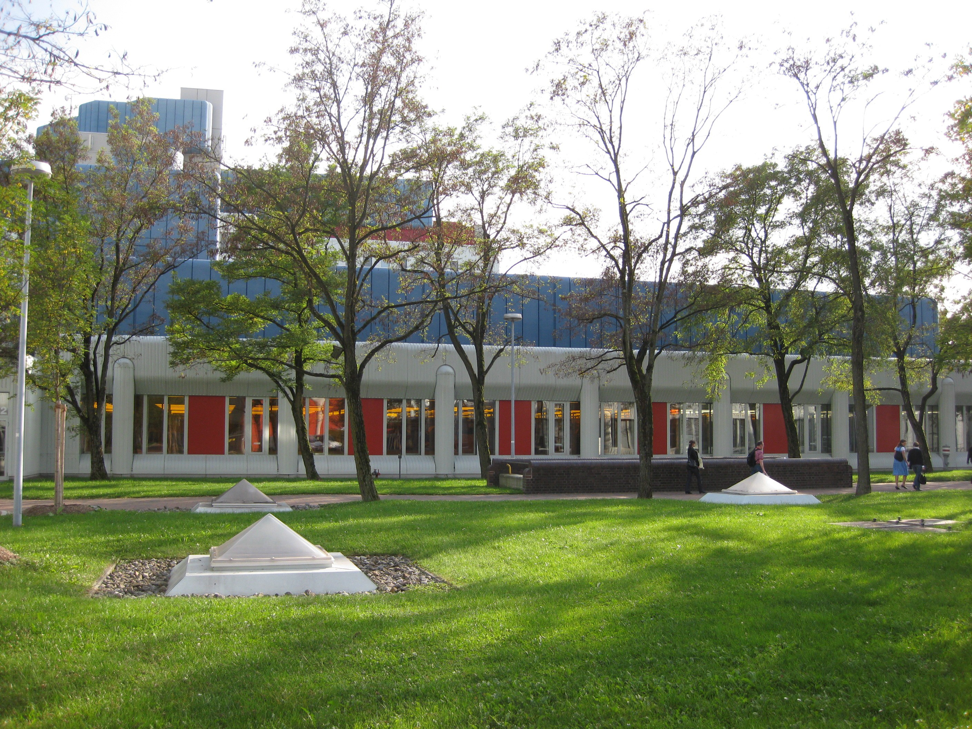
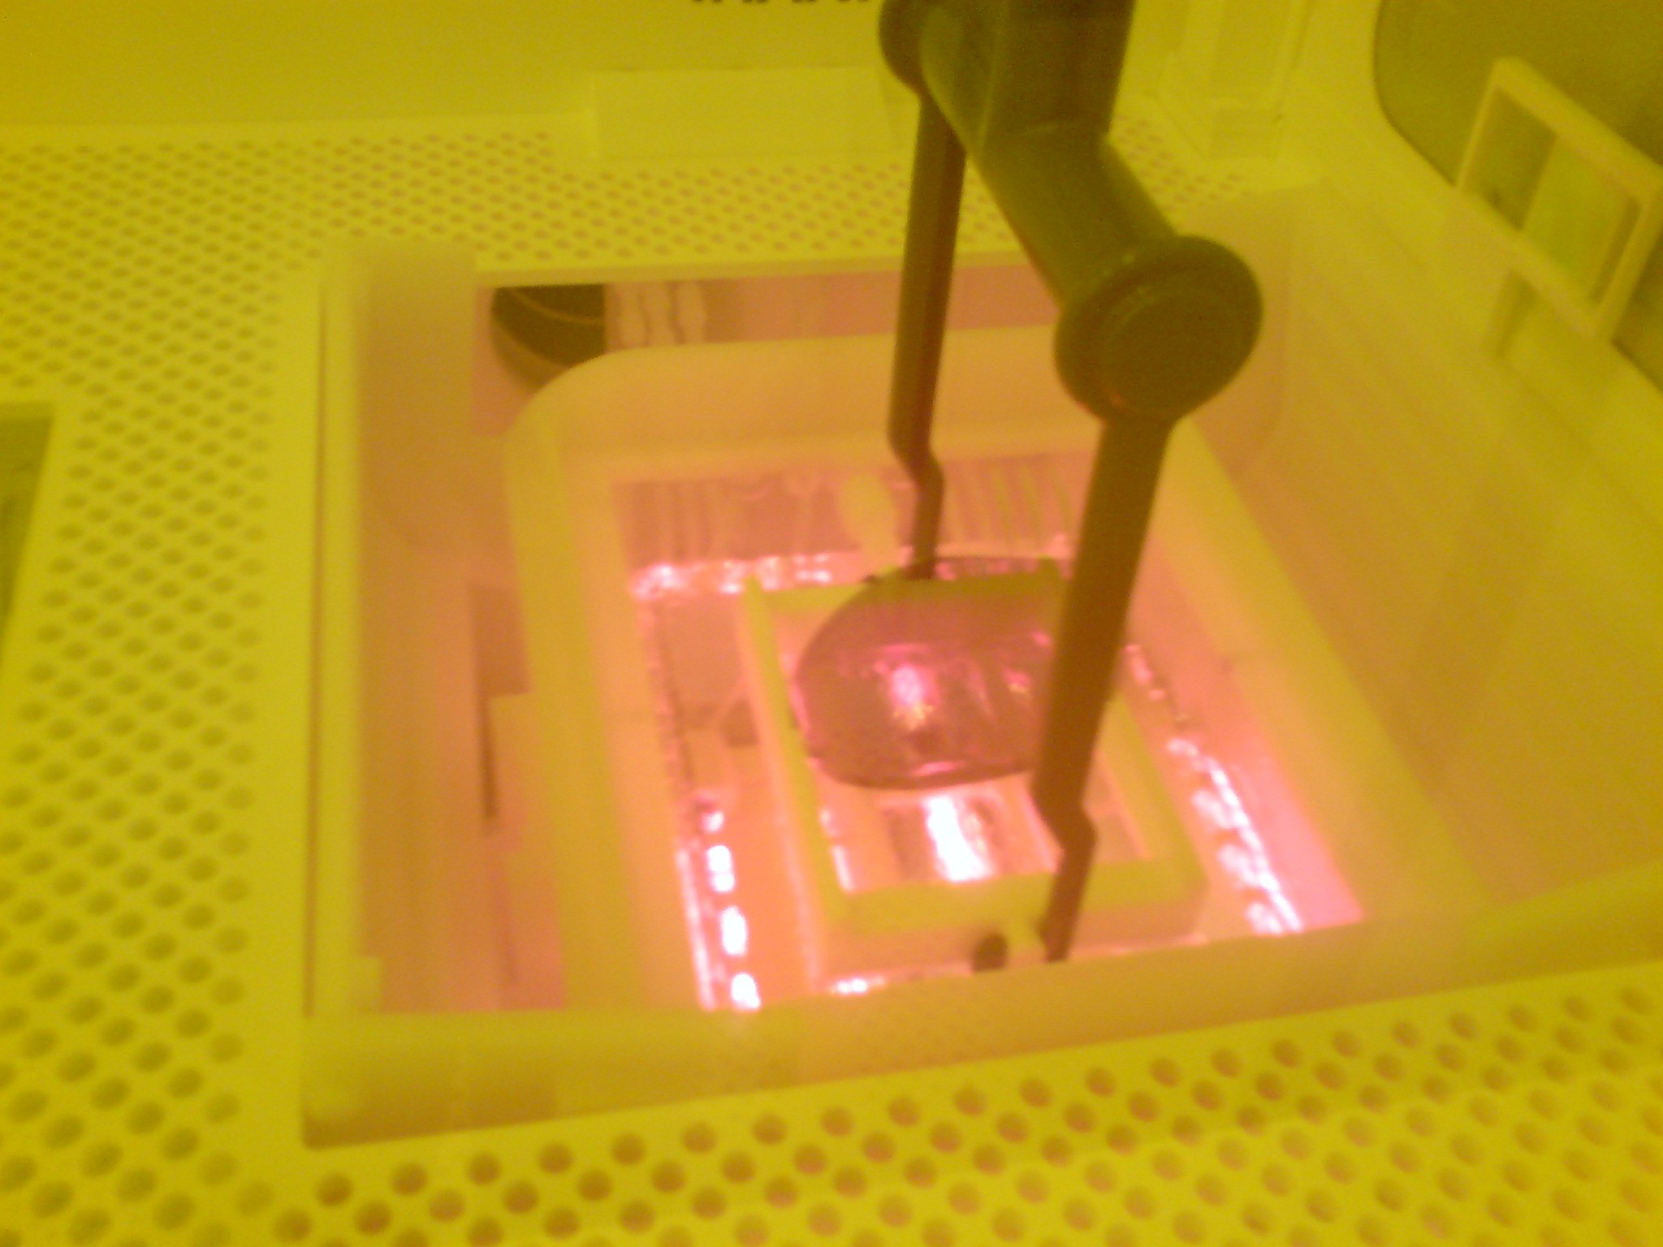
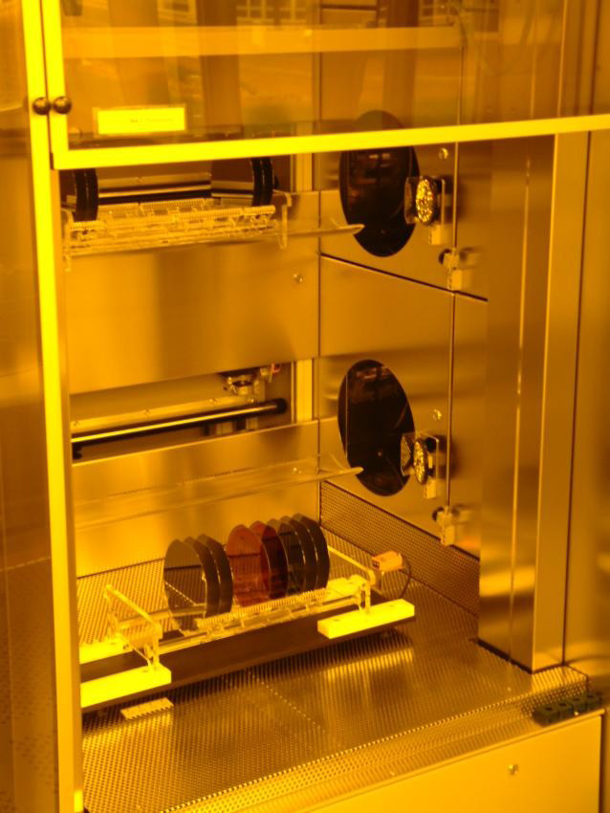
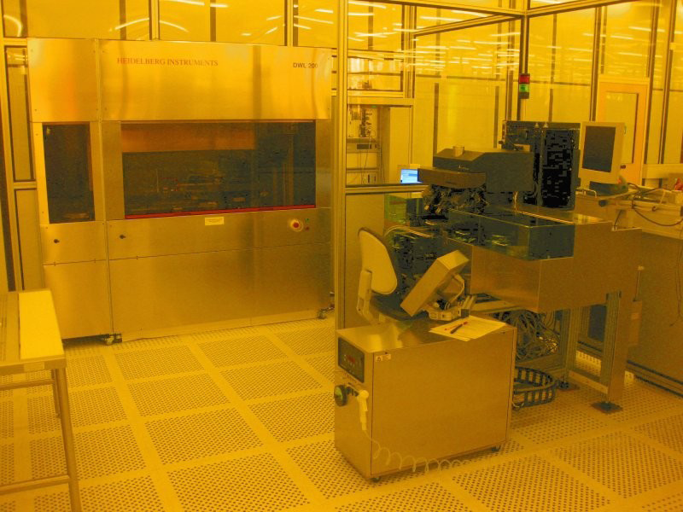
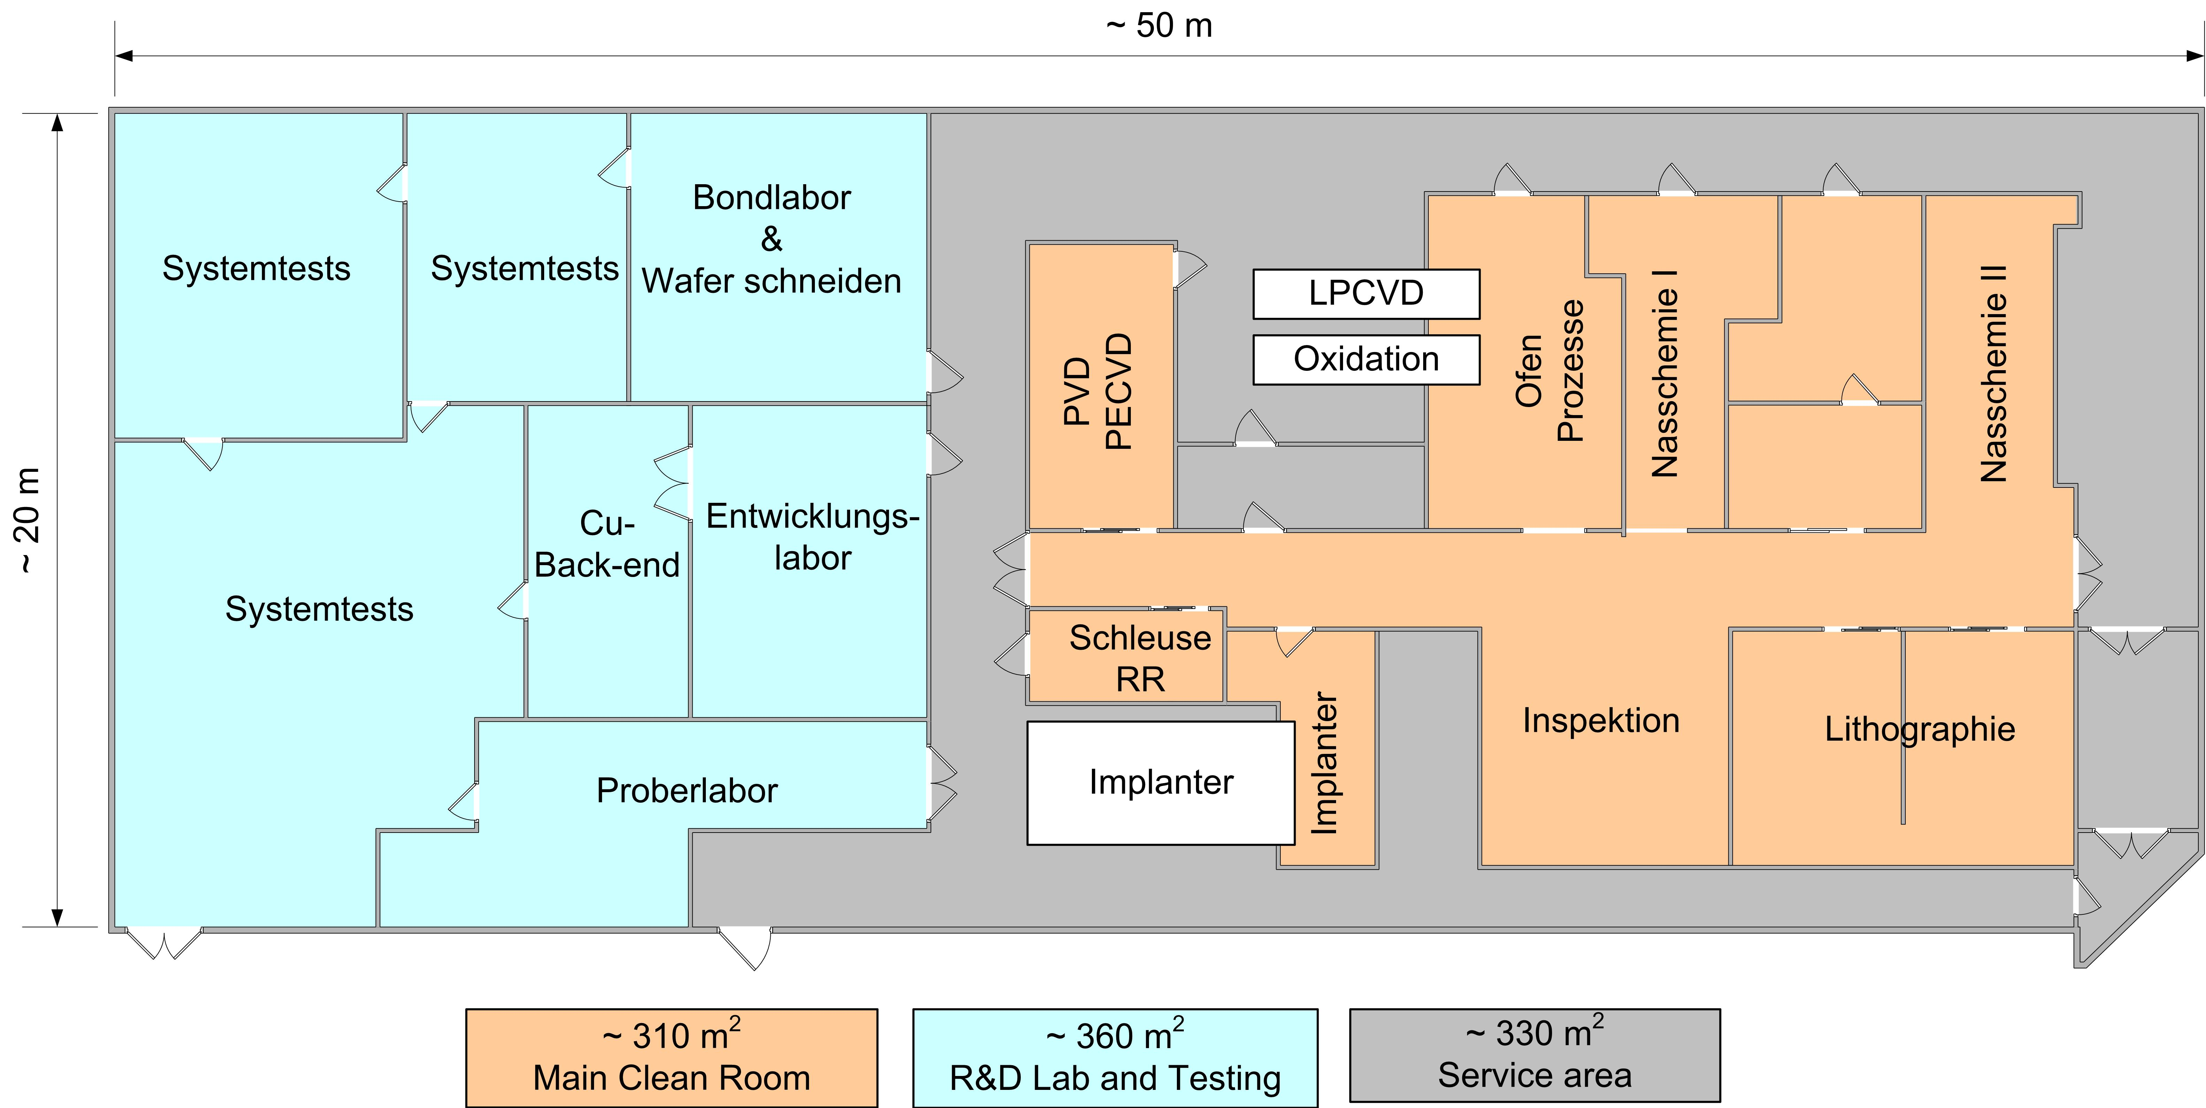
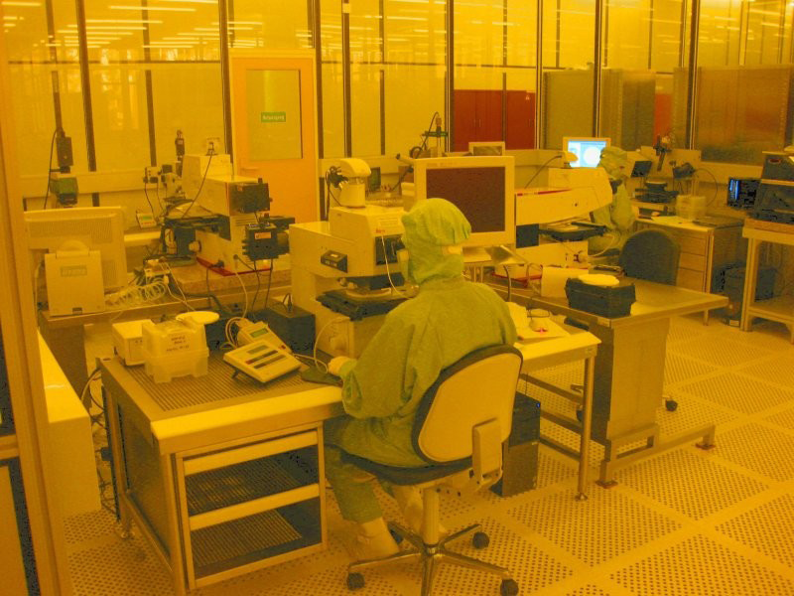
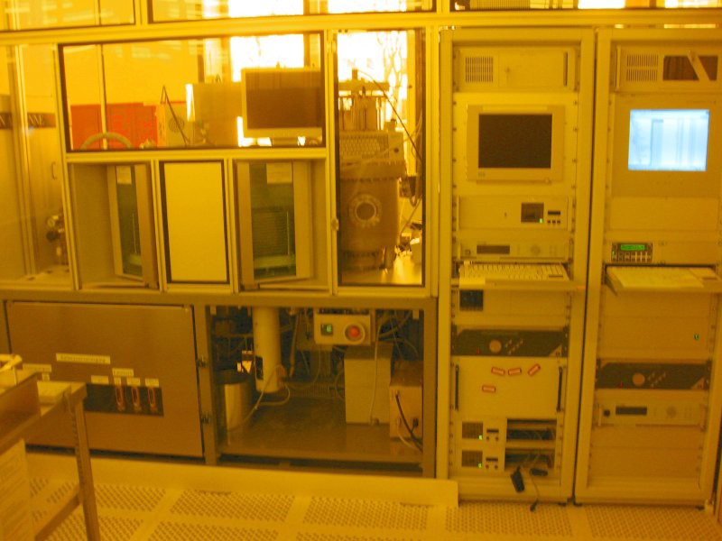
Inside HLL
Cleaning
Lithography
Hot H₂SO₄/H₂O₂
Thermal processing
Inspection
MPI HLL is the only lab worldwide doing fully depleted silicon radiation sensors
with integrated electronics
Plasma Processes

Slide 3
HLL inside
MPP
Collider based and Astro Particle
Experiments
Pixels/Strips
  ATLAS
  sLHC
DEPFETs
  ILC
  Belle II
Geiger Mode APDs
  MAGIC/EUSO/CTA
  ILC (calorimeter)
CFEL
Center for Free Electron
Laser Science
pnCCDs
  FLASH, Hamburg
  BESSY, Berlin
  LCLS, Stanford
  Spring8, Japan
DEPFETs
  XFEL, Hamburg
MPE
X-Ray Astronomy and
X-Ray Fluorescence Analysis
pnCCDs
  XMM
  eRosita
DEPFETs
  BepiColombo
  IXO
SDDs
  MarsRovers
  SIDDHARTA
  HICAM and Drago
  …
Regular HLL projects reviews (almost) every year, (See MPP Indico)
most recent one at Ringberg, 18-21 April 2010 → intense discussions for more than 2 days
here only projects of MPP (with a small excursion to DEPETs at XFEL)

Slide 4
Key Elements of the MPP Projects
Sensors on SOI Wafers
Interconnection ASIC - Sensor
Geiger Mode APDs
“Simpl”
Thin DEPFETs for
Belle and ILC
Radiation hard pixels for
ATLAS IBL and sLHC
DSSC
(DEPFETs for XFEL)
Radiation tolerance

Slide 5
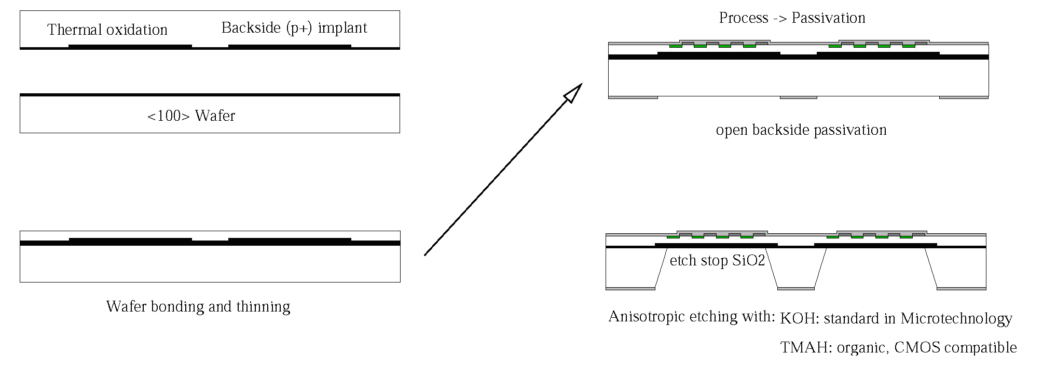
Processing thin detectors - The Idea
a) oxidation and back side implant of top wafer
c) process ➔ passivation
Top Wafer
Handle <100> Wafer
open backside passivation
Custom made SOI Wafer
b) wafer bonding and grinding/polishing of top wafer
d) anisotropic deep etching opens "windows" in
handle wafer
The sensor thickness becomes a free parameter, adjustable to the needs of the experiment!
Key Process Modules:
-: Wafer Bonding and thinning of top layer → Custom made SOI Wafers (thick top, buried implant, HiRes FZ Silicon…)
Start with MPI Halle (Gösele et al.) and SICO → Tracit/Soitec → Icemos → need new supplier(s)
bonding, grinding/edge trimming, polishing and final clean done separately → needs new qualification!!
-: Sensor fabrication on SOI → HLL
-: Etching of the Handle Wafer → HLL
-: Litho on extreme topographies → HLL
Developed for ILC VXD, the technology found its way into other projects:
-: 50 μm thin DEPFETs for Belle II PXD (will be 75 μm)
-: production of thin (75 and 150 μm) ATLAS pixel sensors for sLHC & IBL
-: first production of Geiger-mode APDs on 70 μm top layer

Slide 6
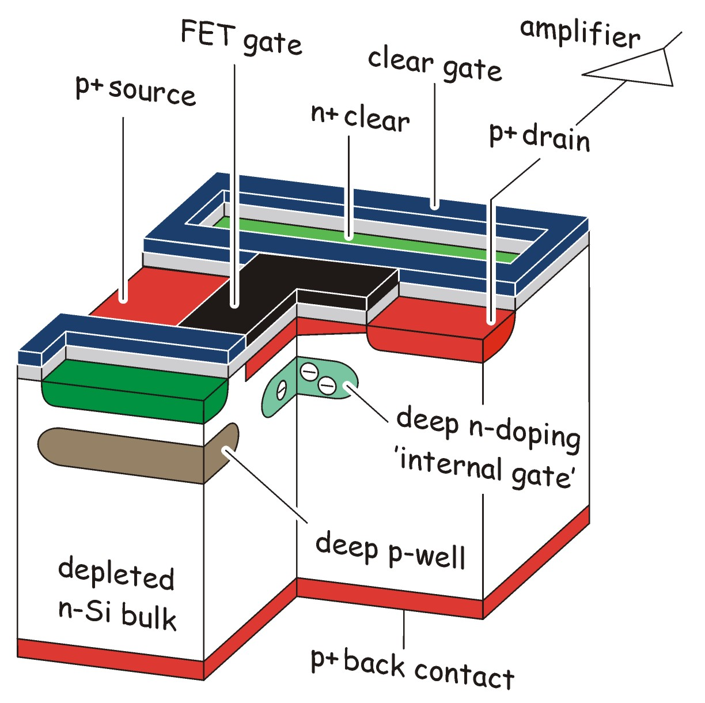
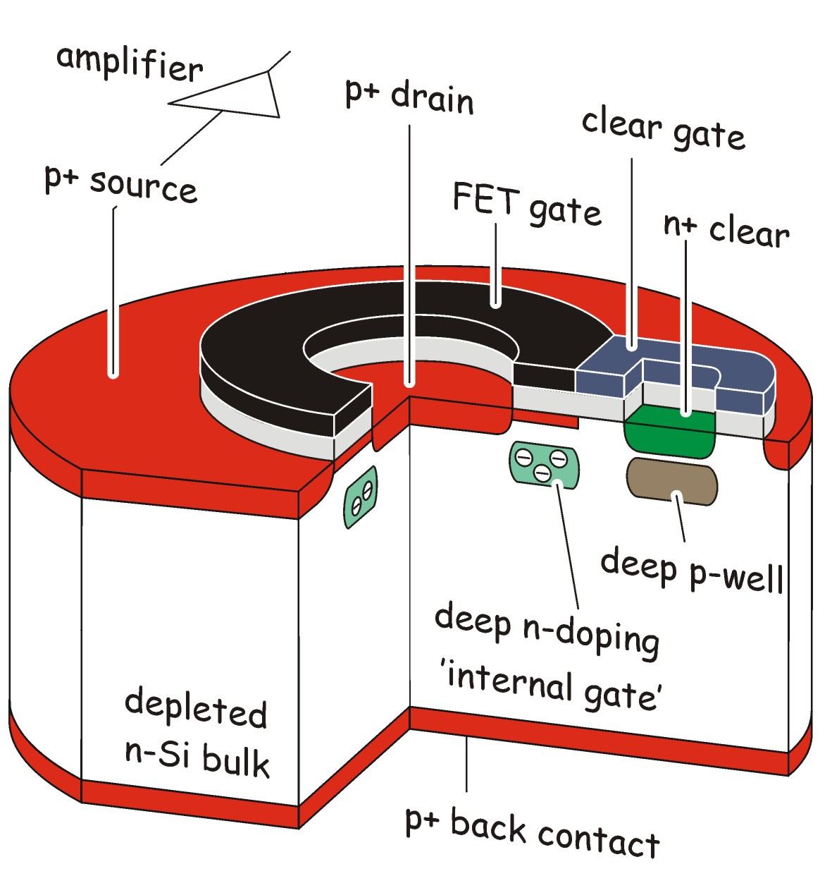
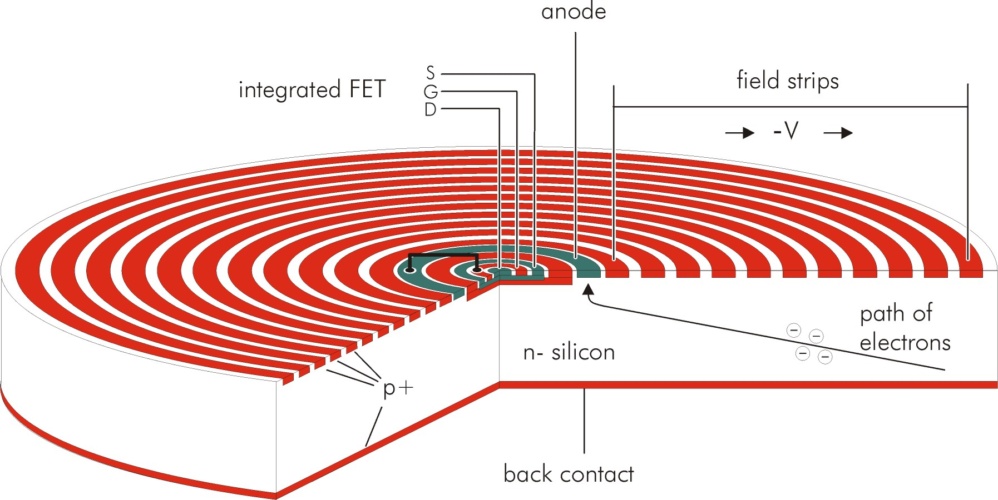
DEPFET Types and Applications
Particle tracking → vertex detector at Belle II and ILC
pixel size: 20µm…75µm
r/o time per row: 25ns-100ns
Noise: ≈100 el ENC
thin detectors: 50µm…75µm → still large signal: 40nA/µm for mip
X-ray imaging spectroscopy → IXO
pixel size: 100µm
r/o time per row: 2.5 µs
Noise: ≈4 el ENC
fully depleted thick detectors better → large QE for higher E
X-ray (imaging) spectroscopy
→ BepiColombo and XFEL
pixel size: 100s of µm
For XFEL: DEPFET → DSSC
DEPFET Sensor with Signal Compression

Slide 7
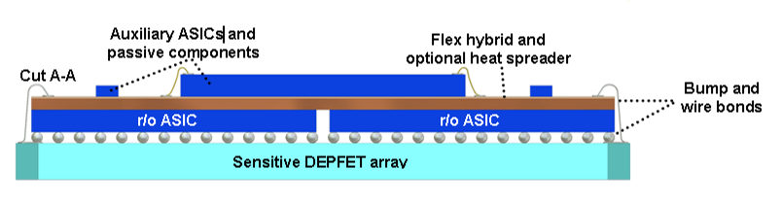
An Array of DEPFETs
Hybrid-pixel-like approach
one amp. (&ADC) per pixel, external common clear
more challenging interconnection
(bump bonding, vertical integration ..)
high power consumption
fast! frame rate comparable with hybrid pixels
→ European XFEL (~5MHz frame rate)
Row wise read-out ("rolling shutter")
select row with external gate, read current,
clear DEPFET, read current again
two different auxiliary ASICs needed, but no
interconnect in sensitive area
r/o needs time…..
only one row active → low power consumption
→ Belle II, ILC, IXO, Bepi Columbo

Slide 8
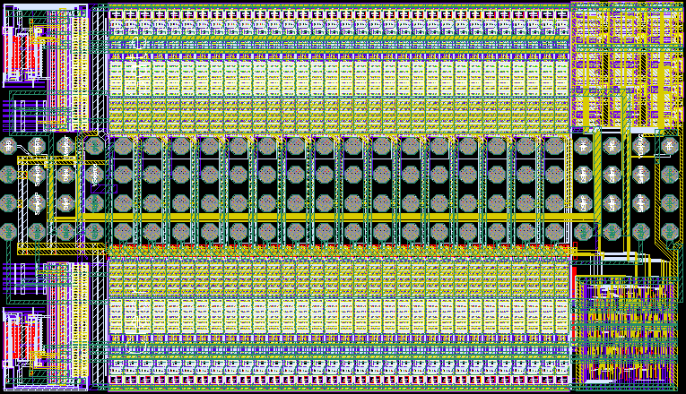
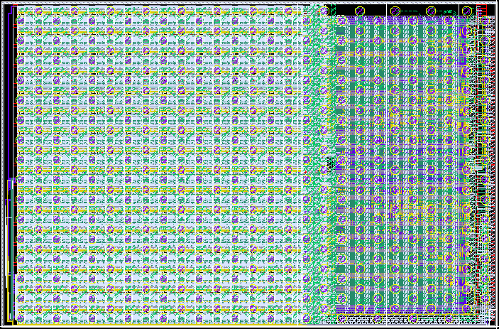
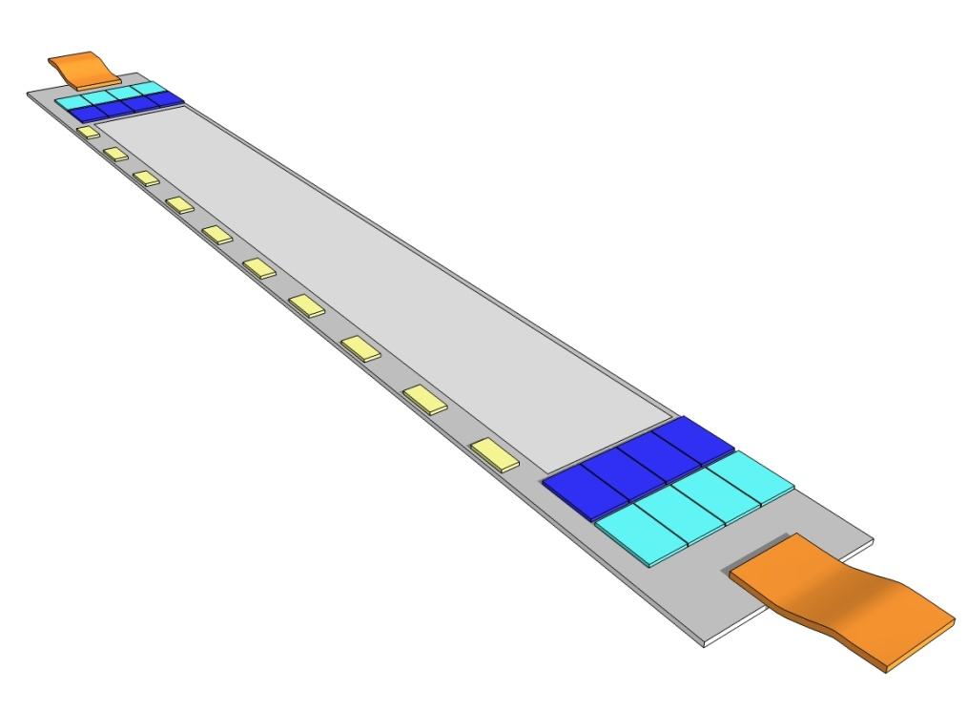
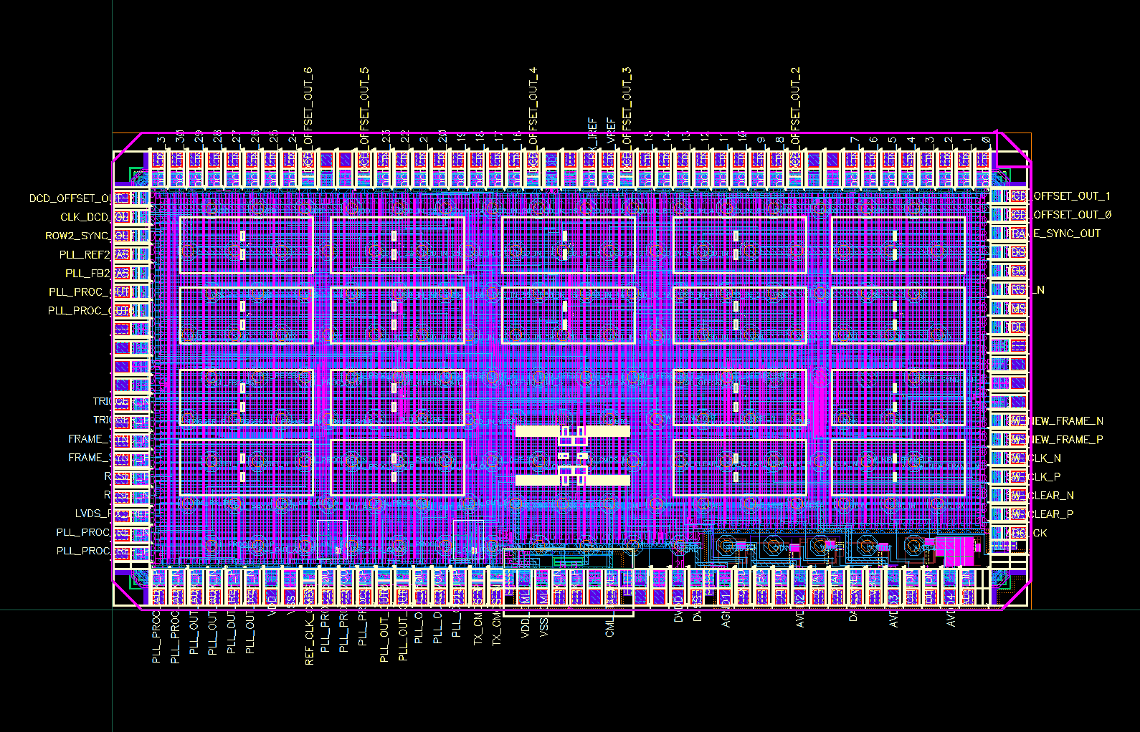
Auxiliary DEPFET ASICs, Bump Bonded to Silicon Module
SwitcherB
  Row control
DCDB (Drain Current Digitizer)
  Analog frontend
Sensor
AMS high voltage 0.35µm
Size 3.6 × 2.1 mm²
Gate and Clear signal
Fast HV up to 30V
1W per ladder
UMC 180nm
Size 3.3 × 5.0 mm²
Integrated ADC
Power dissipation
DEPFETs ~ 1 W
Switcher ~ 1 W
DCD/DHP ~ 8 W on each ladder end
160 W on each side of the detector
40 W in sensitive volume
Kapton
DHP (Data Handling Processor)
IBM CMOS 90nm
Stores raw data and pedestals
Common mode and pedestal correction
Data reduction (zero suppression)
Timing signal generation

Slide 9
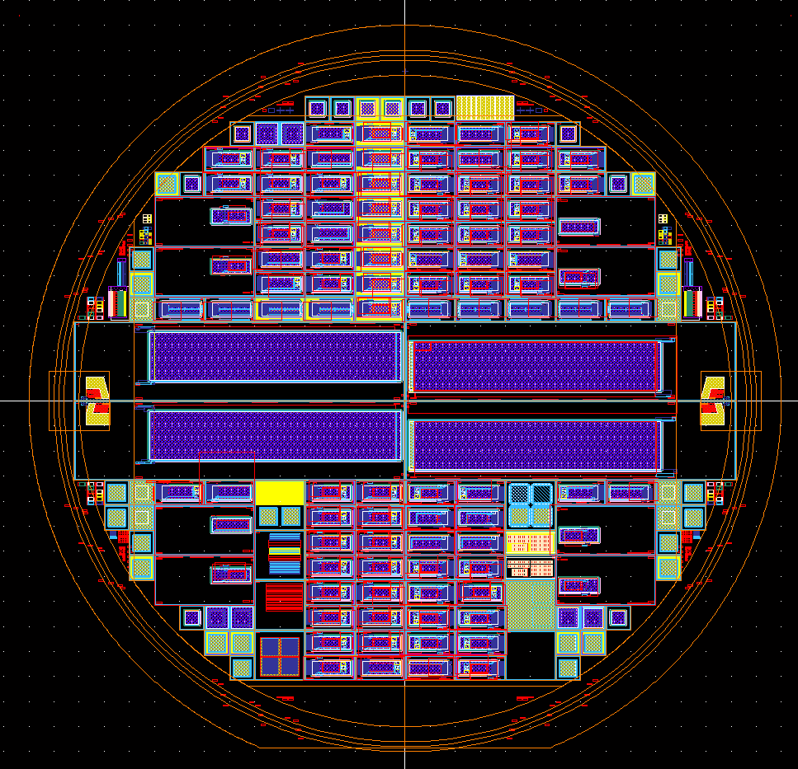
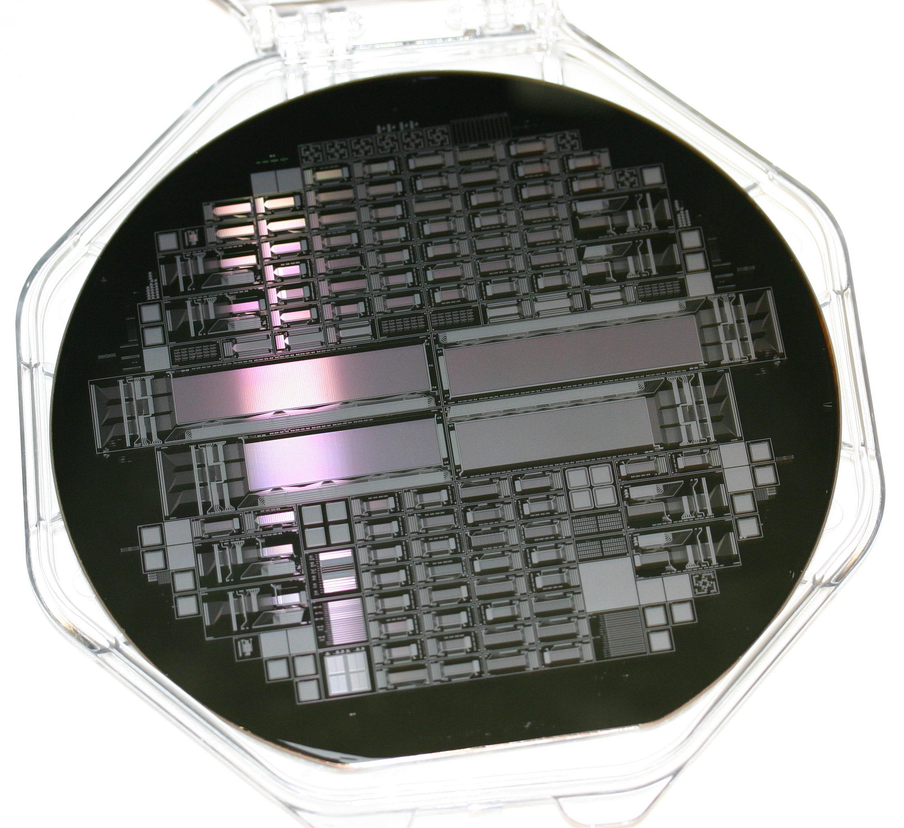
PXD6 Batch: Prototyping for Belle II
8 SOI wafers (→ 50 µm in sensitive area) + 2 monitor wafers on standard thick material
About 100 test matrices in different variations
  pixel sizes from 50 µm to 200 µm
  shorter gate length, improved clear structures, various field shapes..
Technology variations on the wafer level (plasma etching)
4 half-ladders for Belle II with the most promising design options

Slide 10
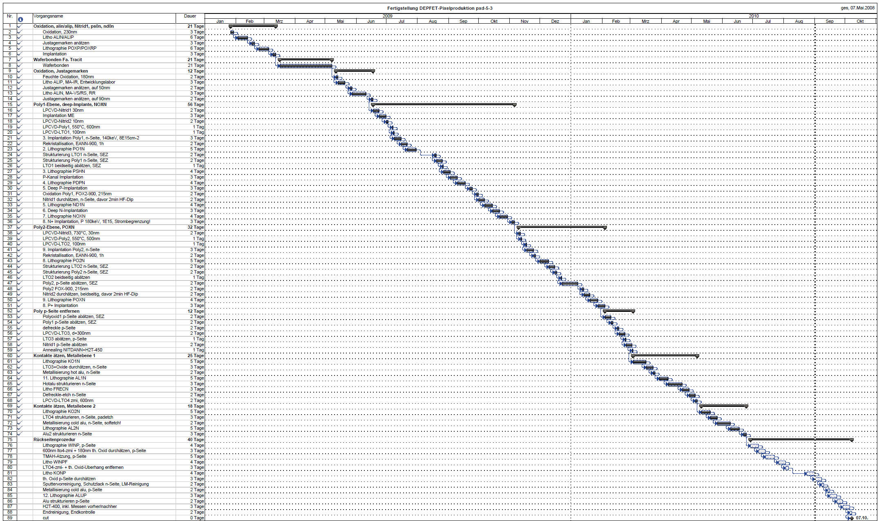
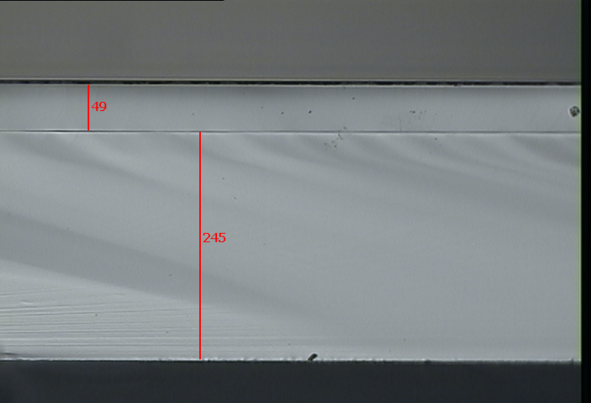
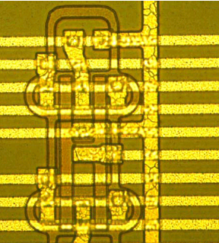
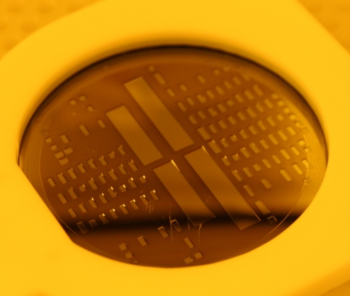
PXD6 Batch: Prototyping for Belle II
9 Implantations
19 Lithographies
2 Poly-layers
2 Alu-layers
sums up to 89 steps with 1-5 WD each
in between:
  a lot of inspection steps!
  process control, dummy wafer production..
→ 19 months processing time (16 after SOI pre-processing)
We are now here: handle wafers of first three PXD6 wafers are etched!

Slide 11
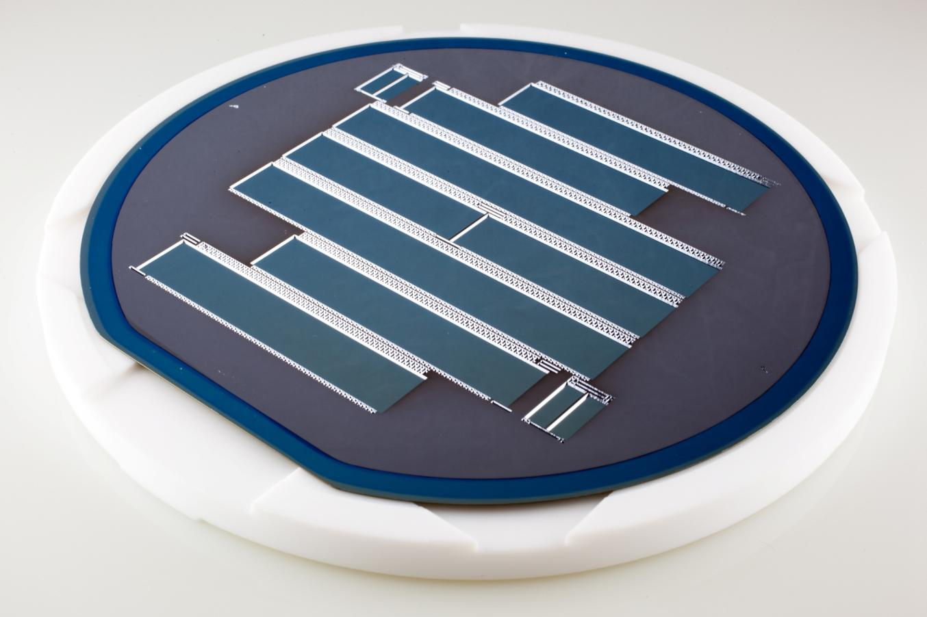
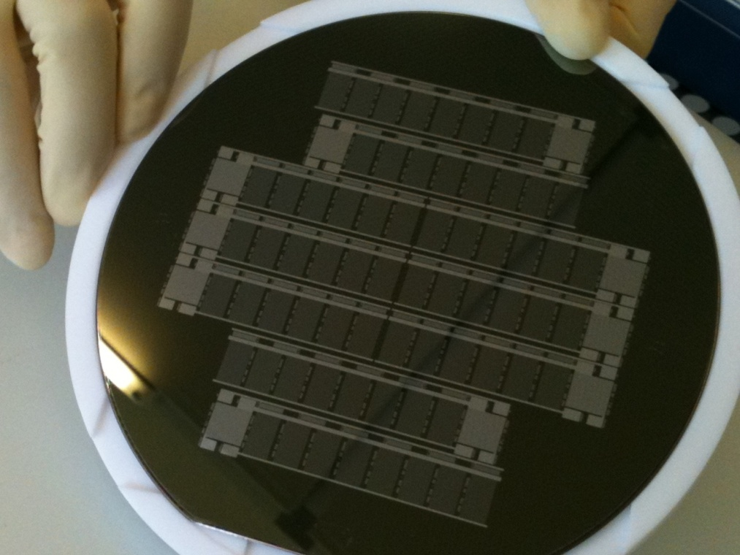
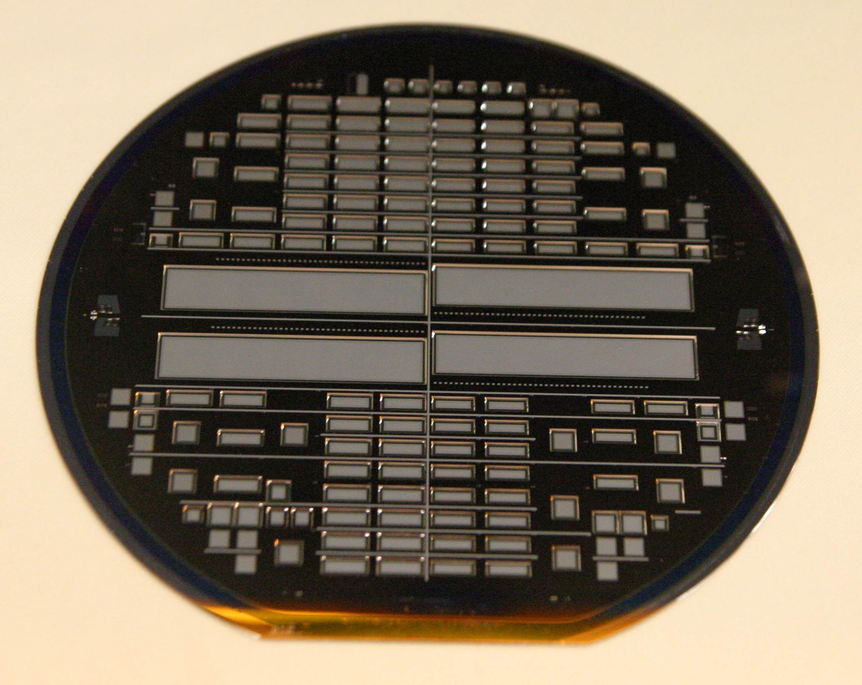
Mechanical and Thermal Dummies
Goals:
-: practice back-etching (50 µ)
-: lithography on thin areas
-: provide samples for thermal mock-ups
(integrated heaters …)
-: test the micro joint between the half-ladders

Slide 12
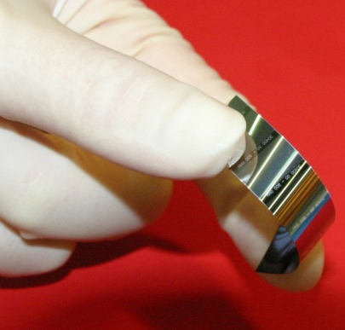
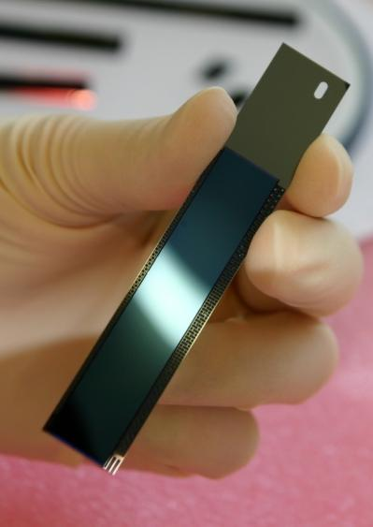
Self-supporting All-Silicon Module
Belle II mechanical sample
50µm Si, unsupported
Half-ladders (modules) are laser-cut
Modules are supported by a monolithic silicon frame
Two modules are assembled to one ladder
overall length is 136 mm (inner) and 169 mm (outer)
50µm Si in Silicon frame

Slide 13
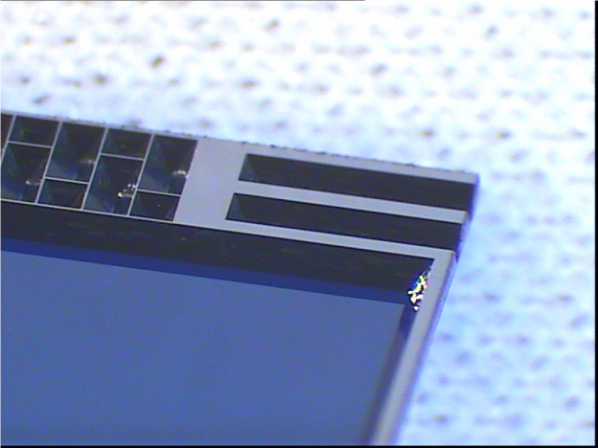
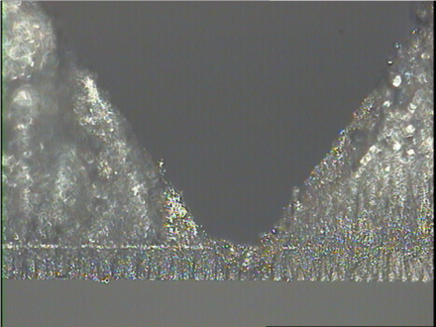
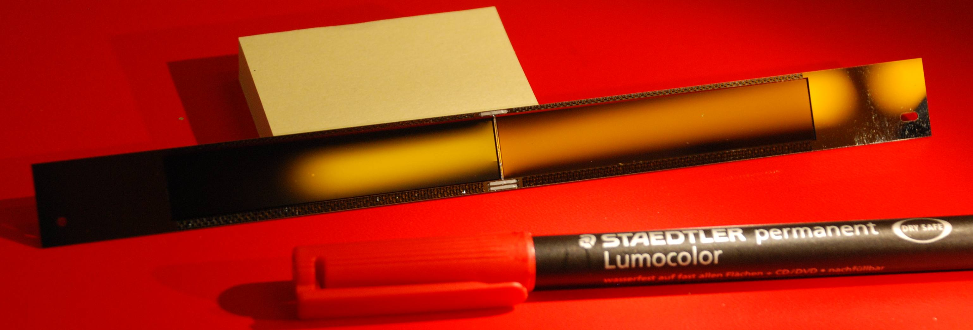
Micro joint between half-ladders
butt-joint between two half-ladders
reinforced with 3 ceramic inserts
2x300µm dead area per ladder

Slide 14
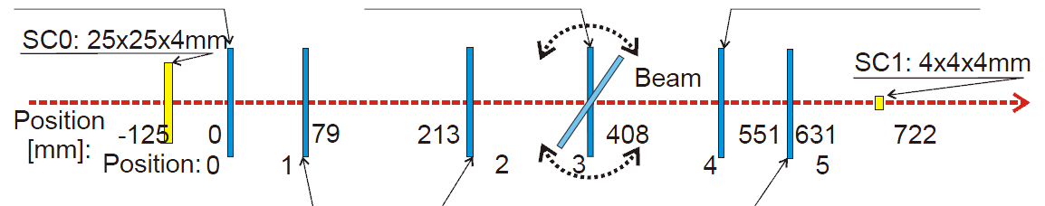
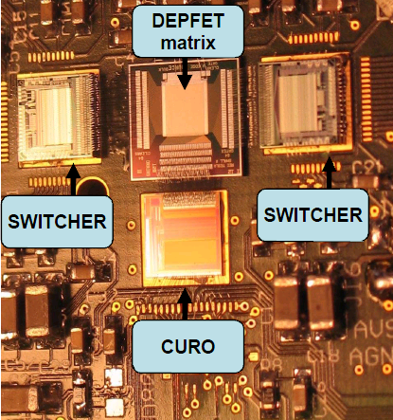
Evaluation of previous batch: Beam Tests at CERN H6
5 telescope planes with “standard” DEPFET matrices, 450 µm thick
  24x32 µm² pixel size
  2008: 64x128 pixels
  2009: new readout board for 64x256 matrices
one device under test (DUT) on the rotation stage
  2008: 64x128 pixels, 24x24 µm²
  2009: 64x256 pixels
    20x20 µm² with shorter gate length
    capacitively coupled clear gate (…better clear)
all devices characterized in the lab before test beam (laser, source..)
Test beam program:
  high statistics run for in-pixel studies
  angular scans
  “clear” parameter and depletion voltage scans
  Beam energy scan
  …

Slide 15
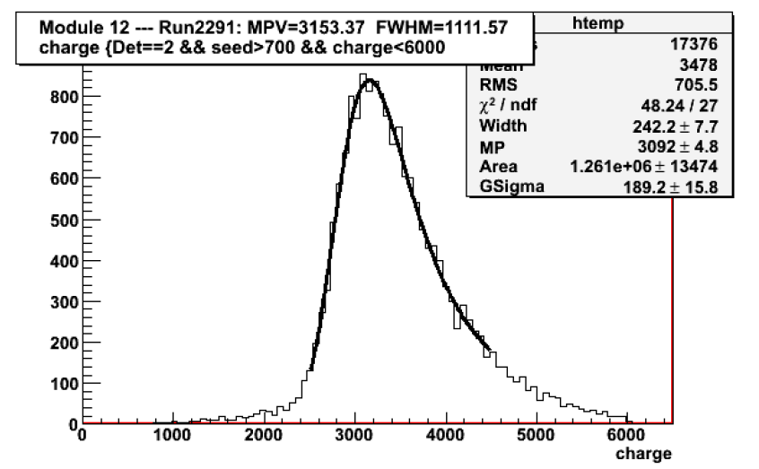
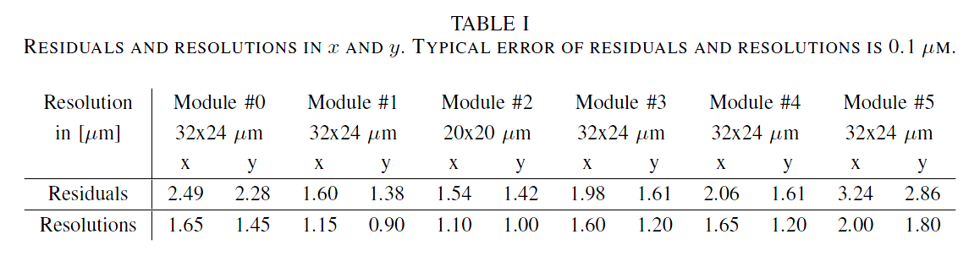
Data Analysis finished 2010, with a world record ..
120 GeV pions, 90˚, 20 x 20 µm² pixel
DEPFET Gate L=5 µm
→ higher g_{q} ≈ 650 pA/e⁻
S/N ≈ 200
≈ 1 µm resolution!

Slide 16
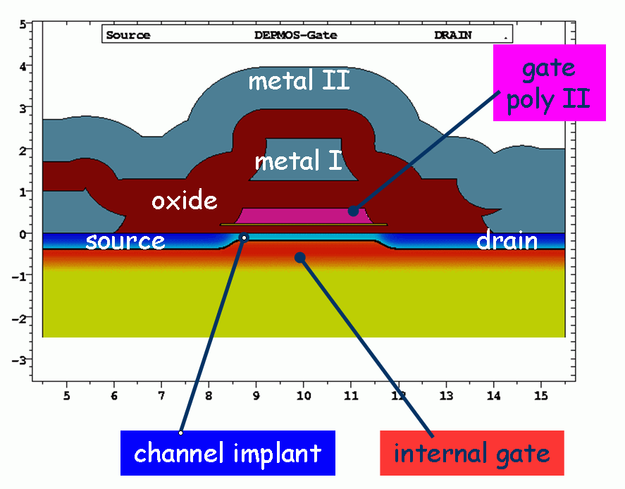
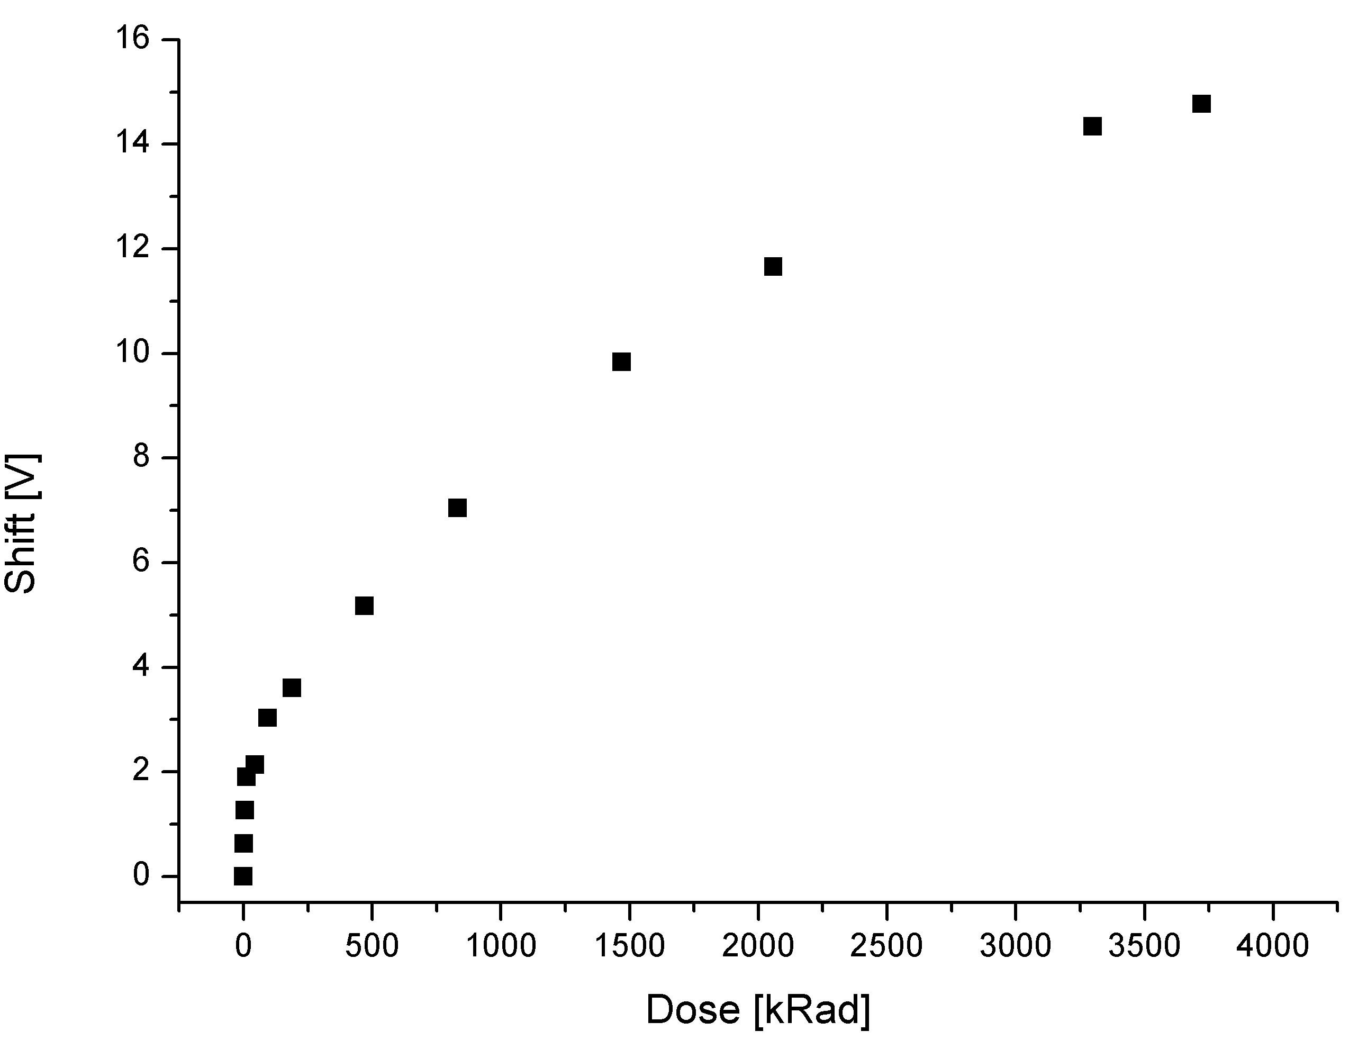
Radiation Tolerance of DEPFETs in Belle II
DEPFET is a MOS device and therefore
susceptible to ionizing radiation!
The radiation field in Belle II is still not completely clear.
The expected numbers after 5 years of operation are:
5-10 Mrad TID (total ionizing dose)
  build up of positive oxide charge ∆Q_{ox}→ - ∆V_{T}
10¹¹ to 10¹² n_{eq}/cm²
  higher leakage current → shot noise
Mostly due to QED background, synchrotron rad., beam-gas, intra-beam scattering
For the standard oxide thickness ∆V_{T} can be very high!
For inhomogeneous irradiation it becomes difficult to find a common operating point for the entire matrix!
Solutions:
a. thinner oxides (∆Q_{ox} ~ t^{n}, n=1..2)
b. compensate positive charges with
trapped electrons → add Si₃N₄ layer
|∆V_{T}| for a standard SiO₂/Si₃N₄ layer

Slide 17
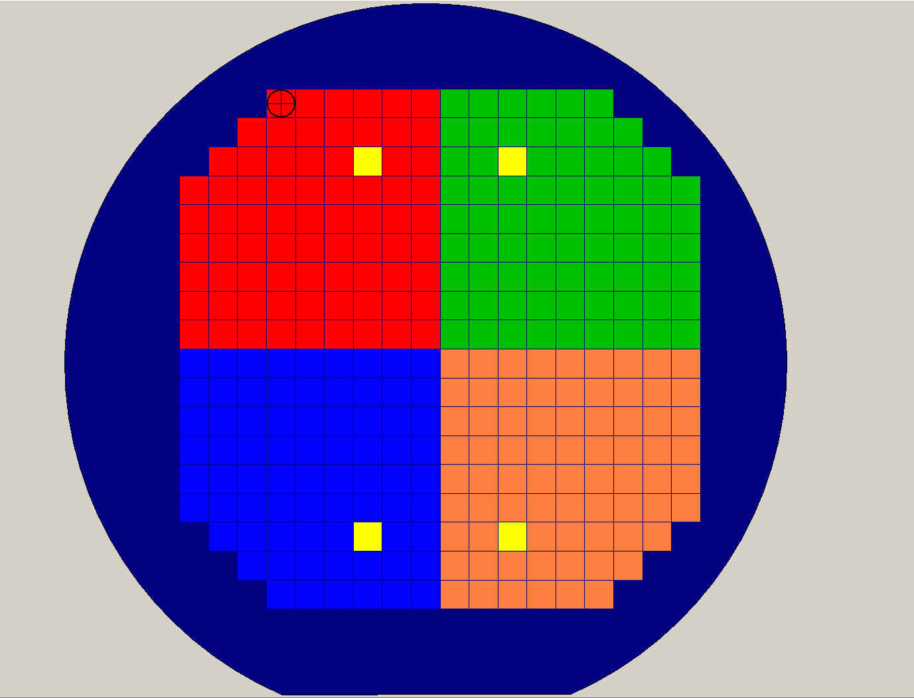
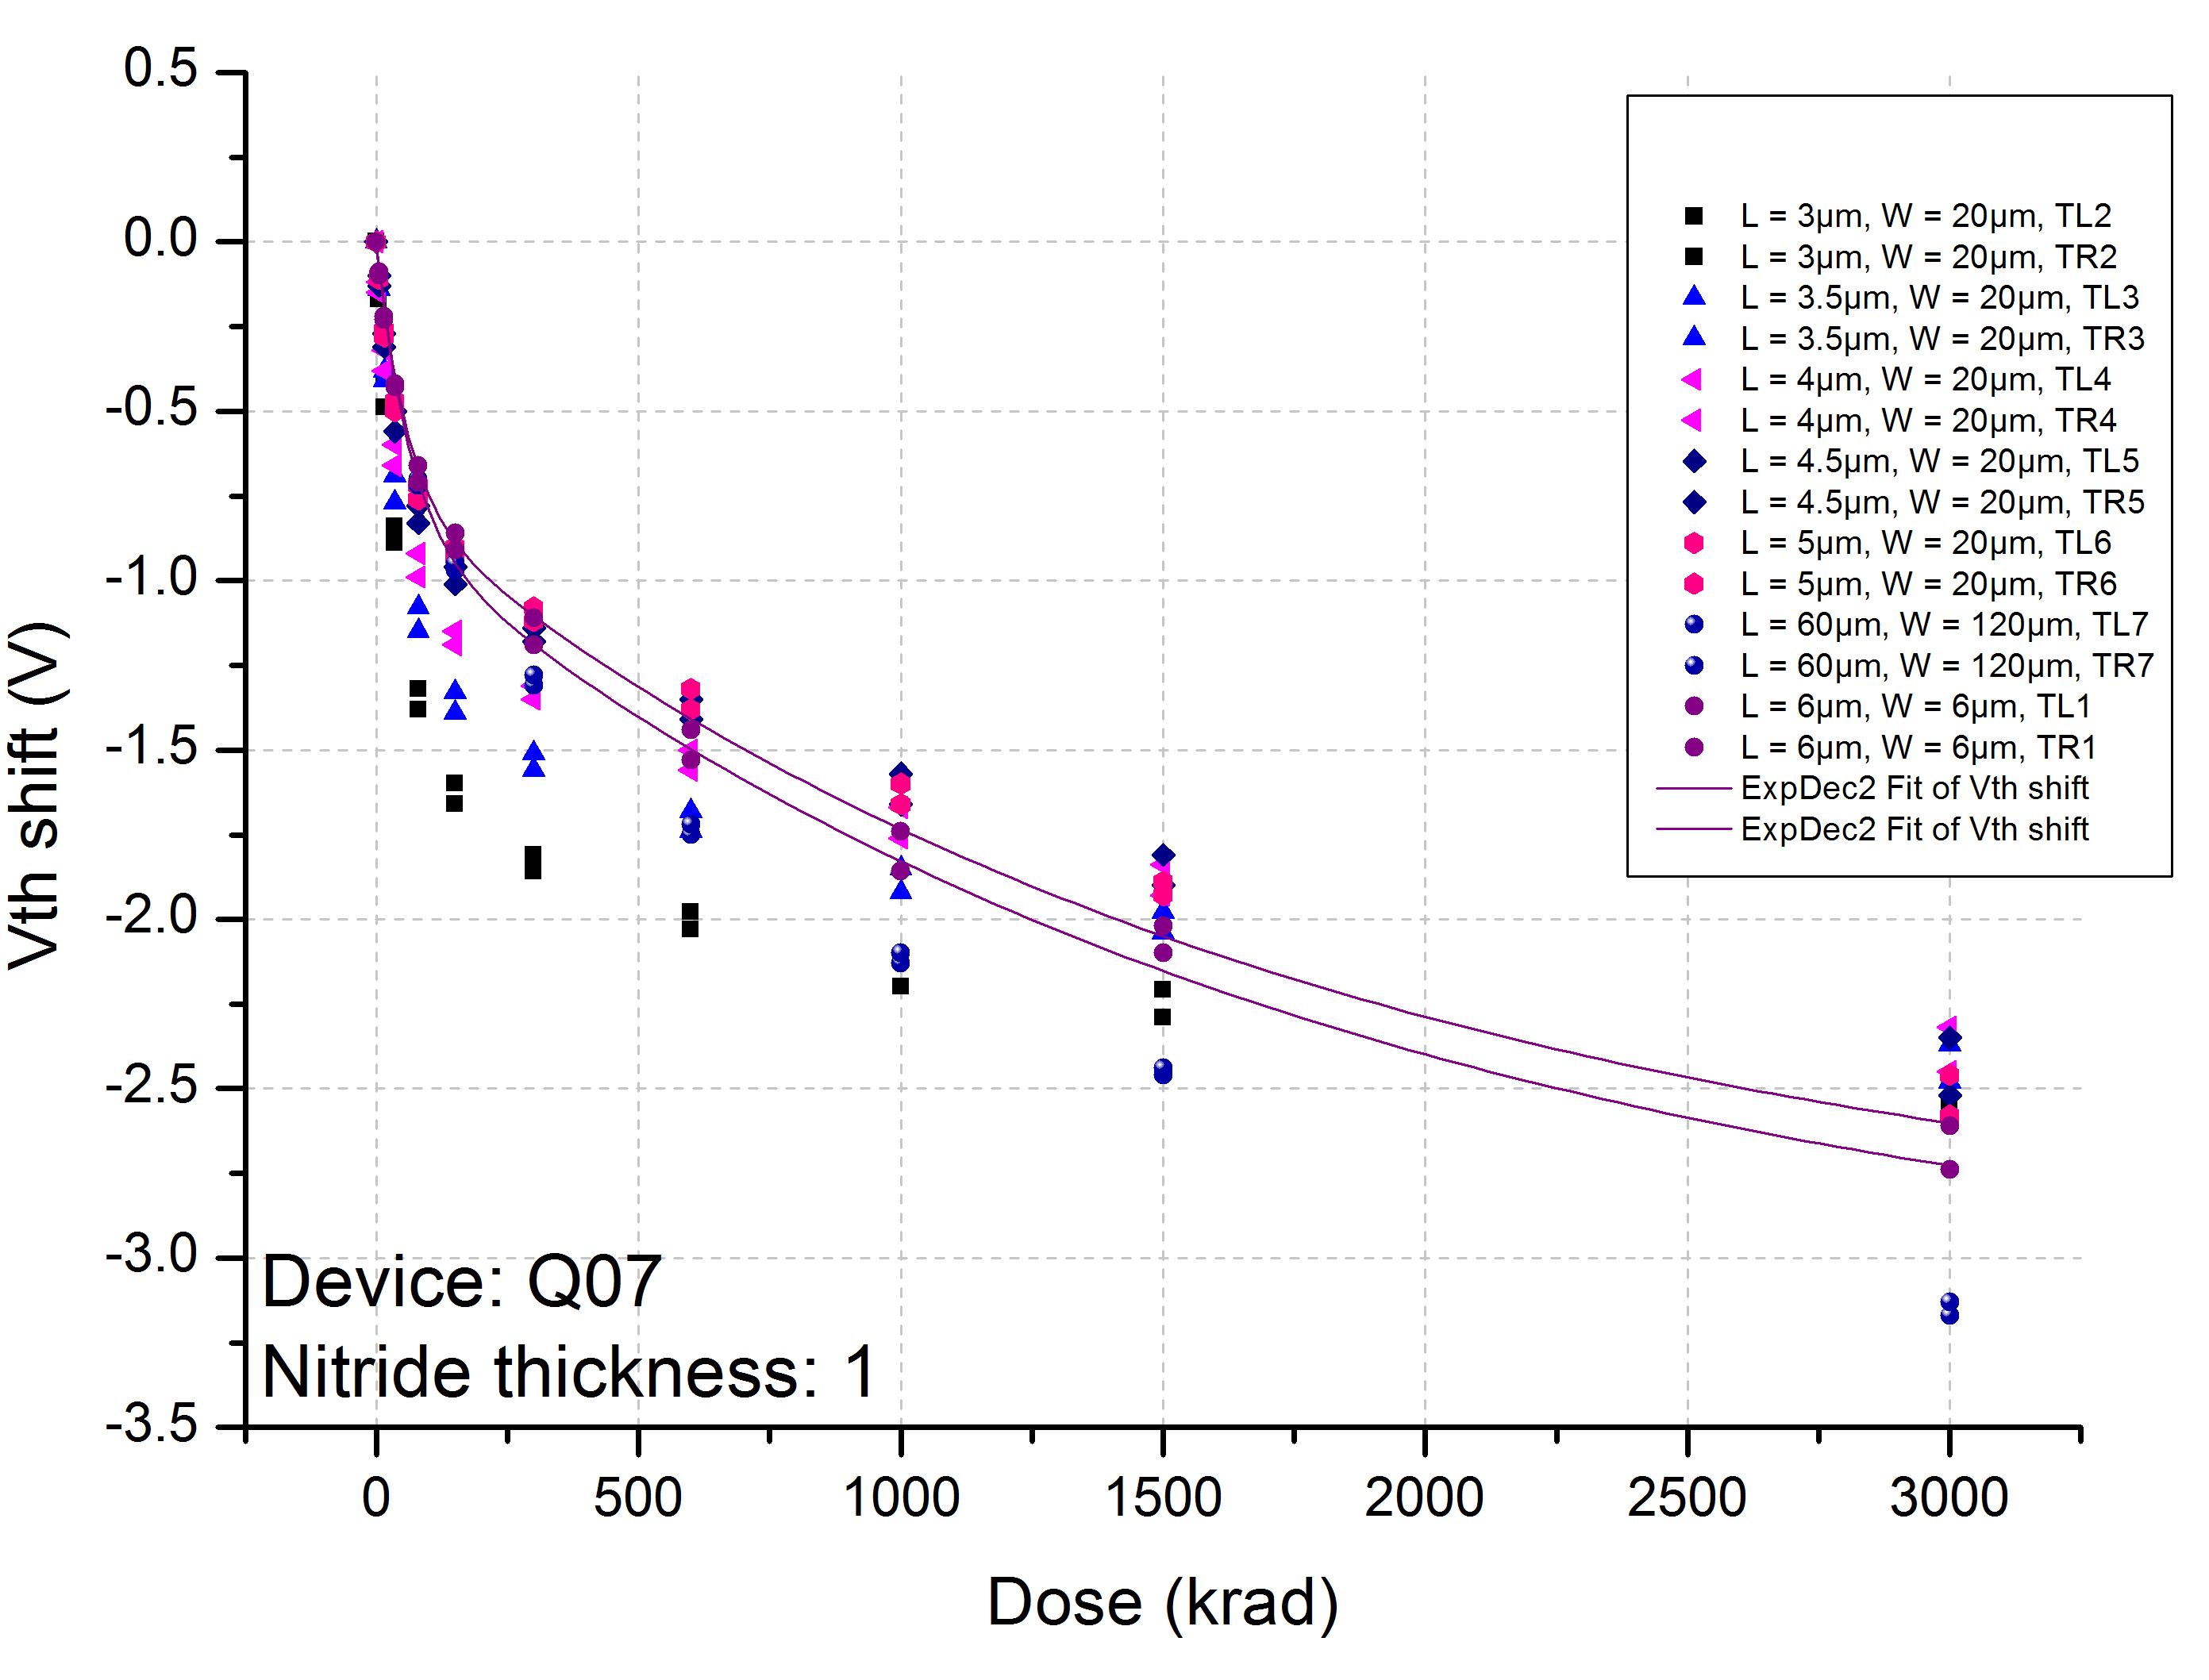
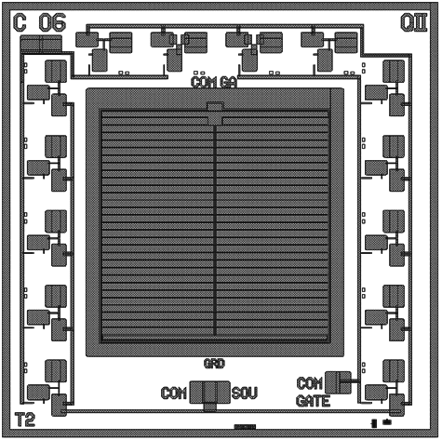
Test Project PXD_TO
Design DEPFET-like structures with various oxide/nitride combinations and maintain the basic transistor properties.
Wafers have four quadrants with four different oxide/nitride combinations.
Chips have MOS caps., diodes, gate controlled diodes, etc., surrounded by 14 MOSFETs with various W/L ratios.
Test project finished summer 2010, followed by extensive irradiation tests in Karlsruhe and at DESY.
→ The best gate dielectric in both irradiations was found to be the one with the thinnest nitride!
→ ΔVt ≈ -2.5 V after 3 Mrad at Karlsruhe (Belle devices)
→ ΔVt ≈ -3.5 V after 100 Mrad at DESY (XFEL devices)
These results will be used for the design and technology definition for the final Belle II production.

Slide 18
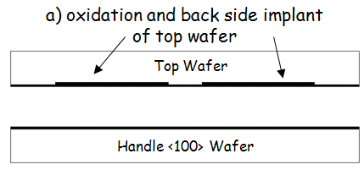
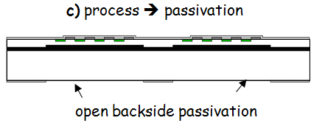
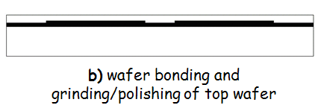
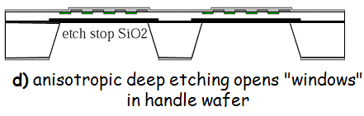
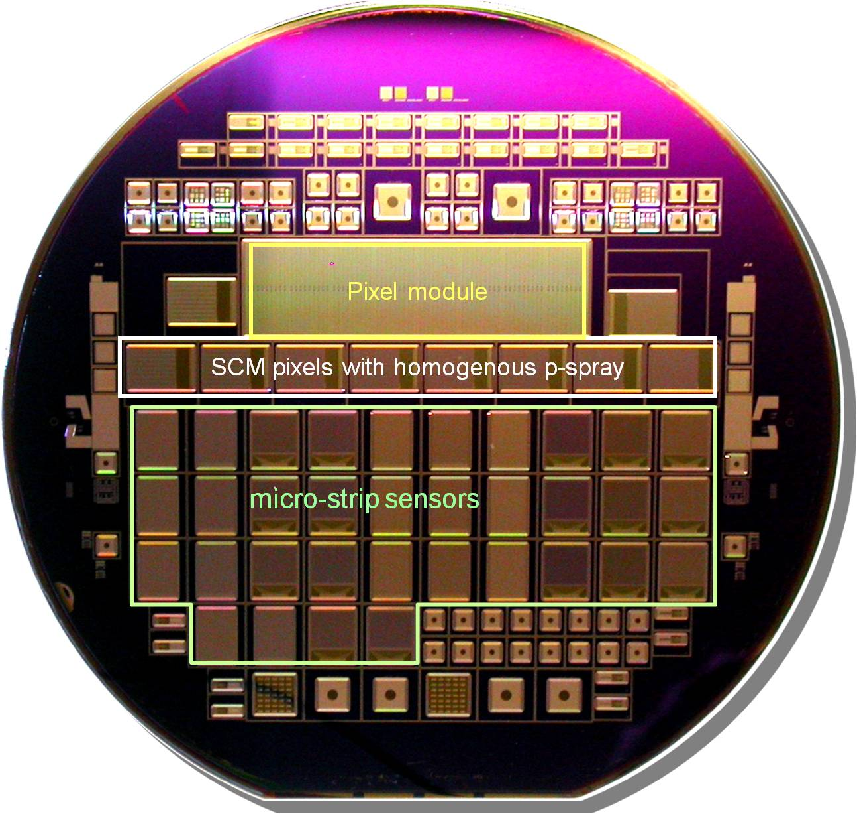
SOI II: Thin Pixel Sensors for ATLAS sLHC and IBL
Advantages of thin sensors:
Lower leakage currents: I ~ V
Lower full depletion voltage: U_{fd}~ d²
Potentially better radiation tolerance
… less material
First thin sensor production:
8 n-in-p wafers, 4 n-in-n wafers
t= 75 μm and 150 μm
Diodes: technology monitoring
Pixel sensors: prototype modules
Strip sensors: charge measurements

Slide 19
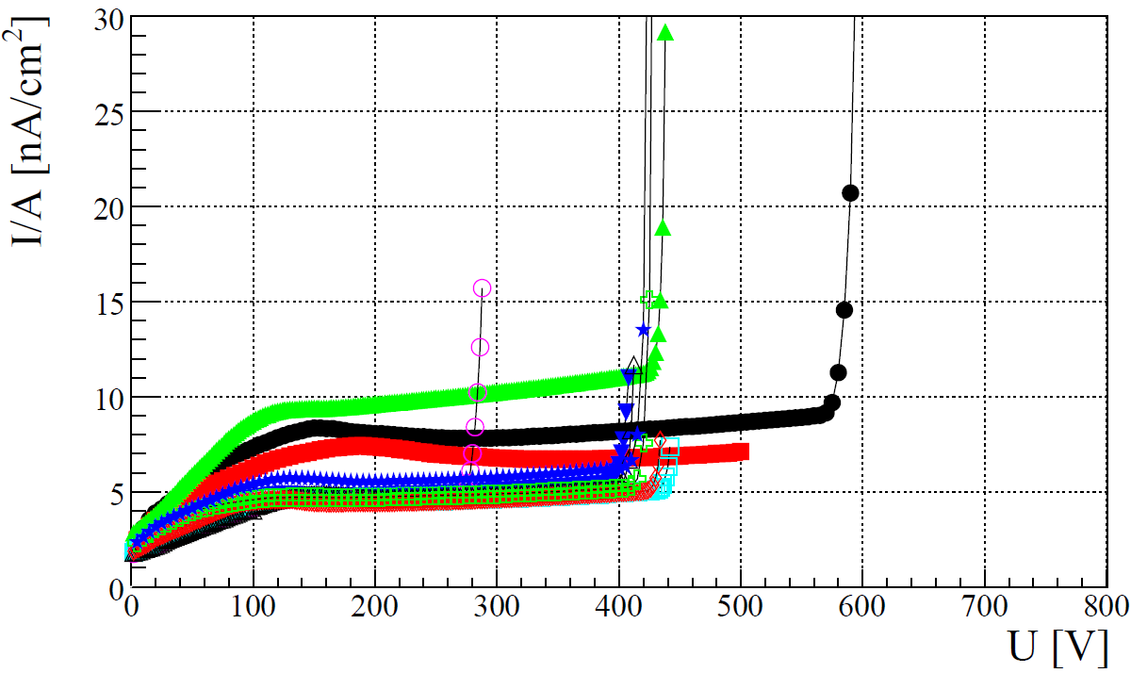

ATLAS sLHC and IBL – Test Results
Pixel sensors 150 & 75 µm
IV Pixel and mini strip sensors:
Break down voltage much higher
than depletion voltage.
Low currents before irradiation (<10nA/cm²).
High device yield (98%)
CCE after irradiation:
CCE better than expected,
even after 10¹⁶ n_{eq}/cm²
Charge multiplication effect also seen by
by other groups
based on this results: MPP n-on-p sensors
are one of the candidates for ATLAS IBL
2nd n-on-p 150µm sensors finished recently
some issues during processing on R&D line
which were fixed by re-work (poor yield!!)
Some of the sensors will be bump bonded
to FE-I4 chips for IBL qualification

Slide 20






SOI III: Geiger-mode APDs → SiPM → SiMPL
Conv. SiPM
Resistor
Al conductor
SiMPL
V_{bias}
n⁺
p⁺ anode
n⁺
SiO₂
n⁻ SOI
R_{Q}
R_{Q}
R_{Q}
p⁺
guard ring n⁻
p⁻
depl. regions
SiO₂ BOX
substrate p⁺
Handle Wafer
V_{bias}
1pe-
Spectrum (650nm) taken
with a SiMPL device
2pe-
3pe-
New concept for an array of Geiger-mode APDs
Bulk integrated quench resistors open the way to build arrays with very high fill factors
Technology much simpler: Two prod. runs on SOI wafers with 70 µm top layer on R&D line

Slide 21


SiMPL – Status 2010
Proof of principle is shown: quenching works and dynamical measurements show
expected behavior
Some process details still need optimization, mainly to reduce dark count rate
In addition to the simplified process the devices have the advantage of
    a lower optical cross talk at
    high geometrical fill factors
studies of the produced sensors (geometry dependent performance, PDE, …) are ongoing
“dark spectrum” of a SiMPL device
Hamamatsu MPPC
SiMPL
ΔV=2V
Single pixel events:
Dark counts
Σ 25% opt. cross talk
ΔV=2V
ΔV=1V
ΔV=1V

Slide 22



Interconnection Sensor - ASICs
2. XFEL:
-: 1-on-1 connection DEPFET ←→ front-end
-: ~4000 bumps / ro-chip and 16 chips in sensitive area
-: 200 µm pitch
-: frame rate 5 MHz for a 1Mpix camera
3. ATLAS Pixel sLHC upgrade:
-: 1-on-1 connection Thin pad detector ←→ front-end
-: Vertical integration project with Fraunhofer EMFT Munich
-: 50 µm pitch
-: frame rate 40 MHz
1. Belle II (and ILC):
-: MCM – ASICs in different technologies
on Sensor as substrate
-: bump bonds only in insenstive
-: ~ 250 bumps/chip, 150 - 200 µm pitch
-: frame rate: 50 kHz
Three important projects demand fine-pitch high-density interconnections
→ bump and bump-less flip-chipping
We have to prepare our sensors for conv. bump bonding → solderable third metal layer
We work with semi-industrial partners on novel vertical integration technologies

Slide 23

The ATLAS Pixel Detector Upgrade – the MPP proposal
Current ATLAS
New proposal
n-in-n
Objectives of the project
Design and build thin pixel sensors on p-type FZ material
Show compatibility and radiation hardness of sensors with SLID metal system
Show feasibility of the post-processing of existing r/o electronics (ICV and thinning)
Build demonstrator module with thin sensors, using SLID and ICV through the r/o Chip

Slide 24


"SLID" - "SOLID" – bump-less Cu-Sn eutectic bonding
SLID: Solid Liquid Interdiffusion
-: 5 µm Cu + 3 µm Sn on Sensor
-: 5 µm Cu on ASIC side
-: pressure and heat → Cu₃Sn alloy
-: for electrical and mechanical connection
-: min. pitch determined by pick and place
ATLAS FE-I3 with Cu pads 27 x 60 μm²
Bonded to a dummy sensor wafer
… Bonding of FE-I3 to real sensors ongoing

Slide 25


Inter-Chip Vias ICV → TSV
Inter-Chip Vias (ICV)
-: Allow for vertical signal transport through Si structures
-: → Compact pixel modules
-: post-processing of the FE-I3 wafer (“via last” approach)
-: via etching (Bosch-process), isolation, and tungsten filling
-: back side thinning of the wafer
-: isolation and metallization for the back side contact (wire bonds)

Slide 26




Location of the vias
FE-I3 chip
wire bond pads → back side of the chip
a.) remove pad metal (Alu)
b.) etch blind vias from the front side
3x10 µm², ~70 µm deep
c.) connect via metal to pad metal on the front
1-to1 SLID connection
to pixels
f/e amplifier etc.
end of column logic
digital circuitry
47 wire bond pads
power, I/O …
Rough cut/break along the long side of a pad showing the structure of the vias and the trench around them.
a. b. c.

Slide 27


Bump bondable DEPFETs for Belle II and XFEL
The UBM and 3rd metal layer are an essential
part of the DEPFET production and need to
be installed at the HLL!
Sputter Ti:W und Cu (externally for now)
Lithography: thick photo resist
Thru mask EP: 3-5 um Cu, ca. 2-3 um Sn
Resist strip
wet etch Cu (FeCl₃, HCl ..)
wet etch Ti:W: (H₂O₂ with additives)
Steps 3. to 6 installed at HLL
processes commissioned and being optimized

Slide 28

1st Cu/Sn Wafer at the HLL

Slide 29
Summary
The main MPP Projects at HLL are
    DEPFETs for Belle II (and ILC)
      prototype run is being finalized, first batch already thinned, will be finalized in Jan.
    Pixel detectors for the sLHC ATLAS upgrade and IBL
      vertical integration project with Fraunhofer EMFT, thin planer sensors for IBL
    SiMPL Photomultiplier with possible applications at MAGIC, CTA, or calorimeter read out
      very encouraging first results, some technology optimization still needed
All MPP projects use custom made SOI wafers
    we need to ensure long term supply of material
Speed requirements from the experiments and the need for parallelization of the read-out
call for the installation of the bump bonding capabilities at HLL. DEPFETs for Belle II and XFEL
will have a solderable third metal layer in Cu. The basic process was installed.

Slide 30
SOI wafers supplied by industrial partners
-: top and handle wafer delivered by MPI
-: pre-processing of top wafer at MPI
-: engineered BSOI wafers prepared by industrial partner
-: DSP, ≈ 420 µm overall thickness, 50 µm top layer
FZ, DSP, <100>, t=450µm, 400Ω.cm, Phosphorous
230 nm thermal oxide
structured Boron implant, through BOX, 90 keV, 5e14 - 1e15 cm-2
alignment marks in BOX: 60nm step
hydrophilic bond
top layer: 75 µm
≈420 µm
DSP
FZ, DSP, <100>, t=450µm, 400Ω.cm, Phosphorous
after bonding, grinding and double sided polishing

Slide 31



Micro joint between half-ladders
Mechanical tests → remarkably robust!!
-: Bowing: up to 1 mm sagitta (over 10 cm)
-: Tension: 40 to 60 N, then the Silicon broke

Slide 32

The DEPFET Belle-II PXD
 | Inner layer | Outer layer
# ladders | 8 | 12
Sens. length | 90 mm | 123 mm
Radius | 1.4 cm | 2.2 cm
Pixel size | 50x50 µm² | 50x75 µm²
# pixels | 1600(z)x250(R-ɸ) | 1600(z)x250(R-ɸ)
Thickness | 75 µm | 75 µm
Frame/row rate | 50 kHz/10 MHz | 50 kHz/10 MHZ
4-fold parallel read-out

Slide 33



Detector Design: Full simulation chain
Particle gun (single event)
EvtGen (physics event)
Detector geometry
Material
E-Field in Silicon
Lorentz angle in B-Field
A/D Conv. and clustering
Marlin tracking
PXD+SVD+CDC
Physics channels
Test Beam Data
Pixel: 20x20x450 µm³
→ σ_{sp}≈1 µm
bigger + thicker + 1.5 T
Pixel: 50x50x75 µm³
→ σ_{sp}≈7.7 µm
small + thin
Pixel: 20x20x50 µm³
→ σ_{sp}≈3.5 µm
Preliminary
Preliminary
Benjamin Schwenker
Single point resolution of DUT in the test beam arrangement (see N37.3)

Slide 34


Total Material Budget within the Sensitive Volume
sensitive area of the first layer ladder: 1.25x9.0 cm² (1.5x9.0 incl. frame), 75 µm thin
support frame: 0.1+0.2 cm, 420 µm
Switcher-Sensor Interconnect: Gold stud bumps, one bump/connection, Φ=48 µm
Cu Layer t=3 µm, 50% coverage in acceptance
Switcher dimensions: 0.15x0.36 cm²
Number of Switchers: 12 (32x2 channels per chip – gate and clear)
Material reduction by frame perforation: 1/3
0.19 %X₀ in total
Silicon contribution (0.15%) experimentally confirmed

Slide 35


Internal Amplification
(Ideal transistor theory - neglecting short channel effects)
(L: nominal gate length)
simulation at I_{D}=50 µA
g_{q} (pA/e-)
g_{q} (pA/e-)
Drain current I_{D} (µA)
effective gate length L_{eff} (µm)
L_{eff} = L - 2 x under etching of 1.2µm
Reduction necessary to improve radiation hardness and output IV curves

Slide 36




Interconnect: Full Size Module Test
Realistic module (dummy chips) was assembled successfully at home (Heidelberg)
DCD
Switcher
DCD
Dummy
ASICs are bump bonded only
Pixel2010

Slide 37
Fill factor & Cross Talk & Photon Detection Efficiency
Produced SiMPl devices have the world record in the fill factors!
Pitch / Gap | Fill factor | Cross talk meas. (ΔV=2V) | PDE calc. (ΔV=2V) | PDE calc. (ΔV=5V)
130μm / 10μm | 85.2% | 29% | 39% | 61%
130μm / 11μm | 83.8% | 27% | 38% | 60%
130μm / 12μm | 82.4% | 25% | 37% | 59%
130μm / 20μm | 71.6% | 15% | 32% | 52%
PDE estimate:
  Optical entrance window: 90% @400nm
  Geiger efficiency : 50% @ 2V overbias 80% @5V overbias

